Slide 1
Lecture 10: Relevance Feedback & Query Expansion

Slide 2
Take-away today
Interactive relevance feedback: improve initial retrieval results by telling the IR system which docs are relevant / nonrelevant
Best known relevance feedback method: Rocchio feedback
Query expansion: improve retrieval results by adding synonyms / related terms to the query
Sources for related terms: Manual thesauri, automatic thesauri, query logs
2

Slide 3
Overview
Motivation
Relevance feedback: Basics
Relevance feedback: Details
Query expansion

Slide 4
Outline
Motivation
Relevance feedback: Basics
Relevance feedback: Details
Query expansion

Slide 5
How can we improve recall in search?
Main topic today: two ways of improving recall: relevance feedback and query expansion
As an example consider query q: [aircraft] . . .
. . . and document d containing “plane”, but not containing “aircraft”
A simple IR system will not return d for q.
Even if d is the most relevant document for q!
We want to change this:
Return relevant documents even if there is no term match with the (original) query
5

Slide 6
Recall
Loose definition of recall in this lecture: “increasing the number of relevant documents returned to user”
6

Slide 7
Options for improving recall
Local: Do a “local”, on-demand analysis for a user query
Main local method: relevance feedback
Part 1
Global: Do a global analysis once (e.g., of collection) to produce thesaurus
Use thesaurus for query expansion
Part 2
7

Slide 8
Outline
Motivation
Relevance feedback: Basics
Relevance feedback: Details
Query expansion

Slide 9
Relevance feedback: Basic idea
The user issues a (short, simple) query.
The search engine returns a set of documents.
User marks some docs as relevant, some as nonrelevant.
Search engine computes a new representation of the information need. Hope: better than the initial query.
Search engine runs new query and returns new results.
New results have (hopefully) better recall.
9

Slide 10
Relevance feedback
We can iterate this: several rounds of relevance feedback.
We will use the term ad hoc retrieval to refer to regular retrieval without relevance feedback.
We will now look at an example of relevance feedback.
10

Slide 11
Example: A real (non-image) example
Initial query:
[new space satellite applications] Results for initial query: (r = rank)
r
+ 1 0.539 NASA Hasn’t Scrapped Imaging Spectrometer
+ 2 0.533 NASA Scratches Environment Gear From Satellite Plan
3 0.528 Science Panel Backs NASA Satellite Plan, But Urges Launches of Smaller Probes
4 0.526 A NASA Satellite Project Accomplishes Incredible Feat: Staying
Within Budget
5 0.525 Scientist Who Exposed Global Warming Proposes Satellites for
Climate Research
6 0.524 Report Provides Support for the Critics Of Using Big Satellites
to Study Climate
7 0.516 Arianespace Receives Satellite Launch Pact From Telesat
Canada
+ 8 0.509 Telecommunications Tale of Two Companies
User then marks relevant documents with “+”.

Slide 12
Expanded query after relevance feedback
2.074 | new | 15.106 | space
30.816 | satellite | 5.660 | application
5.991 | nasa | 5.196 | eos
4.196 | launch | 3.972 | aster
3.516 | instrument | 3.446 | arianespace
3.004 | bundespost | 2.806 | ss
2.790 | rocket | 2.053 | scientist
2.003 | broadcast | 1.172 | earth
0.836 | oil | 0.646 | measure
Compare to original
query: [new space satellite applications]
12

Slide 13
Results for expanded query
r
* 1 0.513 NASA Scratches Environment Gear From Satellite Plan
* 2 0.500 NASA Hasn’t Scrapped Imaging Spectrometer
3 0.493 When the Pentagon Launches a Secret Satellite, Space Sleuths Do Some Spy Work of Their Own
4 0.493 NASA Uses ‘Warm’ Superconductors For Fast Circuit
* 5 0.492 Telecommunications Tale of Two Companies
6 0.491 Soviets May Adapt Parts of SS-20 Missile For Commercial Use
7 0.490 Gaping Gap: Pentagon Lags in Race To Match the Soviets In Rocket Launchers
8 0.490 Rescue of Satellite By Space Agency To Cost $90 Million

Slide 14
Outline
Motivation
Relevance feedback: Basics
Relevance feedback: Details
Query expansion

Slide 15
Key concept for relevance feedback: Centroid
The centroid is the center of mass of a set of points.
Recall that we represent documents as points in a high-dimensional space.
Thus: we can compute centroids of documents.
Definition:
where D is a set of documents and is the vector we use to represent document d.
15

Slide 16
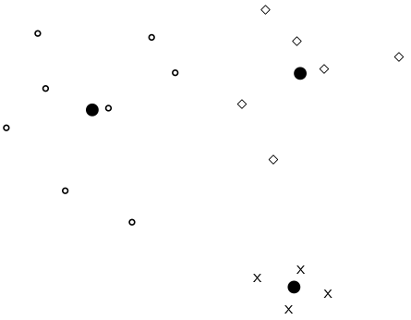
Centroid: Example
16

Slide 17
Rocchio’ algorithm
The Rocchio’ algorithm implements relevance feedback in the vector space model.
Rocchio’ chooses the query that maximizes
D_{r} : set of relevant docs; D_{nr} : set of nonrelevant docs
Intent: ~qopt is the vector that separates relevant and nonrelevant docs maximally.
Making some additional assumptions, we can rewrite as:
17

Slide 18
Rocchio’ algorithm
The optimal query vector is:
We move the centroid of the relevant documents by the difference between the two centroids.
18

Slide 19
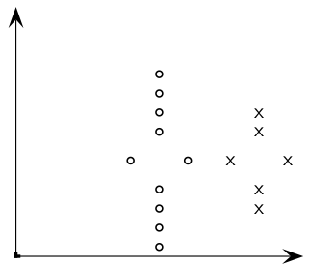
Exercise: Compute Rocchio’ vector
circles: relevant documents, Xs: nonrelevant documents
19

Slide 20
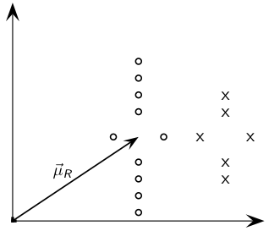
Rocchio’ illustrated
: centroid of relevant documents
20

Slide 21
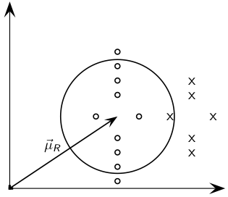
Rocchio’ illustrated
does not separate relevant / nonrelevant.
21

Slide 22
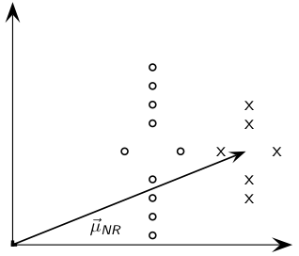
Rocchio’ illustrated
centroid of nonrelevant documents.
22

Slide 23
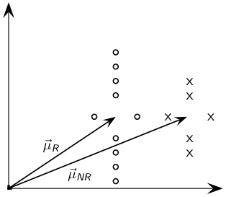
Rocchio’ illustrated
23

Slide 24
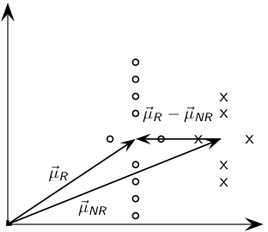
Rocchio’ illustrated
- difference vector
24

Slide 25
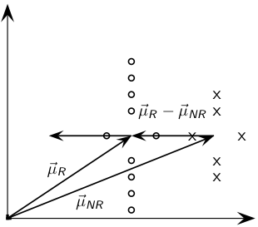
Rocchio’ illustrated
Add difference vector to …
25

Slide 26
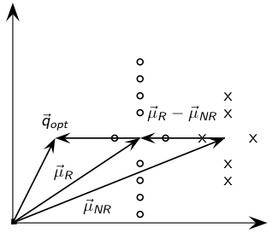
Rocchio’ illustrated
… to get
26

Slide 27
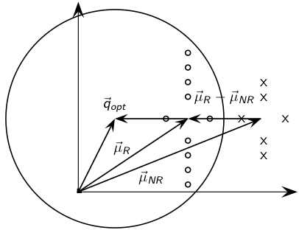
Rocchio’ illustrated
separates relevant / nonrelevant perfectly.
27

Slide 28
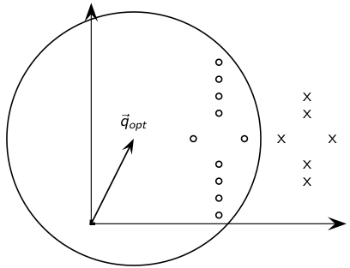
Rocchio’ illustrated
separates relevant / nonrelevant perfectly.
28

Slide 29
Terminology
We use the name Rocchio’ for the theoretically better motivated original version of Rocchio.
The implementation that is actually used in most cases is the SMART implementation – we use the name Rocchio (without prime) for that.
29

Slide 30
Rocchio 1971 algorithm (SMART)
Used in practice:
q_{m}: modified query vector; q₀: original query vector; D_{r} and D_{nr} : sets of known relevant and nonrelevant documents respectively; α, β, and γ: weights
New query moves towards relevant documents and away from nonrelevant documents.
Tradeoff α vs. β/γ: If we have a lot of judged documents, we want a higher β/γ.
Set negative term weights to 0.
“Negative weight” for a term doesn’t make sense in the vector space model.
30

Slide 31
Positive vs. negative relevance feedback
Positive feedback is more valuable than negative feedback.
For example, set β = 0.75, γ = 0.25 to give higher weight to positive feedback.
Many systems only allow positive feedback.
31

Slide 32
Relevance feedback: Assumptions
When can relevance feedback enhance recall?
Assumption A1: The user knows the terms in the collection well enough for an initial query.
Assumption A2: Relevant documents contain similar terms (so I can “hop” from one relevant document to a different one when giving relevance feedback).
32

Slide 33
Violation of A1
Assumption A1: The user knows the terms in the collection well enough for an initial query.
Violation: Mismatch of searcher’s vocabulary and collection vocabulary
Example: cosmonaut / astronaut
33

Slide 34
Violation of A2
Assumption A2: Relevant documents are similar.
Example for violation: [contradictory government policies]
Several unrelated “prototypes”
Subsidies for tobacco farmers vs. anti-smoking campaigns
Aid for developing countries vs. high tariffs on imports from developing countries
Relevance feedback on tobacco docs will not help with finding docs on developing countries.
34

