Slide 1
Application of Network Flows: Matrix Rounding

Slide 2
Matrix Rounding
Consider the following matrix:
$$\left(\begin{matrix}6.3 & 7.6 & 4.6 \\ 4.7 & 2.3 & 2.8 \\ 5.5 & 4.5 & 3.5\end{matrix}\right)$$
y₁
y₂
y₃
Ʃ
x₁
18.5
[18,19]
x₂
9.8
[9,10]
x₃
13.5
[13,14]
Ʃ
16.5
14.4
10.9
[16,17]
[14,15]
[10,11]

Slide 3
Solution
Step 1: Represent the consistent rounding problem as a feasible flow problem.
Step 2: Convert the feasible flow problem into a feasible circulation problem.
Step 3: Convert the feasible circulation problem into a transportation problem.
Step 4: Convert the transportation problem into a network flows problem.

Slide 4
Solution
Step 1: Represent the consistent rounding problem as a feasible flow problem.
Step 2: Convert the feasible flow problem into a feasible circulation problem.
Step 3: Convert the feasible circulation problem into a transportation problem.
Step 4: Convert the transportation problem into a network flows problem.

Slide 5
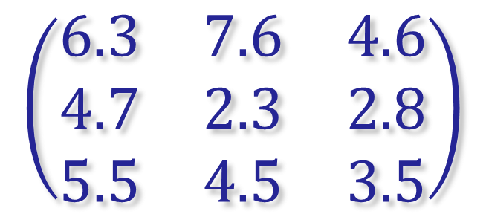
Feasible Flow Problem Formulation
x₁
[6,7]
y₁
[7,8]
[18,19]
[4,5]
[5,6]
[16,17]
x₂
[4,5]
y₂
s
[9,10]
[2,3]
[14,15]
t
[2,3]
[13,14]
x₃
[4,5]
y₃
[10,11]
y₁
y₂
y₃
[3,4]
x₁
$$\left(\begin{matrix}6.3 & 7.6 & 4.6 \\ 4.7 & 2.3 & 2.8 \\ 5.5 & 4.5 & 3.5\end{matrix}\right)$$
[18,19]
x₂
[9,10]
x₃
[13,14]
[16,17]
[14,15]
[10,11]

Slide 6
Solution
Step 1: Represent the consistent rounding problem as a feasible flow problem.
Step 2: Convert the feasible flow problem into a feasible circulation problem.
Step 3: Convert the feasible circulation problem into a transportation problem.
Step 4: Convert the transportation problem into a network flows problem.

Slide 7
Feasible Circulation Problem
Add an edge from t → s with bounds [0,∞]
x₁
[6,7]
y₁
[7,8]
[18,19]
[4,5]
[5,6]
[16,17]
x₂
[4,5]
y₂
s
[9,10]
[2,3]
[14,15]
t
[13,14]
[2,3]
[10,11]
x₃
[4,5]
y₃
[3,4]
[0,∞]

Slide 8
Solution
Step 1: Represent the consistent rounding problem as a feasible flow problem.
Step 2: Convert the feasible flow problem into a feasible circulation problem.
Step 3: Convert the feasible circulation problem into a transportation problem.
Step 4: Convert the transportation problem into a network flows problem.

Slide 9
Transportation Problem
$l^{−}\left(v\right)={\text{Ʃ}}_{e∈\left[V\left(C\right)−v,v\right]}l(e)$
$l^{+}\left(v\right)={\text{Ʃ}}_{e∈\left[v,V\left(C\right)−v\right]}l(e)$
$b\left(v\right)= l^{−}\left(v\right)−l^{+}\left(v\right)$
c$\left(e\right)=u\left(e\right)−l(e)$
c(x₁,y₁) = 1
x₁
[6,7]
y₁
[7,8]
[18,19]
[4,5]
[5,6]
[16,17]
l⁻(v) = 18
l⁺(v) = 6+7+4=17
b(v) = 18-17 = 1
x₂
[4,5]
y₂
s
[9,10]
[2,3]
[14,15]
t
[13,14]
[2,3]
[10,11]
x₃
[4,5]
y₃
[3,4]
[0,∞]

Slide 10
v | l⁻(v) | l⁺(v) | b(v)
s | 0 | 40 | -40
x₁ | 18 | 17 | +1
x₂ | 9 | 8 | +1
x₃ | 13 | 12 | +1
y₁ | 15 | 16 | -1
y₂ | 13 | 14 | -1
y₃ | 9 | 10 | -1
t | 40 | 0 | +40
x₁
[6,7]
y₁
[7,8]
[18,19]
[4,5]
[5,6]
[16,17]
x₂
[4,5]
y₂
s
[9,10]
[2,3]
[14,15]
t
[13,14]
[2,3]
[10,11]
x₃
[4,5]
y₃
[3,4]
[0,∞]

Slide 11
Back to a Network Flows Problem
Add a new source s’ and a new sink t’.
If b(v) ≥ 0, add an edge from s’ to v else add an edge from v to t’.
Is there a flow equal to the total capacity on the edges leaving s? (In this case 43)
x₁
1
y₁
1
1
1
1
1
1
1
1
x₂
1
y₂
1
s'
s
1
1
1
t
t'
1
1
1
1
1
x₃
1
y₃
1
∞
40
40

