Slide 1
Fault Tolerant Distance Oracle

Slide 2

Given a graph $G$, find all pair shortest paths
a
1
c
5
1
Run shortest path algorithm to find all pair shortest path
d
b
a
b
c
d
e
5
3
a
0
5
1
2
5
e
b
0
6
7
5
c
0
1
4
d
0
3
e
0

Slide 3

a
b
c
d
e
a
1
c
a
0
5
1
2
5
5
1
b
0
6
7
5
d
b
c
0
1
4
5
3
d
0
3
e
e
0
Query(s,t): Find the weight of the shortest path from s to t
Return the corresponding cell in O(1) time
After preprocessing, each query can be served in O(1) time.
Moreover, the space taken by the data structure is O($n^{2}$)

Slide 4
a
1
c
What happens to shortest paths when some edges are deleted?
5
1
d
b
5
3
e

Slide 5
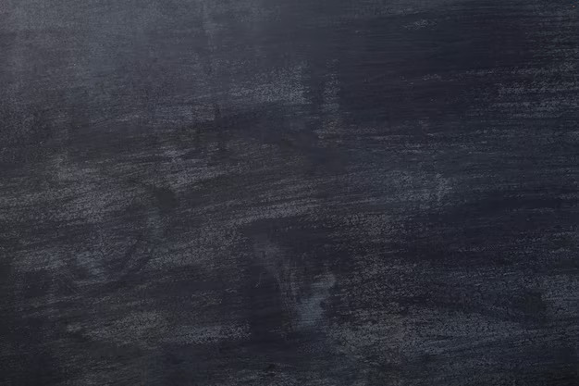
a
1
c
What happens to shortest paths when some edges are deleted?
5
1
d
b
5
e

Slide 6
a
1
c
What happens to shortest paths when some edges are deleted?
5
1
d
b
5
e

Slide 7
a
1
c
What happens to shortest paths when some edges are deleted?
5
1
Build a data-structure and a query algorithm such the following query can be answered quickly
d
b
5
3
Query(s,t,e): Find the shortest path from s to t avoiding e
e
Such a data-structure and query algorithm is called distance oracle in literature.
Since we are dealing with faults, our oracle is called fault tolerant distance oracle

Slide 8
Such a data-structure and query algorithm is called distance oracle in literature.
Since we are dealing with faults, our oracle is called fault tolerant distance oracle
a
1
c
5
1
d
b
5
3
There are four parameters on which your oracle will be judged:
Space – lesser space is better
Query Time – lesser query time is better
Number of handled faults – more is better
Preprocessing Time – lesser preprocessing time is better
e

Slide 9
Such a data-structure and query algorithm is called distance oracle in literature.
Since we are dealing with faults, our oracle is called fault tolerant distance oracle
a
1
c
5
1
d
b
5
3
There are four parameters on which your oracle will be judged:
Space – lesser space is better
Query Time – lesser query time is better
Number of handled faults – more is better
Preprocessing Time – lesser preprocessing time is better
e

Slide 10
Outline of the talk
Oracle for single fault
Why dealing with multiple faults is hard?
New tools
New results
            (i) Duan and Ren’s (STOC 2022) approach
            (ii) Dey and Gupta’s (STOC 2024) improvement
            (if time permits)

Slide 11
Oracle for Single Fault

Slide 12
Build a data-structure and a query algorithm such the following query can be answered quickly
Query(s,t,e): Find the shortest path from s to t avoiding e
Demestrescu, Thorup, Chowdhary and Ramachandran (SICOMP 2008) designed $\tilde{O}(n^{2})$ space and O(1) query time

Slide 13
One assumption for the rest of the talk:
The shortest path between any two vertices is unique even after deletion of edges.

Slide 14
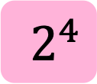
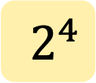
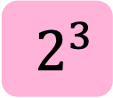
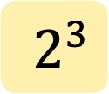
Data-Structures
Store all pair shortest path – takes O($n^{2}$) space
Let $st$ denote the shortest path from $s$ to $t$ and |st| denote it length
For each $s,t∈G$, store the shortest path from $s$ to $t$ avoiding the $2^{i}$-th edge on $st$ path where $0≤i≤⌊log{|st|⌋}$
Let $st⋄ ⊕2^{i}$ denote the shortest path from s to t avoiding the $2^{i}$-th edge from s on st path
The space taken by this data-structure is O($\log{n})$ per pair. So, the total space taken is $\tilde{O}(n^{2})$.
Similarly, $st⋄ ⊖2^{i}$ denotes the length of the shortest path from s to t avoiding the $2^{i}$-th edge from t on st path
$2^{0}$
$2^{2}$
s
t
$2^{1}$
$2^{3}$
$2^{4}$
$2^{2}$
$2^{0}$
s
t
$2^{4}$
$2^{3}$
$2^{1}$

Slide 15
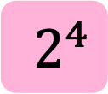
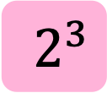
Data-Structures
Store all pair shortest path – takes O($n^{2}$) space
Let $st$ denote the shortest path from $s$ to $t$
For each $s,t∈G$, store the shortest path from $s$ to $t$ avoiding the $2^{i}$-th edge on $st$ path where $1≤i≤⌊log{|st|⌋}$
Let $st⋄ ⊕2^{i}$ denote the shortest path from s to t avoiding the $2^{i}$-th edge from s on st path
The space taken by this data-structure is O($\log{n})$ per pair. So, the total space taken is $\tilde{O}(n^{2})$.
Similarly, $st⋄ ⊖2^{i}$ denotes the length of the shortest path from s to t avoiding the $2^{i}$-th edge from t on st path
For a $(i,j)$, $st⋄[⊕2^{i},⊖2^{j}]$ denotes the shortest path from s to t avoiding the subpath starting from $2^{i}$ edge from s and ending at $2^{j}$ edge from t.
For a $s,t$ pair, the above data-structure takes $O(\log^{2}{n})$ space. So, the total space taken is $\tilde{O}(n^{2})$.
$$st⋄\{⊕2^{4},⊖2^{2}\}$$
$2^{0}$
$2^{2}$
$2^{2}$
$2^{0}$
s
t
s
t
$2^{1}$
$2^{4}$
$2^{3}$
$2^{3}$
$2^{4}$
$2^{1}$

Slide 16
Data-Structures
How to handle Query(s,t,e) using these data-structures?
$st⋄ ⊕2^{i}$
$st⋄ ⊖2^{i}$
$st⋄[⊕2^{i},⊖2^{j}]$
Find the farthest vertex on es path that is a power of 2. Let this vertex be u.
Similarly let v be the farthest vertex on et path that is a power of 2.
There are three cases to handle:
1) $st⋄e$ passes through u
  return $\left|su\right|+|ut⋄⊕2^{i}|$
s
t
u
$$e$$
v
$2^{i}$
$2^{j}$

Slide 17
Data-Structures
How to handle Query(s,t,e) using these data-structures?
$st⋄ ⊕2^{i}$
$st⋄ ⊖2^{i}$
$st⋄[⊕2^{i},⊖2^{j}]$
Find the farthest vertex on es path that is a power of 2. Let this vertex be u.
Similarly let v be the farthest vertex on et path that is a power of 2.
There are three cases to handle:
1) $st⋄e$ passes through u
  return $\left|su\right|+|ut⋄⊕2^{i}|$
  2) $st⋄e$ passes through v
    return $\left|sv⋄ ⊖2^{j}\right|+\left|vt\right|$
s
t
u
$$e$$
v
$2^{i}$
$2^{j}$

Slide 18
Data-Structures
How to handle Query(s,t,e) using these data-structures?
$st⋄ ⊕2^{i}$
$st⋄ ⊖2^{i}$
$st⋄[⊕2^{i},⊖2^{j}]$
Find the farthest vertex on es path that is a power of 2. Let this vertex be u.
Similarly let v be the farthest vertex on et path that is a power of 2.
There are three cases to handle:
1) $st⋄e$ passes through u
  return $\left|su\right|+|ut⋄⊕2^{i}|$
  2) $st⋄e$ passes through v
    return $\left|sv⋄ ⊖2^{j}\right|+|vt|$
  3) $st⋄e$ avoids the uv path
s
t
u
$$e$$
v
$2^{i}$
$2^{j}$

Slide 19
Data-Structures
How to handle Query(s,t,e) using these data-structures?
$st⋄ ⊕2^{i}$
$st⋄ ⊖2^{i}$
$st⋄[⊕2^{i},⊖2^{j}]$
  3) $st⋄e$ avoids the uv path
  a) Let x be the farthest vertex on path se that is a power of 2
  b) Let y be the farthest vertex on path te that is a power of 2
s
t
u
x
$$e$$
y
v
$2^{i}$
$2^{j}$

Slide 20
Data-Structures
How to handle Query(s,t,e) using these data-structures?
$st⋄ ⊕2^{i}$
$st⋄ ⊖2^{i}$
$st⋄[⊕2^{i},⊖2^{j}]$
  3) $st⋄e$ avoids the uv path
  a) Let x be the farthest vertex on path se that is a power of 2
  b) Let y be the farthest vertex on path te that is a power of 2
  c) $|st⋄ [⊕2^{i},⊖2^{j}]|≤|st⋄e|$, since $st⋄e$ is one of the paths that avoid xy
  path
  d) But $\left|st⋄e\right|≤|st⋄[⊕2^{i},⊖2^{j}]|$ as the left hand side avoids an edge and
  the right hand side avoids a path containing that edge.
  e) Thus, $\left|st⋄e\right|=|st⋄[⊕2^{i},⊖2^{j}]|$
$2^{i}$
$2^{j}$
s
t
u
x
$$e$$
y
v

Slide 21
Data-Structures
How to handle Query(s,t,e) using these data-structures?
$st⋄ ⊕2^{i}$
$st⋄ ⊖2^{i}$
$st⋄[⊕2^{i},⊖2^{j}]$
Find the farthest vertex on es path that is a power of 2. Let this vertex be u.
Similarly let v be the farthest vertex on et path that is a power of 2.
There are three cases to handle:
$st⋄e$ passes through u
  return $\left|su\right|+|ut⋄ ⊕2^{i}|$
  2) $st⋄e$ passes through v
    return $\left|sv⋄ ⊖2^{j}\right|+|vt|$
  3) $st⋄e$ avoids the uv path
  return $|st⋄[⊕2^{i},⊖2^{j}]|$
$2^{i}$
$2^{j}$
s
t
u
x
$$e$$
y
v

Slide 22
Data-Structures
How to handle Query(s,t,e) using these data-structures?
$st⋄ ⊕2^{i}$
$st⋄ ⊖2^{i}$
$st⋄[⊕2^{i},⊖2^{j}]$
Find the farthest vertex on es path that is a power of 2. Let this vertex be u.
Similarly let v be the farthest vertex on et path that is a power of 2.
There are three cases to handle:
return min { $\left|su\right|+\left|ut⋄⊕2^{i}\right|,\left|sv⋄ ⊖2^{j}\right|+\left|vt\right|,\left|st⋄[⊕2^{i},⊖2^{j}]\right|$}
Space taken by the algorithm is $\tilde{O}(n^{2})$
The query time of the algorithm is O(1)

Slide 23
Why dealing with multiple faults is hard?

Slide 24
For a single fault, the faulty edge lies on the st path.
But we dealt with 3 cases to solve the problem.

Slide 25
For a single fault, the faulty edge lies on the st path.
But we dealt with 3 cases to solve the problem.
For two faults, there are two possibilities
Both the faults lie on the st path
The first fault, say e, lies in st path and the second lies in $st⋄e$
But the number of cases required to deal with the above two scenarios explode
Indeed, Pettie and Duan [SODA 2009] designed a distance oracle for two faults that has more than 15 cases

Slide 26
For two faults, there are two possibilities
Both the faults lie on the st path
The first fault, say e, lies in st path and the second lies in $st⋄e$
But the number of cases required to deal with the above two scenarios explode
Indeed, Pettie and Duan [SODA 2009] designed a distance oracle for two faults that has more than 15 cases
For a single fault, the faulty edge lies on the st path.
But we dealt with 3 cases to solve the problem.
  The number of possibilities and cases explode as f increases
  That is why solving this problem for a general f is challenging
  Let us now look at the recent results for the general version of the problem

Slide 27
  $f$-faults
Reference
Space
Query Time
Remark
Weimenn and Yuster, FOCS 2010
$$\tilde{O}(n^{3−α})$$
$$\tilde{O}\left(n^{2−\frac{1−α}{f}}\right)$$
$$α∈[0,1]$$
Brand and Saranurak, FOCS 2019
$$\tilde{O}\left(\begin{aligned}Wn^{2−α}f^{2}+ \\ Wnf^{ω}\end{aligned}\right)$$
$$\tilde{O}(Wn^{2+α})$$
$$α∈[0,1]$$
Karczmarz and Sankowski, FOCS 2023
$$\tilde{O}(n^{2})$$
$$\tilde{O}\left(nf^{ω}\right)$$
All these algorithms have roughly O($n^{2}$) space but $Ω(n)$ query time
Let us understand why these algorithm take high query time

Slide 28
Let us look at two cases depending on the length of $st⋄F$
$st⋄F$ is short, say less than $\sqrt{n}$
$st⋄F$ is long, say greater than $\sqrt{n}$
s
t
s
t
There are ways to find short path that we will not discuss in this talk
Let us look at the case when the path is long

Slide 29
$st⋄F$ is long, say greater than $\sqrt{n}$
u
s
t
Our strategy to find the path
Divide and Conquer
Find a vertex, say u, on $st⋄F$
Recursively, find $su⋄F$ and $ut⋄F$
It is not clear why this recursive strategy works, but we will come to that later
How to find the vertex u on the path? How can we use the fact that the path is long?

Slide 30
$st⋄F$ is long, say greater than $\sqrt{n}$
s
t
Randomly select $\sqrt{n}$ vertices in the graph
With a high probability, one vertex will hit the path $st⋄F$
But since we don’t know which vertex hits $st⋄F$, we will have to process all $\sqrt{n}$ vertices
Thus, the query time is at least $\sqrt{n}$
In reality, we have to much more after this step and the query time increases to $Ω(n)$

Slide 31
To get a better query time, we require new tools which we will see next

Slide 32
New Tools

Slide 33
  $f$-faults
Reference
Space
Query Time
Remark
Weimenn and Yuster, FOCS 2010
$$\tilde{O}(n^{3−α})$$
$$\tilde{O}\left(n^{2−\frac{1−α}{f}}\right)$$
$$α∈[0,1]$$
Brand and Saranurak, FOCS 2019
$$\tilde{O}\left(\begin{aligned}Wn^{2−α}f^{2}+ \\ Wnf^{ω}\end{aligned}\right)$$
$$\tilde{O}(Wn^{2+α})$$
$$α∈[0,1]$$
Karczmarz and Sankowski, FOCS 2023
$$\tilde{O}(n^{2})$$
$$\tilde{O}\left(nf\right)$$
Duan and Ren, STOC 2022
$$O({fn}^{4})$$
$$O\left(f^{O(f)}\right)$$
Dey and Gupta, STOC 2024
$$\tilde{O}({f^{4}n}^{2})$$
$$O\left({(flog n)}^{O(f^{2})}\right)$$

Slide 34
  $f$-faults
Reference
Space
Query Time
Remark
Duan and Ren, STOC 2022
$$O({fn}^{4})$$
$$O\left(f^{O(f)}\right)$$
Tool 1 : Maximiser

Slide 35
  $f$-faults
Reference
Space
Query Time
Remark
Duan and Ren, STOC 2022
$$O({fn}^{4})$$
$$O\left(f^{O(f)}\right)$$
s
t
Our old question: How to find the vertex on the path?
Can you select a small set of vertices deterministically such that one of them hit the path?

Slide 36
  $f$-faults
Reference
Space
Query Time
Remark
Duan and Ren, STOC 2022
$$O({fn}^{4})$$
$$O\left(f^{O(f)}\right)$$
s
t
Can you select a small set of vertices deterministically such that one of them hit the path?
Clearly this must be impossible
I would have ended this line of thinking after this question
But this is indeed possible and it brings new life to this problem

Slide 37
Can you select a small set of vertices deterministically such that one of them hit the path?
$$e_{2}^{∗}$$
$$e_{1}^{∗}$$
$$P=st⋄\{e_{1},e_{2},e_{3}\}$$
$$e_{3}^{∗}$$
$$e_{2}$$
s
$$e_{3}$$
t
$$e_{1}$$
Let F*={$e_{1}^{∗},e_{2}^{∗},e_{3}^{∗}$} be the set of edges whose removal maximises the distance from s to t
Let us assume that we have stored, F* and |st $⋄$ F*|
If F* does not hit P, then |P| $≥$ |st $⋄$ F*|
But st $⋄$ F* is the maximum distance from s to t avoiding three edges
So, |st $⋄$ F*| $≥$ |P|
This means |st $⋄$ F*| $=$ |P|
Since all paths are unique, st $⋄$ F* $=$ P

Slide 38
Can you select a small set of vertices deterministically such that one of them hit the path?
$$e_{2}^{∗}$$
$$e_{1}^{∗}$$
$$P=st⋄\{e_{1},e_{2},e_{3}\}$$
$$e_{3}^{∗}$$
$$e_{2}$$
s
$$e_{3}$$
t
$$e_{1}$$
If F* hits P, then we have found two vertices that hit P

Slide 39
Can you select a small set of vertices deterministically such that one of them hit the path?
$$e_{2}^{∗}$$
$$e_{1}^{∗}$$
$$P=st⋄\{e_{1},e_{2},e_{3}\}$$
$$e_{3}^{∗}$$
$$e_{2}$$
s
$$e_{3}$$
t
$$e_{1}$$
If F* hits P, then we have found two vertices that hit P
If F* does not hit P, its even better
Then, st $⋄$ F* $=$ P, and we can return st $⋄$ F* as our answer

Slide 40
$$e_{2}^{∗}$$
$$e_{1}^{∗}$$
$$P=st⋄\{e_{1},e_{2},e_{3}\}$$
$$e_{3}^{∗}$$
$$e_{2}$$
s
$$e_{3}$$
t
$$e_{1}$$
If F* hits P, then we have found two vertices that hit P
If F* does not hit P, its even better
Then, st $⋄$ F* $=$ P, and we can return st $⋄$ F* as our answer
Can you select a small set of vertices deterministically such that one of them hit the path?
Yes

Slide 41
Our grand plan
Divide and Conquer
Find a vertex, say u, on $st⋄F$ (using a maximiser)
Recursively, find $su⋄F$ and $ut⋄F$
Unfortunately, running time of this strategy is high even if u is near middle of the path $st⋄F$
T(st $⋄$ F) = T(su $⋄$ F) + T(ut $⋄$ F) + time taken to find a hitting
vertex using the maximiser

Slide 42
Our grand plan
Divide and Conquer
Find a vertex, say u, on $st⋄F$ (using a maximiser)
Recursively, find $su⋄F$ and $ut⋄F$
Unfortunately, running time of this strategy is high even if u is near middle of the path $st⋄F$
T(st $⋄$ F) = T(su $⋄$ F) + T(ut $⋄$ F) + O(1)

Slide 43
Our grand plan
Divide and Conquer
Find a vertex, say u, on $st⋄F$ (using a maximiser)
Recursively, find $su⋄F$ and $ut⋄F$
Unfortunately, running time of this strategy is high even if u is near middle of the path $st⋄F$
T(n) = T(n/2) + T(n/2) + O(1)

Slide 44
Our grand plan
Divide and Conquer
Find a vertex, say u, on $st⋄F$ (using a maximiser)
Recursively, find $su⋄F$ and $ut⋄F$
Unfortunately, running time of this strategy is high even if u is near middle of the path $st⋄F$
T(n) = O(n)
Not Good
But we have one more tool in our armour

Slide 45
Tool 2 : Decomposable Paths

Slide 46
Decomposable paths: A path P is f-decomposable if it is a concatenation of at most f shortest path interleaved with at most f-1 edges.
a
b
c
d
s
t
Shortest path in G
An edge in G

Slide 47
Decomposable paths: A path P is f-decomposable if it is a concatenation of at most f shortest path interleaved with at most f-1 edges.
$$P=st⋄\{e_{1},e_{2}\}$$
a
b
c
d
s
$$e_{1}$$
$$e_{2}$$
t
(Afek, Barr, Kaplan, Cohen and Merrit, 2002)
Lemma: If st $⋄$ F avoids f edges, then it is f+1- decomposable

Slide 48
$$P=st⋄\{e_{1},e_{2}\}$$
a
b
c
d
s
$$e_{1}$$
$$e_{2}$$
t
First Segment
Last Segment
A vertex that is not on the first or the last segment is called an intermediate vertex

Slide 49
Our grand plan
Divide and Conquer
Find a vertex, say u, on $st⋄F$ (using a maximiser)
Recursively, find $su⋄F$ and $ut⋄F$
$$P=st⋄\{e_{1},e_{2}\}$$
a
b
c
d
s
u
$$e_{1}$$
$$e_{2}$$
t

Slide 50
Change in Our grand plan
Divide and Conquer
Find a vertex, say u, on $st⋄F$ (using a maximiser)
Recursively, find $su⋄F$ and $ut⋄F$
$$P=st⋄\{e_{1},e_{2}\}$$
a
b
c
d
s
u
$$e_{1}$$
$$e_{2}$$
t

Slide 51
Change in Our grand plan
Divide and Conquer
Find an intermediate vertex, say u, on $st⋄F$ (using a maximiser)
Recursively, find $su⋄F$ and $ut⋄F$
$st⋄F$ is f+1-decomposable
$su⋄F$ and $ut⋄F$ are both $≤$f-decomposable
Thus, we get better running time
$$ut⋄F$$
$$su⋄F$$
$$P=st⋄\{e_{1},e_{2}\}$$
a
b
c
d
u
s
$$e_{1}$$
$$e_{2}$$
t

Slide 52
Change in Our grand plan
Divide and Conquer
Find an intermediate vertex, say u, on $st⋄F$ (using a maximiser)
Recursively, find $su⋄F$ and $ut⋄F$
$st⋄F$ is f+1-decomposable
$su⋄F$ and $ut⋄F$ are both $≤$f-decomposable
Thus, we get a better running time
T(st $⋄$ F) = T(su $⋄$ F) + T(ut $⋄$ F) + O(1)

Slide 53
Change in Our grand plan
Divide and Conquer
Find an intermediate vertex, say u, on $st⋄F$ (using a maximiser)
Recursively, find $su⋄F$ and $ut⋄F$
$st⋄F$ is f+1-decomposable
$su⋄F$ and $ut⋄F$ are both $≤$f-decomposable
Thus, we get a better running time
T(f+1) = T(f) + T(f) + O(1)

Slide 54
Change in Our grand plan
Divide and Conquer
Find an intermediate vertex, say u, on $st⋄F$ (using a maximiser)
Recursively, find $su⋄F$ and $ut⋄F$
$st⋄F$ is f+1-decomposable
$su⋄F$ and $ut⋄F$ are both $≤$f-decomposable
Thus, we get a better running time
T(f+1) = T(f) + T(f) + O(1)

Slide 55
Change in Our grand plan
Divide and Conquer
Find an intermediate vertex, say u, on $st⋄F$ (using a maximiser)
Recursively, find $su⋄F$ and $ut⋄F$
$st⋄F$ is f+1-decomposable
$su⋄F$ and $ut⋄F$ are both $≤$f-decomposable
Thus, we get a better running time
T(f+1) = O($2^{f}$)

Slide 56
Change in Our grand plan
Divide and Conquer
Find an intermediate vertex, say u, on $st⋄F$ (using a maximiser)
Recursively, find $su⋄F$ and $ut⋄F$
But the maximiser only ensures that we hit the path st $⋄$ F. It may hit it on the first or the last segment. How do we ensure that we always hit an intermediate vertex?
$$ut⋄F$$
$$su⋄F$$
$$P=st⋄\{e_{1},e_{2}\}$$
a
b
c
d
u
s
$$e_{1}$$
$$e_{2}$$
t

Slide 57
Duan and Ren’s approach to find an intermediate vertex

Slide 58
s
t
Look at the shortest path tree from s and t
Concentrate on the faulty edges lying on the shortest path tree

Slide 59
s
t
Look at the shortest path tree from s and t
Concentrate on the faulty edges lying on the shortest path tree
Concentrate on the paths from the faulty edges to the root

Slide 60
s
t
Look at the shortest path tree from s and t
Concentrate on the faulty edges lying on the shortest path tree
Concentrate on the paths from the faulty edges to the root

Slide 61
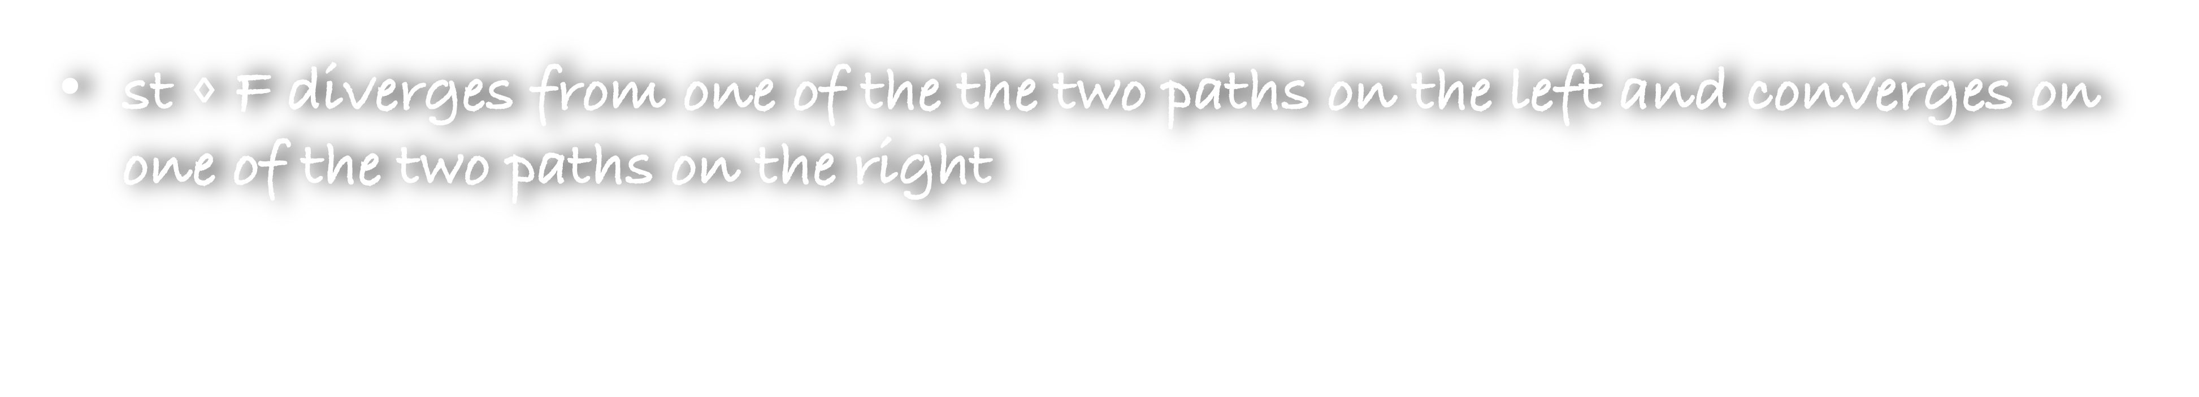
s
t
st $⋄$ F diverges from one of the the two paths on the left and converges on one of the two paths on the right

Slide 62
s
t
st $⋄$ F diverges from one of the the two paths on the left and converges on one of the two paths on the right

Slide 63
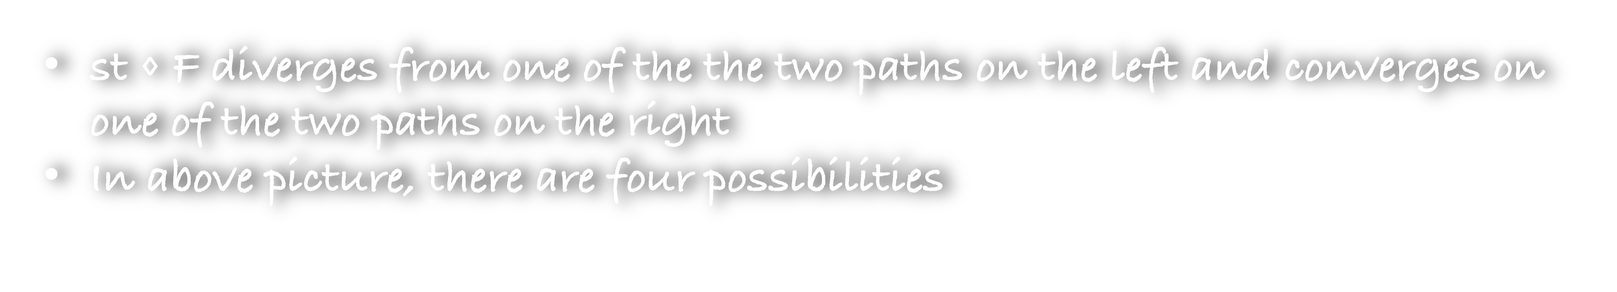
s
t
st $⋄$ F diverges from one of the the two paths on the left and converges on one of the two paths on the right
In above picture, there are four possibilities

Slide 64
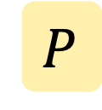
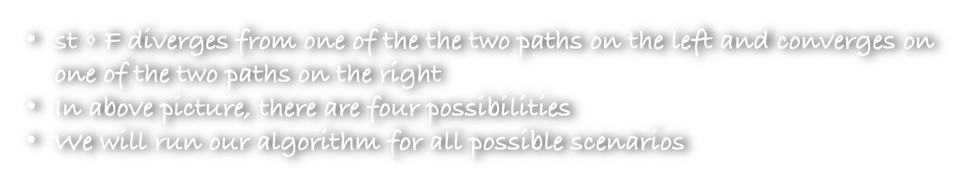
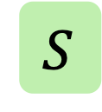
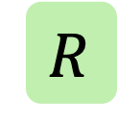

$$R$$
$$P$$
s
$$S$$
t
$$Q$$
st $⋄$ F diverges from one of the the two paths on the left and converges on one of the two paths on the right
In above picture, there are four possibilities
We will run our algorithm for all possible scenarios

Slide 65


v
u
s
$$S$$
t
$$Q$$
In this case, we know that su and tv are intact from failures
Consider the following maximiser
D(s,t,u,v): A set of failures that maximise the shortest path from s to t such that su and tv are intact from the failures

Slide 66
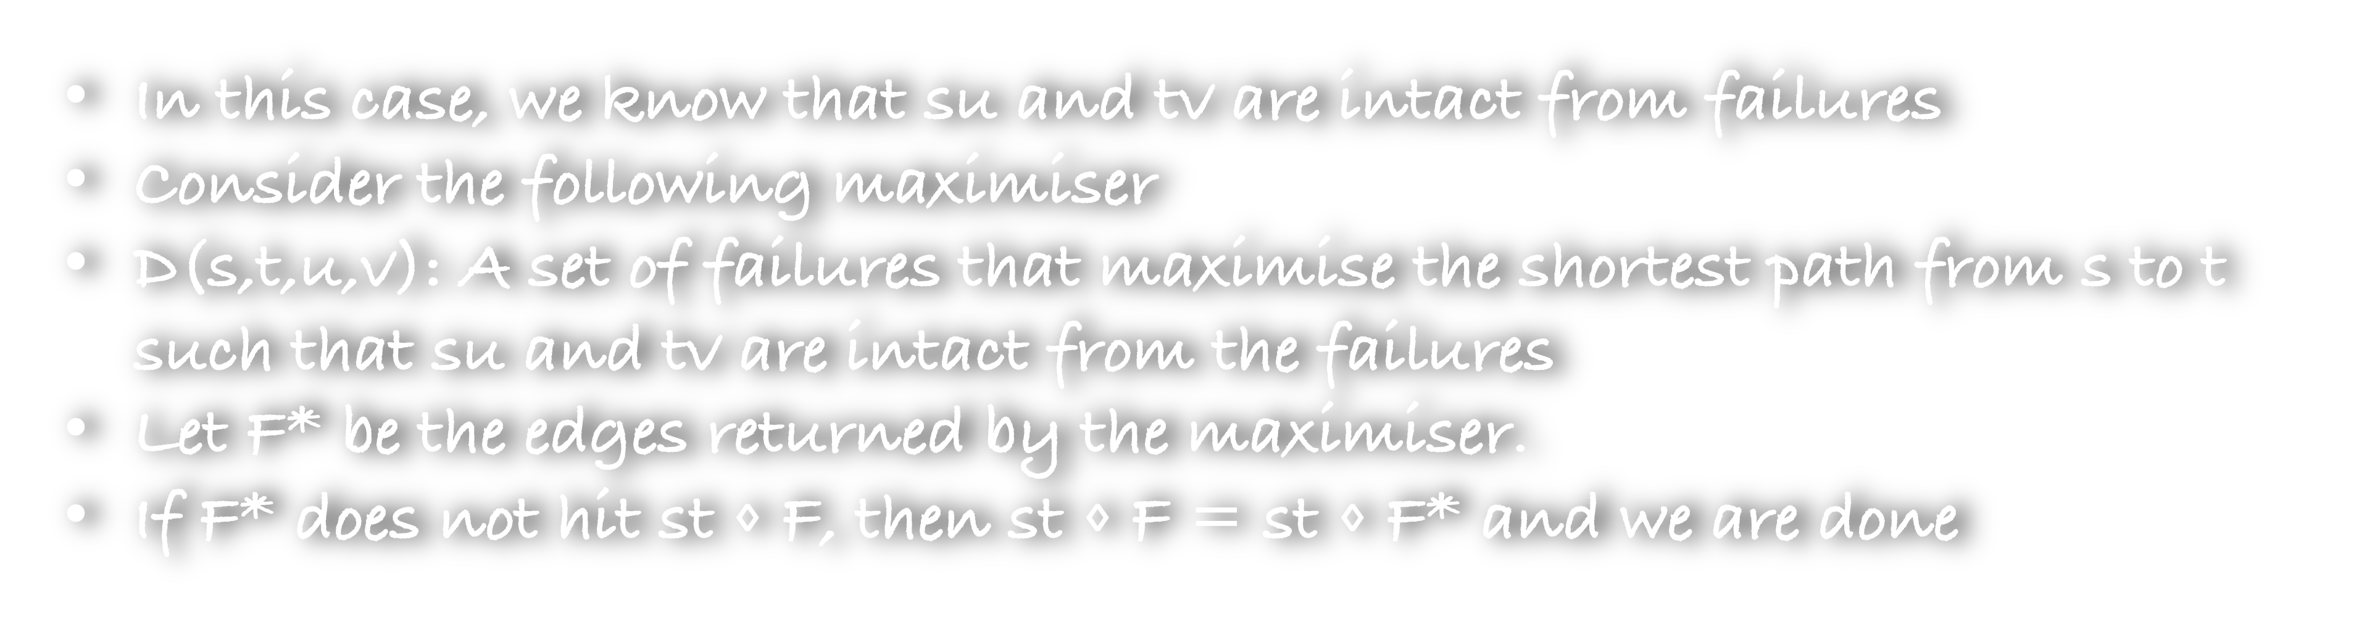
v
u
s
$$S$$
t
$$Q$$
In this case, we know that su and tv are intact from failures
Consider the following maximiser
D(s,t,u,v): A set of failures that maximise the shortest path from s to t such that su and tv are intact from the failures
Let F* be the edges returned by the maximiser.
If F* does not hit st $⋄$ F, then st $⋄$ F = st $⋄$ F* and we are done

Slide 67
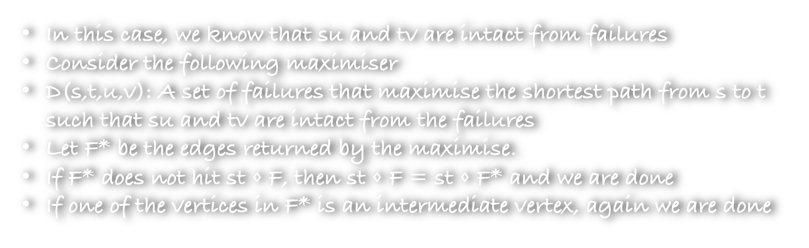
v
u
s
$$S$$
t
$$Q$$
In this case, we know that su and tv are intact from failures
Consider the following maximiser
D(s,t,u,v): A set of failures that maximise the shortest path from s to t such that su and tv are intact from the failures
Let F* be the edges returned by the maximise.
If F* does not hit st $⋄$ F, then st $⋄$ F = st $⋄$ F* and we are done
If one of the vertices in F* is an intermediate vertex, again we are done

Slide 68
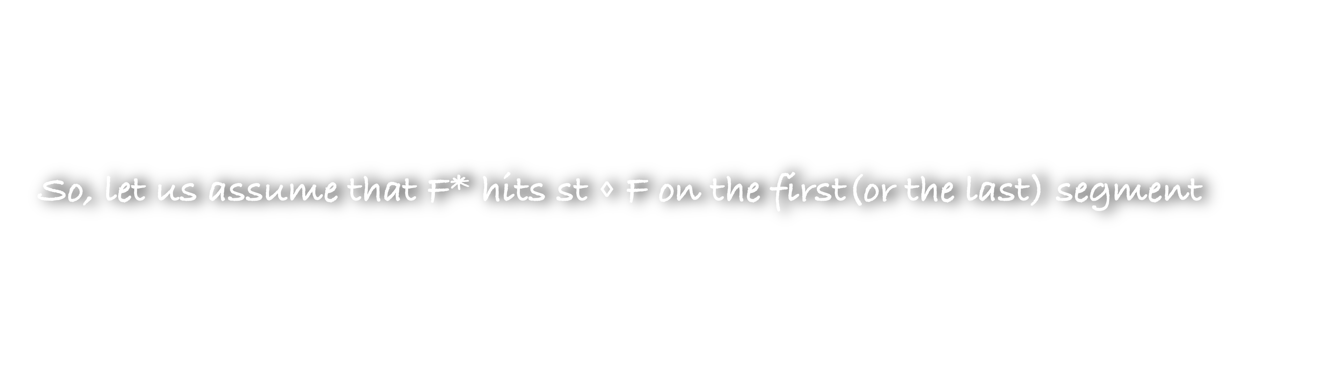
v
u
s
$$S$$
t
$$Q$$
So, let us assume that F* hits st $⋄$ F on the first(or the last) segment

Slide 69

v
u
s
$$S$$
t
$$Q$$
So, let us assume that F* hits st $⋄$ F on the first(or the last) segment
Can F* hit the path here?
No, because the maximiser explicitly states that su should be avoided

Slide 70
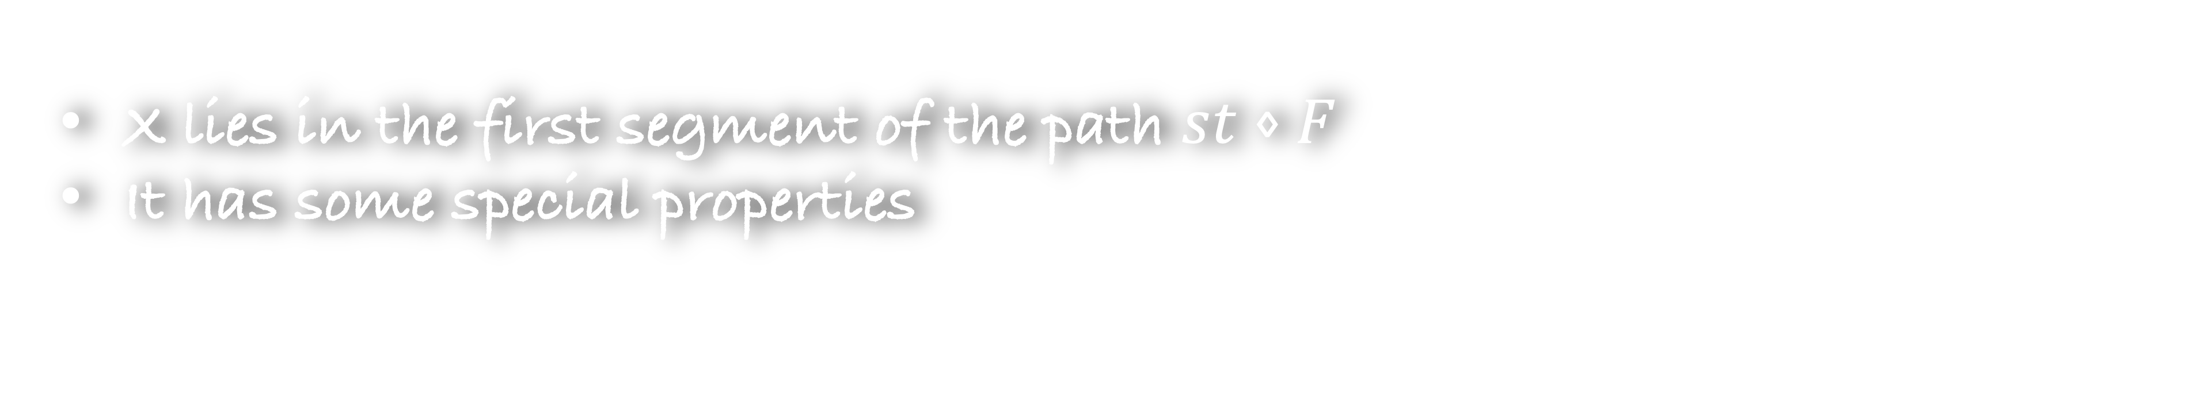
v
u
s
$$S$$
t
$$Q$$
x
X lies in the first segment of the path $st⋄F$
It has some special properties

Slide 71
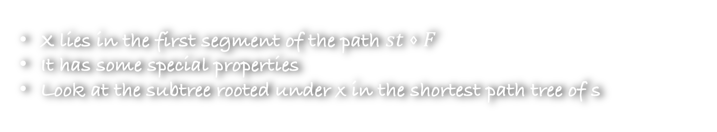
v
u
s
$$S$$
t
$$Q$$
x
X lies in the first segment of the path $st⋄F$
It has some special properties
Look at the subtree rooted under x in the shortest path tree of s
Can this subtree contain a faulty edge (or a red edge)
No, because at the start, we retained path from the s to a faulty edge

Slide 72
v
u
s
$$S$$
t
$$Q$$
x
X is called a s-clean vertex
(1) sx does not contain any faults
(2) The subtree under x in the shortest path tree of s does not
contains any fault

Slide 73
v
u
s
$$S$$
t
$$Q$$
x
Let us now use another maximiser
D(s,t,x,v): A set of failures that maximise the shortest path from s to t such that x is s-clean and tv are intact from the failures

Slide 74
v
u
s
$$S$$
t
$$Q$$
x
y
Let us now use another maximiser
D(s,t,x,v): A set of failures that maximise the shortest path from s to t such that x is s-clean and tv are intact from the failures
This time you may get a set F* that hits the last segment of the path

Slide 75
v
u
s
$$S$$
t
$$Q$$
x
y
Let us now use another maximiser
D(s,t,x,v): A set of failures that maximise the shortest path from s to t such that x is s-clean and tv are intact from the failures
This time you may get a set F* that hits the last segment of the path
But we will be able to show that y is t-clean

Slide 76
v
u
s
$$S$$
t
$$Q$$
y
x
Let us now use another maximiser
D(s,t,x,y): A set of failures that maximise the shortest path from s to t such that x is s-clean and y is t-clean
Again you get a set F* from the maximiser

Slide 77
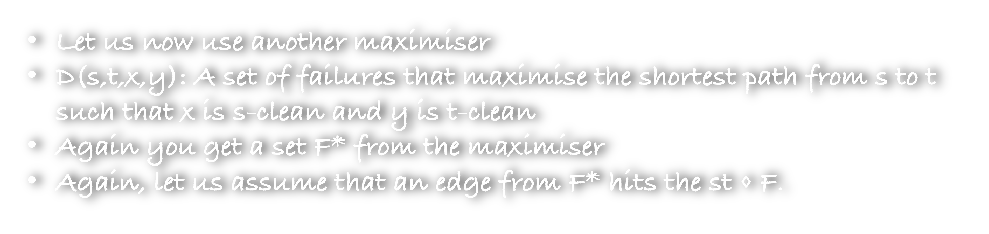
v
u
s
$$S$$
t
$$Q$$
y
x
Let us now use another maximiser
D(s,t,x,y): A set of failures that maximise the shortest path from s to t such that x is s-clean and y is t-clean
Again you get a set F* from the maximiser
Again, let us assume that an edge from F* hits the st $⋄$ F.
Can the hitting edge be on the first or last segment?

Slide 78
v
u
s
$$S$$
t
$$Q$$
y
x
Can the hitting edge be on the first or last segment?
Let us assume that the hitting edge is in the first segment

Slide 79
v
u
s
$$S$$
t
$$Q$$
y
x
Can the hitting edge be on the first or last segment?
Let us assume that the hitting edge is in the first segment
But this would imply that it lies in the subtree of x which is not allowed
So, the hitting edge cannot be on the first segment
Similarly, the hitting edge cannot be on the last segment

Slide 80
v
u
s
$$S$$
t
$$Q$$
y
x
Can the hitting edge be on the first or last segment?
Let us assume that the hitting edge is in the first segment
But this would imply that it lies in the subtree of x which is not allowed
So, the hitting edge cannot be on the first segment
Similarly, the hitting edge cannot be on the last segment
Thus, we have found an intermediate vertex

Slide 81
Duan and Ren’s approach to find an intermediate vertex
Find an intermediate vertex
Find a s-clean vertex
Find a t-clean vertex
First maximiser
Second maximiser
Third maximiser

Slide 82
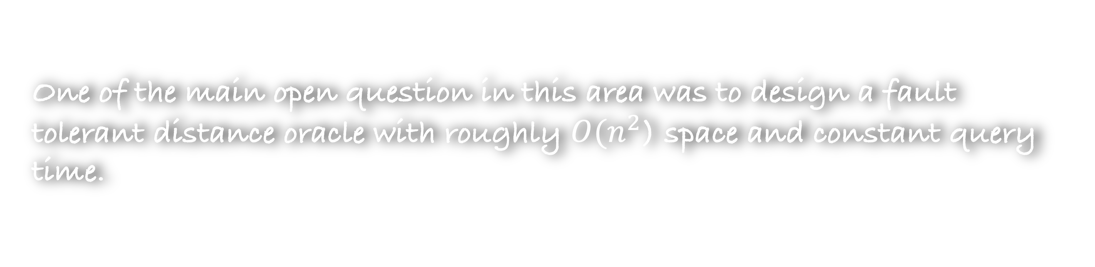

Space taken by Duan and Ren’s approach to find an intermediate vertex
D(s,t,u,v): A set of failures that maximise the shortest path from s to t such that su and tv are intact from the failures
First maximiser
What is the space taken by this maximiser?
O($n^{4}$)
One of the main open question in this area was to design a fault tolerant distance oracle with roughly $O(n^{2}$) space and constant query time.

Slide 83













  $f$-faults
Reference
Space
Query Time
Remark
Weimenn and Yuster, FOCS 2010
$$\tilde{O}(n^{3−α})$$
$$\tilde{O}\left(n^{2−\frac{1−α}{f}}\right)$$
$$α∈[0,1]$$
Brand and Saranurak, FOCS 2019
$$\tilde{O}\left(\begin{aligned}Wn^{2−α}f^{2}+ \\ Wnf^{ω}\end{aligned}\right)$$
$$\tilde{O}(Wn^{2+α})$$
$$α∈[0,1]$$
Karczmarz and Sankowski, FOCS 2023
$$\tilde{O}(n^{2})$$
$$\tilde{O}\left(nf\right)$$
Duan and Ren, STOC 2022
$$O(fn^{4})$$
$$O\left(f^{O(f)}\right)$$
Dey and Gupta, STOC 2024
$$\tilde{O}({f^{4}n}^{2})$$
$$O\left({(flog n)}^{O(f^{2})}\right)$$

Slide 84
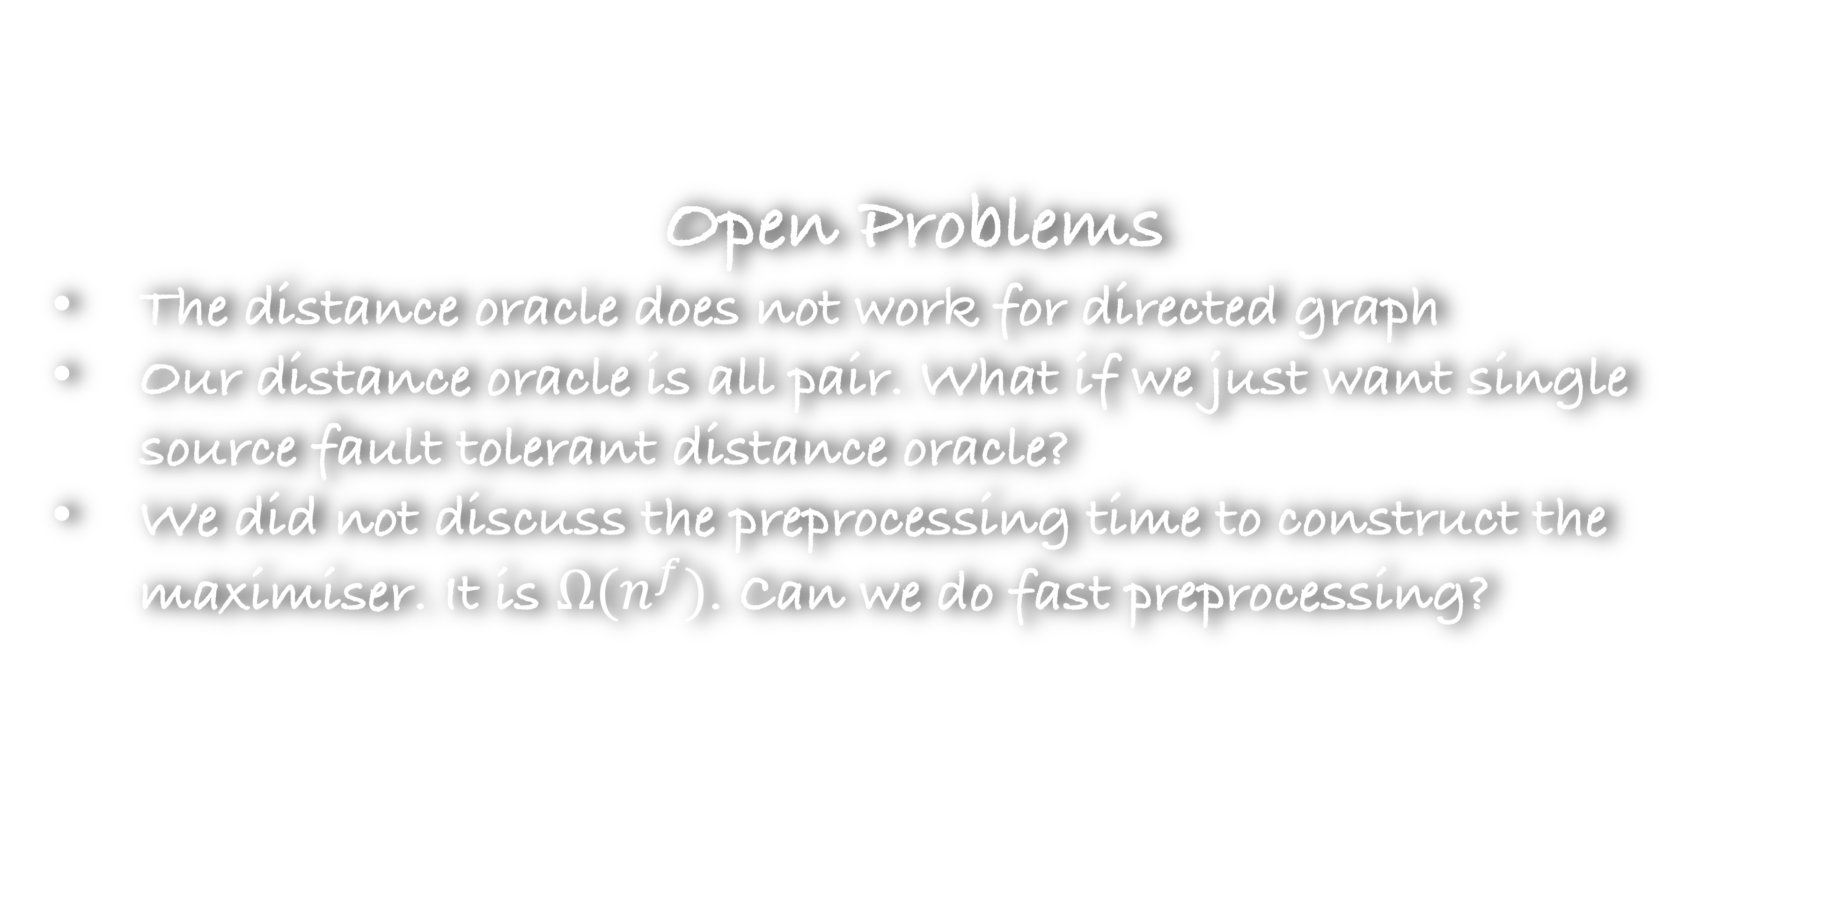
Open Problems
The distance oracle does not work for directed graph
Our distance oracle is all pair. What if we just want single source fault tolerant distance oracle?
We did not discuss the preprocessing time to construct the maximiser. It is $Ω(n^{f})$. Can we do fast preprocessing?

