Slide 1
Context Sensing

Slide 2
Context Aware Computing
Context aware computing: the use of sensors and other sources of information about a user’s context to provide more relevant information and services
Context independent:
acts exactly the same
Computer System
input
output
Human in the loop

Slide 3
Context Aware Computing
explicit
input
Context-Aware
System
explicit
output
Context:
state of the user
state of the physical environment
state of the computing system
history of user-computer interaction
...

Slide 4
What is context?
Identity (Who)
Activity (What)
Time (When)
Location (Where)
Who + What + When + Where → Context

Slide 5
Examples of Context
Identity
Spatial: location, orientation, speed
Temporal: date, time of day, season
Environmental: temperature, light, noise
Social: people nearby, activity, calendar
Resources: nearby, availability
Physiological: blood pressure, heart rate, tone of voice
Emotion

Slide 6
Rule based Context Sensing

Slide 7
Background
Context sensing
Sensors in smartphone
Applications react based on operating condition
Example
Location based reminder, Mute phone while in meeting, Greeting message while driving
Energy consumption
Big overhead
Continuous context sensing

Slide 8
Contribution
Develop ACE
Acquisitional Context Engine
A middleware that supports continuous context-aware applications
While mitigating sensing costs for inferring context

Slide 9
ACE
Provides user's current context to applications running on it
Context attributes (AtHome, IsDrving)
Key Idea: Human contexts are limited by physical constraints => context attributes are correlated
Dynamically learns relationships among various context attributes
e.g., whenever the user is Driving, he is not AtHome
Application
Request for current value
ACE
Sensors

Slide 10
Key idea
We can infer unknown context attribute values from
Known context attributes
Unknown but cheaper context attribute
Bob is running App1 (monitors walking, driving, running -accelerometer) and App2 (monitors location AtHome, Isoffice---GPS, WiFi, BT)
ACE infers rule: When driving is T, AtHome is F
Context rules

Slide 11
Two Powerful Optimizations
ACE exploits these automatically learned relationships for two powerful optimizations
The first is inference caching
allows ACE to opportunistically infer one context attribute (AtHome) from another already-known attribute (Driving)
without acquiring any sensor data
Example: App1 requests value of Driving ----Request, cache, App2---cache
App3 requests for AtHome =>short window
Respond without sensor data=>proxy

Slide 12
Two Powerful Optimizations
The second optimization is speculative sensing IsOffice=>GPS, wifi
Driving-T, Running-T, AtHome-T
IsOffice-F
InMeeting-T=>IsOffice-T
Enables ACE to occasionally infer the value of an expensive attribute (e.g., AtHome) by sensing cheaper attributes (e.g., Driving)

Slide 13
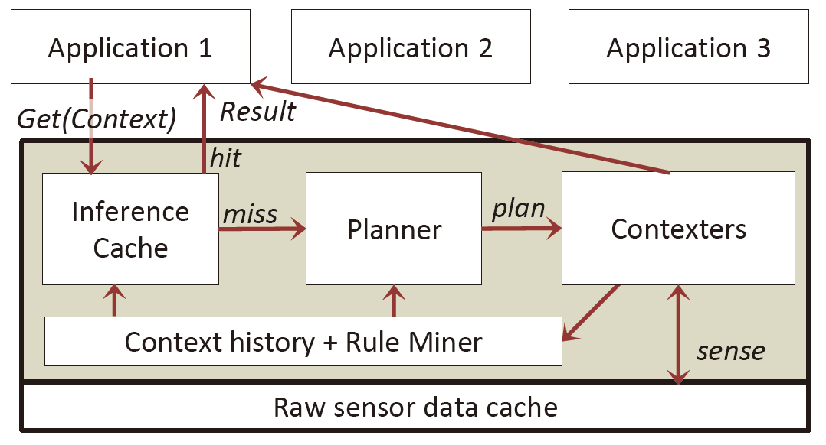
ACE Architecture

Slide 14
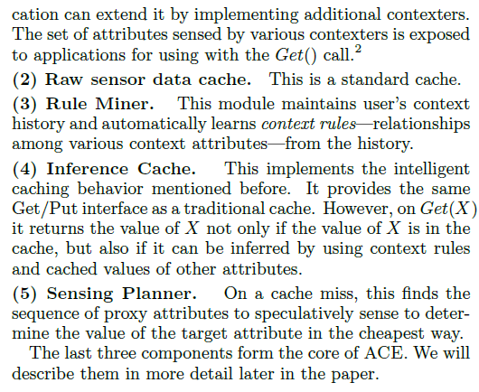

Slide 15
Contexters
Collection of modules
Determine the current value of context attribute
Data from sensors
Denote each context attribute and value as (tuple) {D=T}
Derived values based on decision tree
Based on training data

Slide 16
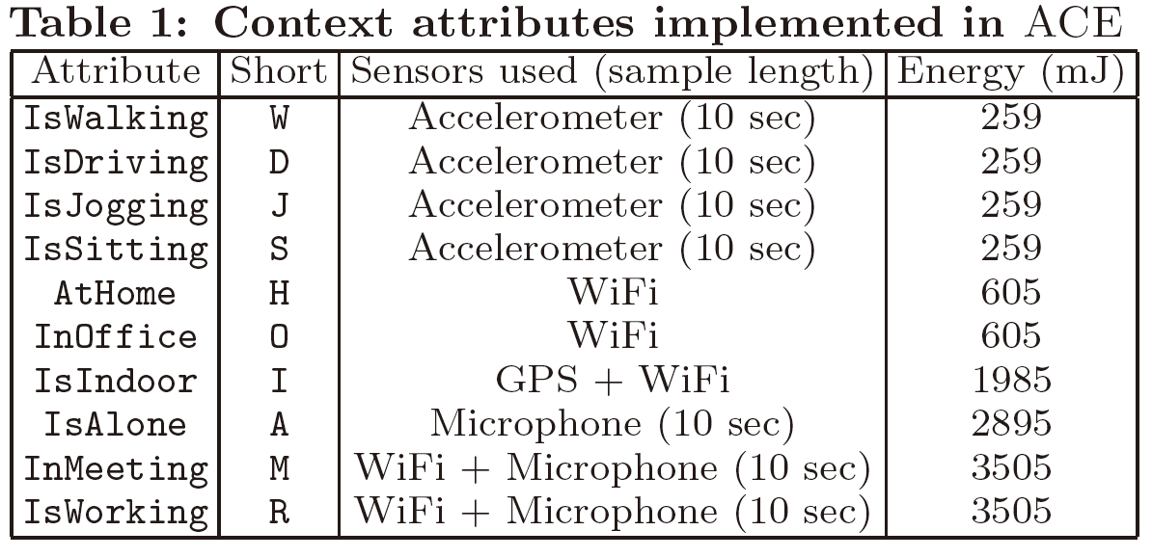
Contexters

Slide 17
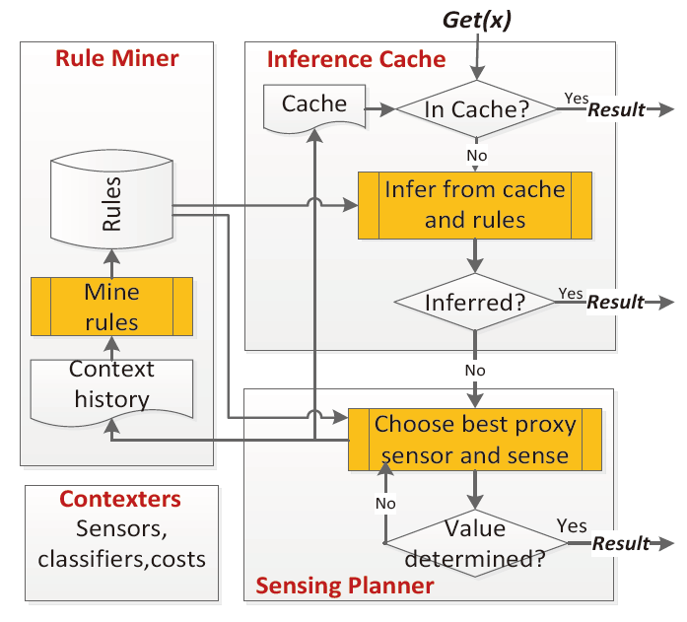
Work Flow of ACE

Slide 18
Rule Miner
Maintains the history of time stamped tuples {AtHome=true}
Derives rules regarding relationship among various context attributes
Association rule mining (Apriori algo)

Slide 19
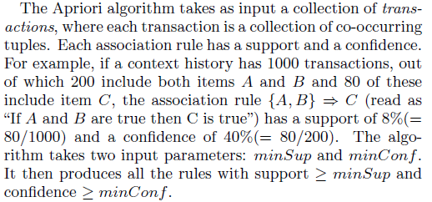
Algo Outline

Slide 20
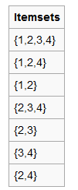
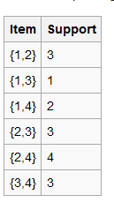
Rule Miner
Determine frequent item set
Apriori algo
Support threshold=3

Slide 21
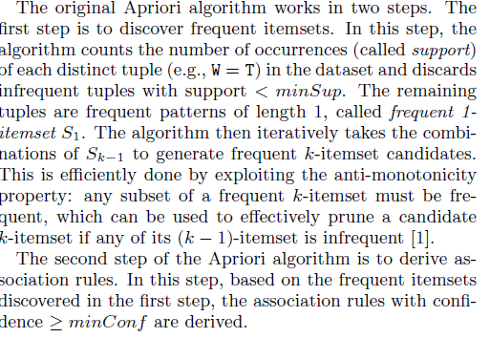

Slide 22
Rule Miner

Slide 23
Intelligent Context Caching
The Inference Cache in ACE, like traditional cache, provides a Get/Put interface
Put(X, v) puts the tuple X = v in the cache
with a predefined expiration time (default is 5 minutes)
On a Get(X) request for a context attribute X
it returns the value of X
not only if it is in the cache
but also if a value of X can be inferred from unexpired tuples in the cache by using context rules learned by the Rule Miner

Slide 24
Intelligent Context Caching
Example: App1 requests value of IsDriving ----Request contexter
Tuple D=T cached with exp time 5 mints
App2 requests D---get from cache
App3 requests for IsIndoor =>short window
No tuple with I in cache
{D=T}=>I=F
Respond I=F

Slide 25
Key challenge
Efficiently exploit the rules
Go over all the rules
Fails for transitive rules
Target context attribute
In cache

Slide 26
Expression tree
Expression tree for tuple {D=T}
Tree representation of boolean expression
Implies {D=T}
Boolean AND-OR tree
Non-leaf represents AND-OR operation with child nodes
Leaf represents a tuple
Evaluation of AND and OR node
Expression tree for {D=T} evaluates true iff it satisfies all the context rules

Slide 27
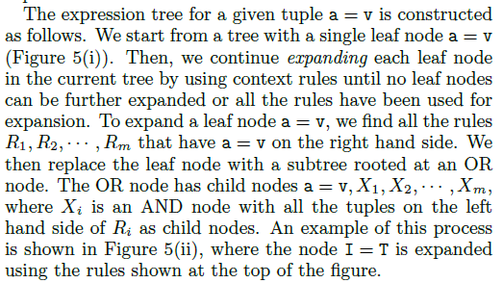
Expression tree

Slide 28
Expression tree

Slide 29
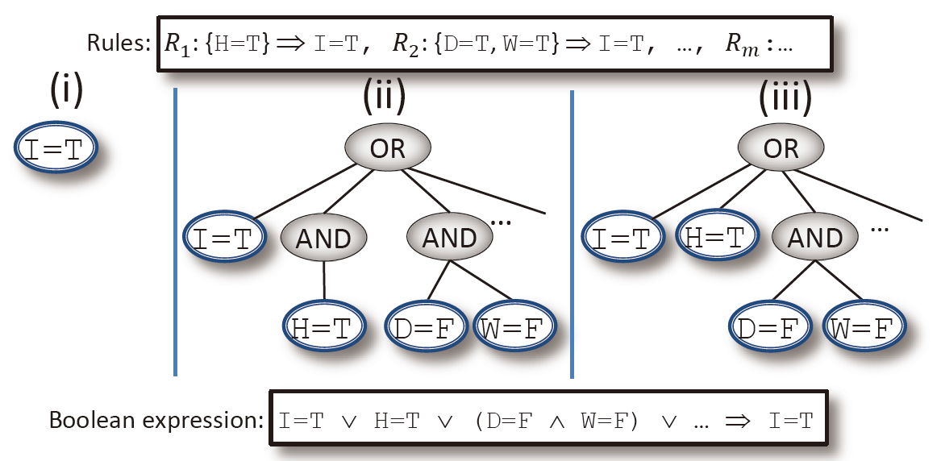
Expression Trees

Slide 30
Inference cache (evaluation of tree)
Maintains one expression tree for each tuple {D=T}, {D=F}
Get(D) evaluates both the tuple
Check satisfiability by tuples in cache
Otherwise invoke sensing planner
How to evaluate?
Leaf node is satisfied iff=>corresponding tuple in cache
Non leaf OR is satisfied if any child node is satisfied
AND is satisfied if all child nodes are satisfied
Recursive
Final=>if root is satisfied

Slide 31
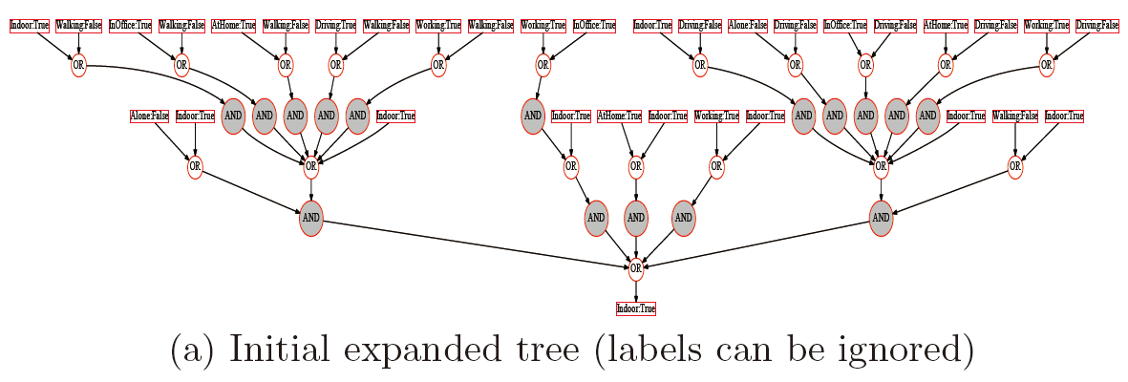
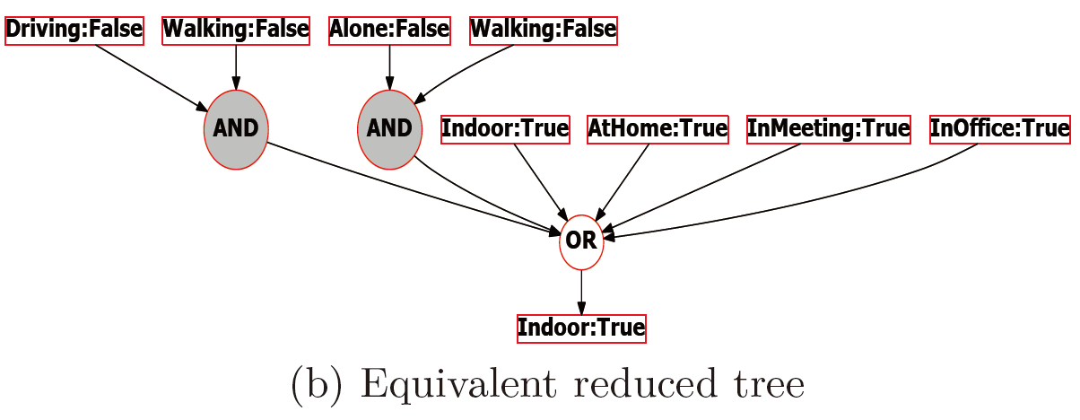

Slide 32
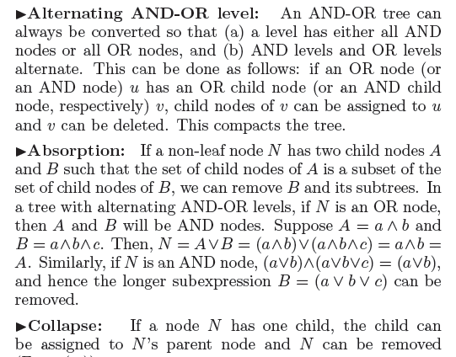
Minimal expression tree
u
OR
v
OR
OR

Slide 33
Sensing planner
Inference cache fails to determine value of X on Get(X)
Need to call necessary contexters
[AtHome] contexter uses GPS, WIFI
ACE may find X in indirect and cheaper way
Speculative sensing

Slide 34
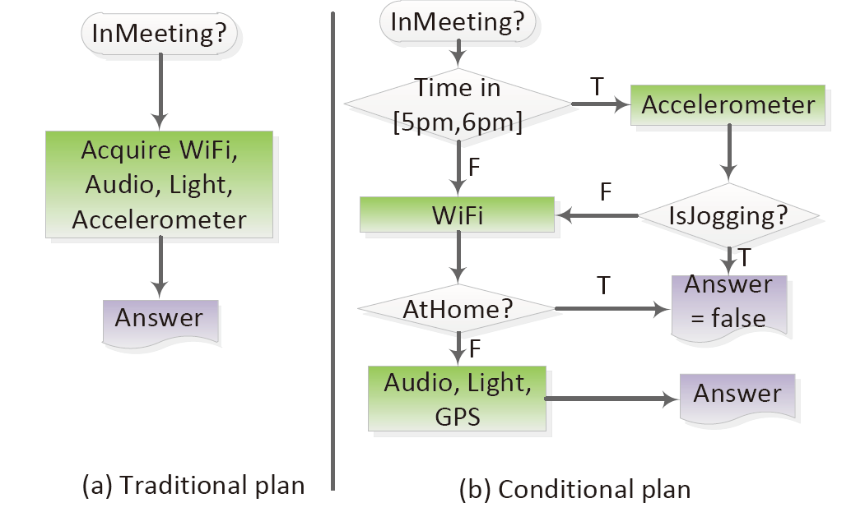
Sensing Planner

Slide 35
ACE Architecture

Slide 36
Sensing plan
Order in which various attributes needs to be checked
Determine the target attribute
Optimal order may depend on
Cost of contexter (c_{i})
Likelihood the attribute returning True value (p_{i})
Expected sensing cost can be computed using ci (config. of contexter), pi (context history)

Slide 37
Speculative sensing API
Option 1: Generate the plan graph
Traverse only a part
Option 2: Incrementally enumerate only next node
Init (X): Target attrb X
a <- next(): returns the next attribute OR null
Update(a,v): Update tuple {a=v}
Value <- Result(): returns the value of X

Slide 38
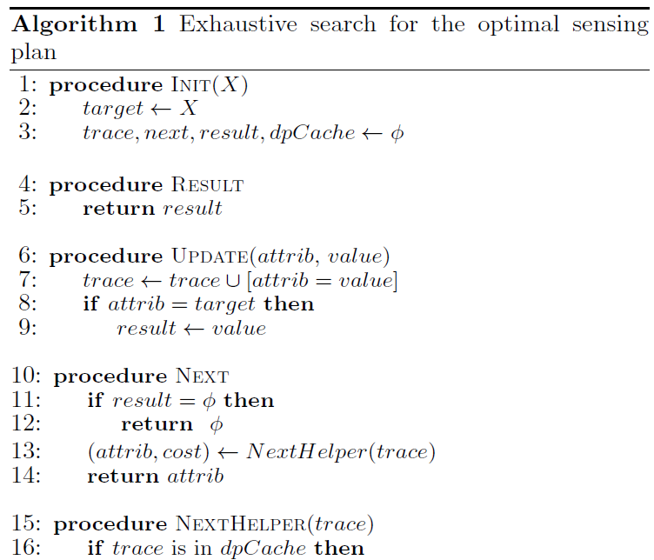
Contexter returns the value of attrib
Update trace
trace = {collection of tuples}
Determines the order of proxy attributes for sensing planer
Invoke the contexter to
evaluate attrib

Slide 39
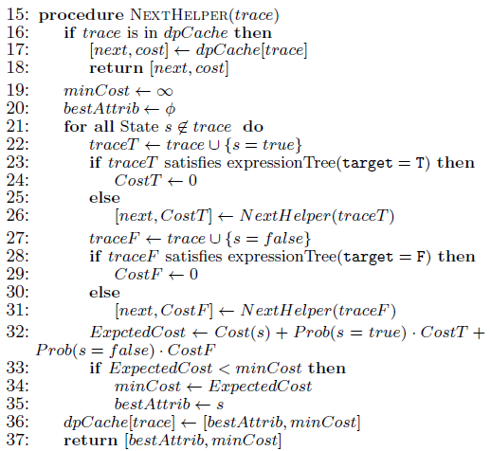
For memoization
Try all unexplored context attributes s
Get it from inference cache
Get it from inference cache
Choose the best proxy attribute
Cache it for memoization

Slide 40
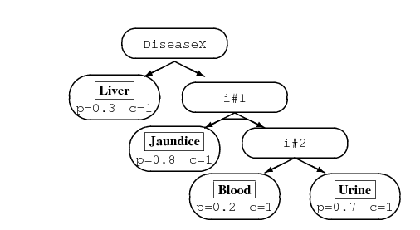

Slide 41
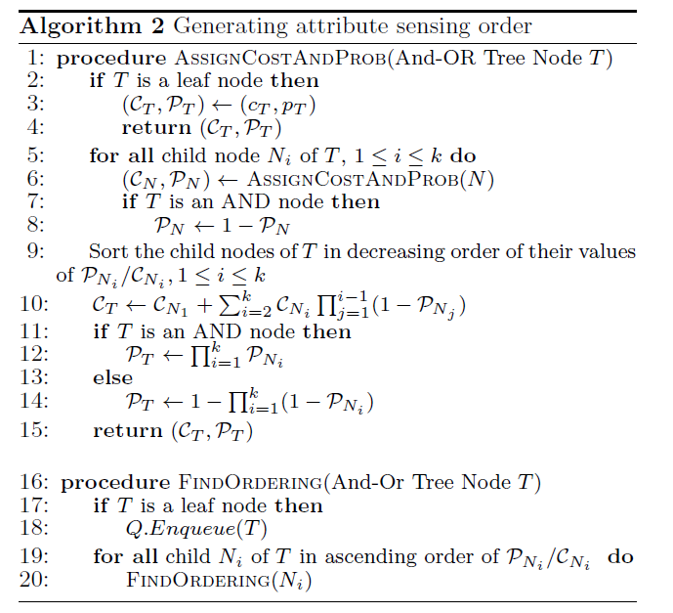

Slide 42
Evaluation
Effectiveness of Inference Cache
Accuracy
Effectiveness of Sensing Planner
Overhead of ACE
End-to-end Energy Savings

Slide 43
Applications
GeoReminder
Monitors user’s current location and displays message
JogTracker
Monitors user’s transportation mode and keeps track of calories burn
PhoneBuddy
Mute the phone while in a meeting

Slide 44
Datasets
Reality Mining Dataset
collected part of the Reality Mining project at MIT
contains continuous data on daily activities of 100 students and staff at MIT
recorded by Nokia 6600 smartphones over the 2004-2005 academic year
Trace contains sequence of lines
Time, attrib1=value1, attrib2=value2

Slide 45
Dataset

Slide 46
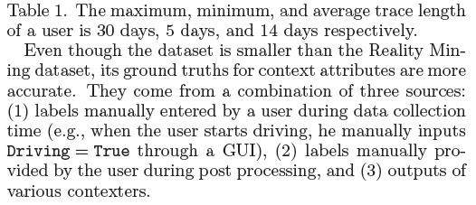
Datasets
ACE Dataset
collected with continuous data collection software running on Android phones
The subjects in the dataset, 9 male and 1 female, worked at Microsoft Research Redmond

Slide 47
Evaluation
Port ACE prototype on a laptop
Replace contexters with the fake one
Return’s current context from trace
Energy consumption is modelled from real contexter.
Run applications at each tick (5 mints)
Expiration time – 1 tick

Slide 48
Evaluation
Effectiveness of Inference Cache
Accuracy
Effectiveness of Sensing Planner
Overhead of ACE
End-to-end Energy Savings

Slide 49
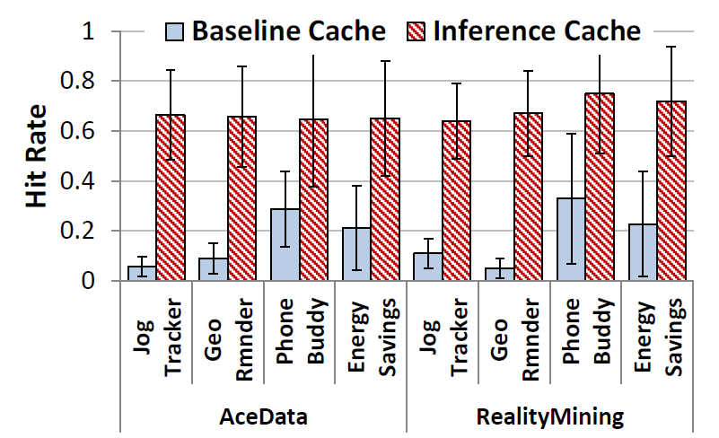
Hit rates and energy savings of Inference Cache
Due to sensor overlap

Slide 50
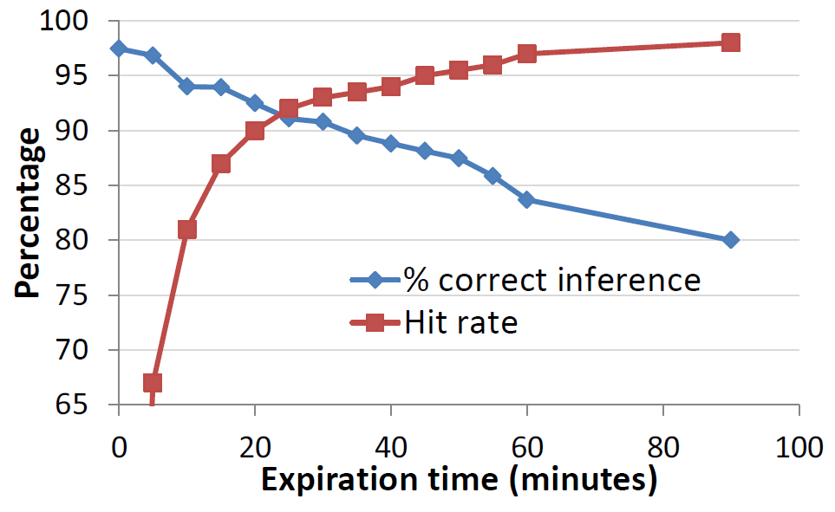
Effect of cache expiration time on hit rate and accuracy
Staleness

Slide 51
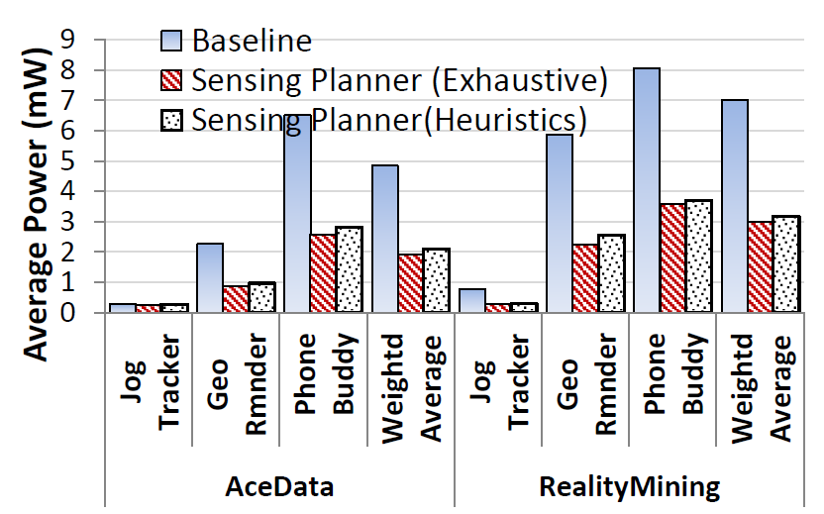
Energy savings by Sensing Planner

Slide 52
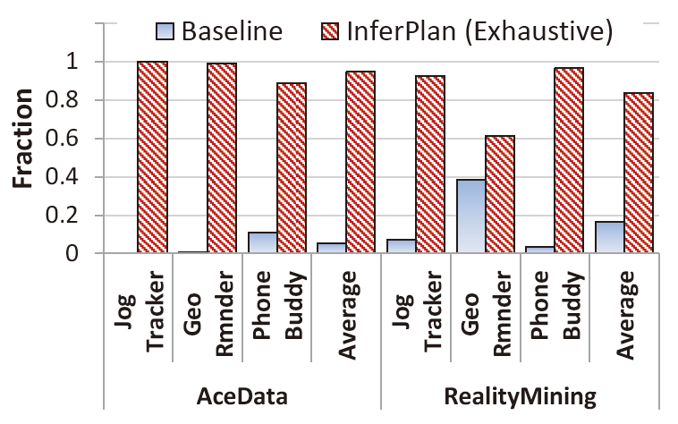
Fraction of times Sensing Planner does better

Slide 53
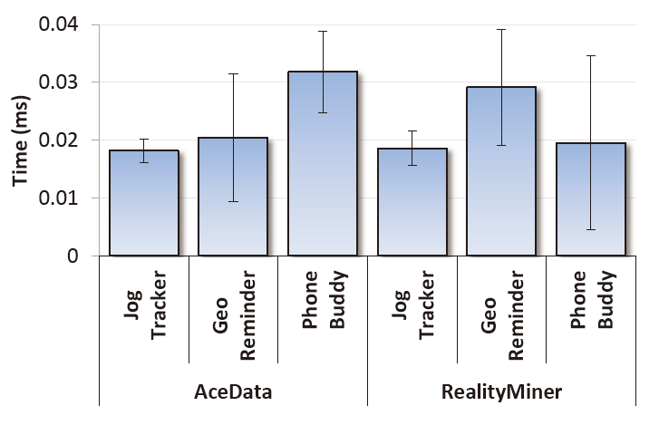
Latency of a Get() request on Inference Cache hit

Slide 54
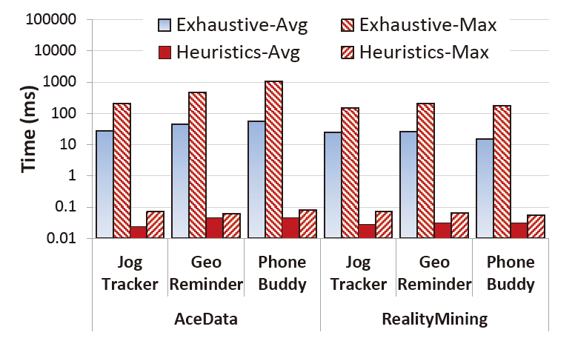
Time required to generate a plan on a Samsung Focus phone

Slide 55
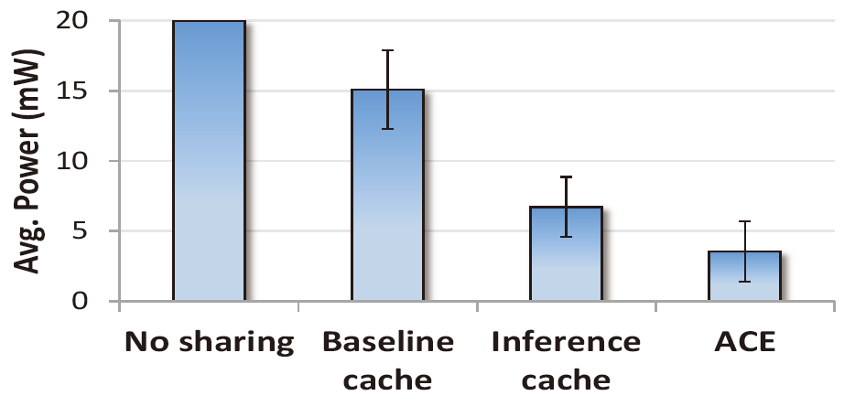
End-to-end energy savings

Slide 56
Per user power consumption (users sorted by ACE power)

