Slide 1
Syntax Directed Definitions Synthesized Attributes

Slide 2
Semantic Analysis
Lexical analysis
(Tokens)
Input code
Parsing (Parse Tree)
Intermediate Code
(m/c-independent)
Target Code
connection
Semantic Analysis:
Parser will generate the parse tree with the semantic information. When the parse tree is evaluated/traversed it will automatically generate the Intermediate Code.

Slide 3
How to accommodate semantic information in CFG?
How to relate programming languages into Terminals & Not-Terminals?
Tokens are Terminals
Constructs are Non-Terminals
Input
Program
Tokens
Constructs

Slide 4
Programming Language Constructs:
Ex: while, if-then else
while(a>b)
{ i=i+1;
}
while
body >
= a b
i +
i 1
Construct
Parse Tree

Slide 5
Attributes : String or value associated with a grammar.
String
Int
Code
Attributes can be added to each non-terminal.
To evaluate the value of attributes semantic rules should be used.
For a production: A→X1X2
Let t, x, y be the attributes for A, X1, X2
i.e., A.t = X1.xX2.y
The above expression is asscociated with A→X1X2

Slide 6
Tokens translate intermediate code.
Infix Expression → Postfix Expression
SDD: Syntax Directed Definition
A CFG with attributes and rules
SDD: Syntax Directed Translation
Attributes associated with grammar symbols and rules are associated with productions and these help to translate.

Slide 7
CFG →Design SDD adding t
Productions Semantic Rules
E→E+T E.t = E.t||+||E.t
E→E-T E.t = E.t||+||E.t
E→T E.t = T.t
T→id T.t = id.t
Input string: 3+7-2
LA : recognizes the token & assigns the values to the terminals.
E
E - T
E + T id
T id Parse Tree corresponding to the input string
id

Slide 8
Parse Tree with attributes and values assigned:
E(E.t=37+2-)
E(E.t=37+) - T(T.t=2-)
E(E.t=3) + T(T.t=7)
T(T.t=3) id(id.t = 7)
id(id.t=3)
The value of E.t is the post fix notation of the given input string.

Slide 9
SDD:
Synthesized Attributes:
Evaluates attributes of non-terminal (A) which is associated with a production(P) with the help of the body(children).
P:A→X1X2X3
A
X1 X2 X3
The augmented grammar with attributes of the previous CFG considered is
L→E L.t=E.t
E→E+T E.t=E.t+T.t
E→T E.t=T.t
T→T*F T.t=T.t*F.t
T→F T.t=F.t
F→id F.t=id.t

Slide 10
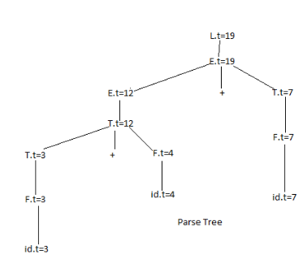
Abstract Syntax Tree:
A syntax where the Internal nodes are Operators and
Leaves are Operands.
Ex:3*4+7 +
id*id+id
Abstract Syntax * 7
Tree
3 4
Bottom Up Evaluating

Slide 11
Input String:12*7*5
T→T*F
T→F
F→id
After Transforming:
T→FT’
T’→*FT’
T’→Ɛ
F→id
T
T
*
F
T
*
F
id
F
id
id
T
F
T’
id12
*
F
T’
id7
*
F
T’
id 5
Ɛ
Top Down Parser

