Slide 1
SHIFT REDUCE PARSER LR AUTOMATON
GROUP 22
UDIT BHUTANI (11CS10048)
UTAKRSH CHANCHLANI (11CS10049)
LECTURE DATE: 10/09/2013

Slide 2

Algorithm to generate LR Automaton
FSM(G’) where G’ is augmented grammar
{
C=closure (S’->.S); //first state
for(each state $I∈C$ )
{
for(each symbol X)
{
if (GOTO(I,X) gives a new state)
{
insert GOTO(I,X) in C
}
}
}
}

Slide 3
With each state a unique grammar symbol is associated
State j
Z
State i
?₁
State x
?₂
State y
?₁ = ?₂ = Z (grammar associated with i should be unique)

Slide 4
Shift Reduce Parser
s_{n}
:
:
s₀
PARSER
States
Grammar
Symbols

Slide 5
Here we maintain two different stacks
One for normal LR parsing (holding the grammar symbol).
One to hold the states.
Parsing table is designed using LR automaton. It guides to the parser whether to shift/reduce.
Whatever state is on top of stack 2, the corresponding grammar symbol needs to be on top of stack 1.

Slide 6
LR Parser Configuration
Shows the state of the parsing process at any point of time.
Initial configuration: (S₀ , W)
Current configuration: ( S₀S₁S₂ …. S_{n} , a_{i}a_{i+1}a_{i+2}….a_{n}$)
(note: W is the entire string)
Behavior of the LR parser:
Shift
Reduce
Accept
Error

Slide 7
Shift
Current configuration: ( S₀S₁S₂ …. S_{n} , a_{i}a_{i+1}a_{i+2}….a_{n}$)
Current stack pointer at S_{n} and input pointer at a_{i}.
Shift j ← Action(S_{n}, a_{i})
This means push state j onto the stack.
The corresponding symbol is also pushed onto the stack.
The input pointer is also incremented.
Final configuration: ( S₀S₁S₂ …. S_{n}S_{j} , a_{i+1}a_{i+2}….a_{n}$)

Slide 8
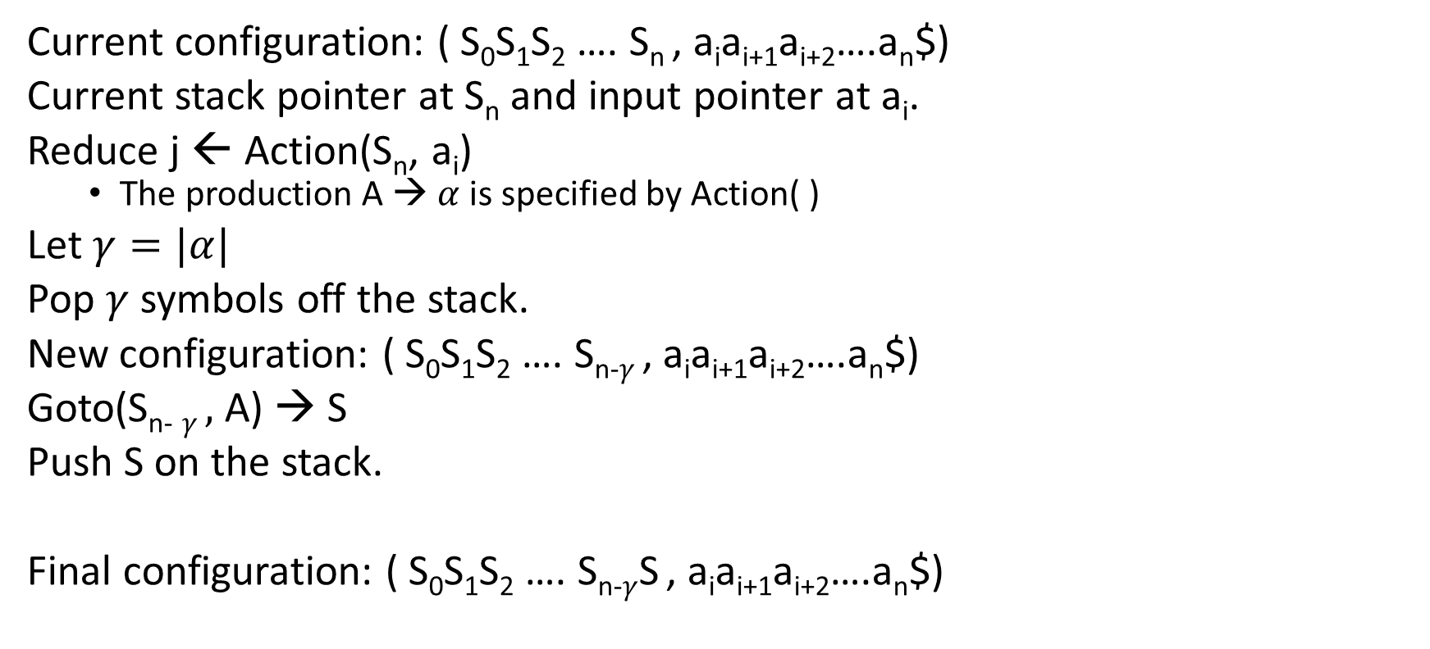
Reduce
Current configuration: ( S₀S₁S₂ …. S_{n} , a_{i}a_{i+1}a_{i+2}….a_{n}$)
Current stack pointer at S_{n} and input pointer at a_{i}.
Reduce j ← Action(S_{n}, a_{i})
The production A → $α$ is specified by Action( )
Let $γ=|α|$
Pop $γ$ symbols off the stack.
New configuration: ( S₀S₁S₂ …. S_{n-}$γ$ , a_{i}a_{i+1}a_{i+2}….a_{n}$)
Goto(S_{n-} $γ ,$ A) → S
Push S on the stack.
Final configuration: ( S₀S₁S₂ …. S_{n-}$γ$S , a_{i}a_{i+1}a_{i+2}….a_{n}$)

Slide 9
Accept and Error
Accept:
Action([S’→S.] , $)
Error:
No action is defined for a state or an input symbol.

