Slide 1
COMPILERS LECTURE(6-Aug-13)
LECTURE-8
As in the Last Lecture ,We were discussing about Lexical Analyzer and how we need to identify the different forms of patterns pertaining to language syntax. These patterns helps us generate Tokens and Lexemes

Slide 2
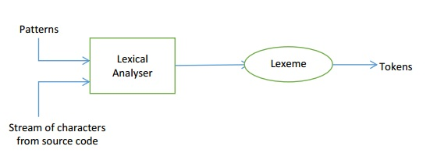
Alphabet: Set of Symbols →(digits, letters, special characters, etc.)
String: Defined on alphabet → (Countable Infinite Set)
Language: Countable set of Strings →(Finite/ Infinite)

Slide 3
REGULAR EXPRESSION
For a finite alphabet ∑
Some regular expressions are as follows:→
Empty set:→ Ø
Empty String :→ ԑ
A Literal:→A symbol in the set ∑

Slide 4
Then the following operations are the valid regular expressions:
1. Union: L U D = { S | S є L or S є D}
2. Concatenation: LD = {ST | S є L , T є D}
3. k-closure: L* → L0UL1U……L.∞
4. p-closure: L+ → L1UL2U……L∞

Slide 5
Operations on regular languages:
1. є => L(є)
2. a є ∑ => L(a)
3. (r + s) => L(r) U L(s)
4. rs = L(r).L(s)
5. r* = L(r)

Slide 6
THEME FOR THE NEXT LECTURE →
Therefore, all these discussions prove the importance
of patterns and how to detect those patterns in
Lexical Analysis stage of Compilation.
Later, we will see how to actually compare
a string of characters with different patterns
using various DFAs and how to construct them
using the given regular expressions.

