Slide 1
Compilers
B V Sai Aravind (11CS10008)

Slide 2
Outlines
Structure of a Compiler
Phases of a Compiler
Lexical Analysis
Syntax Analysis
Semantic Analysis

Slide 3
Structure of a Compiler
Any compiler must perform two major tasks.
Analysis of the source program.
Synthesis of a machine-language program.
Compiler
Analysis
Synthesis

Slide 4
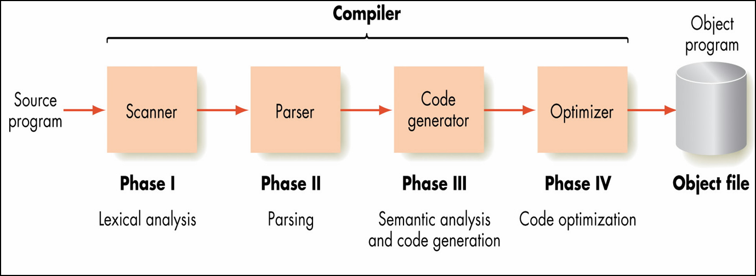
Phases of a Compiler

Slide 5
Phases of a Compiler
Symbol Table Manager
Source
Program
Lexical Analyzer
Syntax Analyzer
Semantic Analyzer
Intermediate Code Generator
Code Optimizer
Code Generator
Target
Program
Error Handler

Slide 6
Lexical Analysis
Characters are grouped into tokens.
Example:
position = initial + rate * 60
Position <Identifier, 1>
Operator = <=>
initial <Identifier, 2>
Operator + <+>
Rate <Identifier, 3>
Operator * <*>
60 <number, 60>

Slide 7
Syntax Analysis
Character groups recorded in symbol table.
The tokens grouped into grammatical phrases.
A parser tree constructed specified by the grammar of the source language.

Slide 8
Semantic Analyzer
Type Checking
  Consider the array element A[i]
  Checks if i is an integer.
Type Casting
  int *float;
  Casts the int to float.

