Slide 1
Combining Models

Slide 2
Motivation 1
Many models can be trained on the same data
Typically none is strictly better than others
  Recall “no free lunch theorem”
Can we “combine” predictions from multiple models?
Yes, typically with significant reduction of error!

Slide 3
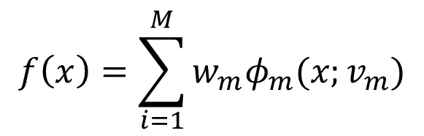
Motivation 2
Combined prediction using Adaptive Basis Functions
M basis functions with own parameters
Weight / confidence of each basis function
Parameters including M trained using data
Another interpretation: automatically learning best representation of data for the task at hand
Difference with mixture models?
$$f\left(x\right)=\sum_{i=1}^{M}{w_{m}φ_{m}(x;v_{m})}$$

Slide 4
Examples of Model Combinations
Also called Ensemble Learning
Decision Trees
Bagging
Boosting
Committee / Mixture of Experts
Feed forward neural nets / Multi-layer perceptrons
…

Slide 5
Decision Trees
Partition input space into cuboid regions
Simple model for each region
    Classification: Single label; Regression: Constant real value
Sequential process to choose model per instance
  Decision tree
Figure from Murphy

Slide 6
Learning Decision Trees
Decision for each region
  Regression: Average of training data for the region
  Classification: Most likely label in the region
Learning tree structure and splitting values
  Learning optimal tree intractable
Greedy algorithm
  Find (node, dim., value) w/ largest reduction of “error”
    Regression error: residual sum of squares
    Classification: Misclassification error, entropy, …
  Stopping condition
Preventing overfitting: Pruning using cross validation

Slide 7
Pros and Cons of Decision Trees
Easily interpretable decision process
  Widely used in practice, e.g. medical diagnosis
Not very good performance
  Restricted partition of space
  Restricted to choose one model per instance
  Unstable

Slide 8
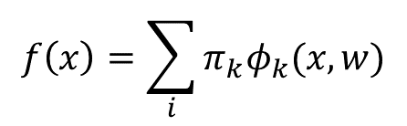
Mixture of Supervised Models
$$f\left(x\right)=\sum_{i}{π_{k}φ_{k}(x,w)}$$
Mixture of linear regression models
Mixture of logistic regression models
Figure from Murphy
Training using EM

Slide 9
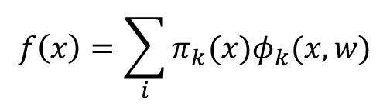
Conditional Mixture of Supervised Models
Mixture of experts
$$f\left(x\right)=\sum_{i}{π_{k}(x)φ_{k}(x,w)}$$
Figure from Murphy

Slide 10

Bootstrap Aggregation / Bagging
Individual models (e.g. decision trees) may have high variance along with low bias
Construct M bootstrap datasets
Train separate copy of predictive model on each
Average prediction over copies
If the errors are uncorrelated, then bagged error reduces linearly with M
$$f\left(x\right)=\frac{1}{M}\sum_{i}{f_{m}(x)}$$

Slide 11
Random Forests
Training same algorithm on bootstraps creates correlated errors
Randomly choose (a) subset of variables and (b) subset of training data
Good predictive accuracy
Loss in interpretability

Slide 12
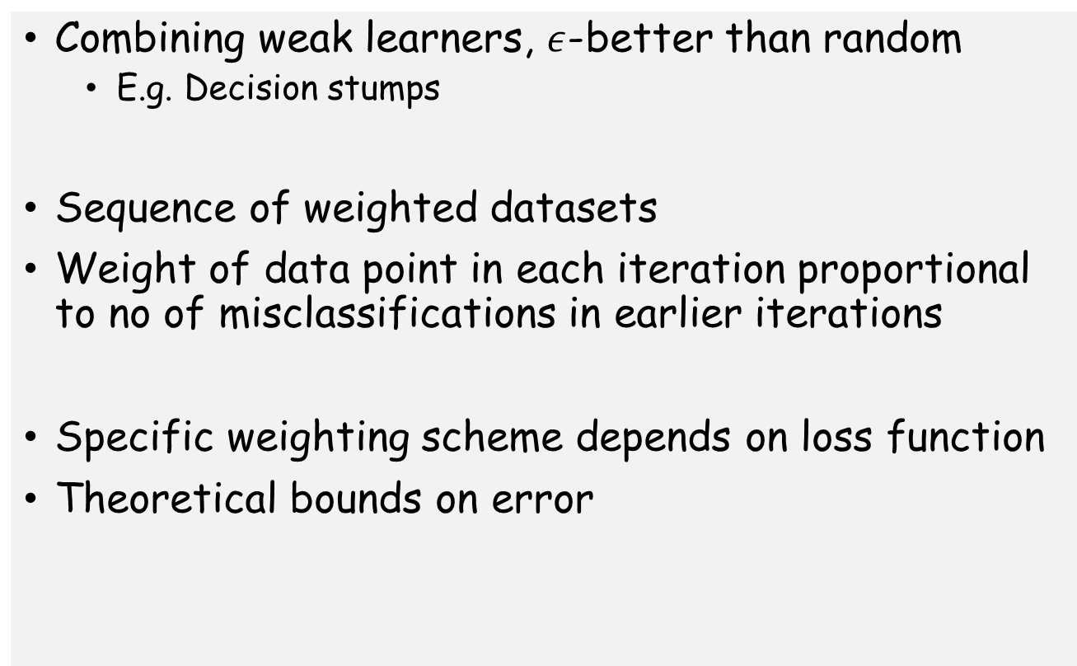
Boosting
Combining weak learners, $ε$-better than random
  E.g. Decision stumps
Sequence of weighted datasets
Weight of data point in each iteration proportional to no of misclassifications in earlier iterations
Specific weighting scheme depends on loss function
Theoretical bounds on error

Slide 13
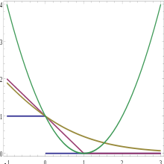
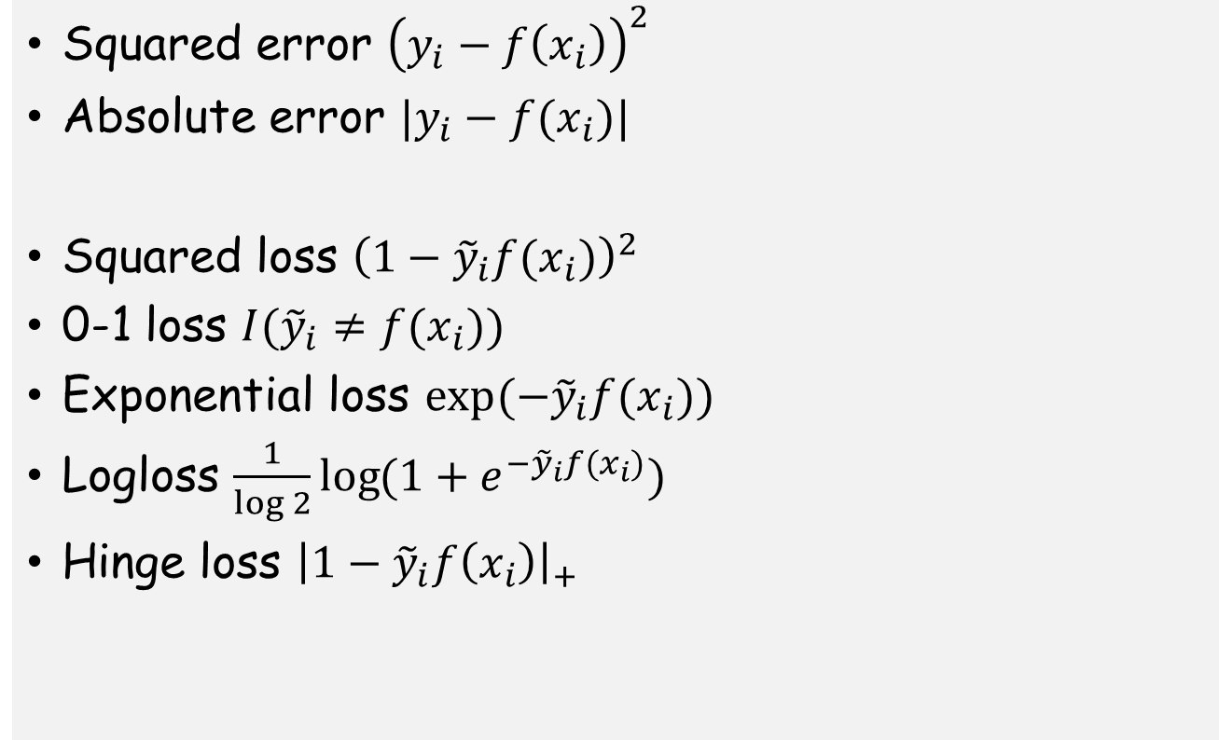
Example loss functions and algorithms
Squared error ${\left(y_{i}−f\left(x_{i}\right)\right)}^{2}$
Absolute error $|y_{i}−f(x_{i})|$
Squared loss ${\left(1−{\tilde{y}}_{i}f(x_{i})\right)}^{2}$
0-1 loss $I({\tilde{y}}_{i}≠f(x_{i}))$
Exponential loss $\exp{(−{\tilde{y}}_{i}f(x_{i}))}$
Logloss $\frac{1}{log 2}\log{(1+e^{−{\tilde{y}}_{i}f(x_{i})})}$
Hinge loss ${\left|1−{\tilde{y}}_{i}f\left(x_{i}\right)\right|}_{+}$

Slide 14
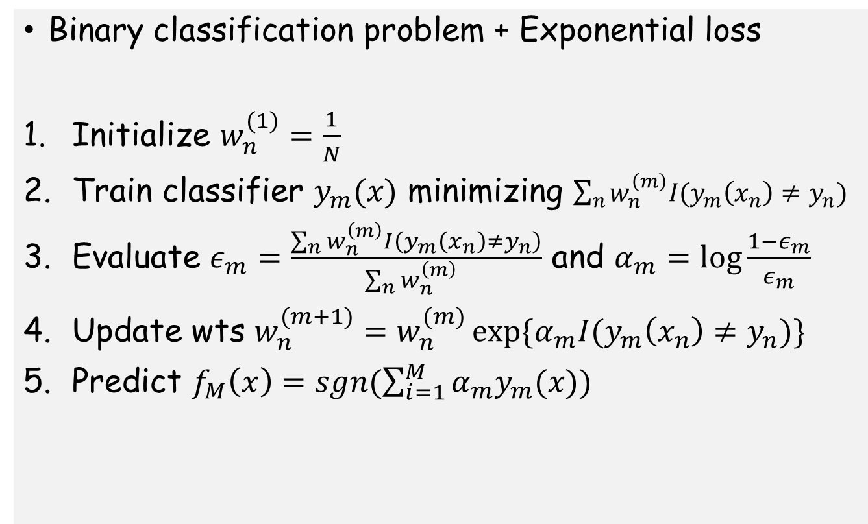
Example: AdaBoost
Binary classification problem + Exponential loss
Initialize $w_{n}^{(1)}=\frac{1}{N}$
Train classifier $y_{m}(x)$ minimizing $\sum_{n}{w_{n}^{\left(m\right)}I(y_{m}\left(x_{n}\right)≠y_{n})}$
Evaluate $ε_{m}=\frac{\sum_{n}{w_{n}^{\left(m\right)}I\left(y_{m}\left(x_{n}\right)≠y_{n}\right)}}{\sum_{n}{w_{n}^{\left(m\right)} }}$ and $α_{m}=\log{\frac{1−ε_{m}}{ε_{m}}}$
Update wts $w_{n}^{(m+1)}=w_{n}^{(m)}\exp{\{α_{m}I(y_{m}\left(x_{n}\right)≠y_{n})\}}$
Predict $f_{M}\left(x\right)=sgn(\sum_{i=1}^{M}{α_{m}y_{m}(x)})$

Slide 15
Neural networks: Multilayer Perceptrons
Multiple layers of logistic regression models
Parameters of each optimized by training
Motivated by models of the brain
Powerful learning model regardless

Slide 16
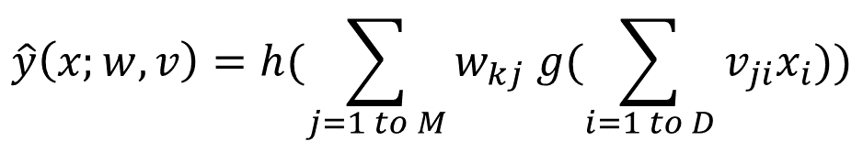
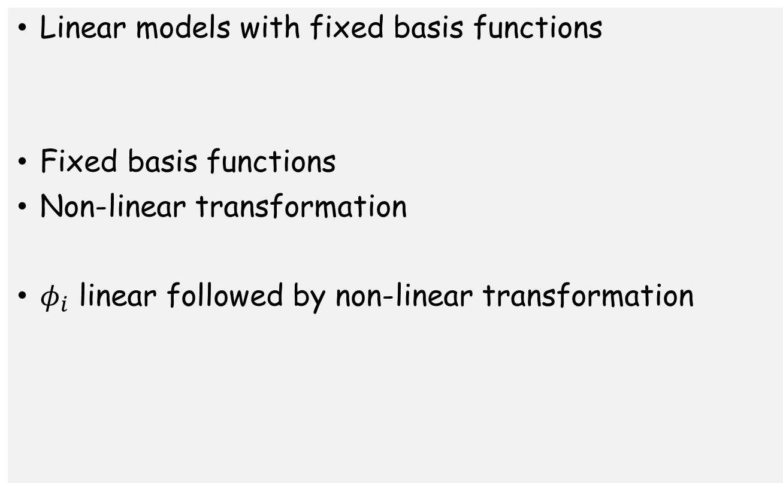
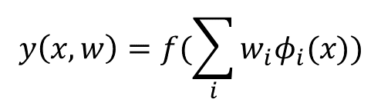
LR and R remembered …
Linear models with fixed basis functions
Fixed basis functions
Non-linear transformation
$φ_{i}$ linear followed by non-linear transformation
$$y\left(x,w\right)=f(\sum_{i}{w_{i}φ_{i}(x))}$$
$$\hat{y}\left(x;w,v\right)=h(\sum_{j=1 to M}{w_{kj} g(\sum_{i=1 to D}{v_{ji}x_{i}})})$$

Slide 17




Feed-forward network functions
M linear combinations of input variables
Apply non-linear activation function
Linear combinations to get output activations
Apply output activation function to get outputs
$$a_{j}=\sum_{i=1 to D}{v_{ji}x_{i}}$$
$$z_{j}=g(a_{j})$$
$$b_{k}=\sum_{j=1 to M}{w_{kj}z_{j}}$$
$$y_{k}=h(b_{k})$$

Slide 18
























Network Representation
$$inputs$$
$$hidden$$
$$outputs$$
$$g$$
$$v$$
$$a_{M}$$
$$z_{M}$$
$$w$$
$$x_{D}$$
$$h$$
$$b_{1}$$
$$y_{1}$$
Easy to generalize to multiple layers
$$v_{ji}$$
$$w_{kj}$$
$$x_{i}$$
$$a_{j}$$
$$z_{j}$$
$$b_{k}$$
$$y_{k}$$
$$b_{K}$$
$$y_{K}$$
$$x_{1}$$
$$a_{1}$$
$$z_{1}$$

Slide 19
Power of feed-forward networks
Universal approximators
Why are >2 layers needed?
A 2 layer network with linear outputs can uniformly approximate any smooth continuous function with arbitrary accuracy given sufficient number of nodes in hidden layer

Slide 20

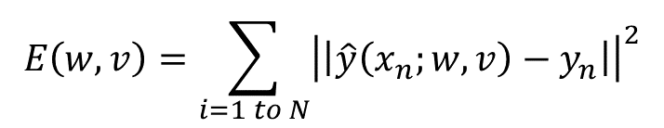
Training
Formulate error function in terms of weights
Optimize weights using gradient descent
Deriving the gradient looks complicated because of feed-forward …
$$E\left(w,v\right)=\sum_{i=1 to N}{{\left|\left|\hat{y}\left(x_{n};w,v\right)−y_{n}\right|\right|}^{2}}$$
$${\left(w,v\right)}^{(t+1)}={\left(w,v\right)}^{(t)}−η∇E({\left(w,v\right)}^{(t)})$$

Slide 21



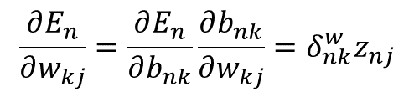








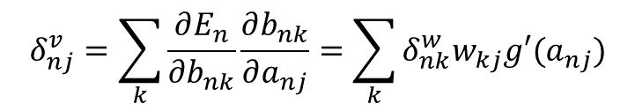



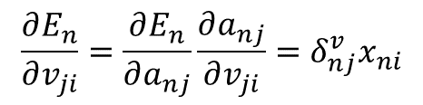


Error Backpropagation
Full gradient: sequence of local computations and propagations over the network
Output layer
$$\frac{∂E_{n}}{∂w_{kj}}=\frac{∂E_{n}}{∂b_{nk}}\frac{∂b_{nk}}{∂w_{kj}}=δ_{nk}^{w}z_{nj}$$
$$forward function$$
$$δ_{nk}^{w}={\hat{y}}_{nk}−y_{nk}$$
$$g$$
$$w_{kj}$$
$$h$$
$$x_{i}$$
$$v_{ji}$$
$$a_{j}$$
$$z_{j}$$
$$b_{k}$$
$${\hat{y}}_{k}$$
$$δ_{nj}^{v}$$
$$δ_{nk}^{w}$$
$$y_{k}$$
Hidden layer
$$\frac{∂E_{n}}{∂v_{ji}}=\frac{∂E_{n}}{∂a_{nj}}\frac{∂a_{nj}}{∂v_{ji}}=δ_{nj}^{v}x_{ni}$$
$$backward error$$
$$δ_{nj}^{v}=\sum_{k}{\frac{∂E_{n}}{∂b_{nk}}\frac{∂b_{nk}}{∂a_{nj}}}=\sum_{k}{δ_{nk}^{w}w_{kj}g′(a_{nj})}$$
$$\frac{∂E}{∂w}=\sum_{n}{\frac{∂E_{n}}{∂w}}$$

Slide 22
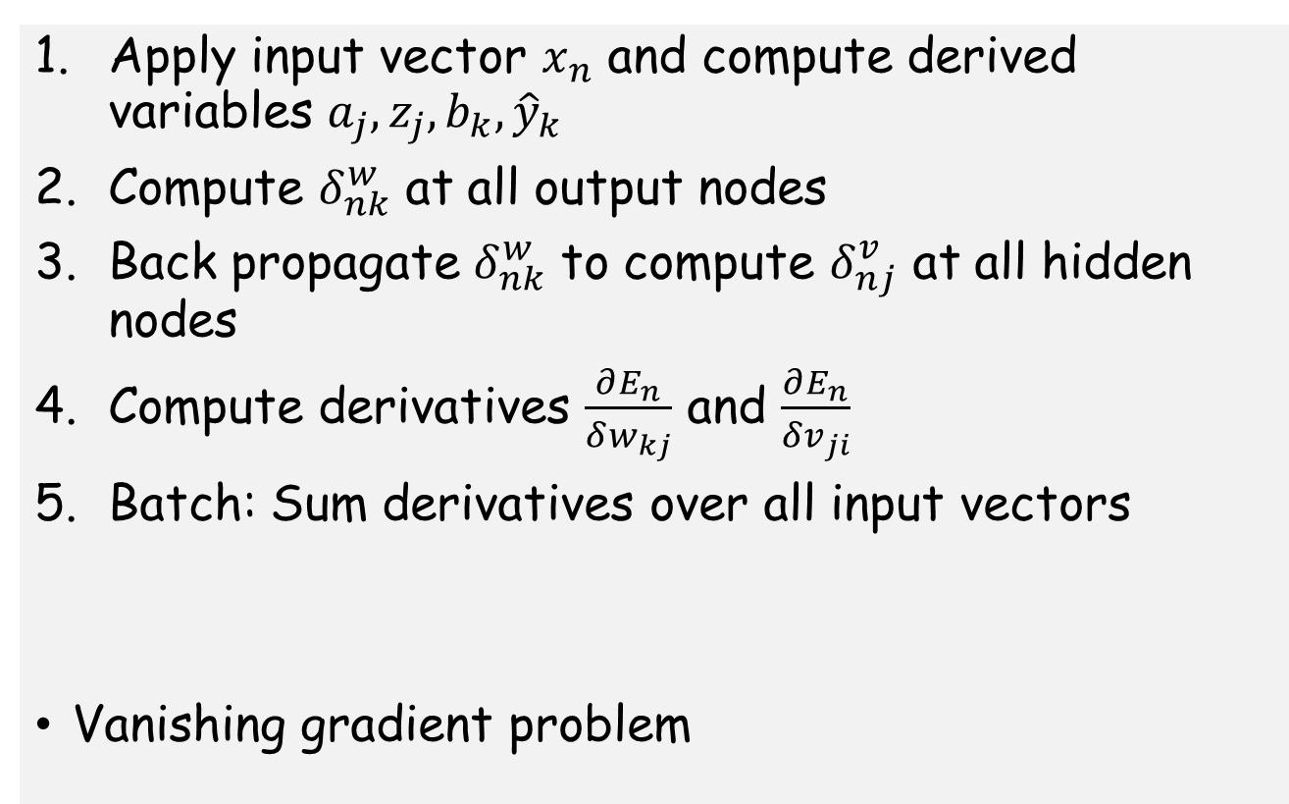
Backpropagation Algorithm
Apply input vector $x_{n}$ and compute derived variables $a_{j},z_{j},b_{k},{\hat{y}}_{k}$
Compute $δ_{nk}^{w}$ at all output nodes
Back propagate $δ_{nk}^{w}$ to compute $δ_{nj}^{v}$ at all hidden nodes
Compute derivatives $\frac{∂E_{n}}{δw_{kj}}$ and $\frac{∂E_{n}}{δv_{ji}}$
Batch: Sum derivatives over all input vectors
Vanishing gradient problem

Slide 23
Neural Network Regularization
Given such a large number of parameters, preventing overfitting is vitally important
Choosing the number of layers + no of hidden nodes
Controlling the weights
  Weight decay
Early stopping
Weight sharing
Structural regularization
  Convolutional neural networks for invariances in image data

Slide 24
So… Which classifier is the best in practice?
Extensive experimentation by Caruana et al 2006
  See more recent study here
Low dimensions (9-200)
Boosted decision trees
Random forests
Bagged decision trees
SVM
Neural nets
K nearest neighbors
Boosted stumps
Decision tree
Logistic regression
Naïve Bayes
High dimensions (500-100K)
HMC MLP
Boosted MLP
Bagged MLP
Boosted trees
Random forests
Remember the “No Free Lunch” theorem …

