Slide 1
Probabilistic Models for Sequence Data

Slide 2
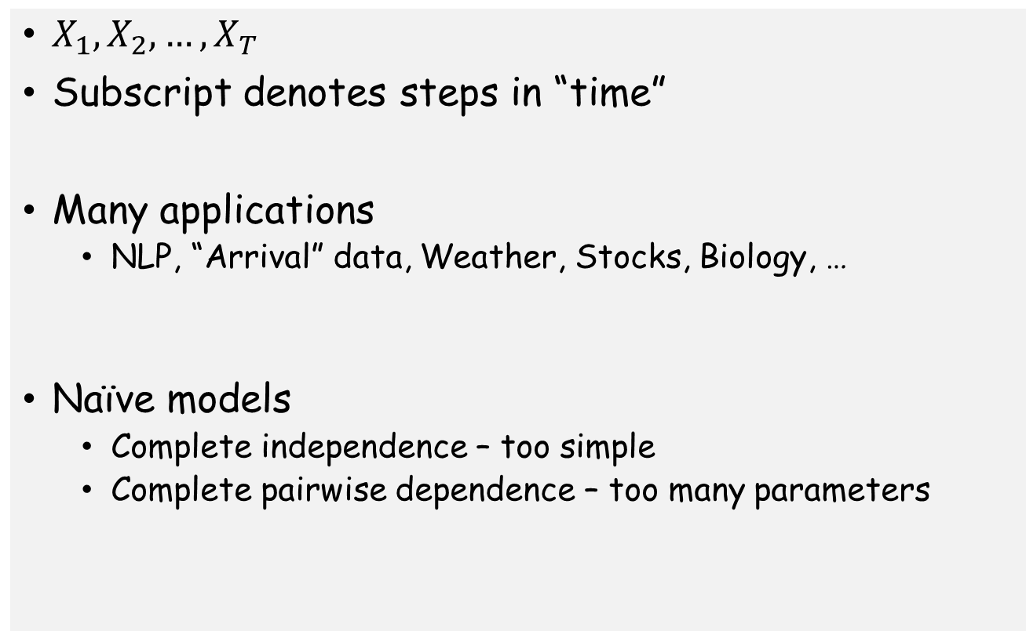
Random Sequence Data
$X_{1}, X_{2}, …, X_{T}$
Subscript denotes steps in “time”
Many applications
  NLP, “Arrival” data, Weather, Stocks, Biology, …
Naïve models
  Complete independence – too simple
  Complete pairwise dependence – too many parameters

Slide 3

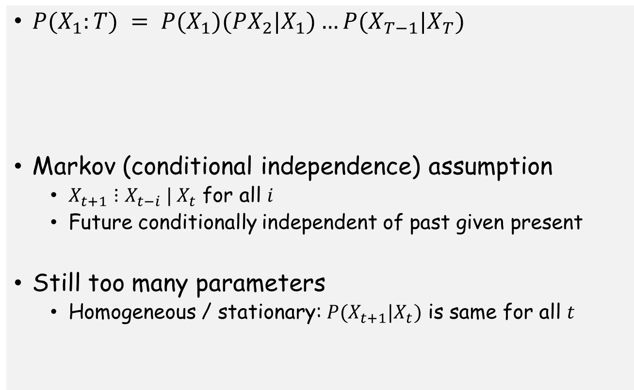

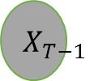

Markov Model
$P(X_{1}:T) = P(X_{1})(PX_{2}|X_{1})…P(X_{T−1}|X_{T})$
Markov (conditional independence) assumption
  $X_{t+1}⋮X_{t−i} | X_{t}$ for all $i$
  Future conditionally independent of past given present
Still too many parameters
  Homogeneous / stationary: $P(X_{t+1}|X_{t})$ is same for all $t$
$$X_{1}$$
$$X_{2}$$
$$X_{T−1}$$
$$X_{T}$$

Slide 4
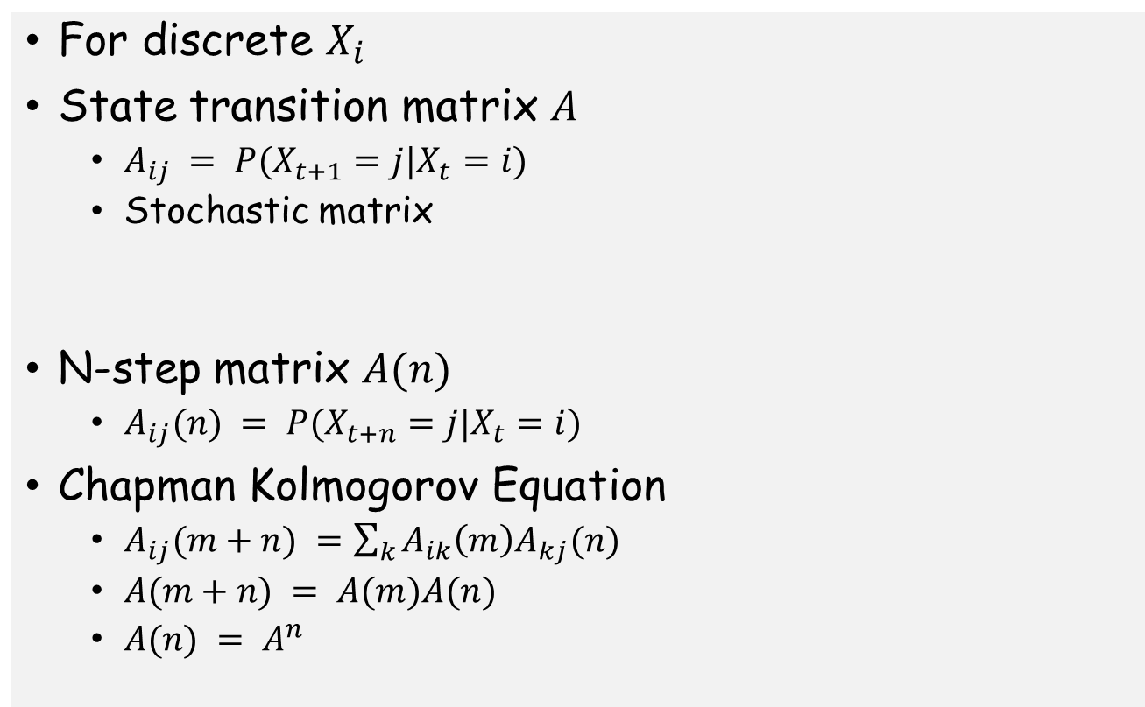
State Transition Matrix
For discrete $X_{i}$
State transition matrix $A$
  $A_{ij} = P(X_{t+1}=j|X_{t}=i)$
  Stochastic matrix
N-step matrix $A(n)$
  $A_{ij}(n) = P(X_{t+n}=j|X_{t}=i)$
Chapman Kolmogorov Equation
  $A_{ij}(m+n) =\sum_{k}{A_{ik}\left(m\right)A_{kj}(n)}$
  $A(m+n) = A(m)A(n)$
  $A(n) = A^{n}$

Slide 5
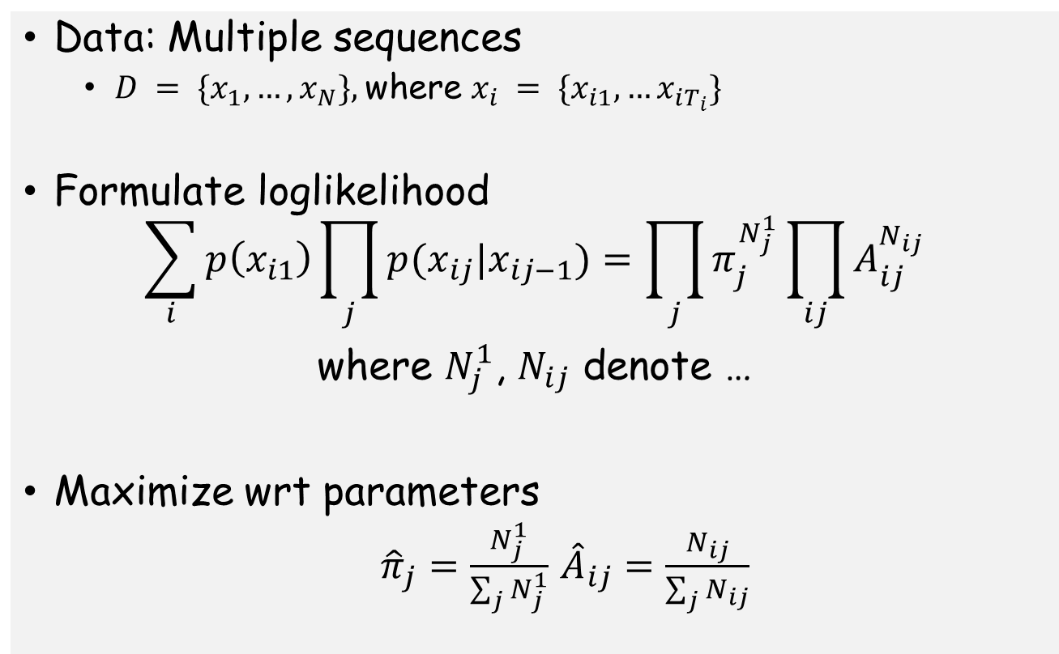
MLE for a Markov Chain
Data: Multiple sequences
  $D = \{x_{1},…,x_{N}\},$where $x_{i} = \{x_{i1},…x_{iT_{i}}\}$
Formulate loglikelihood
$$\sum_{i}{p\left(x_{i1}\right)\prod_{j}{p(x_{ij}|x_{ij−1})}=\prod_{j}{π_{j}^{N_{j}^{1}}}\prod_{ij}{A_{ij}^{N_{ij}}}}$$
where $N_{j}^{1}$, $N_{ij}$ denote …
Maximize wrt parameters
  ${\hat{π}}_{j}=\frac{N_{j}^{1}}{\sum_{j}{N_{j}^{1}}}$ ${\hat{A}}_{ij}=\frac{N_{ij}}{\sum_{j}{N_{ij}}}$

Slide 6
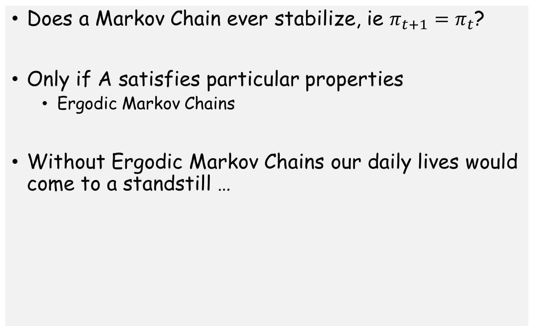
Digression: Stationary Distribution
Does a Markov Chain ever stabilize, ie $π_{t+1}=π_{t}$?
Only if A satisfies particular properties
  Ergodic Markov Chains
Without Ergodic Markov Chains our daily lives would come to a standstill …

Slide 7
Hidden Markov Model
Sequence over discrete states
States generate emissions
Emissions are observed, but states are hidden

Slide 8
Motivations
States have physical “meaning”
  Speech recognition
  Speaker diaritization
  Part of speech tagging
  …
Long range dependencies in Markov Model with a few parameters

Slide 9
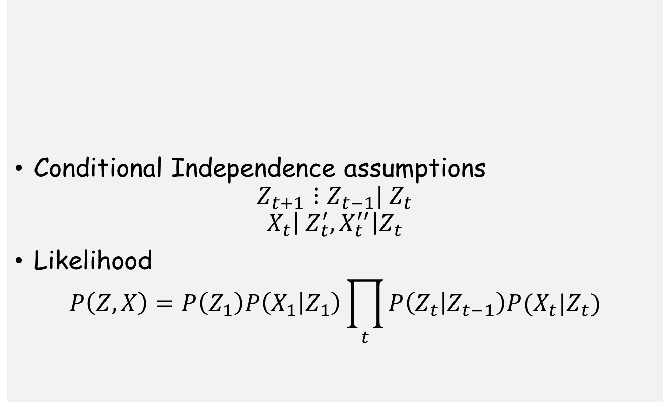
Hidden Markov Model
Conditional Independence assumptions
$$Z_{t+1}⋮Z_{t−1}| Z_{t}$$
$$X_{t}\left| Z_{t}^{′}, X_{t}^{′′}\right|Z_{t}$$
Likelihood
$$P\left(Z,X\right)=P\left(Z_{1}\right)P\left(X_{1} | Z_{1}\right)\prod_{t}{P\left(Z_{t} | Z_{t−1}\right)P(X_{t}|Z_{t})}$$

Slide 10
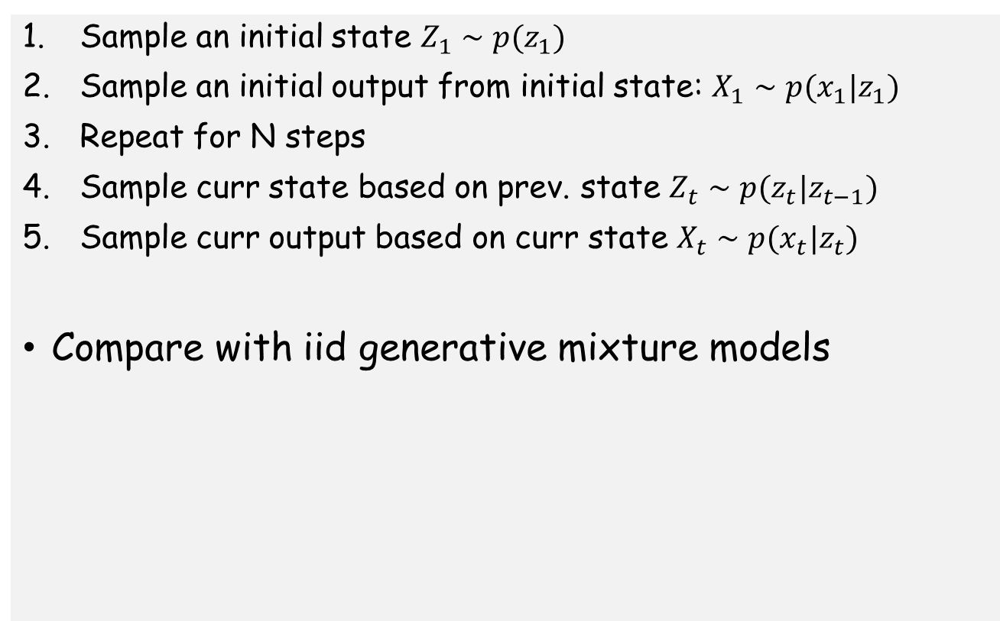
Hidden Markov Model: Generative Process
Sample an initial state $Z_{1}∼p(z_{1})$
Sample an initial output from initial state: $X_{1}∼p(x_{1}|z_{1})$
Repeat for N steps
Sample curr state based on prev. state $Z_{t}∼p(z_{t}|z_{t−1})$
Sample curr output based on curr state $X_{t}∼p(x_{t}|z_{t})$
Compare with iid generative mixture models

Slide 11
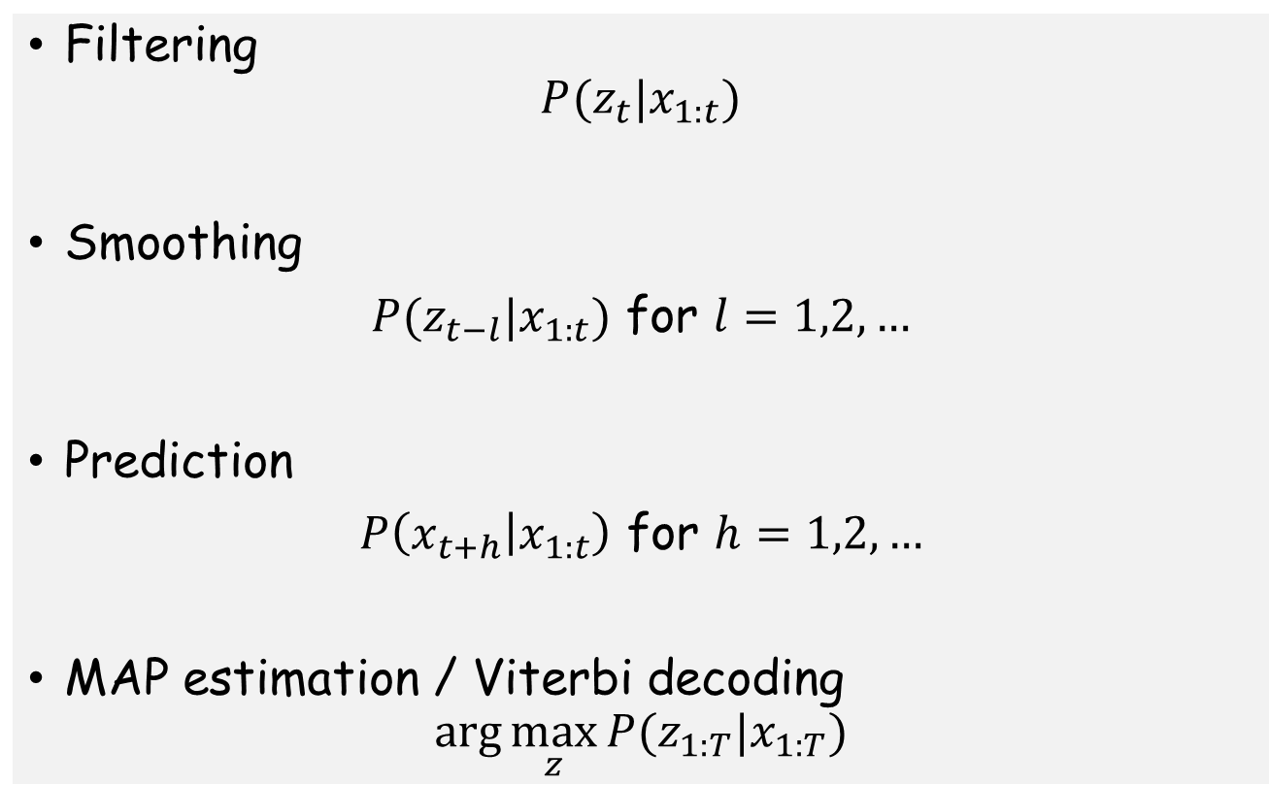
Inference Problems
Filtering
$$P(z_{t}|x_{1:t})$$
Smoothing
$P(z_{t−l}|x_{1:t})$ for $l=1,2,…$
Prediction
$P\left(x_{t+h} | x_{1:t}\right)$ for $h=1,2,…$
MAP estimation / Viterbi decoding
$$arg⁡\max_{z}⁡P(z_{1:T}|x_{1:T})$$

Slide 12
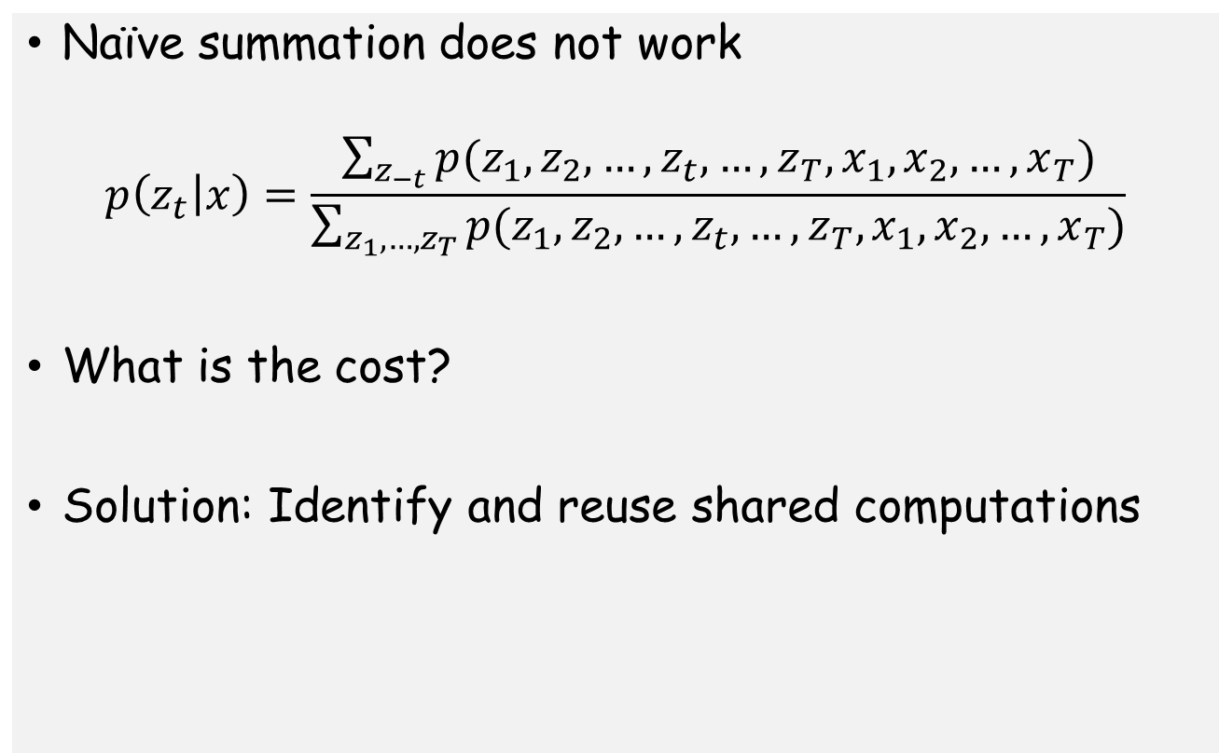
Inference: Challenge
Naïve summation does not work
$$p\left(z_{t} | x\right)=\frac{\sum_{z_{−t}}{p(z_{1},z_{2},…,z_{t},…,z_{T},x_{1},x_{2},…,x_{T})}}{\sum_{z_{1},…,z_{T}}{p(z_{1},z_{2},…,z_{t},…,z_{T},x_{1},x_{2},…,x_{T})}}$$
What is the cost?
Solution: Identify and reuse shared computations

Slide 13
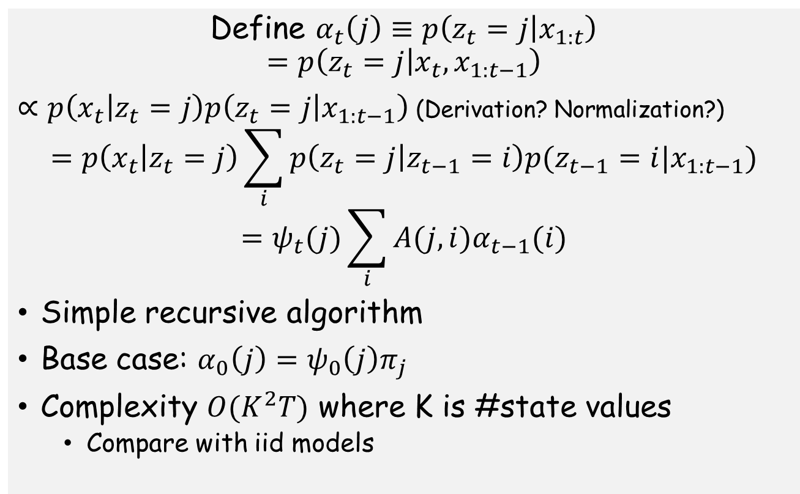
Forward Algorithm
Define $α_{t}\left(j\right)≡p\left(z_{t}=j | x_{1:t}\right)$
$$=p\left(z_{t}=j | x_{t},x_{1:t−1}\right)$$
$∝p\left(x_{t} | z_{t}=j\right)p\left(z_{t}=j | x_{1:t−1}\right)$ (Derivation? Normalization?)
$$=p\left(x_{t} | z_{t}=j\right)\sum_{i}{p\left(z_{t}=j | z_{t−1}=i\right)p(z_{t−1}=i|x_{1:t−1})}$$
$$=ψ_{t}(j)\sum_{i}{A(j,i)α_{t−1}(i)}$$
Simple recursive algorithm
Base case: $α_{0}\left(j\right)=ψ_{0}\left(j\right)π_{j}$
Complexity $O(K^{2}T)$ where K is #state values
  Compare with iid models

Slide 14
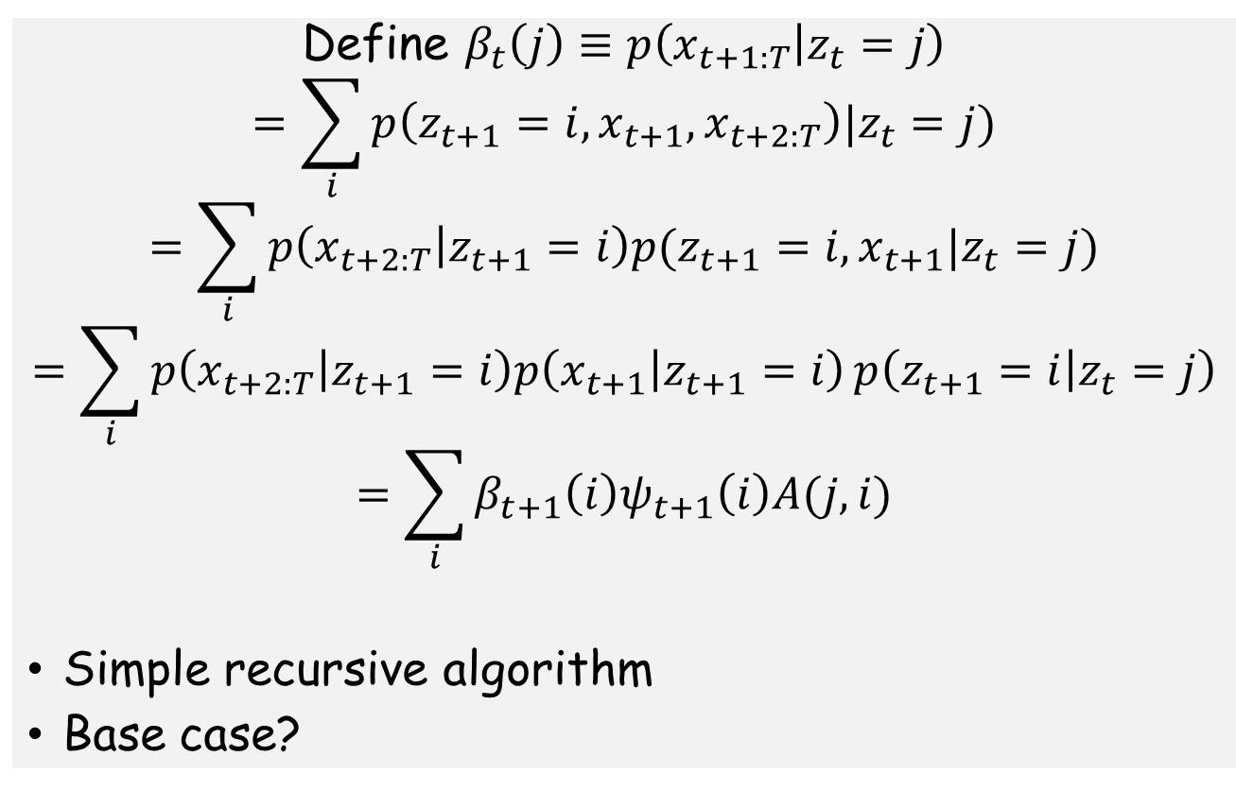
Backward Algorithm
Define $β_{t}\left(j\right)≡p\left(x_{t+1:T} | z_{t}=j\right)$
$$=\sum_{i}{p\left(z_{t+1}=i,x_{t+1},x_{t+2:T}\right)|z_{t}=j})$$
$$=\sum_{i}{p\left(x_{t+2:T} | z_{t+1}=i\right)p(z_{t+1}=i,x_{t+1}|z_{t}=j)}$$
$$=\sum_{i}{p\left(x_{t+2:T} | z_{t+1}=i\right)p\left(x_{t+1} | z_{t+1}=i\right)}p\left(z_{t+1}=i | z_{t}=j\right)$$
$$=\sum_{i}{β_{t+1}\left(i\right)ψ_{t+1}\left(i\right)A(j,i)}$$
Simple recursive algorithm
Base case?

Slide 15
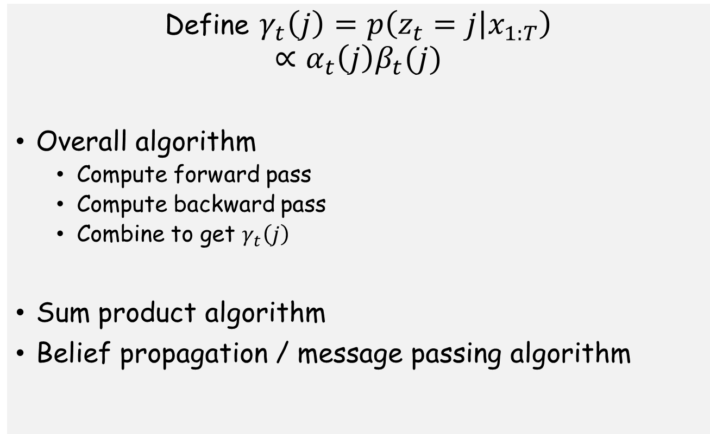
Forward Backward Algorithm
Define $γ_{t}\left(j\right)=p\left(z_{t}=j | x_{1:T}\right)$
$$∝α_{t}\left(j\right)β_{t}(j)$$
Overall algorithm
  Compute forward pass
  Compute backward pass
  Combine to get $γ_{t}\left(j\right)$
Sum product algorithm
Belief propagation / message passing algorithm

Slide 16
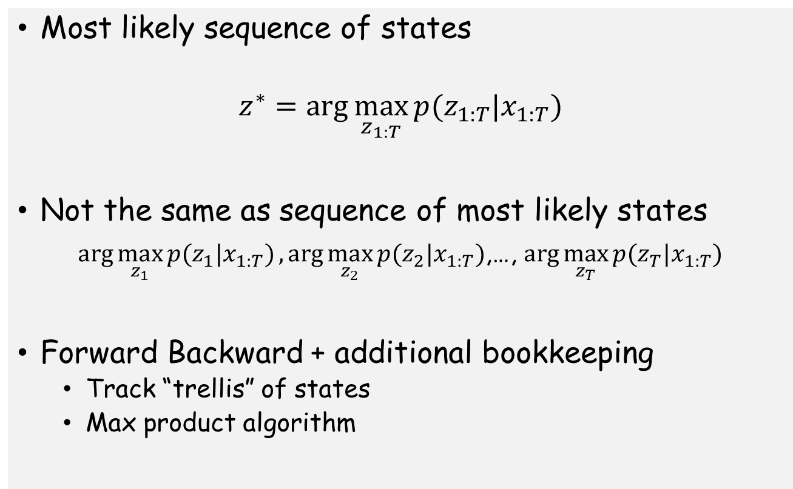
Viterbi Algorithm
Most likely sequence of states
$$z^{∗}=\arg{\max_{z_{1:T}}{p(z_{1:T}|x_{1:T})}}$$
Not the same as sequence of most likely states
$\arg{\max_{z_{1}}{p(z_{1}|x_{1:T})}},\arg{\max_{z_{2}}{p(z_{2}|x_{1:T})}}$,…, $\arg{\max_{z_{T}}{p(z_{T}|x_{1:T})}}$
Forward Backward + additional bookkeeping
  Track “trellis” of states
  Max product algorithm

Slide 17
Parameter Estimation
Straight forward for fully observed data
Homework

Slide 18
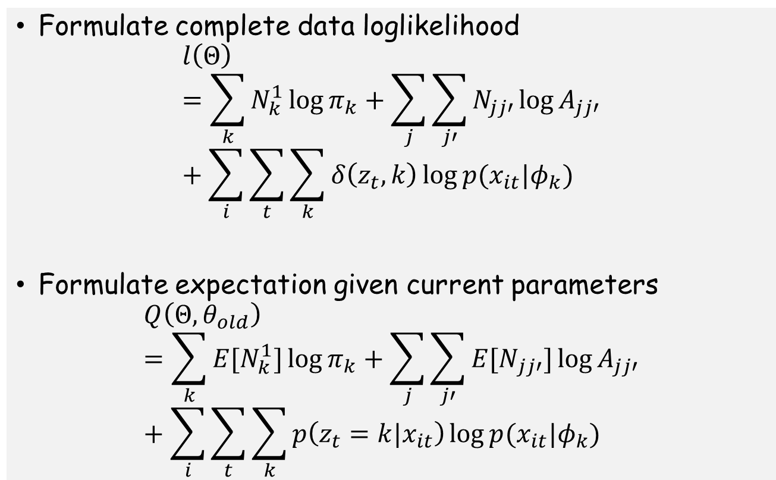
EM for HMMs (Baum Welch Algorithm)
Formulate complete data loglikelihood
$$l\left(Θ\right)=\sum_{k}{N_{k}^{1}\log{π_{k}}}+\sum_{j}{\sum_{j′}{N_{jj′}\log{A_{jj′}}}}+\sum_{i}{\sum_{t}{\sum_{k}{δ\left(z_{t},k\right)\log{p(x_{it}|φ_{k})}}}}$$
Formulate expectation given current parameters
$$Q\left(Θ,θ_{old}\right)=\sum_{k}{E[N_{k}^{1}]\log{π_{k}}}+\sum_{j}{\sum_{j′}{{E[N}_{jj′}]\log{A_{jj′}}}}+\sum_{i}{\sum_{t}{\sum_{k}{p\left(z_{t}=k|x_{it}\right)\log{p(x_{it}|φ_{k})}}}}$$

Slide 19
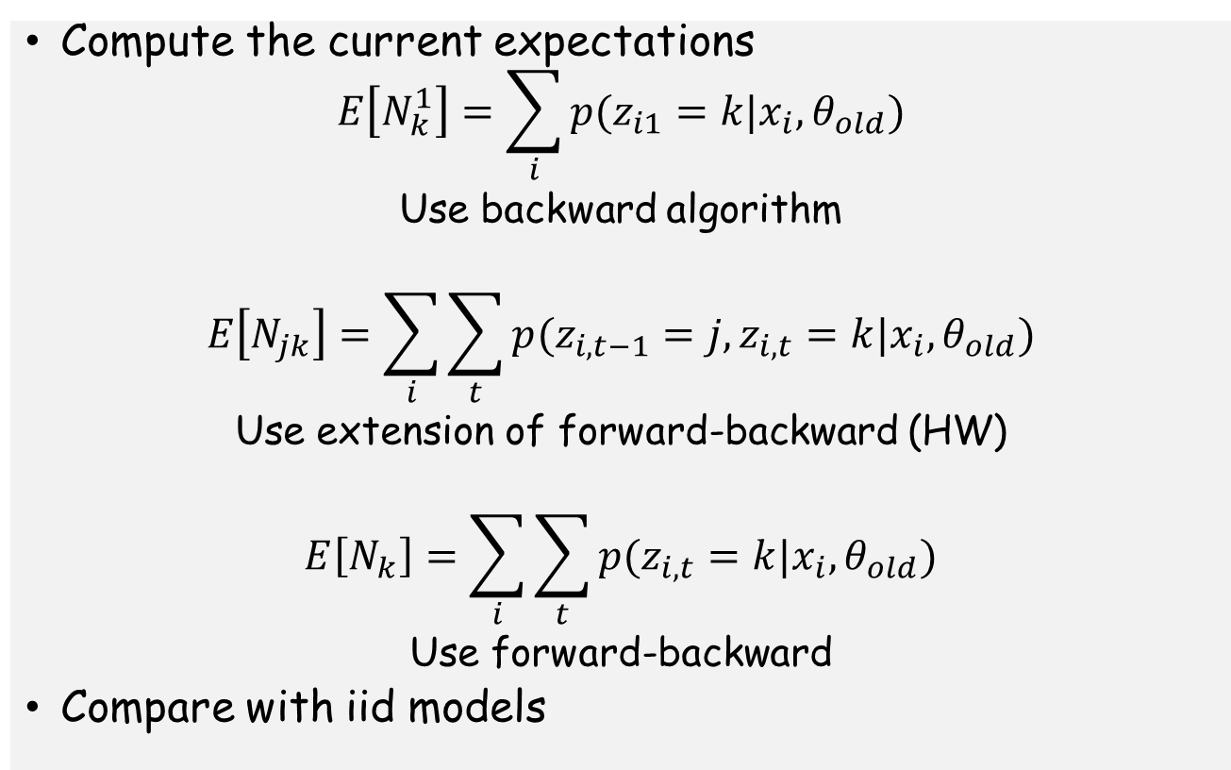
E-step
Compute the current expectations
$$E\left[N_{k}^{1}\right]=\sum_{i}{p(z_{i1}=k|x_{i},θ_{old})}$$
Use backward algorithm
$$E\left[N_{jk}\right]=\sum_{i}{\sum_{t}{p(z_{i,t−1}=j,z_{i,t}=k|x_{i},θ_{old})}}$$
Use extension of forward-backward (HW)
$$E\left[N_{k}\right]=\sum_{i}{\sum_{t}{p(z_{i,t}=k|x_{i},θ_{old})}}$$
Use forward-backward
Compare with iid models

Slide 20
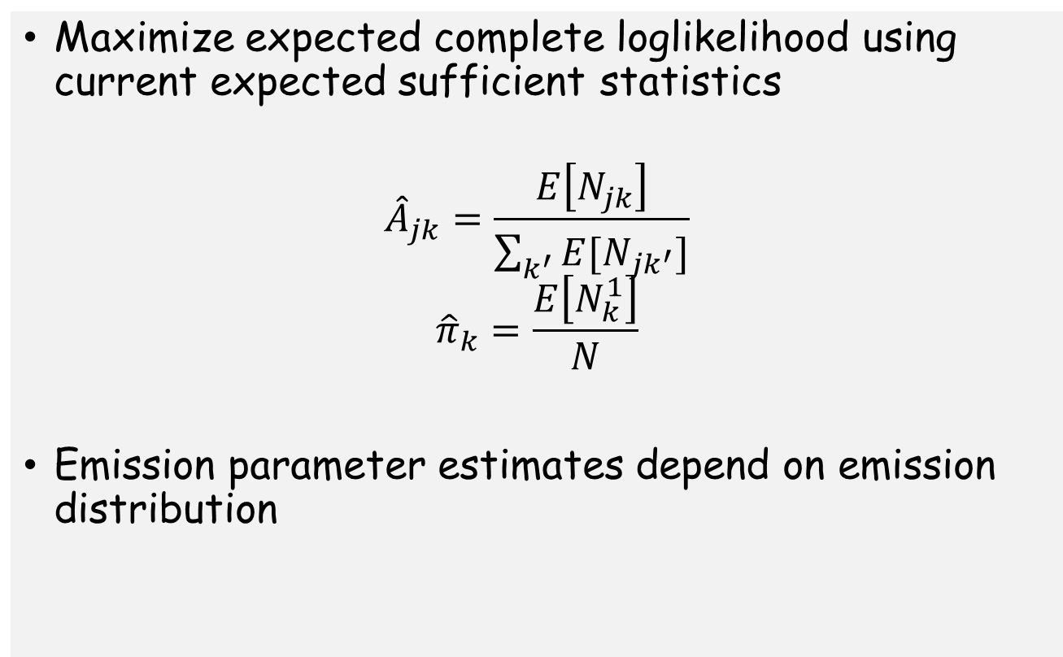
M-step
Maximize expected complete loglikelihood using current expected sufficient statistics
$${\hat{A}}_{jk}=\frac{E\left[N_{jk}\right]}{\sum_{k^{′}}{E[N_{jk^{′}}]}}$$
$${\hat{π}}_{k}=\frac{E\left[N_{k}^{1}\right]}{N}$$
Emission parameter estimates depend on emission distribution

Slide 21
Choosing number of hidden states
Similar to choosing number of components in mixture model
One possibility: Cross validation
Computationally more costly

Slide 22
Many, many generalizations ….
Work horse of signal processing, e.g. speech for decades
Continuous data
Long range dependencies
Multiple hidden layers
Handling inputs
…

Slide 23
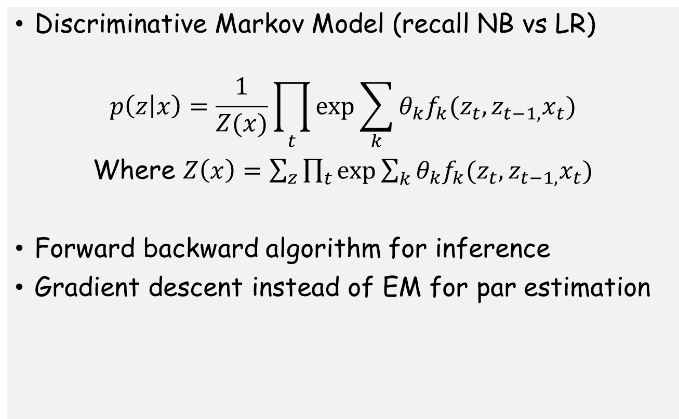
Linear Chain Conditional Random Fields
Discriminative Markov Model (recall NB vs LR)
$$p\left(z | x\right)=\frac{1}{Z(x)}\prod_{t}{\exp{\sum_{k}{θ_{k}f_{k}(z_{t}, z_{t−1,}x_{t})}}}$$
Where $Z\left(x\right)=\sum_{z}{\prod_{t}{\exp{\sum_{k}{θ_{k}f_{k}(z_{t}, z_{t−1,}x_{t})}}}}$
Forward backward algorithm for inference
Gradient descent instead of EM for par estimation

Slide 24
State Space Models
HMM with continuous hidden states
Linear dynamical systems
  Conditional distributions are linear-Gaussian
  Mathematically tractable inference
  Kalman filter
Widely used in time-series analysis + forecasting, object tracking, robotics, etc

Slide 25
Probabilistic Graphical Models
Used for modelling conditional independences in joint distributions using large no. of RVs
Directed Graphical Models / Bayes Nets
Undirected Graphical Models / Random Fields
Inference computationally hard in general
Parameter estimation with hidden variables harder
Probability theory + graph theory

