Slide 1
Probability for
Machine Learning

Slide 2
Probabilistic Machine Learning
Not all machine learning models are probabilistic
  … but most of them have probabilistic interpretations
Predictions need to have associated confidence
  Confidence = probability
Arguments for probabilistic approach
  Complete framework for Machine Learning
  Makes assumptions explicit
  Recovers most non-probabilistic models as special cases
  Modular: Easily extensible

Slide 3
References
“Introduction to Probability Models”, Sheldon Ross
“Introduction to Probability and Statistics for Engineers and Scientists”, Sheldon Ross
“Introduction To Probability”, Dimitri P. Bertsekas, John N. Tsitsiklis

Slide 4
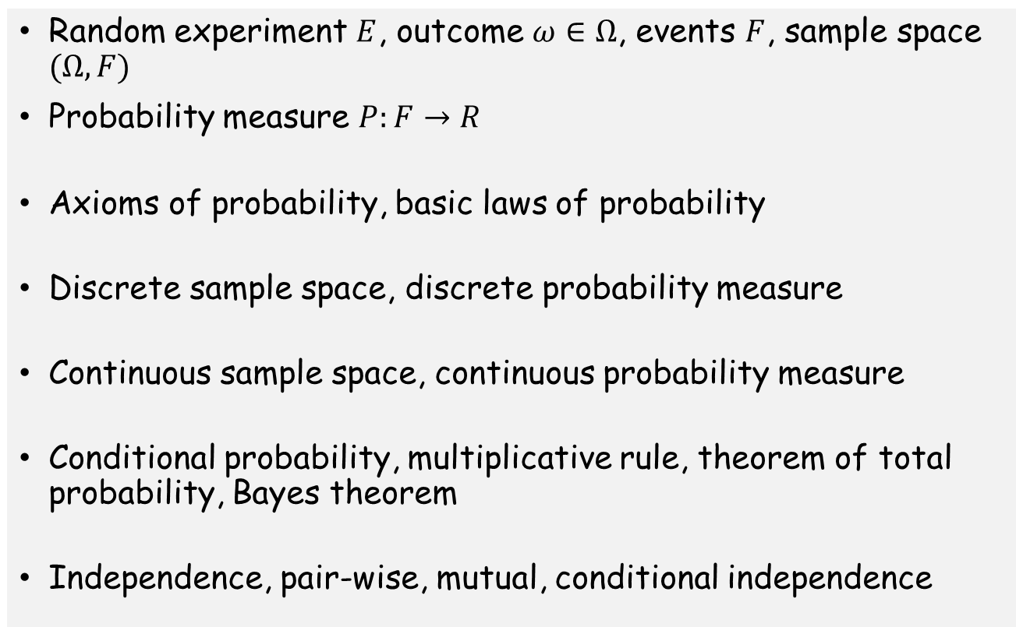
Basics
Random experiment $E$, outcome $ω∈Ω$, events $F$, sample space $(Ω,F)$
Probability measure $P:F→R$
Axioms of probability, basic laws of probability
Discrete sample space, discrete probability measure
Continuous sample space, continuous probability measure
Conditional probability, multiplicative rule, theorem of total probability, Bayes theorem
Independence, pair-wise, mutual, conditional independence

Slide 5
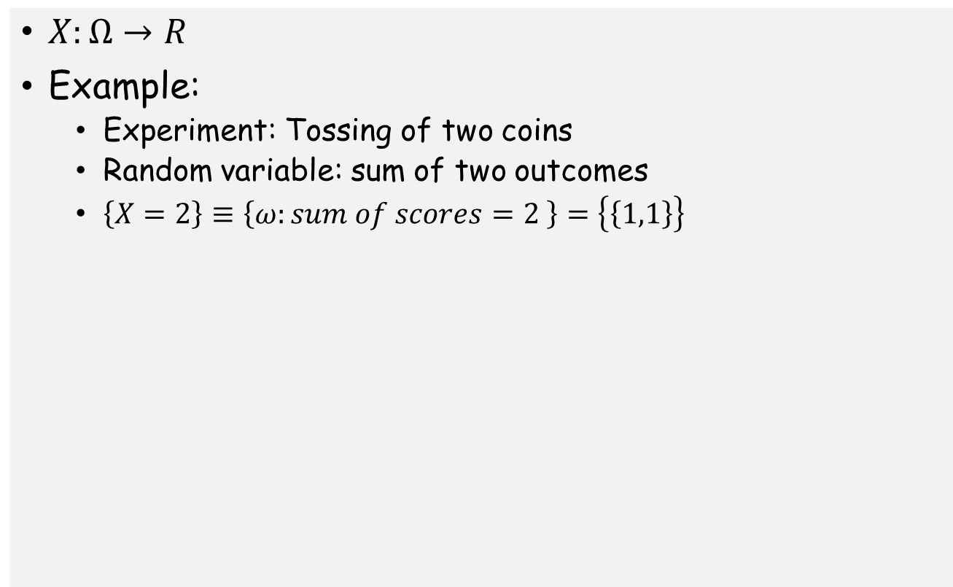
Random Variables
$X:Ω→R$
Example:
  Experiment: Tossing of two coins
  Random variable: sum of two outcomes
  $\left\{X=2\right\}≡\left\{ω:sum of scores=2 \right\}=\left\{\left\{1,1\right\}\right\}$

Slide 6
Discrete Random Variables
Probability mass function

Slide 7
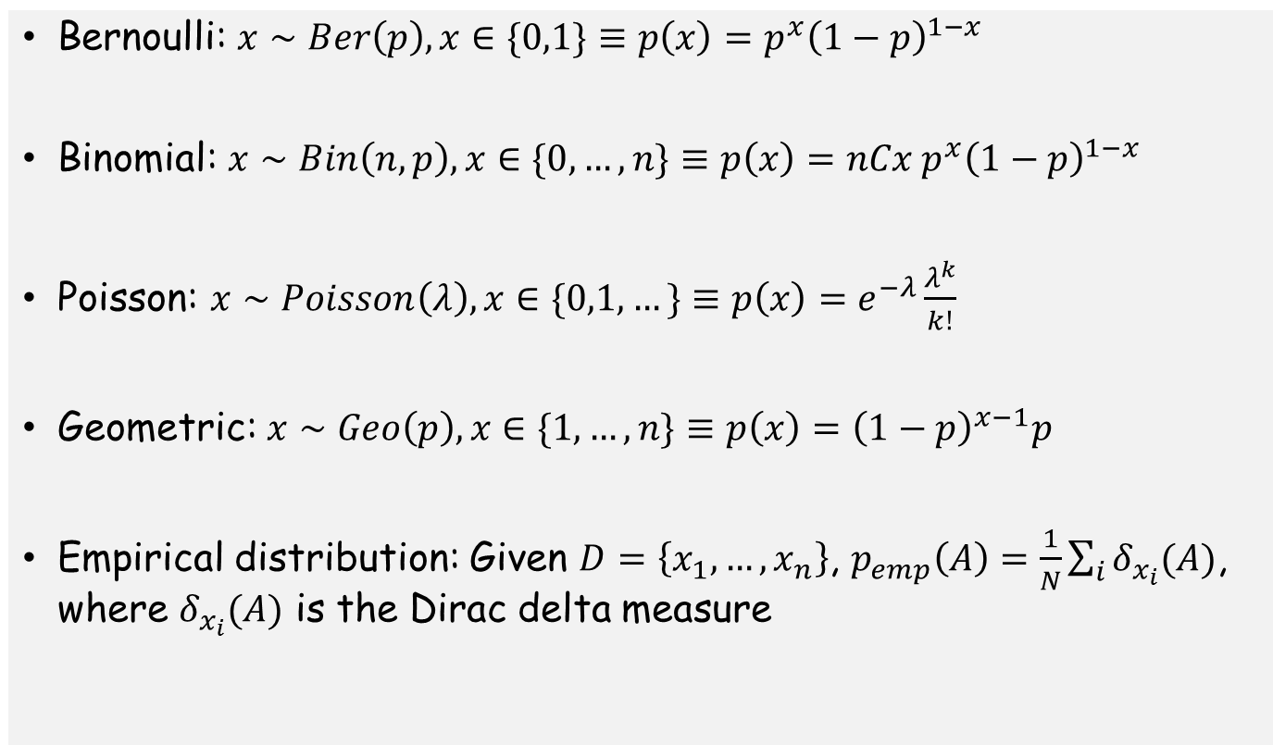
Example distributions: Discrete
Bernoulli: $x∼Ber\left(p\right), x∈\{0,1\}≡p\left(x\right)=p^{x}{\left(1−p\right)}^{1−x}$
Binomial: $x∼Bin\left(n,p\right), x∈\{0,…,n\}≡p\left(x\right)=nCx{ p}^{x}{\left(1−p\right)}^{1−x}$
Poisson: $x∼Poisson\left(λ\right), x∈\{0,1, …\}≡p\left(x\right)=e^{−λ}\frac{λ^{k}}{k!}$
Geometric: $x∼Geo\left(p\right), x∈\{1,…,n\}≡p\left(x\right)={\left(1−p\right)}^{x−1}p$
Empirical distribution: Given $D=\left\{x_{1},…,x_{n}\right\}$, $p_{emp}\left(A\right)=\frac{1}{N}\sum_{i}{δ_{x_{i}}(A)}$, where $δ_{x_{i}}(A)$ is the Dirac delta measure

Slide 8
Continuous Random Variables
Probability density function

Slide 9
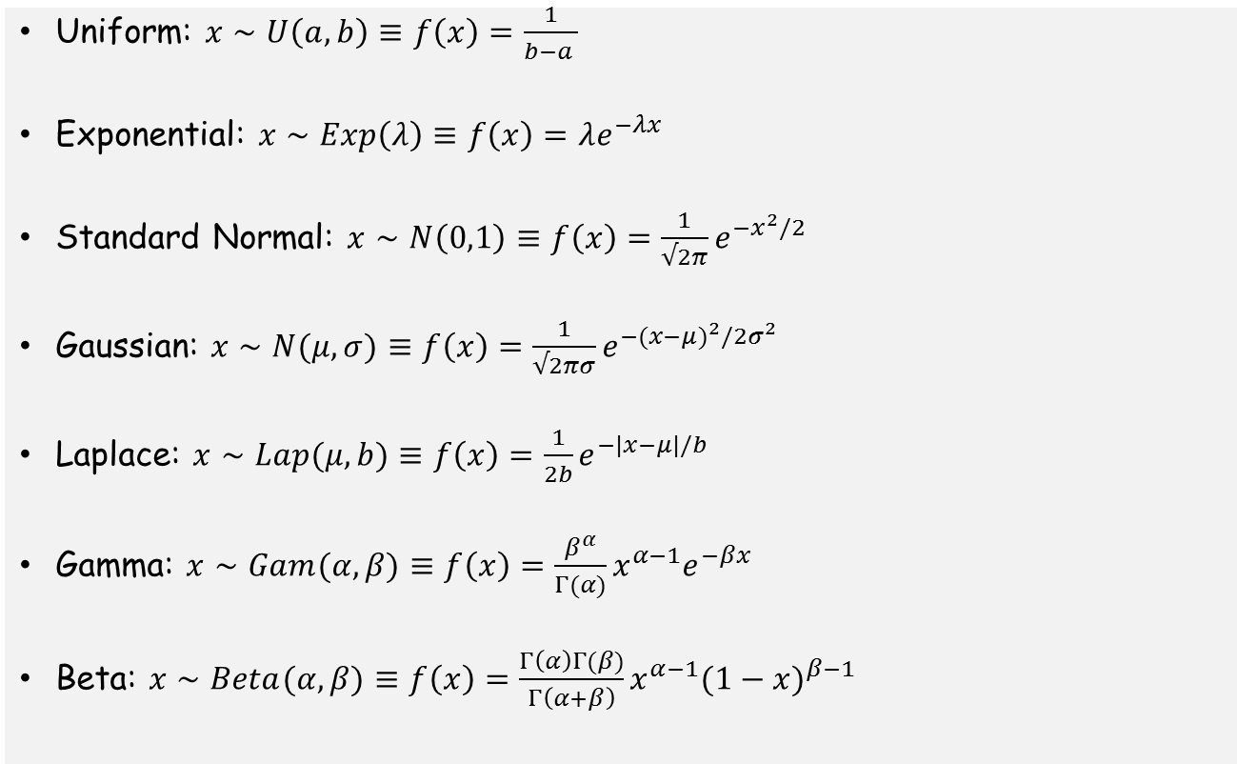
Example density functions
Uniform: $x∼U\left(a,b\right)≡f\left(x\right)=\frac{1}{b−a }$
Exponential: $x∼Exp\left(λ\right)≡f\left(x\right)=λe^{−λx}$
Standard Normal: $x∼N\left(0,1\right)≡f\left(x\right)={\frac{1}{√2π}e}^{−x^{2}/2}$
Gaussian: $x∼N(μ,σ)≡f\left(x\right)={\frac{1}{√2πσ}e}^{−({x−μ)}^{2}/2σ^{2}}$
Laplace: $x∼Lap(μ,b)≡f\left(x\right)={\frac{1}{2b}e}^{−|x−μ|/b}$
Gamma: $x∼Gam(α,β)≡f\left(x\right)={\frac{β^{α}}{Γ(α)}x^{α−1}e}^{−βx}$
Beta: $x∼Beta(α,β)≡f\left(x\right)={\frac{Γ\left(α\right)Γ(β)}{Γ\left(α+β\right)}x^{α−1}(1−x)}^{β−1}$

Slide 10
Random Variables
Cumulative distribution function

Slide 11
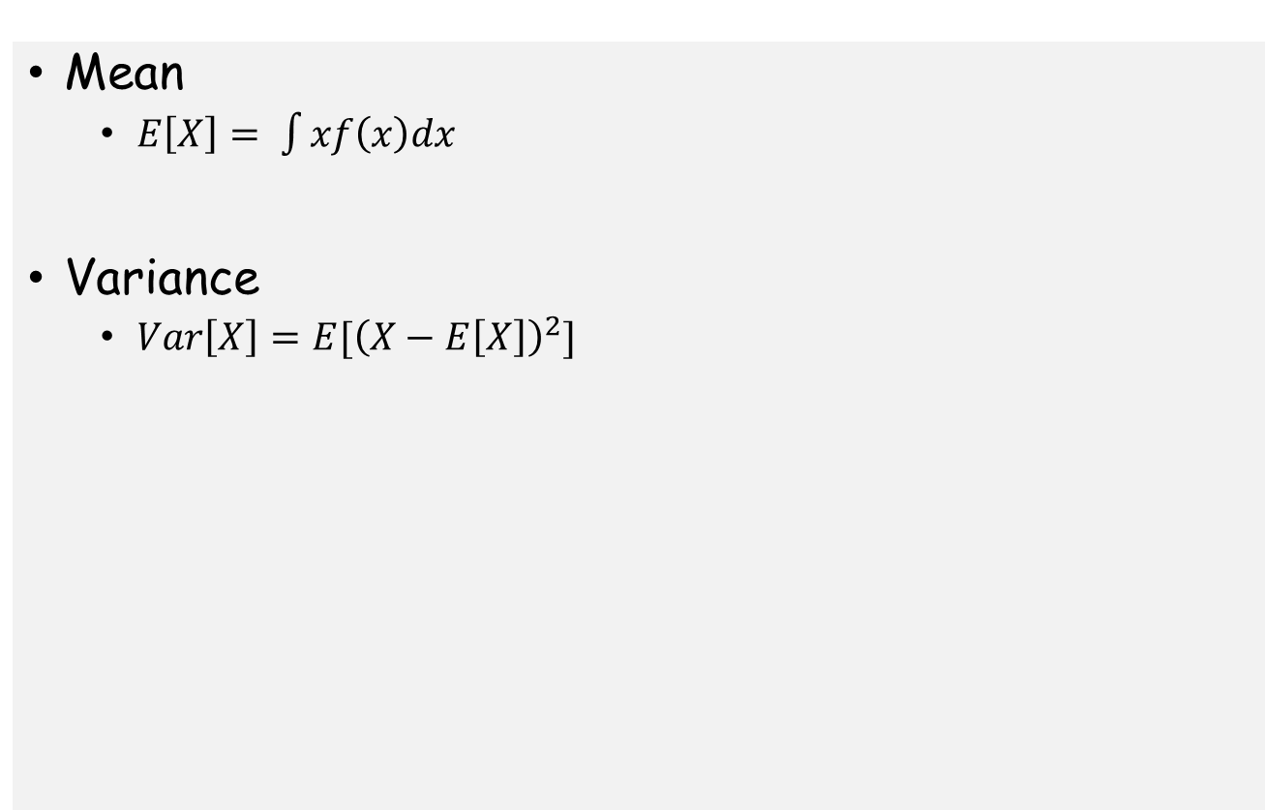
Moments
Mean
  $E\left[X\right]= \int{xf\left(x\right)dx}$
Variance
  $Var\left[X\right]=E[{\left(X−E\left[X\right]\right)}^{2}]$

Slide 12
Random Vectors and Joint Distributions
Discrete Random Vector
Joint pmf
Continuous Random Vector
Joint pdf

Slide 13
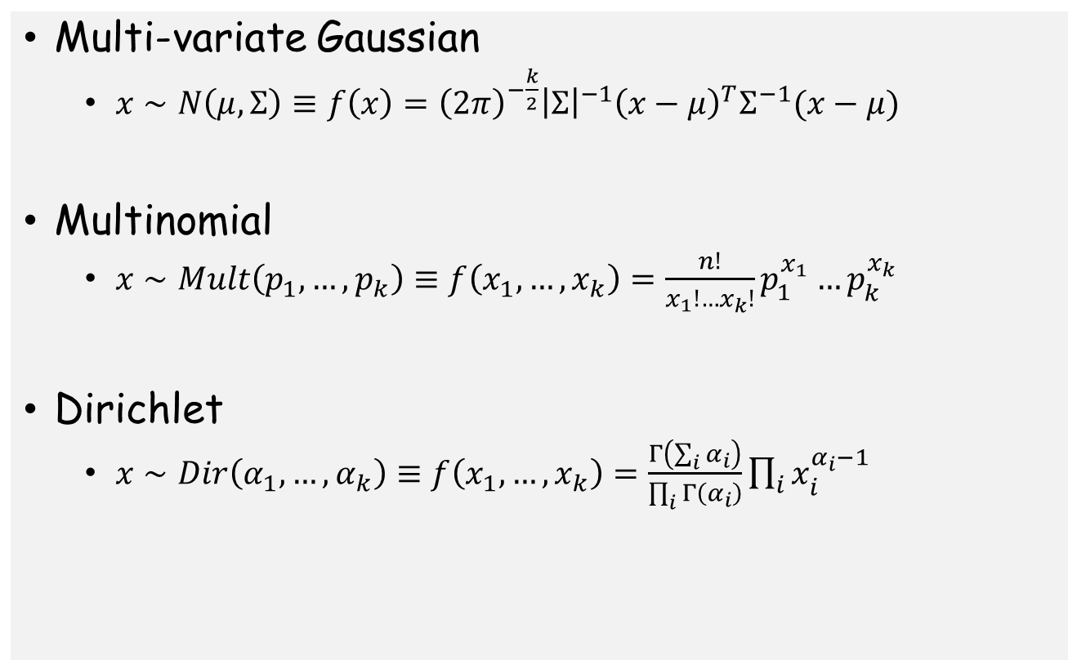
Example multi-variate distributions
Multi-variate Gaussian
  $x∼N\left(μ,Σ\right)≡f\left(x\right)={\left(2π\right)}^{−\frac{k}{2}}{\left|Σ\right|}^{−1}{\left(x−μ\right)}^{T}Σ^{−1}(x−μ)$
Multinomial
  $x∼Mult\left(p_{1},…, p_{k}\right)≡f\left(x_{1},…,x_{k}\right)=\frac{n!}{x_{1}!…x_{k}!}p_{1}^{x_{1}}…p_{k}^{x_{k}}$
Dirichlet
  $x∼Dir\left(α_{1},…, α_{k}\right)≡f\left(x_{1},…,x_{k}\right)=\frac{Γ\left(\sum_{i}{α_{i}}\right)}{\prod_{i}{Γ\left(α_{i}\right)}}\prod_{i}{x_{i}^{α_{i}−1}}$

Slide 14
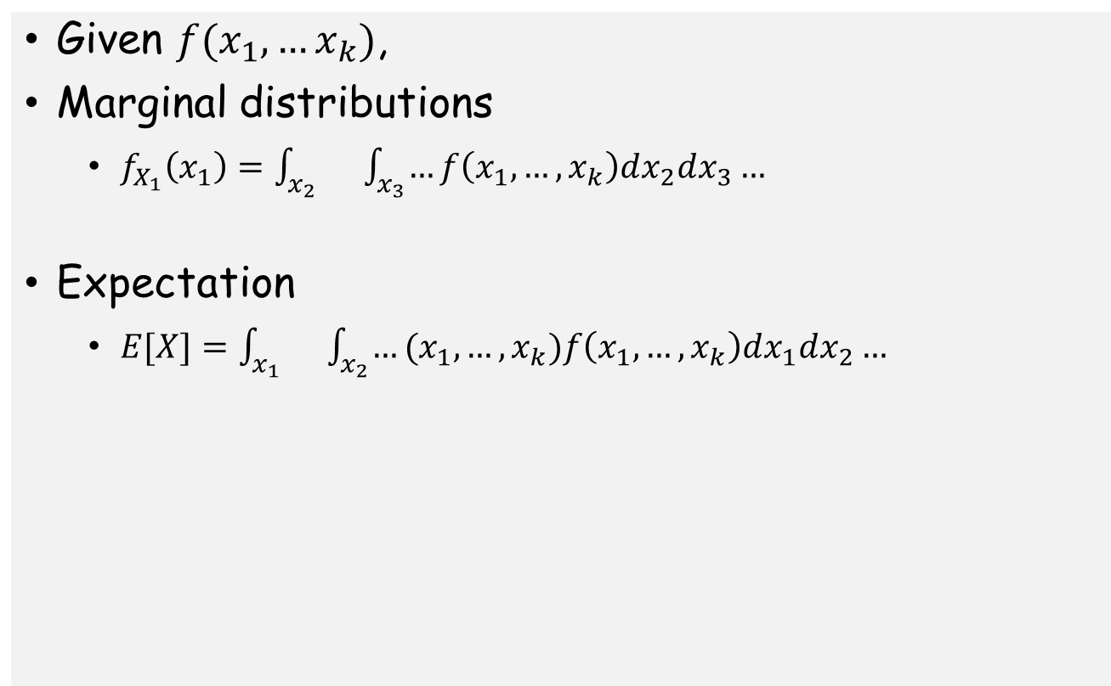
Random Vectors and Joint Distributions
Given $f(x_{1},…x_{k})$,
Marginal distributions
  $f_{X_{1}}\left(x_{1}\right)=\int_{x_{2}}{}\int_{x_{3}}{…}f\left(x_{1},…,x_{k}\right)dx_{2}dx_{3}…$
Expectation
  $E[X]=\int_{x_{1}}{}\int_{x_{2}}{…}(x_{1},…,x_{k})f\left(x_{1},…,x_{k}\right)dx_{1}dx_{2}…$

Slide 15
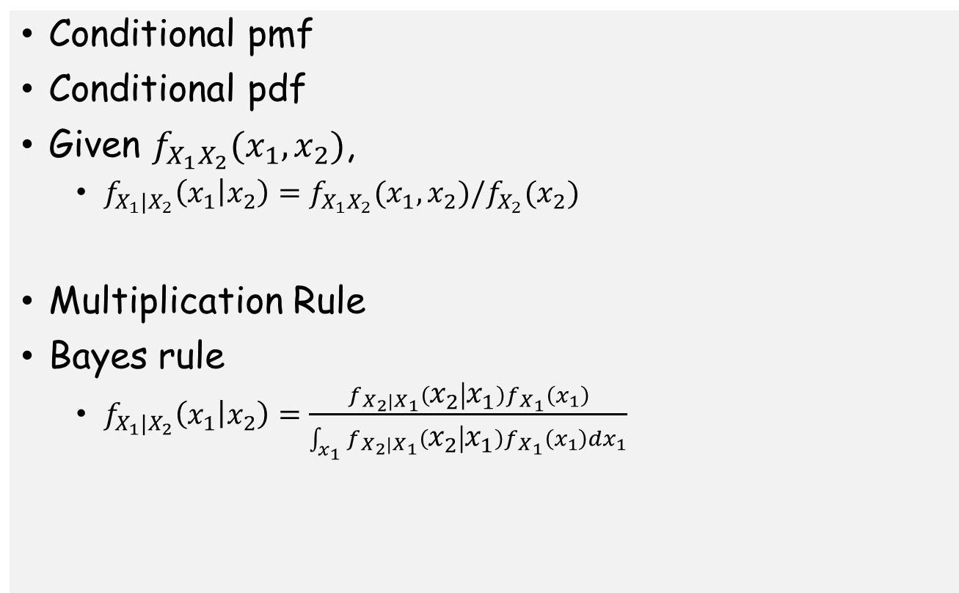
Conditional Probability
Conditional pmf
Conditional pdf
Given $f_{X_{1}X_{2}}(x_{1},x_{2})$,
  $f_{X_{1}|X_{2}}\left(x_{1} | x_{2}\right)=f_{X_{1}X_{2}}(x_{1},x_{2})/f_{X_{2}}(x_{2})$
Multiplication Rule
Bayes rule
  $f_{X_{1}|X_{2}}\left(x_{1} | x_{2}\right)=\frac{f_{X_{2}|X_{1}}\left(x_{2} | x_{1}\right)f_{X_{1}}\left(x_{1}\right)}{\int_{x_{1}}{f_{X_{2}|X_{1}}\left(x_{2} | x_{1}\right)f_{X_{1}}\left(x_{1}\right)dx_{1}}}$

Slide 16
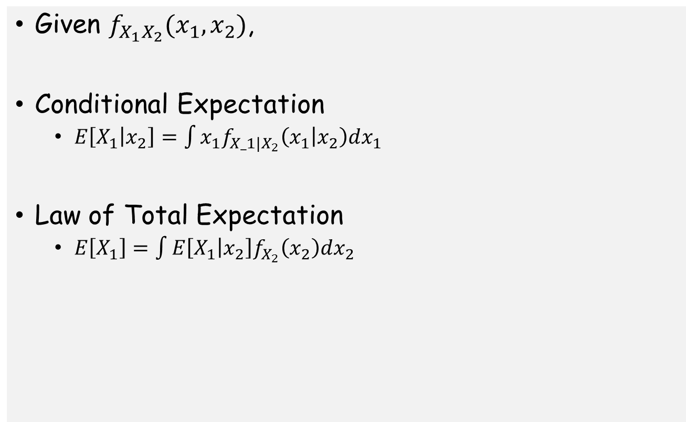
Conditional Probability
Given $f_{X_{1}X_{2}}(x_{1},x_{2})$,
Conditional Expectation
  $E\left[X_{1} | x_{2}\right]=\int{x_{1}f_{X_1|X_{2}}\left(x_{1} | x_{2}\right)dx_{1}}$
Law of Total Expectation
  $E\left[X_{1}\right]=\int{E\left[X_{1} | x_{2}\right]f_{X_{2}}\left(x_{2}\right)dx_{2}}$

Slide 17
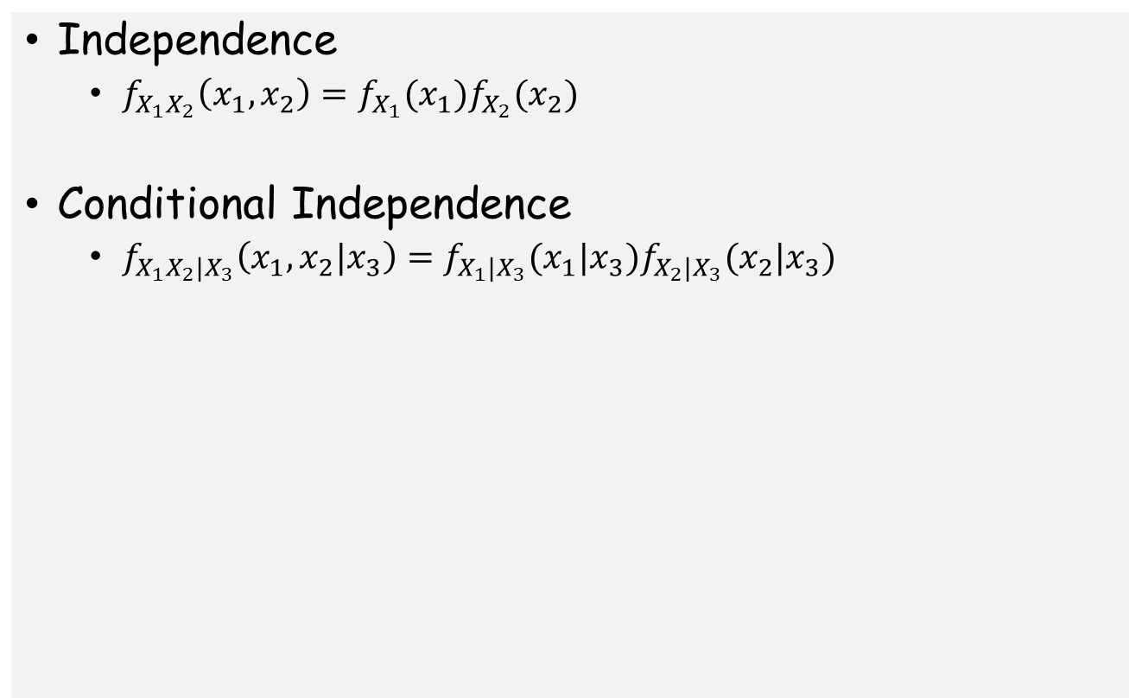
Independence and Conditional Independence
Independence
  $f_{X_{1}X_{2}}\left(x_{1},x_{2}\right)=f_{X_{1}}(x_{1})f_{X_{2}}(x_{2})$
Conditional Independence
  $f_{X_{1}X_{2}|X_{3}}\left(x_{1},x_{2}|x_{3}\right)=f_{X_{1}|X_{3}}(x_{1}|x_{3})f_{X_{2}|X_{3}}(x_{2}|x_{3})$

Slide 18
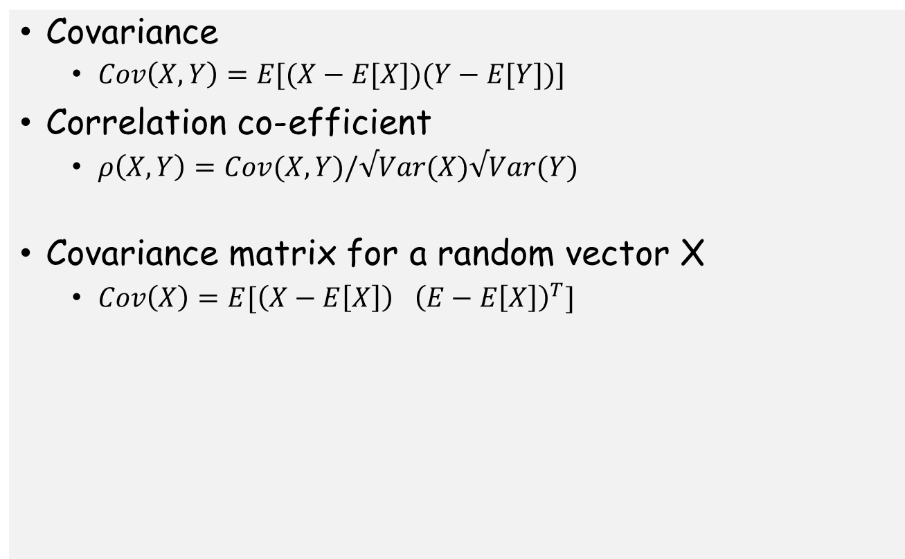
Covariance
Covariance
  $Cov\left(X,Y\right)=E[(X−E[X])(Y−E[Y])]$
Correlation co-efficient
  $ρ\left(X,Y\right)=Cov(X,Y)/√Var(X)√Var(Y)$
Covariance matrix for a random vector X
  $Cov\left(X\right)=E[{\left(X−E\left[X\right]\right)}^{}{\left(E−E\left[X\right]\right)}^{T}]$

Slide 19
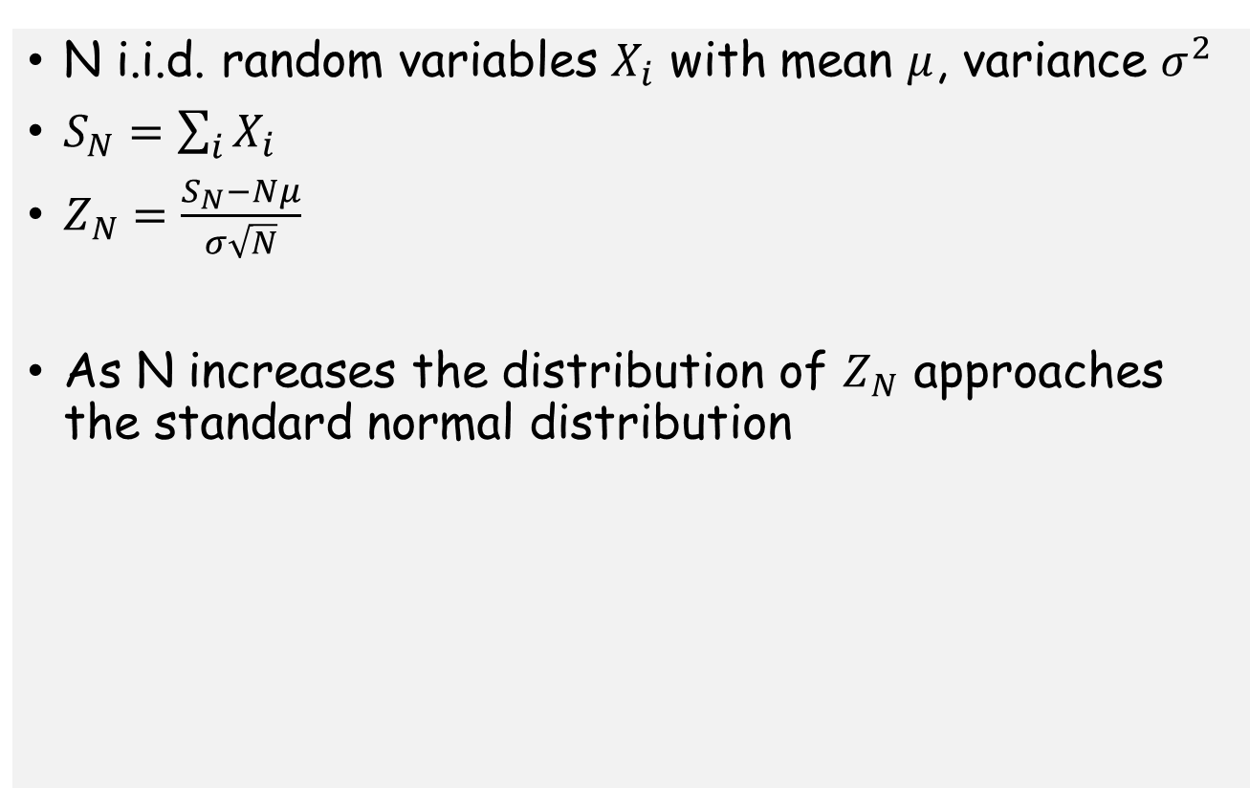
Central Limit Theorem
N i.i.d. random variables $X_{i}$ with mean $μ$, variance $σ^{2}$
$S_{N}=\sum_{i}{X_{i}}$
$Z_{N}=\frac{S_{N}−Nμ}{σ\sqrt{N}}$
As N increases the distribution of $Z_{N}$ approaches the standard normal distribution

Slide 20
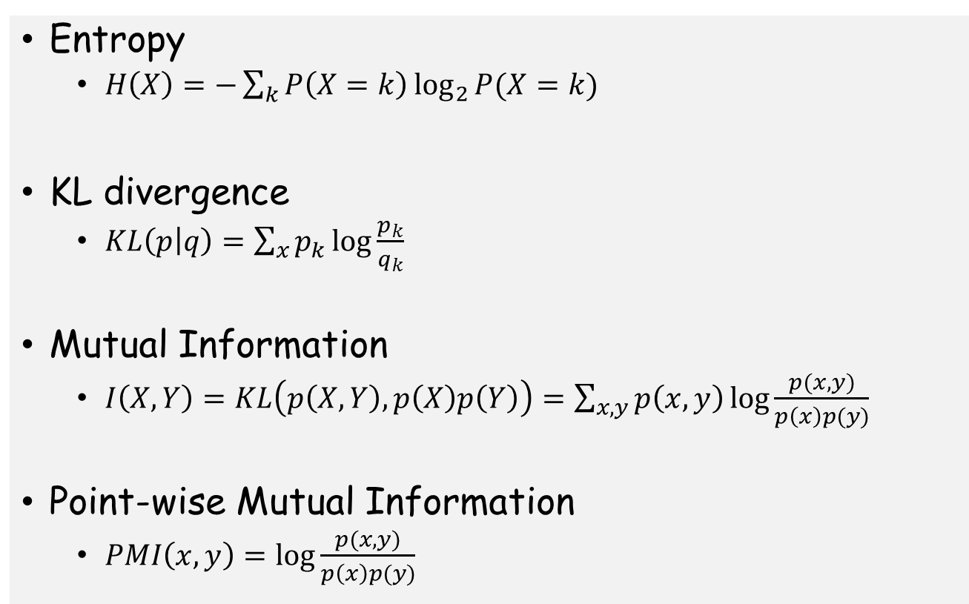
Notions from Information Theory
Entropy
  $H\left(X\right)=−\sum_{k}{P\left(X=k\right)\log_{2}{P(X=k)}}$
KL divergence
  $KL\left(p | q\right)=\sum_{x}{p_{k}\log{\frac{p_{k}}{q_{k}}}}$
Mutual Information
  $I\left(X,Y\right)=KL\left(p\left(X,Y\right),p\left(X\right)p\left(Y\right)\right)=\sum_{x,y}{p\left(x,y\right)\log{\frac{p(x,y)}{p\left(x\right)p(y)}}}$
Point-wise Mutual Information
  $PMI\left(x,y\right)=\log{\frac{p(x,y)}{p\left(x\right)p(y)}}$

Slide 21
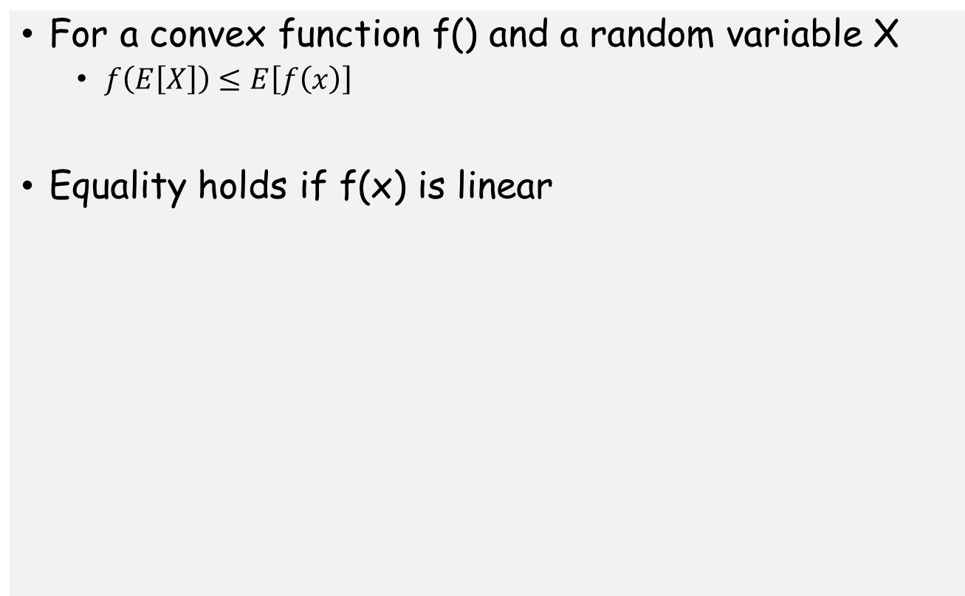
Jensen’s Inequality
For a convex function f() and a random variable X
  $f\left(E\left[X\right]\right)≤E\left[f\left(x\right)\right]$
Equality holds if f(x) is linear

