Slide 1
Reinforcement Learning
Abir Das
Assistant Professor
Computer Science and Engineering Department
Indian Institute of Technology Kharagpur
http://cse.iitkgp.ac.in/~adas/

Slide 2
Logistics
Course Name and code: Reinforcement Learning, CS60077
Time: Thursday (3:00-4:55 pm), Friday (3:00-3:55 pm) [Slot V3]
Office Hours: Friday (4:00-5:00 pm) [Just after the class] at my office [Room beside the class]
Venue: ITCLA1 (Classroom 1, Takshashila Building, Second Floor)
Course website: http://cse.iitkgp.ac.in/~adas/courses/rl_aut2019/rl_aut2019.php
AWS Educate Classroom: [LINK TO BE ANOUNCED]
Piazza Forum: https://piazza.com/iitkgp.ac.in/fall2019/cs60077/home
TAs: Buridi Sree Aditya (buridiaditya@iitkgp.ac.in), Vishal Gupta (ervishal@iitkgp.ac.in)

Slide 3
Course Information
Prerequisites: 1. MA20104: Probability and Statistics 2. CS60050: Machine Learning or CS60010: Deep Learning.
Python Proficiency: Proficiency in Python and familiarity with some Deep Learning tools (Tensorflow, Pytorch etc.) is desirable. A few links to get started.
https://docs.python.org/3/tutorial/
http://cs231n.github.io/python-numpy-tutorial/

Slide 4
Course Information
Books and References:
“Reinforcement Learning: An Introduction”, Richard S. Sutton and Andrew G. Barto, 2nd Edition, Free link.
“An Introduction to Deep Reinforcement Learning”, Vincent François-Lavet, Peter Henderson, Riashat Islam, Marc G. Bellemare and Joelle Pineau, Free link.
“Algorithms for Reinforcement Learning”, Csaba Szepesvari, Free link.
[For Probability Primer] - “Probability, Statistics, and Random Processes for Electrical Engineering”, 3rd Edition, Alberto Leon-Garcia, Free link.
[For Probability Primer] - Lecture Notes on Introduction to Probability, Dimitri P. Bertsekas and John N. Tsitsiklis, Free link
More references specific to the lectures will be added in the course website as and when needed.

Slide 5
Course Information
Online lecture Videos: The following courses will be closely followed in this course
Reinforcement Learning by David Silver (Link)
Deep Reinforcement Learning by Sergey Levine (Link)
NPTEL Reinforcement Learning by Balaraman Ravindran (Link)

Slide 6
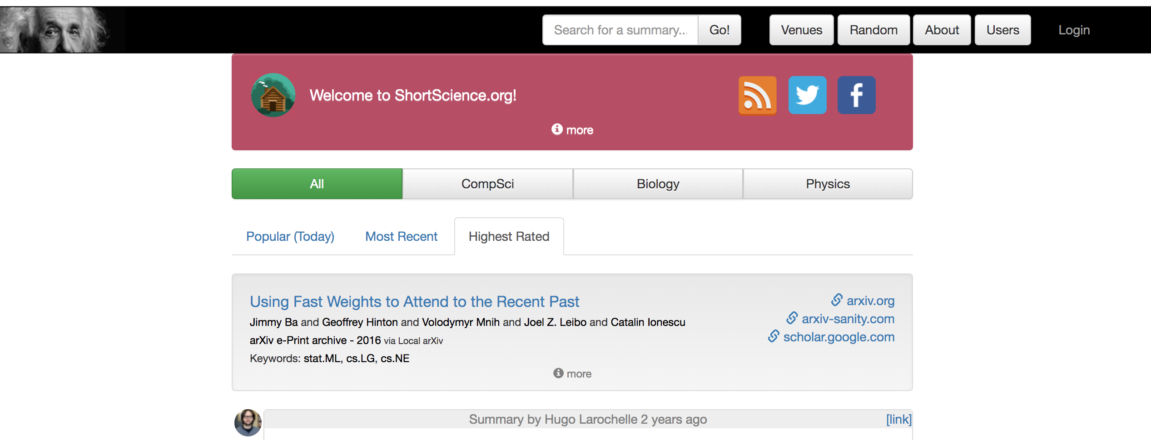
Course Information
Evaluation: Homework (20%) – 4 Homeworks; mid term (30%); End-term (30%); Project (20%).
Project has three options to choose from
Present and write notes in shortscience.org for 2 RL papers. Papers will be provided in the course website or in AWS Educate LMS.
Take part in NeurIPS 2019 Reproducibility Challenge [Tentative]
Indigenous project: Here the deliverables is NeurIPS style 8 page report and a 10 minute presentation at the end of the course.

Slide 7
Reinforcement Learning
“Goal-directed learning from interaction in an uncertain environment” – Reinforcement Learning: An Introduction, Sutton and Barto, Second Edition
Video courtesy: Brendan Cole, youtube link

Slide 8
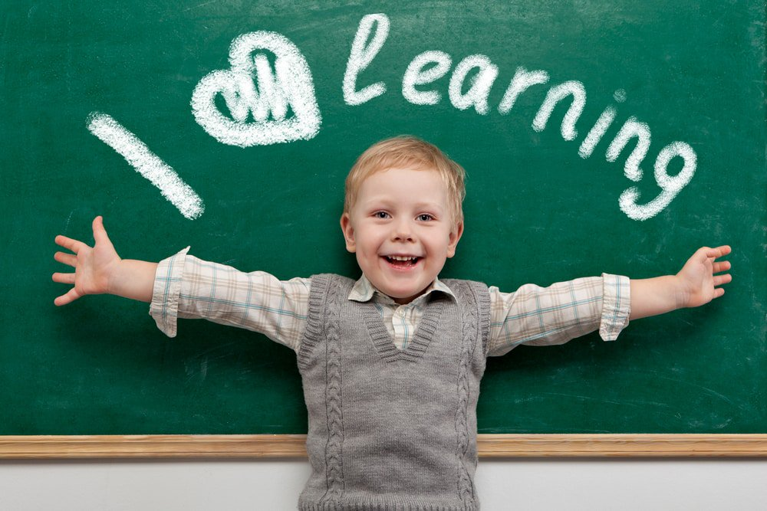
Reinforcement Learning
Definition of Learning from Psychology: Learning is a relatively permanent change in behavior that occurs through experience. It’s a continuous and gradual process.
Image credit: Melbourne Child Psychology & School Psychology Services

Slide 9
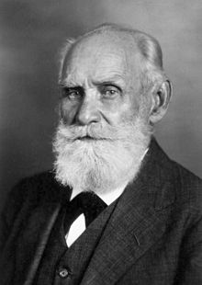
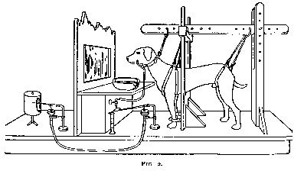
Some more of Psychology
Classical Conditioning: Theory developed by Ivan Pavlov (Nobel prize in 1904).
Dog salivates seeing the food (Unconditioned response (salivating) to Unconditioned Stimulus (food))
Dog salivates hearing the bell (Conditioned response (salivating) to Conditioned Stimulus (bell)). Learning to associate bell to salivation via food.
Images credit: Wikipedia

Slide 10
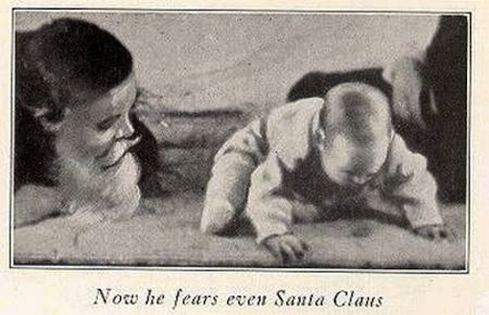
Some more of Psychology
Classical Conditioning: In an experiment with human babies, it was learnt that classical conditioning can occur in humans too.
John B. Watson in 1920 performed his famous “Little Albert experiment”
Mary Cover Jones in 1924 performed her “Little Peter experiment” to show that “counter conditioning” is possible for human subjects.
Image credit: Wikipedia

Slide 11
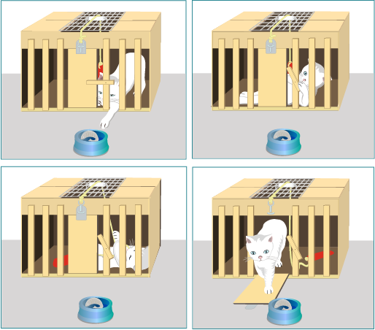
Some more of Psychology
In Classical Conditioning: The reward (e.g., food) is present and that caused the response (e.g., salivation).
At a similar time, Edward Thorndike was conducting experiments on cats to see how positive/negative feedback affects goal directed learning.
Image Link

Slide 12
Some more of Psychology
The Law of effect [Thorndike, 1911]:-
“Of several responses made to the same situation, those which are accompanied or closely followed by satisfaction to the animal will, other things being equal, be more firmly connected with the situation, so that, when it recurs, they will be more likely to recur; those which are accompanied or closely followed by discomfort to the animal will, other things being equal, have their connections with that situation weakened, so that, when it recurs, they will be less likely to occur. The greater the satisfaction or discomfort, the greater the strengthening or weakening of the bond.”
This is later studied more by B. F. Skinner and he popularized the term Operant Conditioning.
Pigeons were provided food grains as reward for some “appropriate” behavior.
Skinner also came up with “Pigeon guided missiles” using similar principle.
Image Link

Slide 13
Some more of Psychology
Reinforcement/Punishment:- In Psychological terms, Reinforcement is a consequence that causes a behavior to occur with greater frequency. Punishment is a response or consequence that causes a behavior to occur with less frequency.
Reinforcement can also mean removal of aversive consequence (Negative Reinforcement).
Similarly, Punishment can also mean removal of rewarding consequence (Negative Punishment).
Image Link

Slide 14
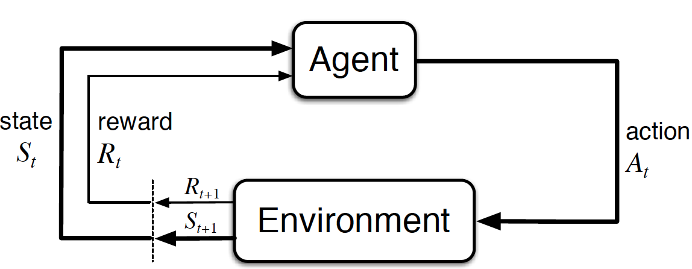
Reinforcement Learning Setting
Agent:- The learner or the decision maker.
Environment:- The thing the learner interacts with, comprising everything outside the agent.
They interact continually. The agent selects actions. The environment responds to these actions by presenting new situation and giving rewards for the action.

Slide 15
Reinforcement Learning Setting
Reward:- Rewards are scalar measures defining what are the good and bad events for the agent.
Value:- Value of a state is the total amount of reward an agent is expected to get in future starting from that state.
Sutton and Barto

Slide 16
Reinforcement Learning Setting
Goal in RL Problem:- to maximize the total reward “in expectation” over the long run.
$τ≝\left(s_{1},a_{1},s_{2},a_{2},…\right), p\left(τ\right)=p(s_{1})\prod_{t}{p\left(a_{t}|s_{t}\right)p(s_{t+1}|s_{t},a_{t})}$
$\max{𝔼_{τ\sim p(τ)}\left[\sum_{t}{R(s_{t},a_{t})}\right]}$

Slide 17
Distinguishing Features of Reinforcement Learning
Trial and error:- The learner is not told which actions to take, but instead must discover which actions are most rewarding by trying them.
Delayed rewards:- actions may affect not only the immediate reward but also the next situation and, through that, all subsequent rewards.
Exploration-vs-exploitation:-
- Sutton and Barto

Slide 18
When to use Reinforcement Learning
Trajectories:- Data comes in the form trajectories.
Decisions:- Need to take decisions that affect the trajectory data.
Feedback:- Need to get feedback about the choice of actions.

Slide 19
Supervised, Unsupervised and Reinforcement Learning
Supervised Learning:- Learn $y=f(x)$ – You are given a bunch of $(x,y)$ pairs and your goal is to find the function $f$ mapping $x$ to $y$.
Unsupervised Learning:- Learn $f(x)$ – You don’t have access to any $y$, you are given a bunch of $x^{′}s$ and your goal is to find some $f$ that gives a “compact description” of these $x^{′}s$.
Reinforcement Learning:- Learn $y=f(x)$, given $z$ – You are given a bunch of $(x,z)$ pairs and your goal is to find the function $f$ mapping $x$ to $y$.
$x$ is state, $y$ is action, $z$ is reward

Slide 20
Supervised, Unsupervised and Reinforcement Learning
Supervised Learning:- Does not involve the problem of temporal credit assignment and exploration.
Unsupervised Learning:- Here, the correct labels are not available

Slide 21
RL Algorithm Landscape
Slide credit: Deep RL Bootcamp, 2017

Slide 22
Early History of Reinforcement Learning
Optimal Policy/Optimal Control [Pontryagin and Neustadt, 1962]
Dynamic Programming
[Bellman, 1959] and many more
Optimal solution to global problem is conjunction of solution to sub-problems
Model knowledge is necessary
Curse of dimensionality – Computation increases exponentially with number of states
Has good convergence properties
Learning by Trial and Error
[Thorndike 1911, Skinner 1953]
[Turing 1948, Pleasure and Pain System, 1948]
[Minsky, PhD Thesis, 1954]
[Michie, 1961, 1968, 1974]
[Widrow, Gupta and Maitra, 1973] and many more
Continued to show importance of trial and error learning
Reinforcement Learning
[Sutton, Barto, Arthur Samuel, Bertsekas, Tsitsiklis and many more]

Slide 23
Tentative Plans for the Course
Dynamic Programming based Methods
Policy Optimization
Actor-Critic Methods
Advanced Policy Optimization
Advanced Topics (Inverse RL, Meta Learning, Safe RL)

Slide 24
Advanced Topics
Inverse Reinforcement Learning:- Learning the reward function.
Meta Reinforcement Learning:- Learning to reinforcement learn. Babies explore – they move and act in highly variable and playful ways that are not goal-oriented and are seemingly random. In doing so, they discover new problems and new solutions. Exploration makes intelligence open-ended and inventive.
Safe Reinforcement Learning:- When we do not have much opportunity to explore safely (Guest Lectures by Prof. S. Dey).
"The Development of Embodied Cognition: Six Lessons from Babies" - Linda Smith
"The Development of Embodied Cognition: Six Lessons from Babies" - Linda Smith

Slide 25
Concluding with a quote from 1968 paper
Donald Michie, “Memo Functions and Machine Learning”, Nature, 1968

Slide 26
Thank You!!

