Slide 1
Deep Learning
CS60010
Abir Das
Assistant Professor
Computer Science and Engineering Department
Indian Institute of Technology Kharagpur
http://cse.iitkgp.ac.in/~adas/

Slide 2
Announcements
Class Test 1 is graded.
Solutions are also uploaded.
Login to the moodle server where you gave the exam. In gradebooks you will get to see the marks.
Ignore the percentages. Just the marks obtained will be taken to compute your grades at the end. The percentages shown here are meaningless.

Slide 3
Agenda
The Building Blocks of Convolutional Neural Networks/CNNs/ConvNets

Slide 4
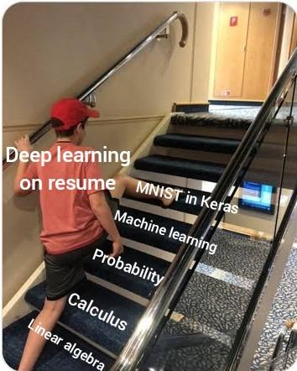
Importance of MNIST

Slide 5
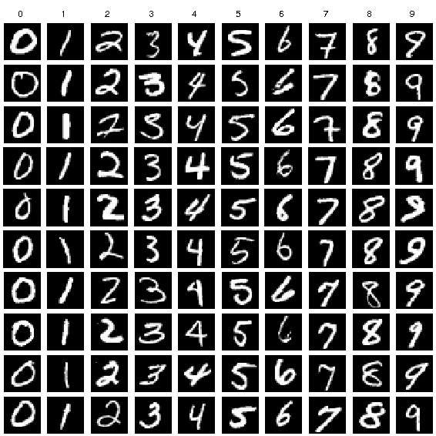
MNIST
database of handwritten digits
10 classes
  Training set 60,000 images
  Test set of 10,000 images
Greyscale images of size 28x28
Often treated as `Hello World’ for any ML/DL practioner
Image taken from Researchgate

Slide 6
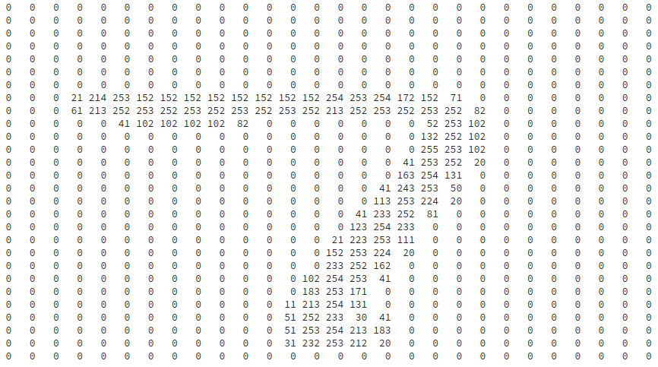
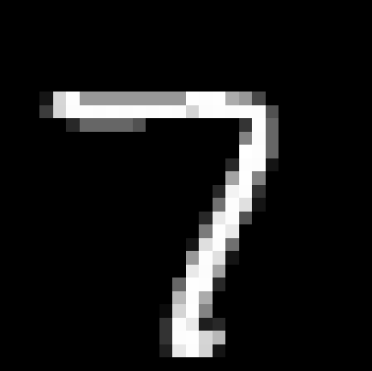
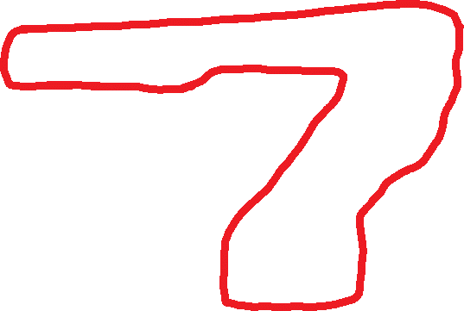
Example from MNIST

Slide 7
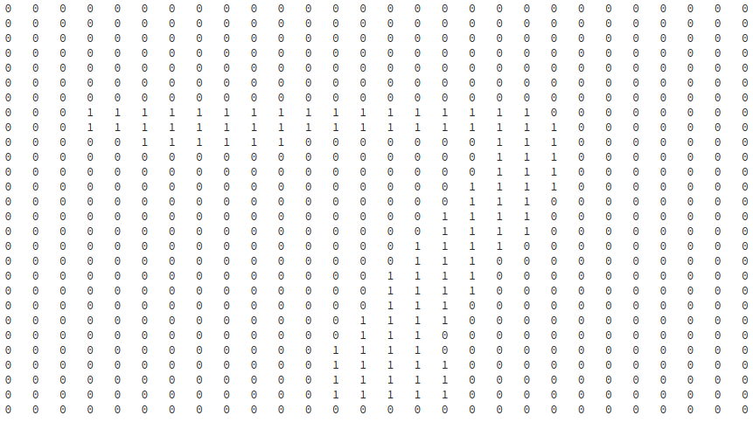

7 Like Window?

Slide 8
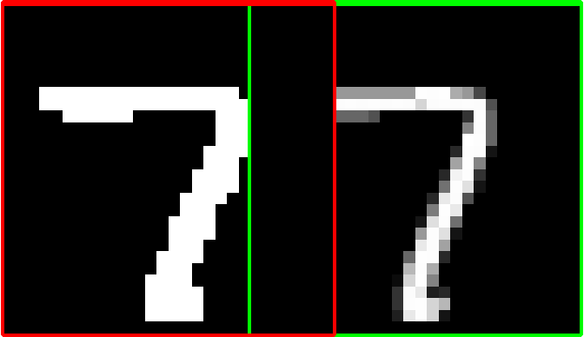
Filtering
0

Slide 9
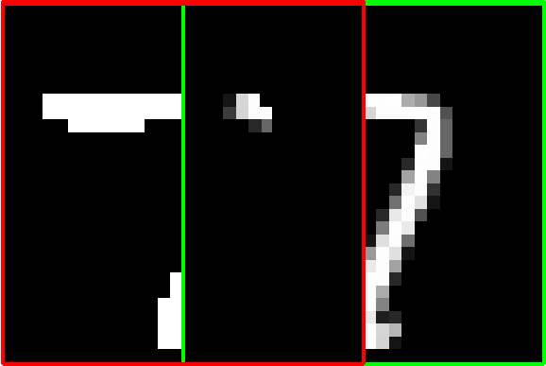
Filtering
1410

Slide 10
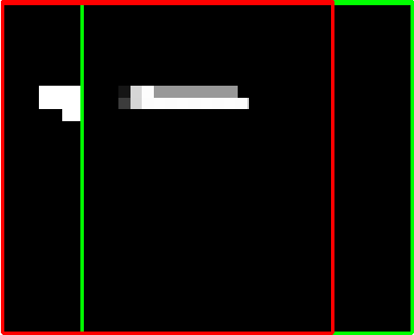
Filtering
4098

Slide 11
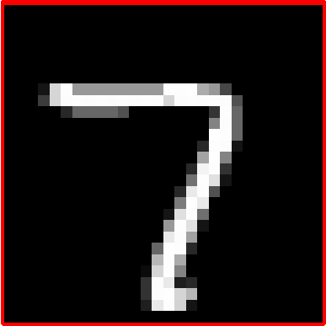
Filtering
18604

Slide 12
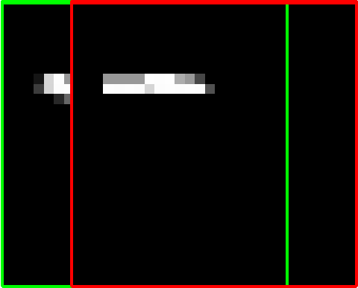
Filtering
4331

Slide 13
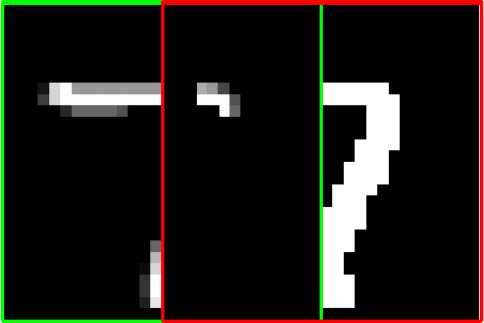
Filtering
1589

Slide 14
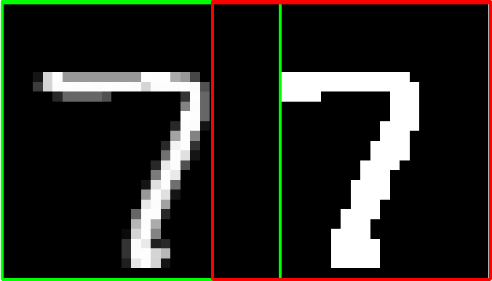
Filtering
0

Slide 15






Filters
Classification by Matching Filters
Test Images
But what if the test image is a little
Rotated (or)
Skewed (or)
Zoomed out and so on

Slide 16
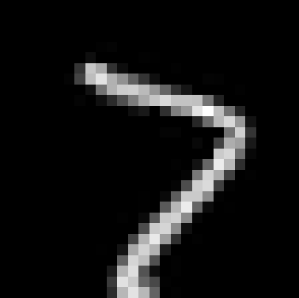
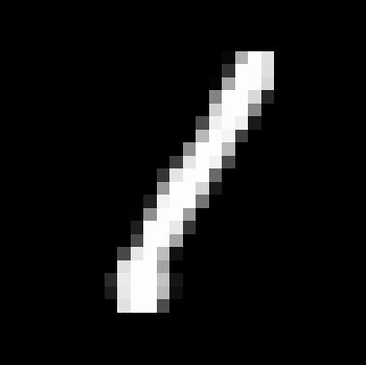
Effect of Slight Rotation
18604
18 degrees
rotation
9974
10278

Slide 17
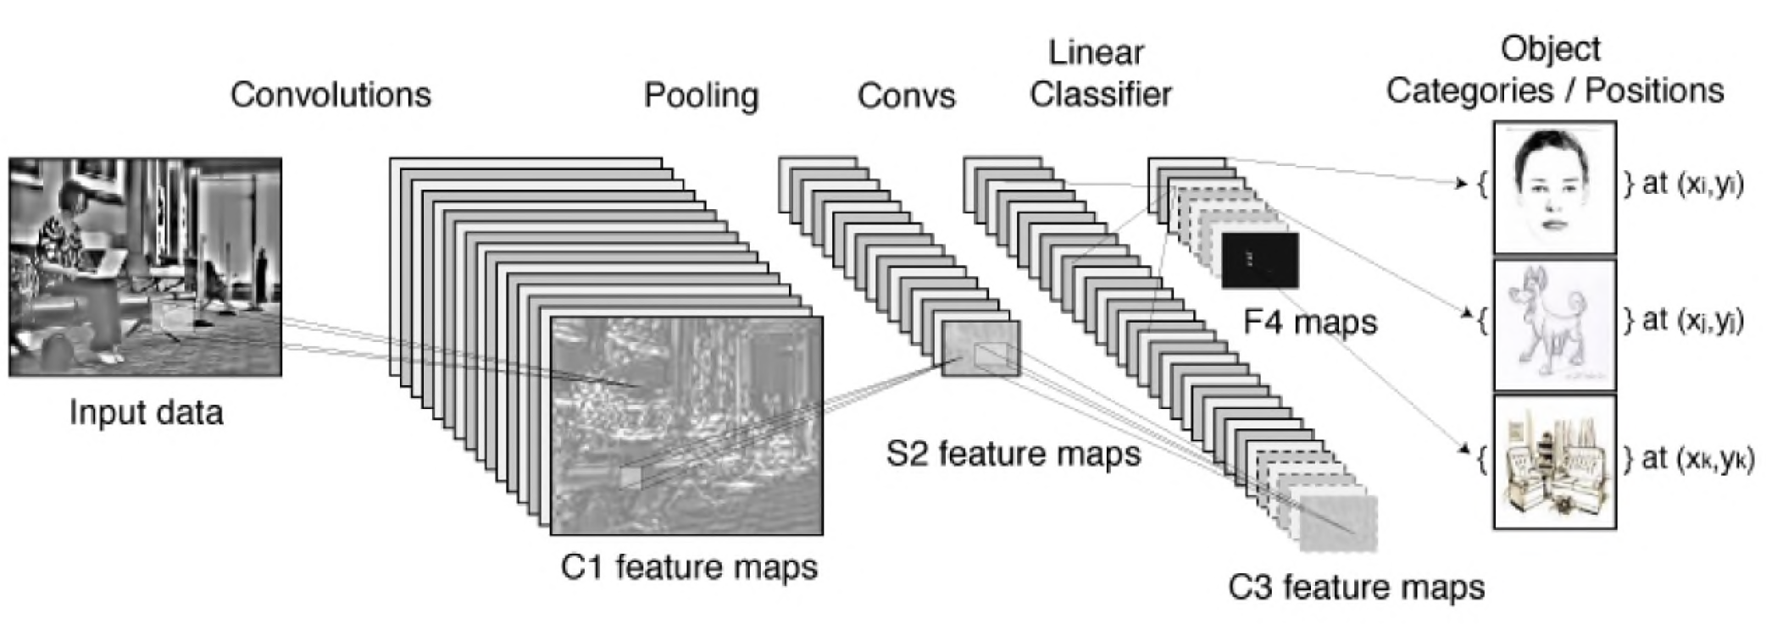
Convnets (Fukushima, LeCun, Hinton)
Slide courtesy: Nando de Freitas, University of Oxford

Slide 18
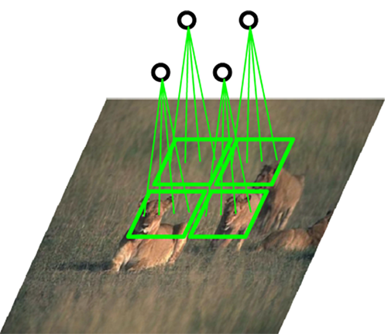
Convnets (Fukushima, LeCun, Hinton)
Slide courtesy: Nando de Freitas, University of Oxford

Slide 19
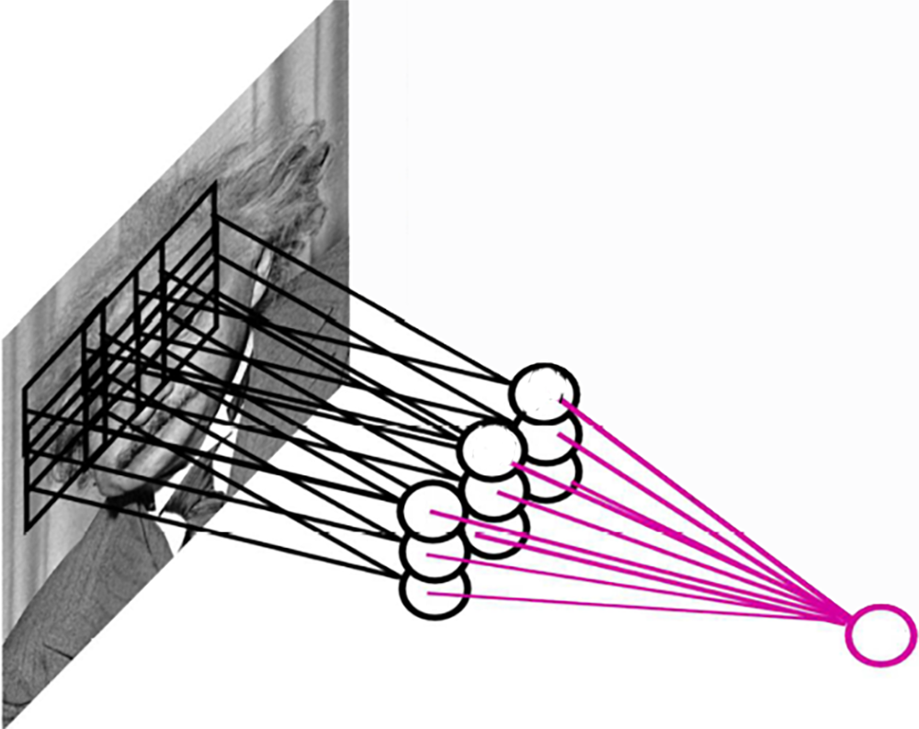
Pooling
By "pooling" (e.g., max or average) filter responses, we gain robustness to the exact spatial location of features.
Image courtesy: Nando de Freitas, University of Oxford

Slide 20
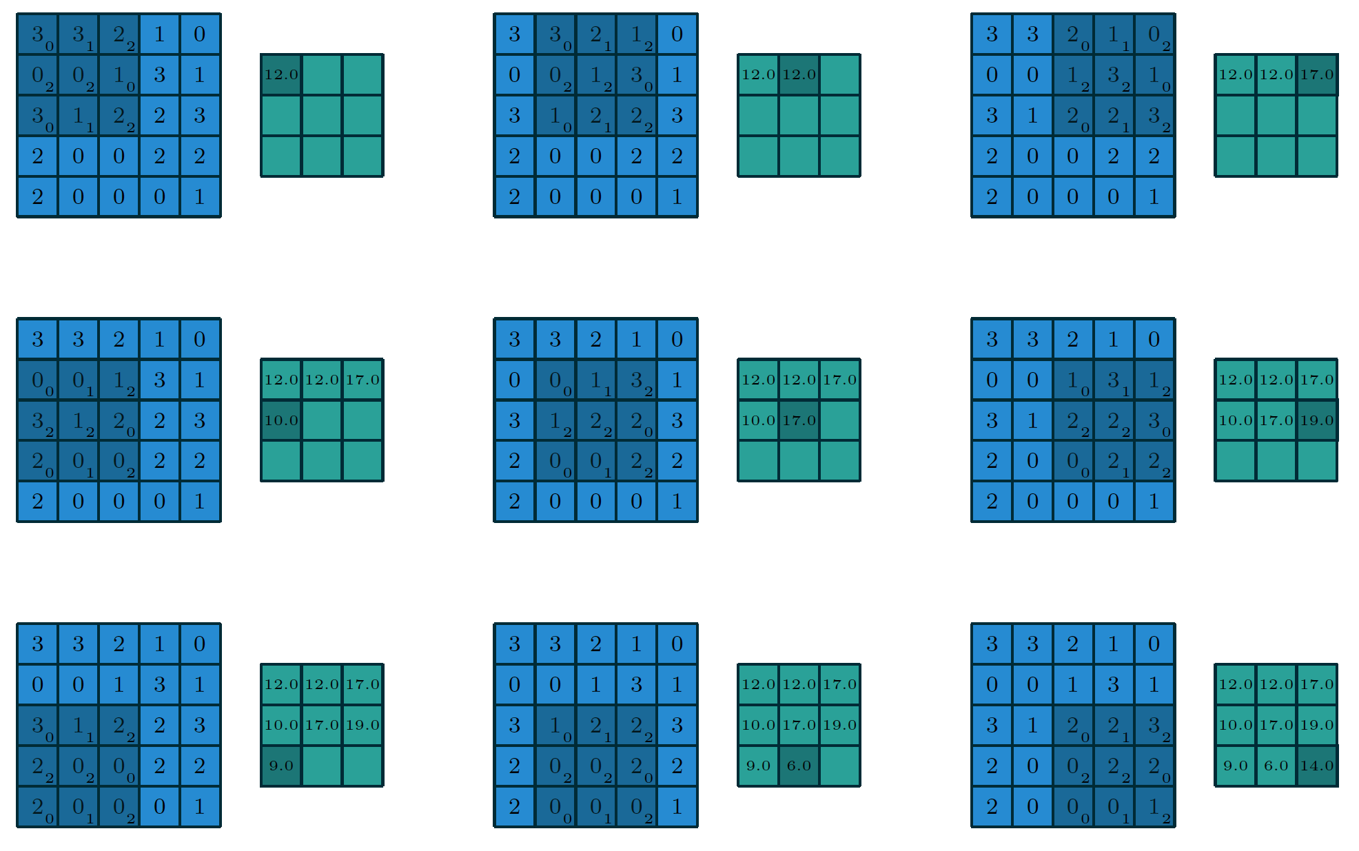
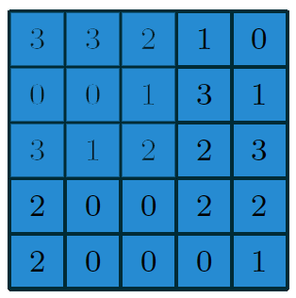
Convolution
Filter
Image
Image courtesy:Vincent Dumoulin

Slide 21
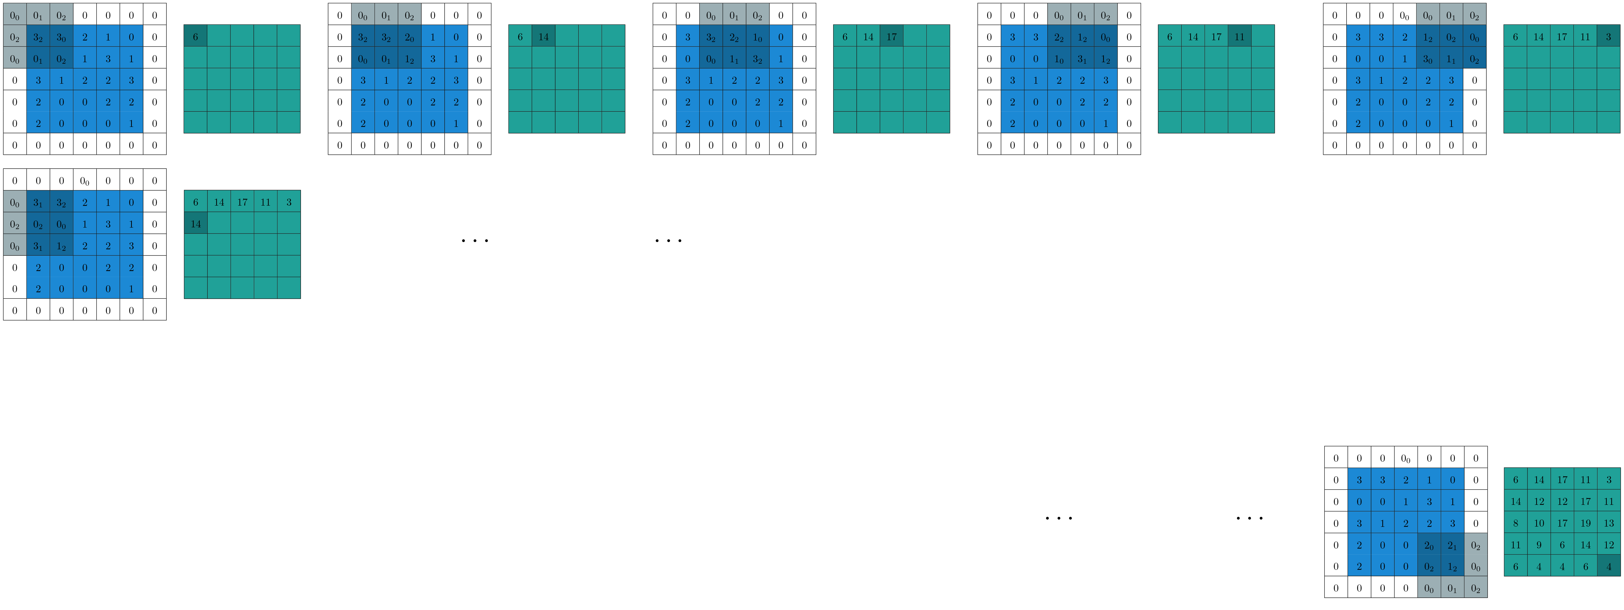
Convolution with Zero Padding
Filter
Image

Slide 22
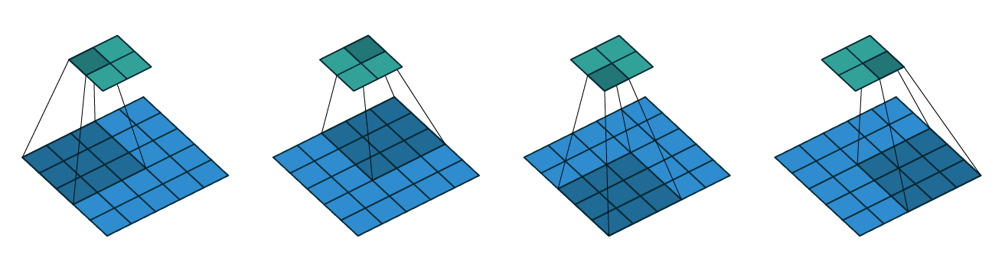
Convolution with Strides
Convolving a 3x3 kernel over a 5x5 input using 2x2 strides
Image courtesy:Vincent Dumoulin

Slide 23
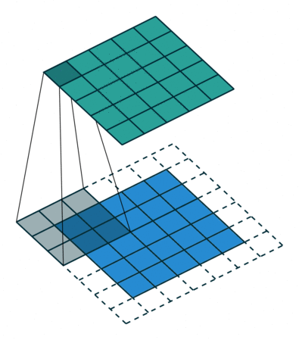
Convolution with Strides and Zero Padding
Convolving a 3x3 kernel over a 5 x5 input using 1 x1 strides and half padding
Image courtesy:Vincent Dumoulin

Slide 24
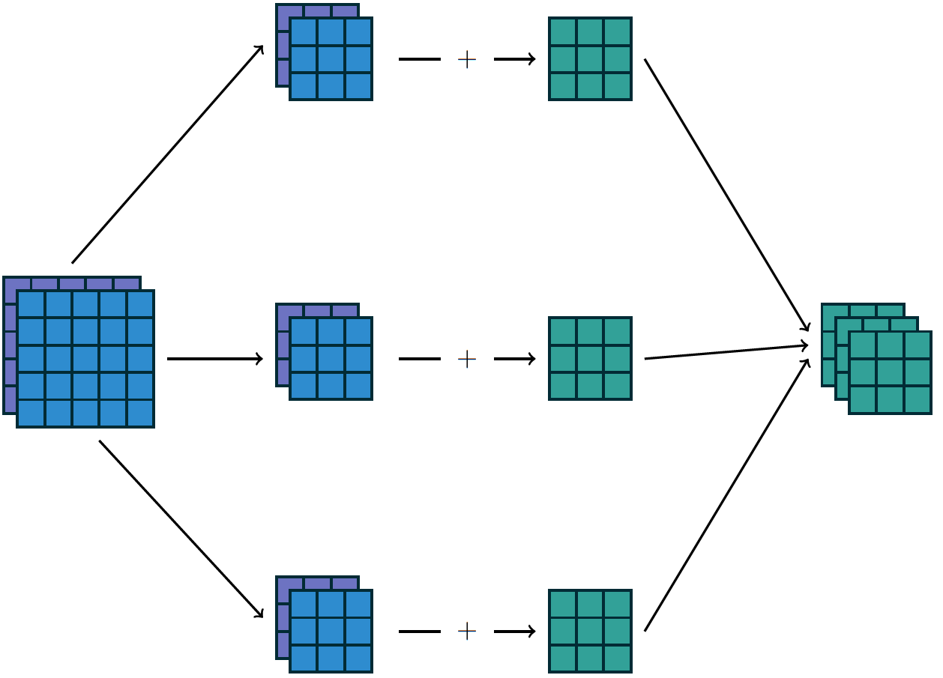
Inputs Generally have Multiple Channels
Image courtesy:Vincent Dumoulin

Slide 25
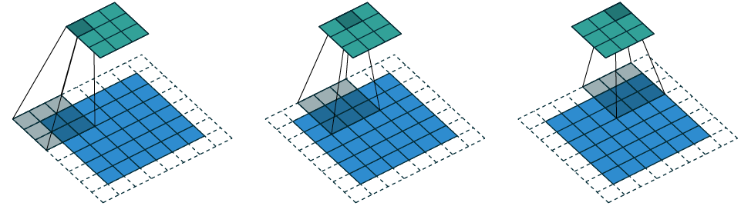
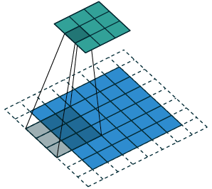
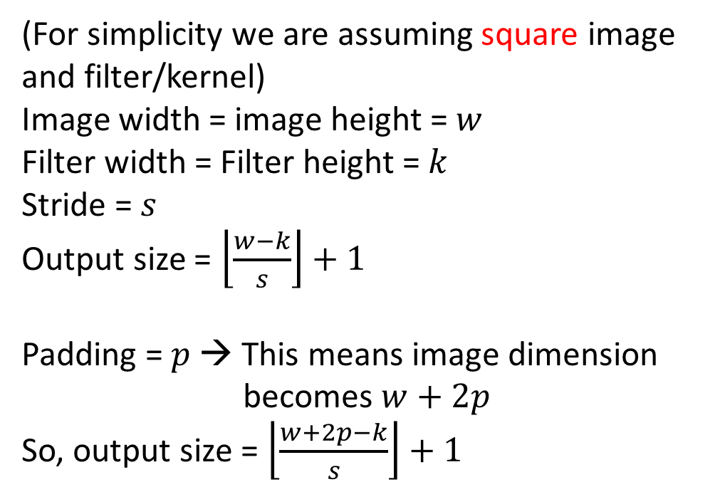

Convolution Arithmetic
(For simplicity we are assuming square image
and filter/kernel)
Image width = image height = $w$
Filter width = Filter height = $k$
Stride = $s$
Output size = $\left\lfloor \frac{w−k}{s}\right\rfloor +1$
Padding = $p$ → This means image dimension
becomes $w+2p$
So, output size = $\left\lfloor \frac{w+2p−k}{s}\right\rfloor +1$
Note the box function
$$w=6, p=1,k=3, s=2$$
Image courtesy:Vincent Dumoulin

Slide 26
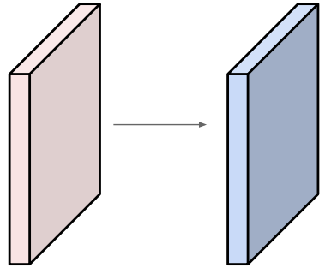
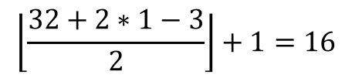
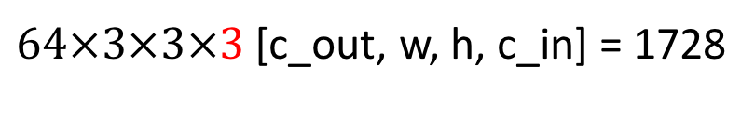
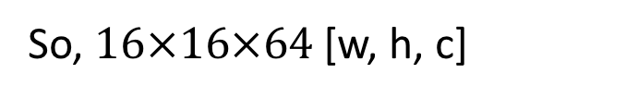
Convolution Arithmetic
Input volume: 32x32x3 [w, h, c].
64 filters of size 3x3 [k, k] with
stride 2 [s], pad 1 [p]
What is the output feature map size?
And What is the number of parameters in this convolution layer?
$$\left\lfloor \frac{32+2∗1−3}{2}\right\rfloor +1=16$$
So, $16×16×64$ [w, h, c]
$64×3×3×3$ [c_out, w, h, c_in] = 1728
Image courtesy: Andrej Karpathy

Slide 27
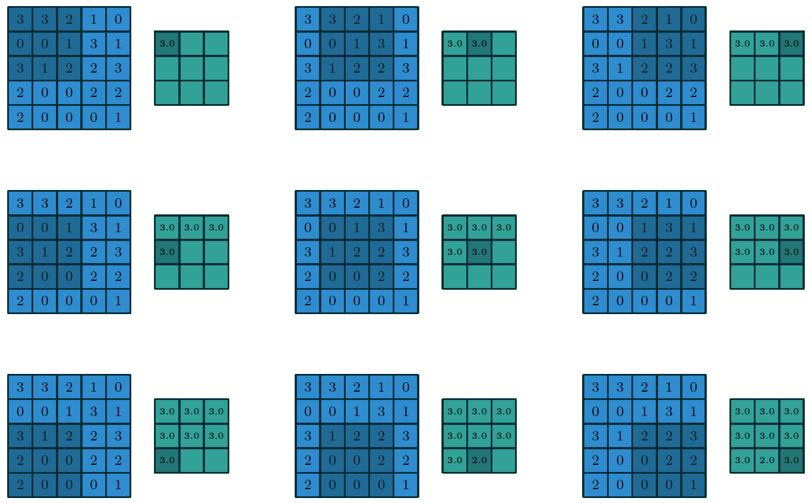
Pooling
3x3 max-pooling on 5x5 input with
1x1 stride
Image courtesy:Vincent Dumoulin

Slide 28
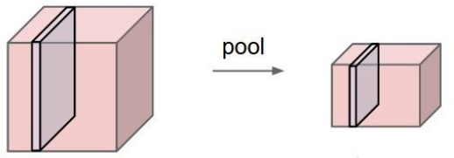
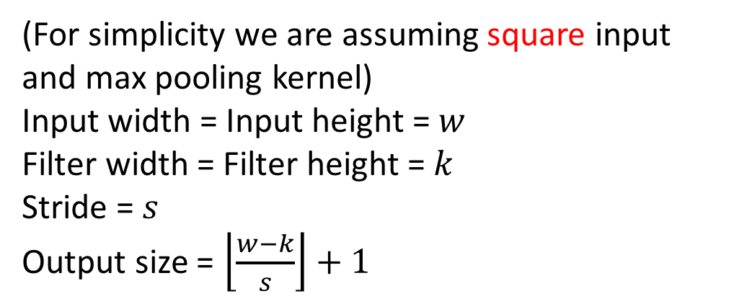

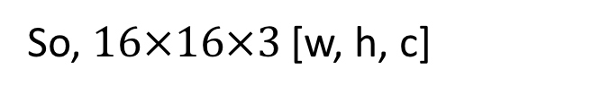
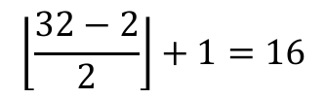
Pooling Arithmetic
(For simplicity we are assuming square input
and max pooling kernel)
Input width = Input height = $w$
Filter width = Filter height = $k$
Stride = $s$
Output size = $\left\lfloor \frac{w−k}{s}\right\rfloor +1$
And What is the number of parameters in this pooling layer?
Input volume: 32x32x3 [w, h, c].
Max-pooling kernel of size 2x2 [k, k] with
stride 2 [s]
What is the output feature map size?
$$0$$
$$\left\lfloor \frac{32−2}{2}\right\rfloor +1=16$$
So, $16×16×3$ [w, h, c]
Image courtesy: Andrej Karpathy

Slide 29
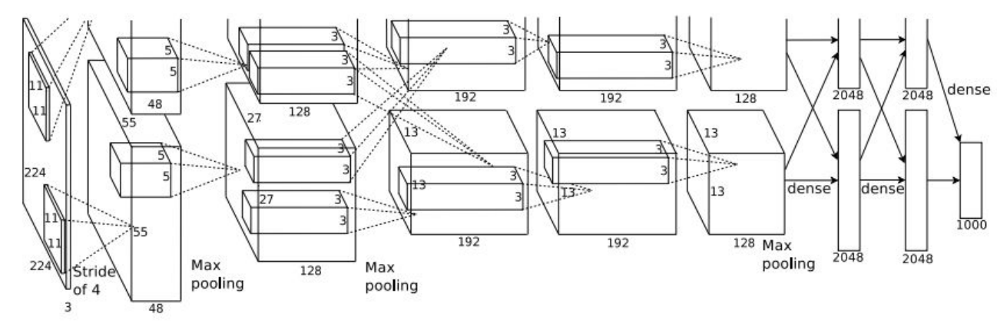
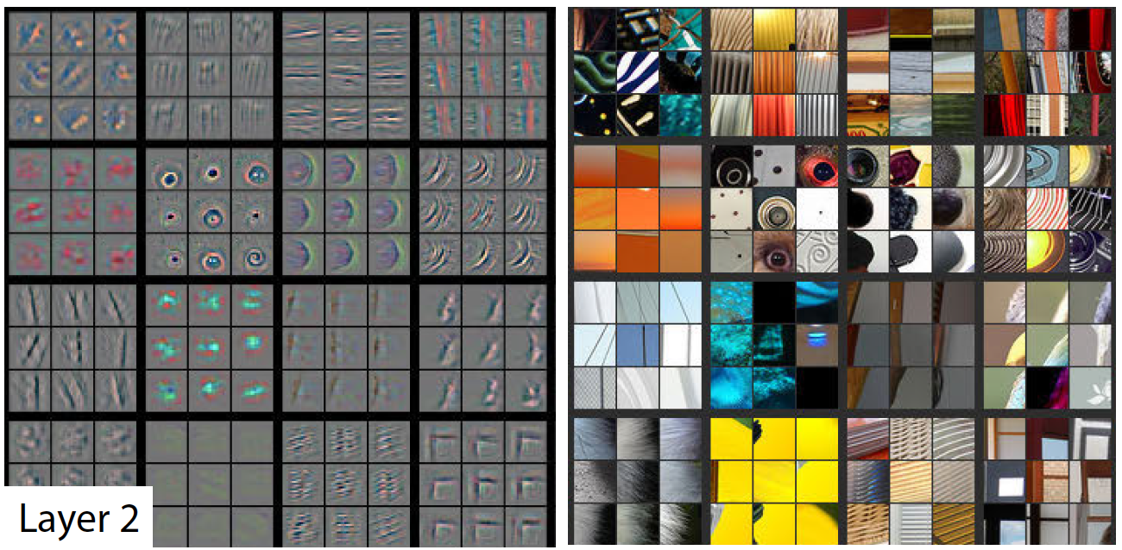
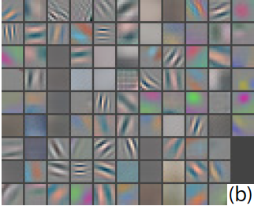
Visualizations
AlexNet (2012)
First layer (CONV1): 96 11x11 filters
Image courtesy: Zeiler, Fergus, 2013

Slide 30
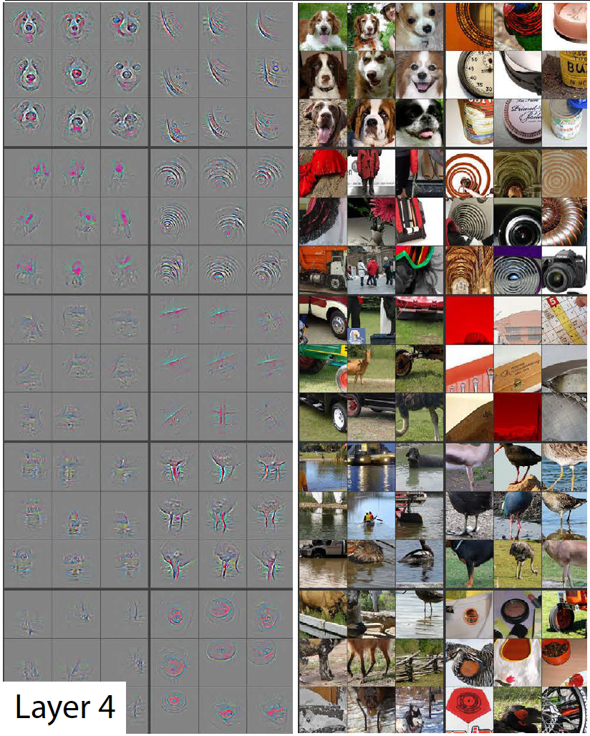
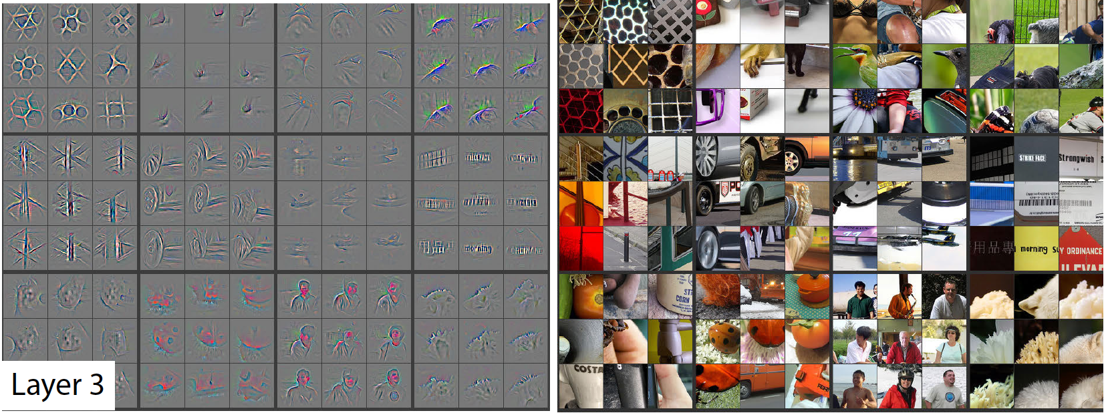
Visualizations
Image courtesy: Zeiler, Fergus, 2013
Notes:
They are taking a random subset of feature maps – say 10 or 20 feature maps. Then they are passing bunch of images through the network and finding what are the neurons across all the feature maps that are maximally activated. Say we have chosen 10 random feature maps, each of size 7x7. So for each image passing through the network, we will have 7*7 = 49 activations in each of the 10 feature maps. For a single image, in each feature map, we take a note (out of the 49 neurons in each feature map) of the activation value that is maximum. So, for each image, we get 10 such neuron positions in 10 separate feature maps. So, in total for 100 images, for each of the 10 feature maps, we 1get 00 such values [or positions] of the neuron which has the maximum activation. We take 9 top-most out of these 100 values for each feature map. These 9 are shown in the lowest group. In layer 2, they have chosen 16 random feature maps [as I could interprete from the second hierarchical grouping].

Slide 31
