Slide 1
Deep Learning CS60010
Abir Das, Sudeshna Sarkar
Computer Science and Engineering Department
Indian Institute of Technology Kharagpur
http://cse.iitkgp.ac.in/~adas/ http://www.facweb.iitkgp.ac.in/~sudeshna/

Slide 2
Agenda
Understand basics of Matrix/Vector Calculus and Optimization concepts to be used in the course.
Understand different types or errors in learning

Slide 3
Resources
”Deep Learning”, I. Goodfellow, Y. Bengio, A. Courville. (Chapter 8)

Slide 4
Optimization and Deep Learning- Connections
Deep learning (machine learning, in general) involves optimization in many contexts
The goal is to find parameters $θ$ of a neural network that significantly reduce a cost function or objective function $J\left(θ\right)$.
Gradient based optimization is the most popular way for training Deep Neural Networks.
There are other ways too, e.g., evolutionary or derivative free optimization, but they come with issues particularly crucial for neural network training.
Its easy to spend a semester on optimization. Thus, these few lectures will only be a scratch on a very small part of the surface.

Slide 5
Optimization and Deep Learning- Differences
In learning we care about some performance measure $P$ (e.g., image classification accuracy, language translation accuracy etc.) on test set, but we minimize a different cost function $J(θ)$ on training set, with the hope that doing so will improve $P$
This is in contrast to pure optimization where minimizing $J(θ)$ is a goal in itself
Lets see what types of errors creep in as a result

Slide 6
Expected and Empirical Risk
Training data is$\left\{x^{(i)},y^{(i)}:i=1,…,N\right\}$ coming from probability distribution $𝒟(x,y)$
Let the neural network learns the output functions as $g^{𝒟}(x)$ and the loss is denoted as $l(g^{𝒟}\left(x\right),y)$
What we want to minimize is the expected risk $E\left(g^{𝒟}\right)=\int{l\left(g^{𝒟}\left(x\right),y\right)}d𝒟\left(x,y\right)=𝔼\left(l\left(g^{𝒟}\left(x\right),y\right)\right)$
If we could minimize this risk we would have got the true optimal function $f=arg\min_{g^{𝒟}}{E\left(g^{𝒟}\right)}$
But we don’t know the actual distribution that generates the data. So, what we actually minimize is the empirical risk $E_{n}\left(g^{𝒟}\right)=\frac{1}{N}\sum_{i=1}^{N}{l\left(g^{𝒟}\left(x_{i}\right),y_{i}\right)}=𝔼_{n}\left(l\left(g^{𝒟}\left(x\right),y\right)\right)$
We choose a family $ℋ$of candidate prediction functions and find the function that minimizes the empirical risk $g_{n}^{𝒟}=arg\min_{g^{𝒟}∈ℋ}{E_{n}\left(g^{𝒟}\right)}$
Since $f$ may not be found in the family $ℋ$, we also define $g_{ℋ∗}^{𝒟}=arg\min_{g^{𝒟}∈ℋ}{E\left(g^{𝒟}\right)}$

Slide 7
Sources of Error
 | Minimizes | Staying within
$$f$$ | expected risk | No constraints on function family | True data distribution known Family of functions exhaustive
$$g_{ℋ∗}^{𝒟}$$ | expected risk | family of functions $ℋ$ | True data distribution known Family of functions not exhaustive
$$g_{n}^{𝒟}$$ | empirical risk | family of functions $ℋ$ | True data distribution not known Family of functions not exhaustive
True data generation procedure not known
Family of functions [or hypothesis] to try is not exhaustive
(And not to forget) we rely on a surrogate loss in place of the true classification error rate

Slide 8
A Simple Learning Problem
2 Data Points. 2 hypothesis sets:
$$ℋ_{0}: h\left(x\right)= b$$
$$ℋ_{1}: h(x) = ax + b$$
y
y
x
x
Slide courtesy: Malik Magdon-Ismail

Slide 9
Let’s Repeat the Experiment Many Times
Slide courtesy: Malik Magdon-Ismail

Slide 10
What’s Happening on Average
y
g¯(x)
g¯(x)
y
sin(x)
sin(x)
We can define
x
x
$$g_{n}^{𝒟}(x)$$
Random value, depending on $𝒟$
$$\overline{g}\left(x\right)=𝔼_{𝒟}\left[g_{n}^{𝒟}(x)\right]=\frac{1}{K}\left(g_{n}^{𝒟_{1}}\left(x\right)\text{+}g_{n}^{𝒟_{2}}\left(x\right)+…+g_{n}^{𝒟_{K}}(x)\right)$$
Your average prediction on $x$
$$var\left(x\right)=𝔼_{𝒟}\left[{\left(g_{n}^{𝒟}\left(x\right)−\overline{g}\left(x\right)\right)}^{2}\right]=𝔼_{𝒟}\left[{g_{n}^{𝒟}\left(x\right)}^{2}\right]−{\overline{g}\left(x\right)}^{2}$$
How variable is your prediction
Slide courtesy: Malik Magdon-Ismail
Notes:
Any intuition why variance is less in the middle of the right figure

Slide 11
$E_{out}$ on Test Point $x$ for Data $𝒟$
f (x)
f (x)
E_{o}^{D}_{ut}(x)
E_{o}^{D}_{ut}(x)
$$g_{n}^{𝒟}\left(x\right)$$
$$g_{n}^{𝒟}\left(x\right)$$
x
x
$$E_{out}^{𝒟}\left(x\right)={\left(g_{n}^{𝒟}\left(x\right)−f\left(x\right)\right)}^{2}$$
Squared error, a random value depending on $𝒟$
$$E_{out}\left(x\right)=𝔼_{𝒟}\left[E_{out}^{𝒟}\left(x\right)\right]=𝔼_{𝒟}\left[{\left(g_{n}^{𝒟}\left(x\right)−f\left(x\right)\right)}^{2}\right]$$
Expected value of the above random value
Slide motivation: Malik Magdon-Ismail

Slide 12
The Bias-Variance Decomposition
$$E_{out}\left(x\right)=𝔼_{𝒟}\left[{\left(g_{n}^{𝒟}\left(x\right)−f\left(x\right)\right)}^{2}\right]$$
$$=𝔼_{𝒟}\left[{f\left(x\right)}^{2}−2f\left(x\right)g_{n}^{𝒟}\left(x\right)+{g_{n}^{𝒟}\left(x\right)}^{2}\right]$$
$$+$$
$$={f\left(x\right)}^{2}−2f\left(x\right)𝔼_{𝒟}\left[g_{n}^{𝒟}\left(x\right)\right]+𝔼_{𝒟}\left[g_{n}^{𝒟}{\left(x\right)}^{2}\right]$$
$$E_{out}\left(x\right)=$$
Bias
Variance
$$={f\left(x\right)}^{2}−2f\left(x\right)\overline{g}\left(x\right)+𝔼_{𝒟}\left[g_{n}^{𝒟}{\left(x\right)}^{2}\right]$$
$$={f\left(x\right)}^{2}−\overline{g}{\left(x\right)}^{2}+\overline{g}{\left(x\right)}^{2}−2f\left(x\right)\overline{g}\left(x\right)+𝔼_{𝒟}\left[g_{n}^{𝒟}{\left(x\right)}^{2}\right]$$
$$={\left(f\left(x\right)−\overline{g}\left(x\right)\right)}^{2}+𝔼_{𝒟}\left[g_{n}^{𝒟}{\left(x\right)}^{2}\right]−\overline{g}{\left(x\right)}^{2}$$
Bias
Variance
Slide motivation: Malik Magdon-Ismail
Notes:
Approximation: how far your prediction is on average from the actual value.

Slide 13
Bias-Variance to Overfitting-Underfitting
Suppose the true underlying function is $f(x)$.
But the observations (data points) are noisy i.e., $f\left(x\right)+ε$
$$f(x)$$

Slide 14
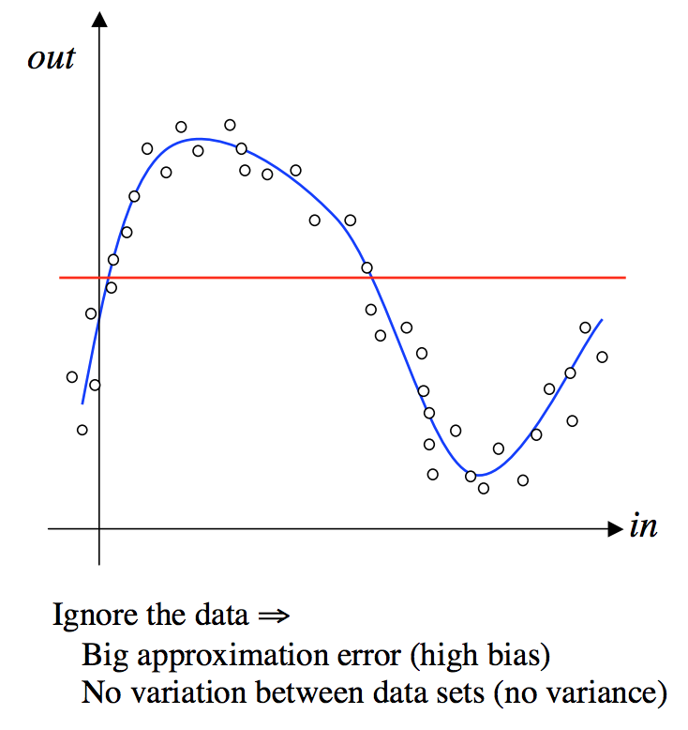
The Extreme Cases of Bias and Variance - Under-fitting
A good way to understand the concepts of bias and variance is by considering the two extreme cases of what a neural network might learn.
Suppose the neural network is lazy and just produces the same constant output whatever training data we give it, i.e. $g_{n}^{𝒟}(x)$=c, then
$$E_{out}\left(x\right)=$$
$${\left(f\left(x\right)−\overline{g}\left(x\right)\right)}^{2}+𝔼_{𝒟}\left[g_{n}^{𝒟}{\left(x\right)}^{2}\right]−\overline{g}{\left(x\right)}^{2}$$
$$={\left(f\left(x\right)−c\right)}^{2}+𝔼_{𝒟}\left[c^{2}\right]−c^{2}$$
$$={\left(f\left(x\right)−c\right)}^{2}+0$$
In this case the variance term will be zero, but the bias will be large, because the network has made no attempt to fit the data. We say we have extreme under-fitting
Slide motivation: John A. Bullinaria

Slide 15
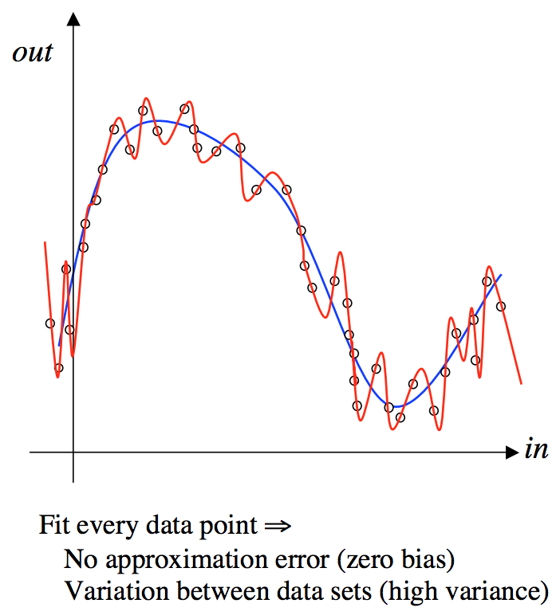
The Extreme Cases of Bias and Variance - Over-fitting
On the other hand, suppose the neural network is very hard working and makes sure that it exactly fits every data point, i.e. $g_{n}^{𝒟}\left(x\right)=f\left(x\right)+ε$, then, $\overline{g}\left(x\right)=𝔼_{𝓓}\left[g_{n}^{𝒟}\left(x\right)\right]=𝔼_{𝓓}\left[f\left(x\right)+ε\right]=𝔼_{𝓓}\left[f\left(x\right)\right]+0=f\left(x\right)$
$$E_{out}\left(x\right)=$$
$${\left(f\left(x\right)−\overline{g}\left(x\right)\right)}^{2}+𝔼_{𝒟}\left[g_{n}^{𝒟}{\left(x\right)}^{2}\right]−\overline{g}{\left(x\right)}^{2}$$
$$={\left(f\left(x\right)−f\left(x\right)\right)}^{2}+𝔼_{𝒟}\left[{\left(g_{n}^{𝒟}\left(x\right)−\overline{g}(x)\right)}^{2}\right]$$
$$=0+𝔼_{𝒟}\left[{\left(f\left(x\right)+ε−f\left(x\right)\right)}^{2}\right]$$
$$=0+𝔼_{𝒟}\left[ε^{2}\right]$$
In this case the bias term will be zero, but the variance is the square of the noise on the data, which could be substantial. In this case we say we have extreme over-fitting.
Slide motivation: John A. Bullinaria

Slide 16
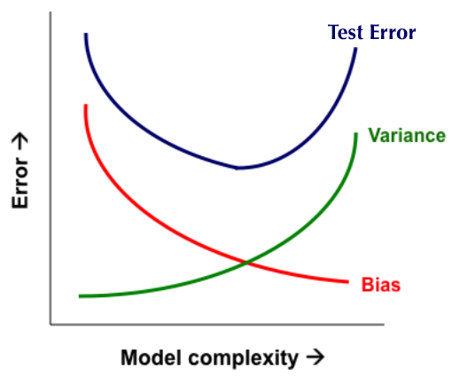
Bias-Variance Trade-off
Overfitting
Underfitting
Error
Test Error
Training Error
Number of Data Points, N

Slide 17
Vector/Matrix Calculus
If $f\left(x\right)∈ℝ$ and $x∈ℝ^{n}$, then $∇_{x}f≜{\left[\begin{matrix}\frac{∂f}{∂x_{1}} & \frac{∂f}{∂x_{2}} & ⋯ & \frac{∂f}{∂x_{n}}\end{matrix}\right]}^{T}$is called the gradient of $f(x)$
If $f\left(x\right)={\left[\begin{matrix}f_{1}(x) & f_{2}(x) & ⋯ & f_{m}(x)\end{matrix}\right]}^{T}∈ℝ^{m}$and $x∈ℝ^{n}$, then
$∇_{x}f={\left[\begin{matrix}\frac{∂f_{1}}{∂x_{1}} & \frac{∂f_{1}}{∂x_{2}} & ⋯ & \frac{∂f_{1}}{∂x_{n}} \\ \frac{∂f_{2}}{∂x_{1}} & \frac{∂f_{2}}{∂x_{2}} & ⋯ & \frac{∂f_{2}}{∂x_{n}} \\ . & . & . & . \\ \frac{∂f_{m}}{∂x_{1}} & \frac{∂f_{m}}{∂x_{2}} & ⋯ & \frac{∂f_{m}}{∂x_{n}}\end{matrix}\right]}_{m×n}$
is called “Jacobian matrix” of $f\left(x\right)$ w.r.t. $x$

Slide 18
Vector/Matrix Calculus
If $f\left(x\right)∈ℝ$ and $x∈ℝ^{n}$, then
$∇_{x}^{2}f=\left[\begin{matrix}\frac{∂^{2}f}{∂x_{1}^{2}} & \frac{∂^{2}f}{∂x_{1}x_{2} } & ⋯ & \frac{∂^{2}f}{∂x_{1}x_{n} } \\ \frac{∂^{2}f}{∂x_{1}x_{2}} & \frac{∂^{2}f}{∂x_{2}^{2}} & ⋯ & \frac{∂^{2}f}{∂x_{2}x_{n}} \\ . & . & . & . \\ \frac{∂^{2}f}{∂x_{1}x_{n}} & \frac{∂^{2}f}{∂x_{2}x_{n}} & ⋯ & \frac{∂^{2}f}{∂x_{n}^{2}}\end{matrix}\right]$
is called the “Hessian matrix” of $f\left(x\right)$ w.r.t. $x$

Slide 19
Vector/Matrix Calculus
Some standard results:
$\frac{∂}{∂x}b^{T}x=\frac{∂}{∂x}x^{T}b=b$
$\frac{∂}{∂x}Ax=A$
$\frac{∂}{∂x}x^{T}Ax=\left(A+A^{T}\right)x$; if $A=A^{T},\frac{∂}{∂x}{\frac{1}{2}x}^{T}Ax=Ax$
Product rule: $u∈ℝ^{m},v∈ℝ^{m},x∈ℝ^{n}$
${{\left[\frac{∂u^{T}v}{∂x}\right]}^{T}}_{1×n}={\left[u^{T}\right]}_{1×m}{\left[\frac{∂v}{∂x}\right]}_{m×n}+{\left[v^{T}\right]}_{1×m}{\left[\frac{∂u}{∂x}\right]}_{m×n}$

Slide 20
Vector/Matrix Calculus
Some standard results:
If $F\left(f\left(x\right)\right)∈ℝ, f\left(x\right)∈ℝ,x∈ℝ^{n}$, then
${\left[\frac{∂F}{∂x}\right]}_{n×1}={\left[\frac{∂f}{∂x}\right]}_{n×1}{\left[\frac{∂F}{∂f}\right]}_{1×1}$
If $F\left(f\left(x\right)\right)∈ℝ, f\left(x\right)∈ℝ^{m},x∈ℝ^{n}$, then
${\left[\frac{∂F}{∂x}\right]}_{n×1}={\left[\frac{∂f}{∂x}\right]}_{n×m}^{T}{\left[\frac{∂F}{∂f}\right]}_{m×1}$

Slide 21
Vector/Matrix Calculus
Derivatives of norms:
For two norm of a vector $\frac{∂}{∂x}{\left|\left|x\right|\right|}_{2}^{2}=\frac{∂}{∂x}x^{T}x=2x$
For Frobenius norm of a matrix $\frac{∂}{∂X}{\left|\left|X\right|\right|}_{F}^{2}=\frac{∂}{∂X}tr({XX}^{T})=2X$

Slide 22
Optimization Problem
Problem Statement: $\min_{s.t. x∈χ}{f(x)}$
Problem statement of convex optimization: $\min_{s.t. x∈χ}{f(x)}$
with $f: ℝ^{n}→ℝ$ is a convex function and
$χ$is a convex set

Slide 23
Convex Sets and Functions
Convex Set: A set $𝒞⊆ℝ^{n}$ is a convex set if for all $x,y∈𝒞$, the line segment connecting $x$and $y$ is in $𝒞 ,$ i.e., $∀x,y∈𝒞, θ∈\left[0,1\right], θx+\left(1−θ\right)y∈𝒞$
$$θx+\left(1−θ\right)y, θ∈[0,1]$$
$$𝒞$$
$$y$$
$$x$$

Slide 24
Convex Sets and Functions
Convex Function: A function $f: ℝ^{n}→ℝ$ is a convex function if its domain $dom(f)$ is a convex set and for all $x,y∈dom(f)$, and $θ∈\left[0,1\right]$, we have $f\left(θx+\left(1−θ\right)y\right)≤θf(x)+\left(1−θ\right)f(y)$
All norms are convex functions
$$\left\|θx+\left(1−θ\right)y\right\|≤\left\|θx\right\|+\left\|\left(1−θ\right)y\right\|$$
$$=θ\left\|x\right\|+\left(1−θ\right)\left\|y\right\|$$

Slide 25
Alternative Definition of Convexity for differentiable functions
Theorem: (first order characterization) Let $f: ℝ^{n}→ ℝ$be a differentiable function whose dom(f) is convex. Then, f is convex iff
$f\left(y\right)≥f\left(x\right)+\left\langle ∇f\left(x\right)\right.,\left.y−x\right\rangle ∀x,y∈dom\left(f\right)$ …(1)

Slide 26
Proof (part 1): ${Eq}^{n} \left(1\right)⇒Convex$
Given ${Eq}^{n} \left(1\right): f\left(y\right)≥f\left(x\right)+\left\langle ∇f\left(x\right)\right.,\left.y−x\right\rangle$
Let us consider $x,y∈dom\left(f\right)$ and $θ∈\left[0,1\right]$
Let $z=\left(1−θ\right)x+θy$
Now, By ${eq}^{n} \left(1\right),$
$f\left(x\right)≥f\left(z\right)+\left\langle ∇f\left(z\right)\right.,\left.x−z\right\rangle …(2),$ taking $x,z$
$f\left(y\right)≥f\left(z\right)+\left\langle ∇f\left(z\right)\right.,\left.y−z\right\rangle …(3)$ $,$ taking $y,z$

Slide 27
Multiplying ${Eq}^{n} \left(2\right)$ with $\left(1−θ\right),$ we get,
$(1−θ)f\left(x\right)≥(1−θ)f\left(z\right)+(1−θ)\left\langle ∇f\left(z\right)\right.,\left.x−z\right\rangle$ …(4)
and ${Eq}^{n} \left(3\right)$ with $θ$
$$θf\left(y\right)≥θf\left(z\right)+θ\left\langle ∇f\left(z\right)\right.,\left.y−z\right\rangle …(5)$$
Now combining ${Eq}^{n}s \left(4\right) and (5)$, we have,
$\left(1−θ\right)f\left(x\right)+θf\left(y\right)≥\left(1−θ\right)f\left(z\right)+θf\left(z\right)+\left(1−θ\right)\left\langle ∇f\left(z\right)\right.,\left.x−z\right\rangle$ $+θ\left\langle ∇f\left(z\right)\right.,\left.y−z\right\rangle$

Slide 28
=0 (Why ?)
$\left(1−θ\right)f\left(x\right)+θf\left(y\right)≥\left(1−θ\right)f\left(z\right)+θf\left(z\right)+\left(1−θ\right)\left\langle ∇f\left(z\right)\right.,\left.x−z\right\rangle$ $+θ\left\langle ∇f\left(z\right)\right.,\left.y−z\right\rangle$
$$⇒\left(1−θ\right)f\left(x\right)+θf\left(y\right)≥f\left(z\right)−θf\left(z\right)+θf\left(z\right)+\left\langle ∇f\left(z\right)\right.,\left.\left(1−θ\right)\left(x−z\right)\right\rangle \\ +\left\langle ∇f\left(z\right)\right.,\left.θ(y−z)\right\rangle$$
$$⇒ \left(1−θ\right)f\left(x\right)+θf\left(y\right)≥f\left(z\right)+\left\langle ∇f\left(z\right)\right.,\left(1−θ\right)\left(x−z\right)+θ(\left.y−z)\right\rangle$$
$$\left(1−θ\right)\left(x−z\right)+θ\left(y−z\right)=\left(1−θ\right)x−\left(1−θ\right)z+θy −θz \\ =\left(1−θ\right)x−z+θz+θy −θz \\ =\left(1−θ\right)x+θy−z=z−z=0$$
$$= f\left(z\right)=f(\left(1−θ\right)x+θy)$$

Slide 29
Proof (part 2): $Convex⇒$ ${Eq}^{n} \left(1\right)$
Suppose $f$is convex, i.e., $∀x,y∈dom\left(f\right)$ and $∀θ∈\left[0,1\right],$
$$f\left(\left(1−θ\right)x+θy\right)≤\left(1−θ\right)f(x)+θf(y)$$
Equivalently,
$$f\left(x+θ(y−x)\right)≤f(x)+θ(f\left(y\right)−f\left(x\right))$$
$$⇒f\left(y\right)−f\left(x\right)≥\frac{f\left(x+θ\left(y−x\right)\right)−f(x)}{θ}$$

Slide 30
(How?)
By taking the limit as $θ→0$ on both sides and using the definition of derivative, we obtain,
$$f\left(y\right)−f\left(x\right)≥\lim_{θ→0}{\frac{f\left(x+θ\left(y−x\right)\right)−f(x)}{θ}}$$
$$=\left\langle ∇f\left(x\right)\right.,\left.y−x\right\rangle$$
$$g=\lim_{θ→0}{\frac{f\left(x+θ\left(y−x\right)\right)−f(x)}{θ}}$$
[Let us see in case of 1-D $x,y$.]
$$g=\lim_{θ→0}{\frac{f\left(x+θ\left(y−x\right)\right)−f\left(x\right)}{θ(y−x)}(y−x)}$$
[Multiplying numerator and denominator by $(y−x)]$
Let, $θ\left(y−x\right)=h,$ As $θ→0,h→0$
$$∴g=\lim_{h→0}{\frac{f\left(x+h\right)−f\left(x\right)}{h}(y−x)}$$
$$=f′(x){(y−x)}$$

Slide 31
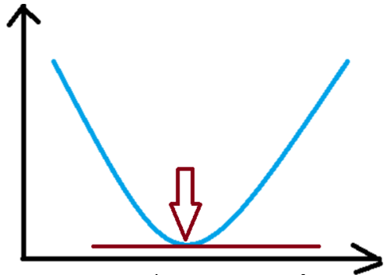
Gradient Descent
$$\min_{w, b}{loss function}$$
$$J(θ)$$
More formally,
$$\min_{θ}{J(θ)}$$
For scalar $θ$, the condition is
$$J^{′}\left(θ\right)= \frac{∂J}{∂θ}=0$$
For higher dimensional $θ$, the condition boils down to
$$J^{′}\left(θ\right)= ∇_{θ}J=0$$
$$⇒ \left[\frac{∂J}{∂θ_{1}},\frac{∂J}{∂θ_{2}}, …,\frac{∂J}{∂θ_{N}}\right]=0$$
$$⇒ \left[\begin{aligned}\frac{∂J}{∂θ_{1}} \\ \frac{∂J}{∂θ_{2}} \\ ⋮ \\ \frac{∂J}{∂θ_{N}}\end{aligned}\right]=\left[\begin{aligned}0 \\ 0 \\ ⋮ \\ 0\end{aligned}\right]$$
$$J^{′}\left(θ\right)=0$$
$$θ$$
Notes:
We are after those w and b which gives the minimum loss.

Slide 32
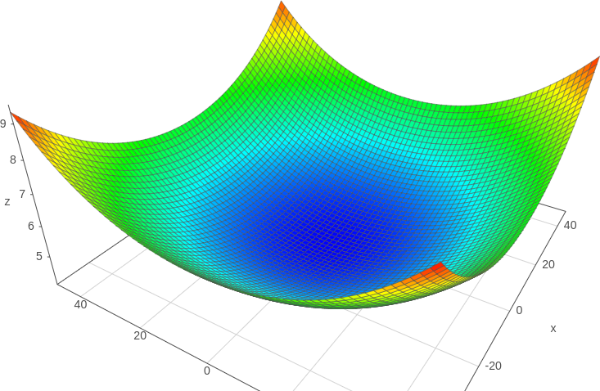
One Way to Find Minima – Gradient Descent
This is helpful but not always useful.
For example $J\left(θ\right)=\log{\sum_{i=1}^{m}{e^{(a_{i}^{T}θ+b_{i})}}}$ is a convex function with
clear minima, but finding analytical solution is not easy.
$$∇_{θ}J=0$$
$$⇒\frac{1}{\sum_{i=1}^{m}{e^{(a_{i}^{T}θ+b_{i})}}}\sum_{i=1}^{m}{e^{\left(a_{i}^{T}θ+b_{i}\right)}a_{i}}=0$$
$$⇒\sum_{i=1}^{m}{e^{\left(a_{i}^{T}θ+b_{i}\right)}a_{i}}=0$$
So, a numerical iterative solution is sought for.

Slide 33
One Way to Find Minima – Gradient Descent
Start with an initial guess $θ^{0}$
Repeatedly update $θ$ by taking a small step: $θ^{k}=θ^{k−1}+ηΔθ$ … (1)
so that $J(θ)$ gets smaller with each update i.e., $J\left(θ^{k}\right)≤J(θ^{k−1})$ … (2)
implies, $J\left(θ^{k}\right)=J\left(θ^{k−1}+ηΔθ\right)$
$=J\left(θ^{k−1}\right)+η{(Δθ)}^{T}J^{′}\left(θ^{k−1}\right)+h.o.t.$ [Using Taylor series expansion]
$≈J\left(θ^{k−1}\right)+η{(Δθ)}^{T}J^{′}\left(θ^{k−1}\right)$ [Neglecting $h.o.t.$] … (3)
Combining (2) and (3),
$η{(Δθ)}^{T}J^{′}\left(θ^{k−1}\right)≤0 i.e.,{(Δθ)}^{T}J^{′}\left(θ^{k−1}\right)≤0$ [as $η$ is positive]
So, for $θ$ to minimize $J\left(θ\right), i.e.,$ to satisfy (2) we have to choose some $Δθ$ that is negative when a dot product of it is done with the gradient $J^{′}\left(θ^{k−1}\right)$.
Then why not choose, $Δθ={−J}^{′}\left(θ^{k−1}\right)$ !!
Then,${(Δθ)}^{T}J^{′}\left(θ^{k−1}\right)={−||J^{′}\left(θ^{k−1}\right)||}^{2}$ surely is a negative quantity and satisfies the condition.

Slide 34
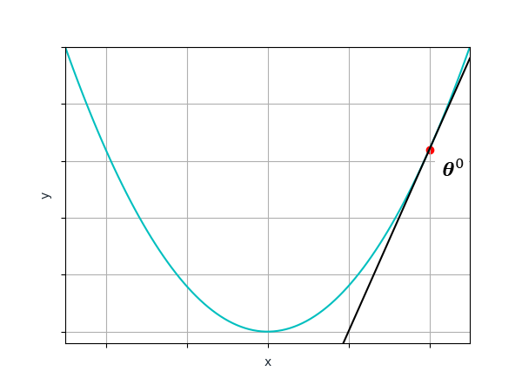
Gradient Descent
Start with an initial guess $θ^{0}$
Repeatedly update $θ$ by taking a small step: $θ^{k}=θ^{k−1}−ηJ^{′}\left(θ^{k−1}\right)$ until convergence ($J^{′}\left(θ^{k−1}\right)$ is very small)

Slide 35
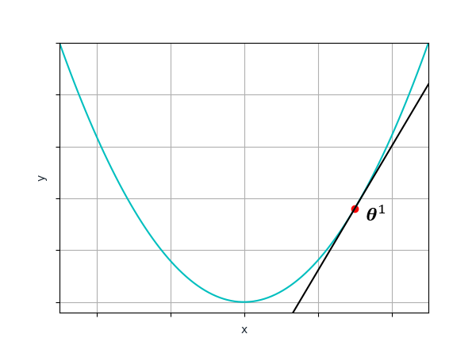
Gradient Descent
Start with an initial guess $θ^{0}$
Repeatedly update $θ$ by taking a small step: $θ^{k}=θ^{k−1}−ηJ^{′}\left(θ^{k−1}\right)$ until convergence ($J^{′}\left(θ^{k−1}\right)$ is very small)

Slide 36
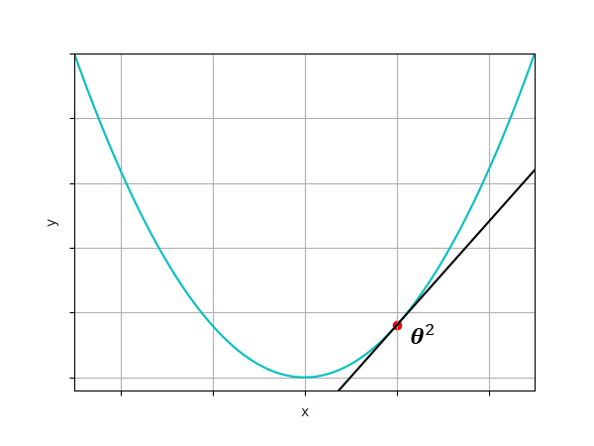
Gradient Descent
Start with an initial guess $θ^{0}$
Repeatedly update $θ$ by taking a small step: $θ^{k}=θ^{k−1}−ηJ^{′}\left(θ^{k−1}\right)$ until convergence ($J^{′}\left(θ^{k−1}\right)$ is very small)

Slide 37
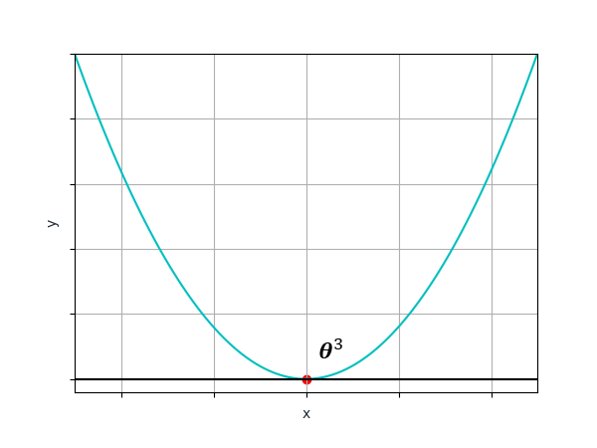
Gradient Descent
Start with an initial guess $θ^{0}$
Repeatedly update $θ$ by taking a small step: $θ^{k}=θ^{k−1}−ηJ^{′}\left(θ^{k−1}\right)$ until convergence ($J^{′}\left(θ^{k−1}\right)$ is very small)
Remember, in Neural Networks, the loss is computed by averaging the losses for all examples

Slide 38
But Imagine This
Adapted from Olivier Bousquet’s invited talk at NeurIPS 2018 after winning Test of Time Award for NIPS 2007 paper: “The Trade-Offs of Large Scale Learning” by Leon Bottou and Olivier Bousquet. Link of the talk.

Slide 39
Batch, Stochastic and Minibatch
Optimization algorithms that use the entire training set to compute the gradient are called batch or deterministic gradient methods. Ones that use a single training example for that task are called stochastic or online gradient methods
Most of the algorithms we use for deep learning fall somewhere in between!
These are called minibatch or minibatch stochastic methods

Slide 40
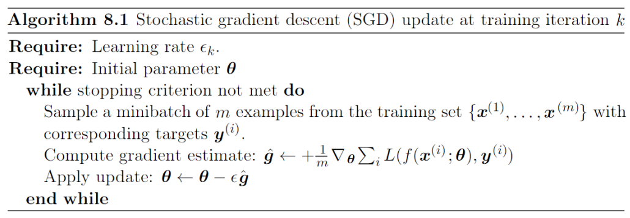
Batch, Stochastic and Mini-batch Stochastic Gradient Descent
Mini-batch
Images courtesy: Shubhendu Trivedi et. Al, Goodfellow et. al..

Slide 41
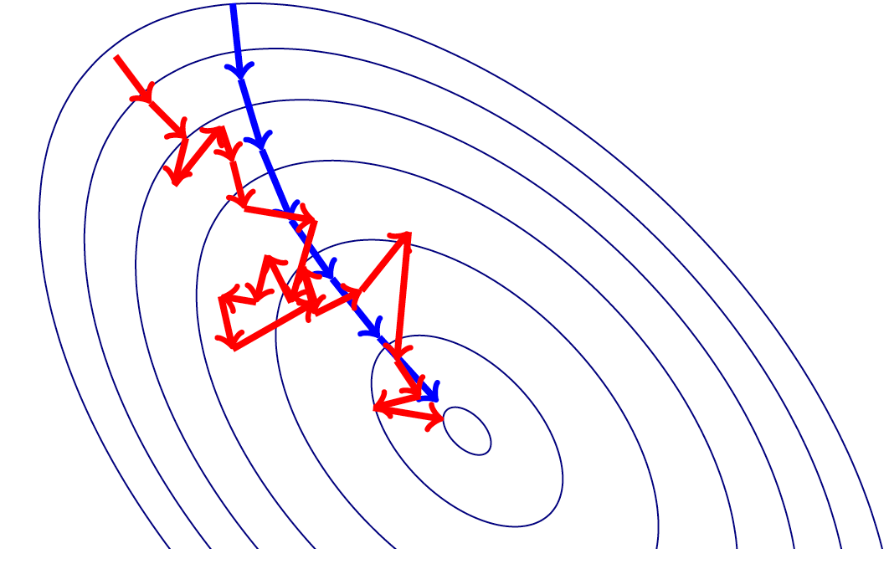
Batch and Stochastic Gradient Descent
Images courtesy: Shubhendu Trivedi et. al.

Slide 42
Images courtesy: Karpathy et. al.

Slide 43
Images courtesy: Karpathy et. al.

Slide 44
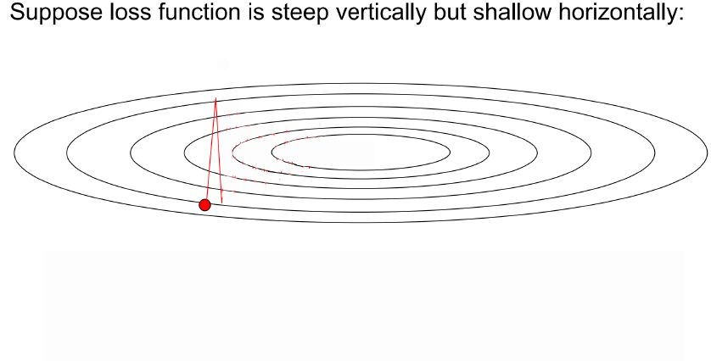

Slide 45
Gradient Descent: only one force acting at any point.

Slide 46
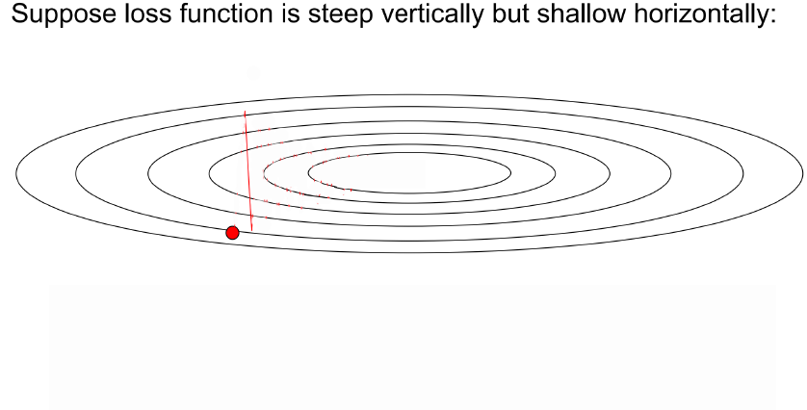
i)
Momentum at the point
Actual step
ii)
Negative of gradient at the point. (Would have reached here w/o momentum)
Momentum: Two forces acting at any point.
i) Momentum built up due to gradients pushing the particle at that point
ii) Gradient computed at that point

Slide 47
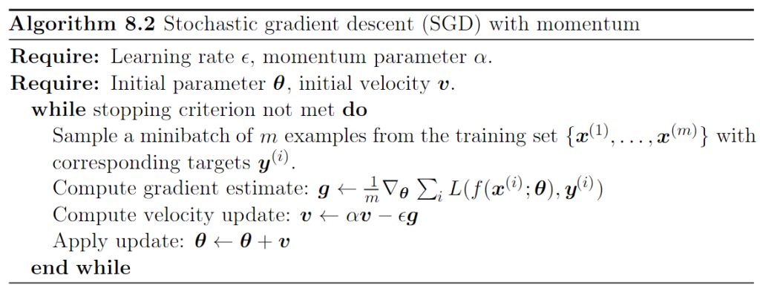
Stochastic Gradient Descent with Momentum
Momentum at the point
Actual step
Negative of gradient at the point. (Would have reached here w/o momentum)
Images courtesy: Goodfellow et. al.

Slide 48
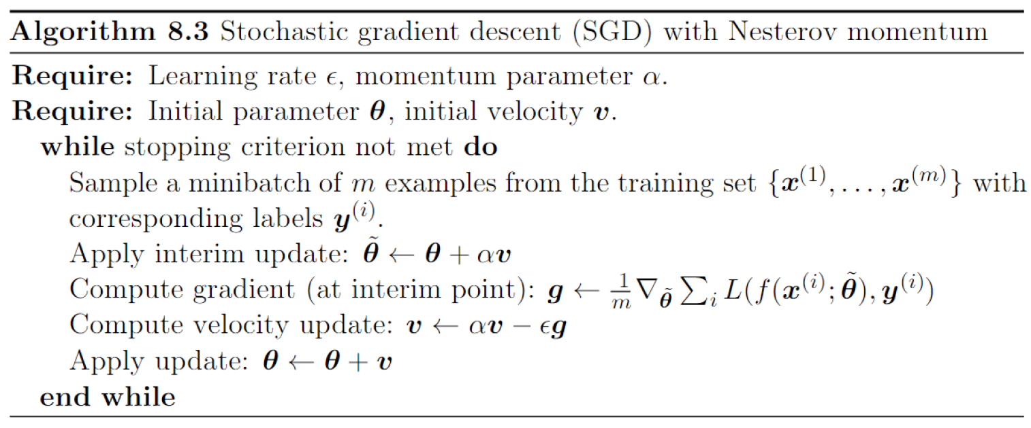
Nesterov Momentum
The difference between Nesterov momentum and standard momentum is where the gradient is evaluated.
With Nesterov momentum the gradient is evaluated after the current velocity is applied.
In practice, Nesterov momentum speeds up the convergence only for well behaved loss functions (convex with consistent curvature)
Images courtesy: Goodfellow et. al.

Slide 49
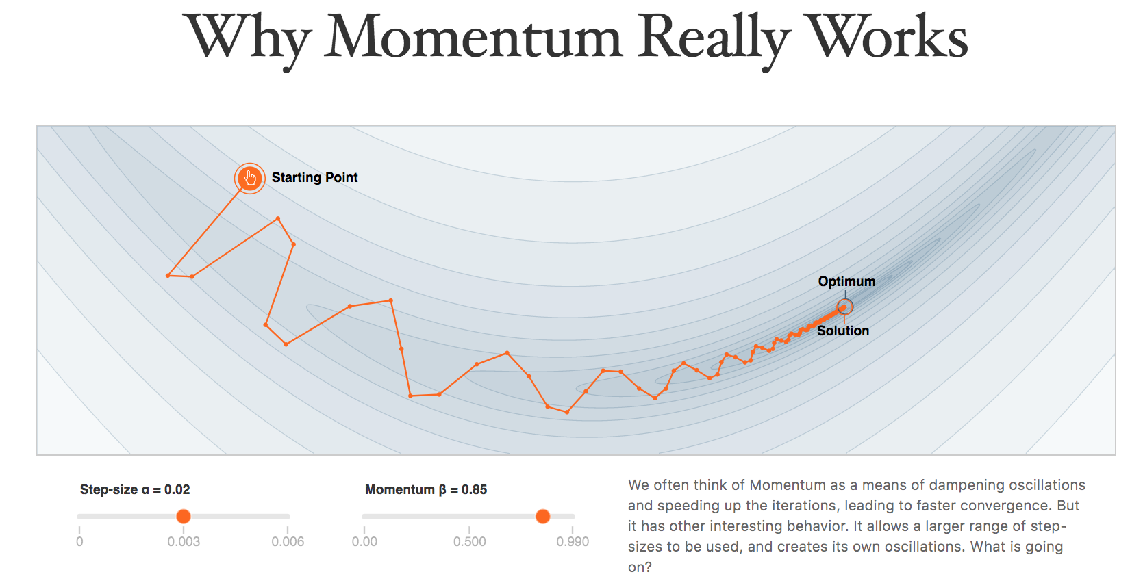
Distill Pub Article on Why Momentum Really Works

Slide 50
Adaptive Learning Rate Methods
Till now we assign the same learning rate in all directions.
Would it not be a good idea if we can move slowly in a steeper direction whereas move fast in a shallower direction?
Images courtesy: Karpathy et. al.

Slide 51
AdaGrad
Downscale learning rate by square-root of sum of squares of all the historical gradient values
Parameters that have large partial derivative of the loss – learning rates for them are rapidly declined
Images courtesy: Shubhendu Trivedi et. al.

Slide 52
AdaGrad
${\hat{g}}_{(1)}=\left[\begin{matrix}g_{\left(1\right),1} \\ g_{\left(1\right),2} \\ \begin{aligned}⋮ \\ g_{\left(1\right),d}\end{aligned}\end{matrix}\right]$, ${\hat{g}}_{(2)}=\left[\begin{matrix}g_{\left(2\right),1} \\ g_{\left(2\right),2} \\ \begin{aligned}⋮ \\ g_{\left(2\right),d}\end{aligned}\end{matrix}\right]$, …, ${\hat{g}}_{(t)}=\left[\begin{matrix}g_{\left(t\right),1} \\ g_{\left(t\right),2} \\ \begin{aligned}⋮ \\ g_{\left(t\right),d}\end{aligned}\end{matrix}\right]$
$r_{(1)}=\left[\begin{matrix}g_{\left(1\right),1}^{2} \\ g_{\left(1\right),2}^{2} \\ \begin{aligned}⋮ \\ g_{\left(1\right),d}^{2}\end{aligned}\end{matrix}\right]$, $r_{(2)}=\left[\begin{matrix}g_{\left(1\right),1}^{2}+g_{\left(2\right),1}^{2} \\ g_{\left(1\right),2}^{2}+g_{\left(2\right),2}^{2} \\ \begin{aligned}⋮ \\ g_{\left(1\right),d}^{2}+g_{\left(2\right),d}^{2}\end{aligned}\end{matrix}\right]$, …., $r_{(t)}=\left[\begin{matrix}g_{\left(1\right),1}^{2}+g_{\left(2\right),1}^{2}+…+g_{\left(t\right),1}^{2} \\ g_{\left(1\right),2}^{2}+g_{\left(2\right),2}^{2}+…+g_{\left(t\right),2}^{2} \\ \begin{aligned}⋮ \\ g_{\left(1\right),d}^{2}+g_{\left(2\right),d}^{2}+⋯+g_{\left(t\right),d}^{2}\end{aligned}\end{matrix}\right]$
$∆θ_{(t)}=−\left[\begin{matrix}\frac{ε{.g}_{\left(t\right),1}}{δ+ \sqrt{g_{\left(1\right),1}^{2}+g_{\left(2\right),1}^{2}+…+g_{\left(t\right),1}^{2}}} \\ \frac{ε{.g}_{\left(t\right),2}}{δ+ \sqrt{g_{\left(1\right),2}^{2}+g_{\left(2\right),2}^{2}+…+g_{\left(t\right),2}^{2}}} \\ \begin{aligned}⋮ \\ \frac{ε{.g}_{\left(t\right),d}}{δ+ \sqrt{g_{\left(1\right),d}^{2}+g_{\left(2\right),d}^{2}+…+g_{\left(t\right),d}^{2}}}\end{aligned}\end{matrix}\right]$

Slide 53
RMSProp
One problem of AdaGrad is that the ‘r’ vector continues to build up and grow its value.
This shrinks the learning rate too aggressively.
RMSProp strikes a balance by exponentially decaying contributions from past gradients.
Images courtesy: Shubhendu Trivedi et. al.

Slide 54
RMSProp
${\hat{g}}_{(1)}$, ${\hat{g}}_{(2)}$, …, ${\hat{g}}_{(t)}$ $r_{(t)}=ρr_{(t−1)}+(1−ρ){\hat{g}}_{(t)}⨀{\hat{g}}_{(t)}$
$r_{(0)}=0$
$r_{(1)}=ρr_{(0)}+\left(1−ρ\right){\hat{g}}_{\left(1\right)}⨀{\hat{g}}_{\left(1\right)}=\left(1−ρ\right){\hat{g}}_{\left(1\right)}⨀{\hat{g}}_{\left(1\right)}$
$r_{(2)}=ρr_{(1)}+\left(1−ρ\right){\hat{g}}_{\left(2\right)}⨀{\hat{g}}_{\left(2\right)}=ρ\left(1−ρ\right){\hat{g}}_{\left(1\right)}⨀{\hat{g}}_{\left(1\right)}+\left(1−ρ\right){\hat{g}}_{\left(2\right)}⨀{\hat{g}}_{\left(2\right)}$
$r_{(3)}=ρr_{(2)}+\left(1−ρ\right){\hat{g}}_{\left(3\right)}⨀{\hat{g}}_{\left(3\right)}=ρ^{2}\left(1−ρ\right){\hat{g}}_{\left(1\right)}⨀{\hat{g}}_{\left(1\right)}+ρ\left(1−ρ\right){\hat{g}}_{\left(2\right)}⨀{\hat{g}}_{\left(2\right)}+\left(1−ρ\right){\hat{g}}_{\left(3\right)}⨀{\hat{g}}_{\left(3\right)}$
RMSProp uses an exponentially decaying average to discard history from the extreme past so that the accumulation of gradients do not stall the learning.
AdaDelta is another variant where instead of exponentially decaying average, a moving window average of the past gradients is taken
Nesterov acceleration can also be applied to both these variants by computing the gradients at a ‘look ahead’ position (i.e., at a place where the momentum would have taken the parameters).

Slide 55
ADAM (Adaptive Moments)
Variant of the combination of RMSProp and Momentum.
Incorporates first order moment of the gradient which can be thought of as equivalent to taking advantage of the momentum strategy. Here momentum is also added with exponential averaging.
It also incorporates the second order term which can be thought of as the RMSProp like exponential averaging of the past gradients.
Both first and second moments are corrected for bias to account for their initialization to zero.

Slide 56
ADAM (Adaptive Moments)
Biased first order moment $s_{(t)}=ρ_{1}s_{(t−1)}+(1−ρ_{1})g_{t}$
Biased second order moment $r_{(t)}=ρ_{2}r_{(t−1)}+(1−ρ_{2})g_{t}⨀g_{t}$
Bias corrected first order moment ${\hat{s}}_{(t)}=\frac{s_{(t)}}{1−ρ_{1}}$
Bias corrected second order moment ${\hat{r}}_{(t)}=\frac{r_{(t)}}{1−ρ_{2}}$
Weight update $∆θ_{(t)}=−ε\frac{{\hat{s}}_{(t)}}{\sqrt{{\hat{r}}_{(t)}}+δ}$ (operations applied elementwise)

Slide 57
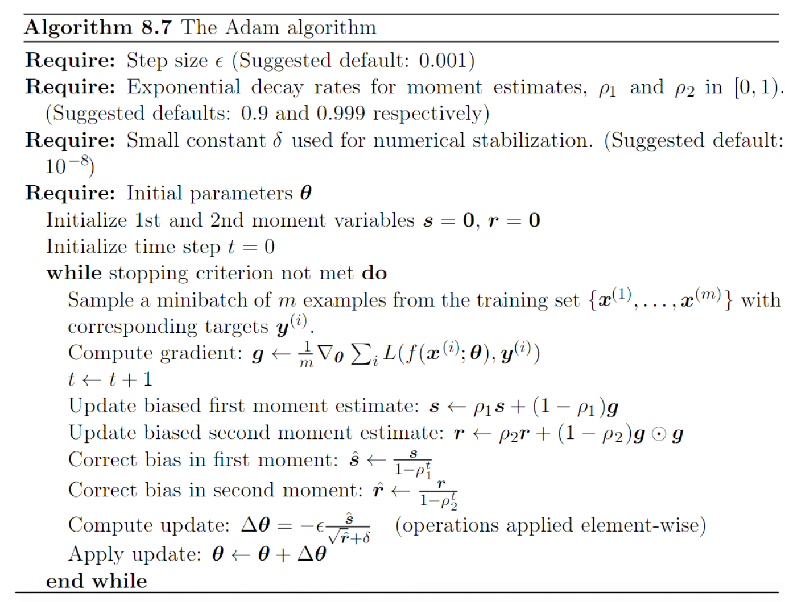
ADAM (Adaptive Moments)
Images courtesy: Shubhendu Trivedi et. al.

Slide 58
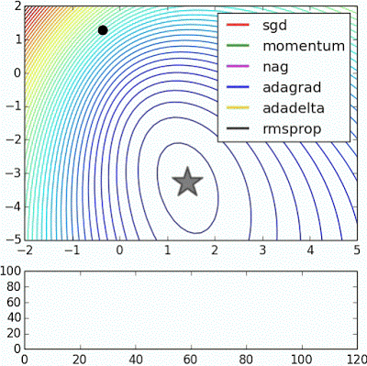
Visualization
Find more animations at
https://tinyurl.com/y6tkf4f8
animation courtesy: Alec Radford

Slide 59
Thank You!!

