Slide 1
Deep Learning
CS60010
Abir Das, Sudeshna Sarkar
Computer Science and Engineering Department
Indian Institute of Technology Kharagpur
http://cse.iitkgp.ac.in/~adas/
http://www.facweb.iitkgp.ac.in/~sudeshna/

Slide 2
Logistics
Course Name and code: Deep Learning, CS60010
Time: Monday (8:00-9:55 am), Tuesday (12:00-12:55 pm)
Venue: Online using MS Teams
Course website: http://cse.iitkgp.ac.in/~adas/courses/dl_spr2021/dl_spr2021.php

Slide 3
Logistics
Moodle Classroom: https://kgpmoodle.iitkgp.ac.in/moodle/course/view.php?id=1888 and then the class name is – Deep Learning (CS60010) - Spring 2021
Piazza Forum: https://piazza.com/iitkgp.ac.in/spring2021/cs60010/home
TAs: Ayan Maity (ayanmaity201@iitkgp.ac.in), K. Nikhil (nikhil.korra@iitkgp.ac.in), Potnuru Anusha (anusha.p@iitkgp.ac.in), S. Prashik Siddharth (prashiksahare110044@iitkgp.ac.in), Manish Chandra (manish.chandra@iitkgp.ac.in), Saptarshi Chatterjee (yoursapto@iitkgp.ac.in), Ishika Kakkar (ishikakakkar@iitkgp.ac.in)

Slide 4
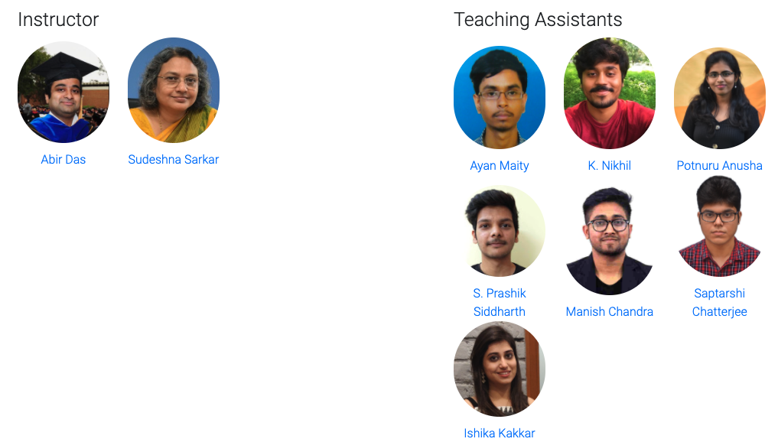
The Team
And YOU!!

Slide 5
Course Information
Prerequisites: 1. CS60050: Machine Learning
Python Proficiency: Proficiency in Python and familiarity with some Deep Learning tools (Tensorflow, Pytorch etc.) is desirable. A few links to get started.
  https://docs.python.org/3/tutorial/
  http://cs231n.github.io/python-numpy-tutorial/

Slide 6
Course Information
Books and References:
  “Deep Learning”, I Goodfellow, Y Bengio and A Courville, 1st Edition, Free link.
More references specific to the lectures will be added in the course website as and when needed.

Slide 7
Course Information
Online lectures/Videos: The following courses will be closely followed in this course
  Convolutional Neural Networks for Visual Recognition from Stanford University (Link)
  Deep Learning by Efstratios Gavves (Link)
  NPTEL Deep Learning by Prabir Kumar Biswas (Link)

Slide 8
Course Information
Evaluation: ClassTest (40%) – 4; Programing Assignments (50%) - 6; Paper presentation (10%). [Tentative]
  ClassTests and Programing Assignments:
    They will have a combination of Mathematical and coding problems.

Slide 9
Course Information
Evaluation: ClassTest (40%) – 4; Programing Assignments (50%) - 6; Paper presentation (10%). [Tentative]
  Paper presentation
    The whole class will be divided into 2 member teams. The team will be formed by the instructors and the TAs. Papers will be assigned to each team by the instructors and the TAs.
    The presentations will be outside class hours [possibly in the evening]. Exact dates will be announced later. The tentative start of paper presentations will be mid of February. The duration of each presentation will be 10 minutes (+ 2 minutes Q&A).
    Each team will have to present one paper during the whole semester.
    Some thumb-rules:
      10-12 slides in total, divide the presentation in problem definition (if required provide importance of the problem), approach (if you can motivate why the approach is good/novel it will be great), Results and what could have been done extra according to you.

Slide 10
Course Information
Evaluation: ClassTest (40%) – 4; Programing Assignments (50%) - 6; Paper presentation (10%). [Tentative]
  Paper presentation – Why are we doing this?
    Deep Learning is a rapidly evolving field. Everyday new papers are coming out. Just check ArXiv and see (especially just after the paper submission deadlines of reputed conferences. We will see what are some good conferences in fields related to Deep Learning in a few slides).
    Some of them are good, some are bad. If we divide and conquer the task of reading papers everybody will be benefitted.
    Papers are BIIIIG things. How do I get started?
    Fantastic tips by Andrew Ng. [Link] (First 30 minutes)

Slide 11
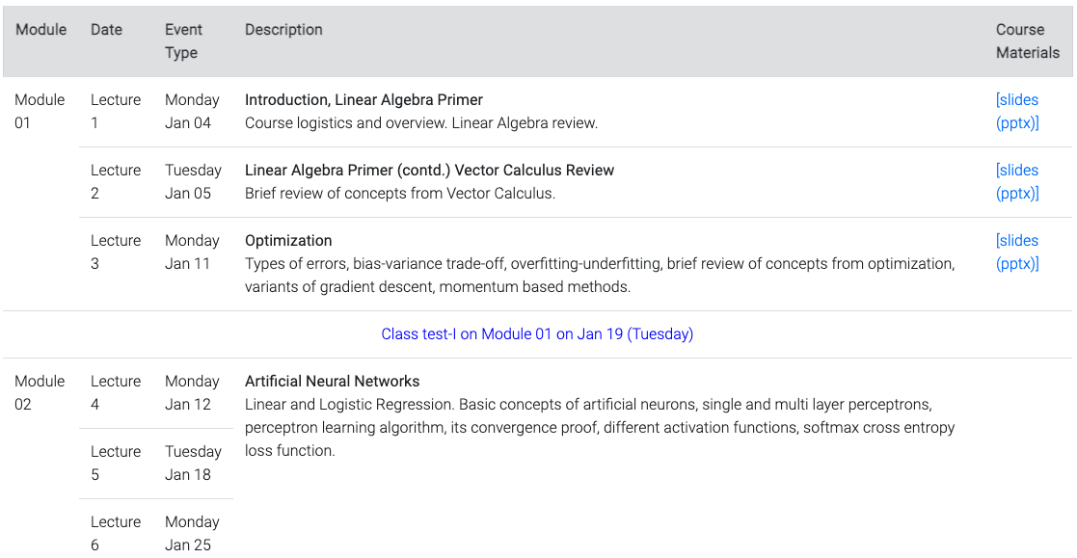
Course Information
Tentative syllabus and schedule: A tentative schedule is posted in the website - http://cse.iitkgp.ac.in/~adas/courses/dl_spr2021/syllabus.html

Slide 12
What about Computing Resources
We are encouraging you to use Google Colab.
Homeworks can be done in your PC and Google Colab (free to use)
We are planning to arrange tutorial session to get you started on Colab and some basics of python.

Slide 13
Computer Vision Conferences
CVPR – Computer Vision and Pattern Recognition, since 1983. Held in USA (2023 is scheduled to be held in Vancouver, first time outside USA)
  Google Scholar h-5 index, 2020 – 299 (Top 5 across any field, any conference or journal)
ICCV – International Conference on Computer Vision, since 1987. Held every other year, across the world.
  Google Scholar h-5 index, 2020 – 176
ECCV - European Conference on Computer Vision, since 1990. Held every other year, in Europe.
  Google Scholar h-5 index, 2020 – 144
Organized under the banner of CVF (Computer Vision Foundation) - Link

Slide 14
Computer Vision Conferences
ACCV – Asian Conference on Computer Vision
BMVC – British Machine Vision Conference
ICIP - International Conference on Image Processing
WACV - Workshop on Applications of Computer Vision
ICPR - International Conference on Pattern Recognition
ICVGIP – Indian Conference on Computer Vision, Graphics and Image Processing
NCVPRIPG - National Conference on Computer Vision, Pattern Recognition, Image Processing and Graphics

Slide 15
Computer Vision Journals
PAMI – IEEE Transactions on Pattern Analysis and Machine Intelligence
  Google Scholar h-5 index, 2020 – 131
  Impact Factor, 2020 – 17.86
TIP - IEEE Transactions on Image Processing
  Google Scholar h-5 index, 2020 – 113
  Impact Factor, 2020 – 9.34
IJCV - International Journal of Computer Vision
  Google Scholar h-5 index, 2020 – 70
  Impact Factor, 2020 – 6.071

Slide 16
Conferences in Other Application Areas
NeurIPS – Neural Information Processing Systems
  Google Scholar h-5 index, 2020 – 198 (Top 30 across any field, any conference or journal)
MICCAI – Medical Image Computing and Computer-Assisted Intervention
ICLR - International Conference on Learning Representations
  Google Scholar h-5 index, 2020 – 203 (Started in 2013)
ICML – International Conference on Machine Learning
  Google Scholar h-5 index, 2020 –171
ACL, EMNLP – Conferences in Natural Language Processing.
  Google Scholar h-5 index, 2020 – 135 [ACL], 112 [EMNLP]
IJCAI, AAAI, NAACL, FAT-ML, ACM-MM, ICRA

Slide 17
Journals Other Application Areas
TMM – IEEE Transactions on Multimedia
  Google Scholar h-5 index, 2020– 73
  Impact Factor, 2020 – 6.051
JMLR - Journal of Machine Learning Research
  Google Scholar h-5 index, 2020 – 82
  Impact Factor, 2020 – 4.091
KDE- IEEE Transactions on Knowledge and Data Engineering
  Google Scholar h-5 index, 2020 – 81
  Impact Factor, 2020 – 4.935
TCSVT, CVIU, IJRR

Slide 18
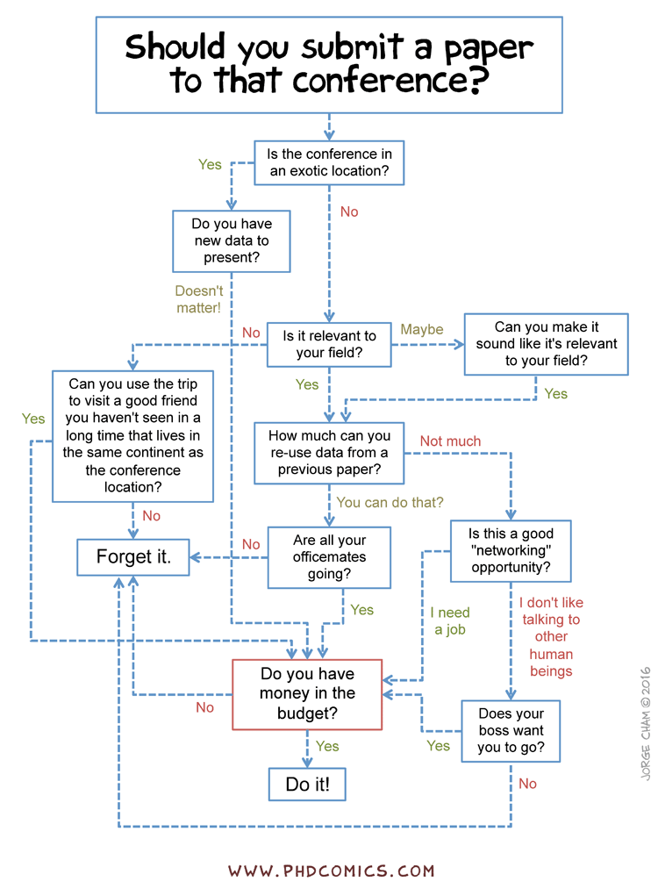
Decide Where to Submit
Taken from phdcomics

Slide 19
The Decision Process: Overview
Program Chairs
8. Program chairs finalize oral decisions based on space/time constraints
1. PCs assign papers to ACs
7. Area chairs discuss with reviewers and each other, make accept/reject decisions and oral recommendations
Primary Area Chair
Secondary Area Chair
2. Primary AC suggests reviewers
Authors
5. Authors provide rebuttal to reviewers and ACs
3. Papers are assigned to reviewers using global matching algorithm
6. Reviewers update final reviews
4. Reviewers write reviews, which are released to authors (after AC checking for quality)
Reviewers
Taken from CVPR 2020 Reviewer guidelines

Slide 20

How to Write a Good Paper
Youtube Link

Slide 21
Thank You!!

