Slide 1
Deep Learning
CS60010
Abir Das
Assistant Professor
Computer Science and Engineering Department
Indian Institute of Technology Kharagpur
http://cse.iitkgp.ac.in/~adas/

Slide 2
Some Logistics Related Announcements
Homework 1 will be up tomorrow. Set up your moodle account.
  Go to https://10.5.18.110/moodle/ and look for the course - Deep Learning (Spring 2020)
  The enrollment key is provided in Piazza
  You must put your Roll Number in your profile. Instruction is in Piazza.
The google form for submitting project group information and abstract is up (Check Piazza). The deadline is Friday Jan 31st, 11:59 pm.
  The link to the Piazza post – https://piazza.com/class/k4viwh96gqm2sa?cid=11
  The link to the Google form – https://forms.gle/erATFN5AcuDZiLxB6
  Use this form to let us know if you did not get Piazza invitation

Slide 3
Some Logistics Related Announcements
The schedule of paper presentations are now in course website (Check Piazza).
  The link to the Piazza post – https://piazza.com/class/k4viwh96gqm2sa?cid=10
  The link to the presentation schedule – Go to course homepage and click on `Student Presentation Schedule’
Today the class will be of 1.5 Hours
From next week – 12:55-1:15 on Thursdays will have extra paper presentations

Slide 4
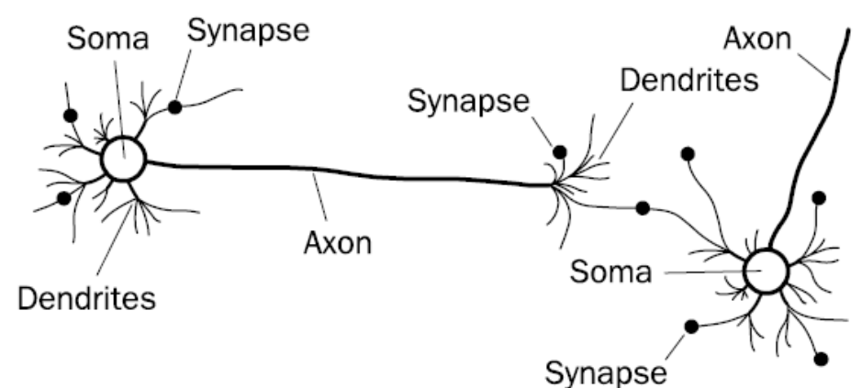
Biological Neural Network
Image courtesy: F. A. Makinde et. al., “Prediction of crude oil viscosity using feed-forward back-propagation neural network (FFBPNN)”." Petroleum & Coal 2012

Slide 5


Slide 6



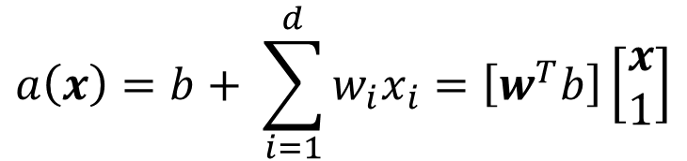



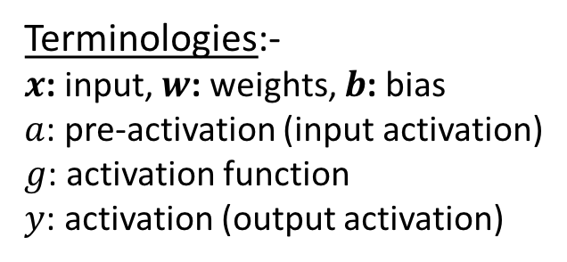








Artificial Neuron
$$w={\left[w_{1} w_{2}…w_{d}\right]}^{T}$$
and
$$x={\left[x_{1} x_{2}…x_{d}\right]}^{T}$$
$$x_{1}$$
$$a\left(x\right)=b+ \sum_{i=1}^{d}{w_{i}x_{i}}=\left[w^{T}b\right]\left[\begin{matrix}x \\ 1\end{matrix}\right]$$
$$w_{1}$$
$$w_{2}$$
$$a(x)$$
$$x_{2}$$
$$g(a)$$
$$y$$
$$y=g(a\left(x\right))$$
$$W_{0}=b$$
$$x_{d}$$
$$w_{d}$$
Terminologies:-
$x$: input, $w$: weights, $b$: bias
$a$: pre-activation (input activation)
$g$: activation function
$y$: activation (output activation)
$$1$$

Slide 7

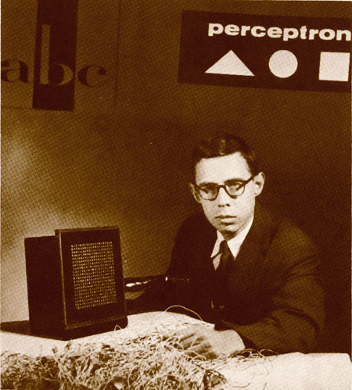
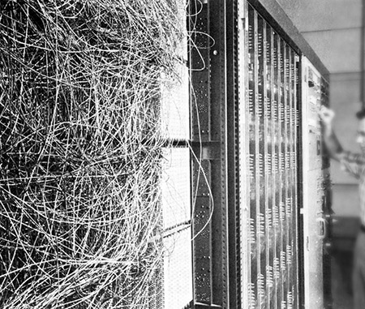
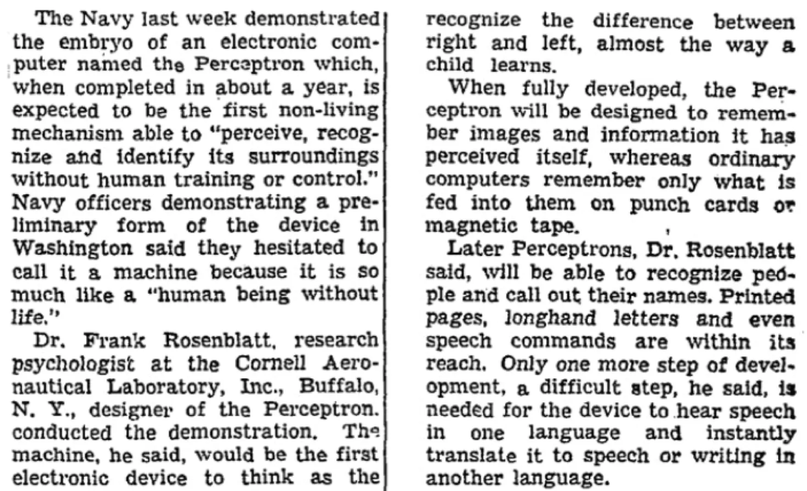
Perceptron
Image courtesy: https://blogs.umass.edu/comphon/2017/06/15/did-frank-rosenblatt-invent-deep-learning-in-1962/

Slide 8
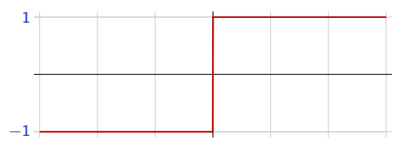


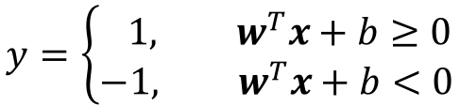


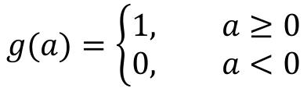
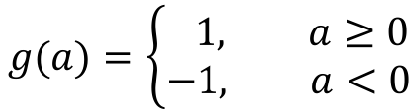
Perceptron
$x∈ℝ^{d}$ and $y∈\{0, 1\}$ – Binary Classification
$$g(a)=\left\{\begin{aligned}1, a≥0 \\ &0, a<0\end{aligned}\right.$$
(Rosenblatt, 1957)
$$x_{1}$$
$$w_{1}$$
$$w_{2}$$
To make things simpler, the response is taken as $y∈\{−1, 1\}$
$$a(x)$$
$$x_{2}$$
$$g(a)$$
$$y$$
$$g(a)=\left\{\begin{aligned} 1, a≥0 \\ &−1, a<0\end{aligned}\right.$$
$$g(a)$$
$$W_{0}=b$$
$$a$$
$$x_{d}$$
$$w_{d}$$
The perceptron classification rule, thus, translates to
$$1$$
$$y=\left\{\begin{aligned} 1, w^{T}x+b≥0 \\ &−1, w^{T}x+b<0\end{aligned}\right.$$
Remember: $w^{T}x+b=0$ represents
a hyperplane.

Slide 9
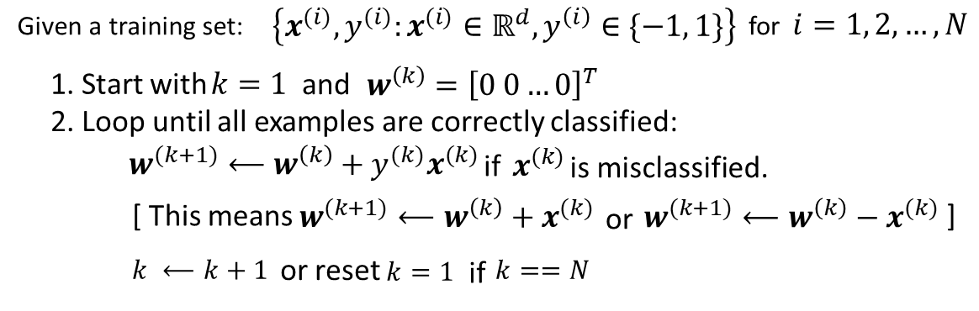
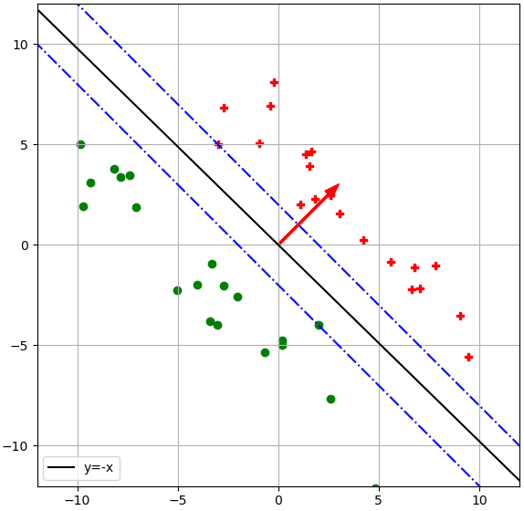
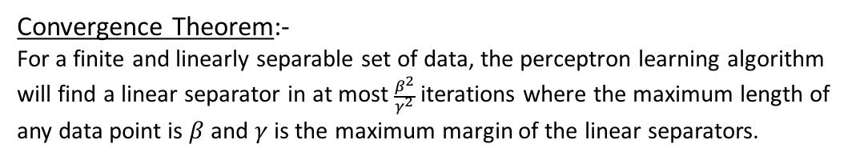


Perceptron Learning Algorithm
$$γ$$
$$β$$
Convergence Theorem:-
For a finite and linearly separable set of data, the perceptron learning algorithm will find a linear separator in at most $\frac{β^{2}}{γ^{2}}$ iterations where the maximum length of any data point is $β$ and $γ$ is the maximum margin of the linear separators.

Slide 10
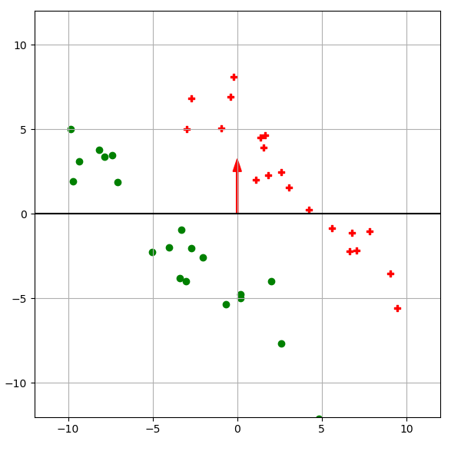
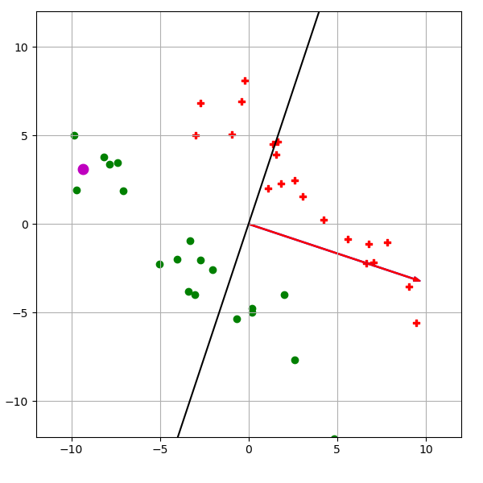
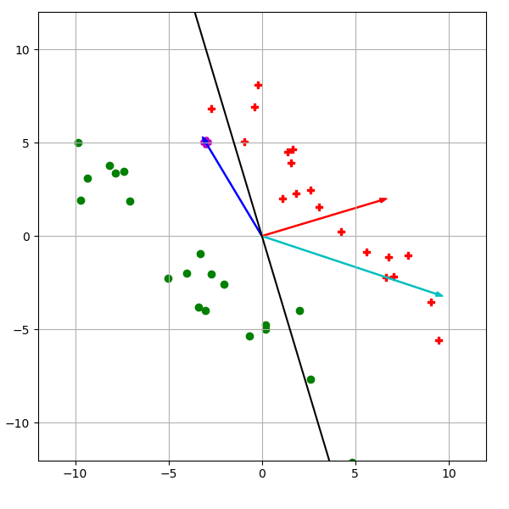
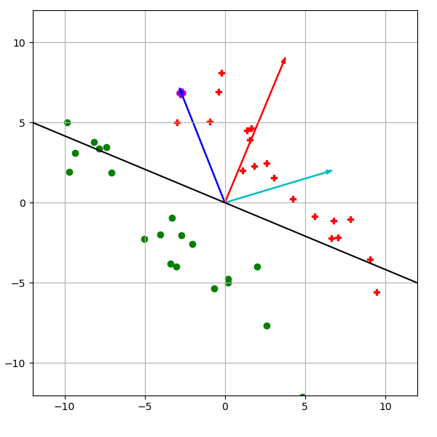
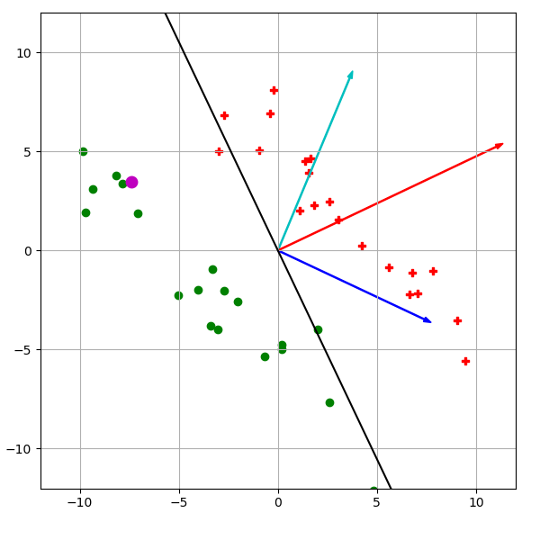
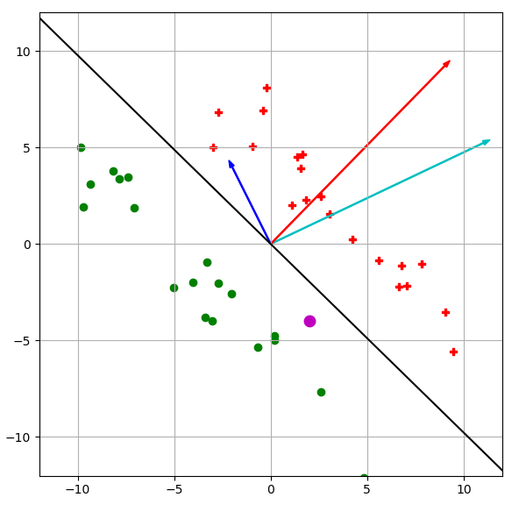

Slide 11




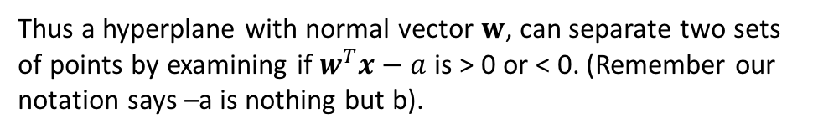
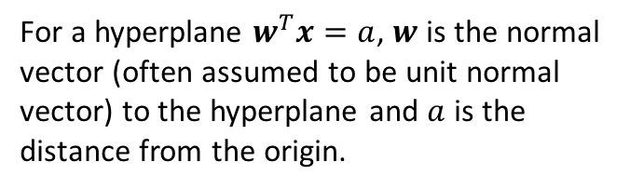















Perceptron Learning Algorithm – Convergence Proof
Some Important Brush-ups:-
$$x^{(1)}$$
$$x^{(1)}$$
$$x^{(1)}$$
$$x^{(2)}$$
$$w$$
$$x^{(2)}$$
$$w$$
$$x^{(2)}$$
$$w$$
$$x^{(3)}$$
$$x^{(3)}$$
$$x^{(3)}$$
$$>a$$
$$a$$
$$<a$$
$$(0,0)$$
$$(0,0)$$
$$(0,0)$$
$$w^{T}x=a$$
$$w^{T}x=a$$
$$w^{T}x=a$$
For a hyperplane $w^{T}x=a$, $w$ is the normal vector (often assumed to be unit normal vector) to the hyperplane and $a$ is the distance from the origin.
Thus a hyperplane with normal vector $w$, can separate two sets of points by examining if $w^{T}x−a$ is > 0 or < 0. (Remember our notation says –a is nothing but b).

Slide 12
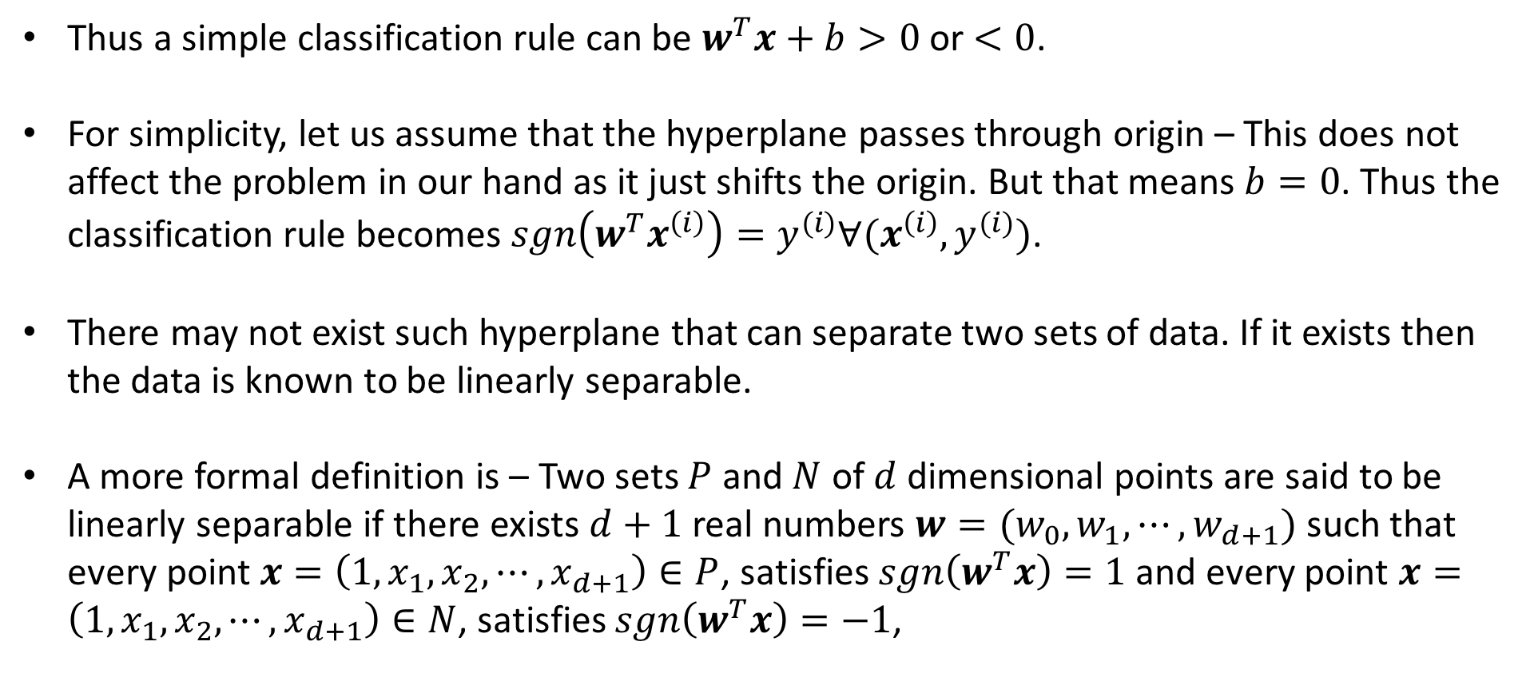
Perceptron Learning Algorithm – Convergence Proof
Thus a simple classification rule can be $w^{T}x+b>0$ or $<0$.
For simplicity, let us assume that the hyperplane passes through origin – This does not affect the problem in our hand as it just shifts the origin. But that means $b=0$. Thus the classification rule becomes $sgn\left(w^{T}x^{\left(i\right)}\right)=y^{(i)}∀(x^{\left(i\right)},y^{(i)})$.
There may not exist such hyperplane that can separate two sets of data. If it exists then the data is known to be linearly separable.
A more formal definition is – Two sets $P$ and $N$ of $d$ dimensional points are said to be linearly separable if there exists $d+1$ real numbers ${w=(w}_{0},w_{1}, ⋯, w_{d+1})$ such that every point $x=\left(1,x_{1}, x_{2},⋯, x_{d+1}\right)∈P$, satisfies $sgn\left(w^{T}x\right)=1$ and every point $x=\left(1,x_{1}, x_{2},⋯, x_{d+1}\right)∈N$, satisfies $sgn\left(w^{T}x\right)=−1$,

Slide 13
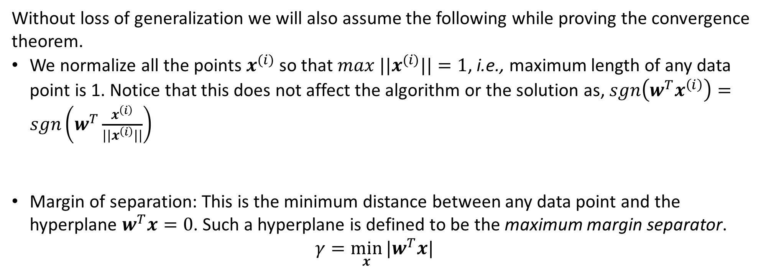
Perceptron Learning Algorithm – Convergence Proof
Without loss of generalization we will also assume the following while proving the convergence theorem.
We normalize all the points $x^{(i)}$ so that ${max ||x}^{(i)}||=1$, i.e., maximum length of any data point is 1. Notice that this does not affect the algorithm or the solution as, $sgn\left(w^{T}x^{\left(i\right)}\right)=sgn\left(w^{T}\frac{x^{\left(i\right)}}{||x^{\left(i\right)}||}\right)$
Margin of separation: This is the minimum distance between any data point and the hyperplane $w^{T}x=0$. Such a hyperplane is defined to be the maximum margin separator.
$γ=\min_{x}{|w^{T}x|}$

Slide 14
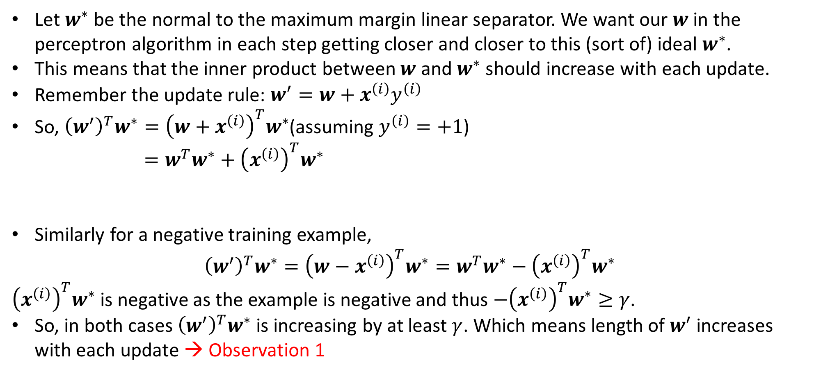


Perceptron Learning Algorithm – Convergence Proof
Let $w^{∗}$ be the normal to the maximum margin linear separator. We want our $w$ in the perceptron algorithm in each step getting closer and closer to this (sort of) ideal $w^{∗}$.
This means that the inner product between $w$ and $w^{∗}$ should increase with each update.
Remember the update rule: $w^{′}=w+x^{\left(i\right)}y^{\left(i\right)}$
So, ${\left(w^{′}\right)}^{T}w^{∗}={\left(w+x^{\left(i\right)}\right)}^{T}w^{∗}$(assuming $y^{\left(i\right)}=+1$)
$=w^{T}w^{∗}+{\left(x^{\left(i\right)}\right)}^{T}w^{∗}$
Similarly for a negative training example,
$${\left(w^{′}\right)}^{T}w^{∗}={\left(w−x^{\left(i\right)}\right)}^{T}w^{∗}=w^{T}w^{∗}−{\left(x^{\left(i\right)}\right)}^{T}w^{∗}$$
${\left(x^{\left(i\right)}\right)}^{T}w^{∗}$ is negative as the example is negative and thus $−{\left(x^{\left(i\right)}\right)}^{T}w^{∗}≥γ$.
So, in both cases ${\left(w^{′}\right)}^{T}w^{∗}$ is increasing by at least $γ$. Which means length of $w^{′}$ increases with each update → Observation 1
Previous $w^{T}w^{∗}$
This is at least $γ$

Slide 15
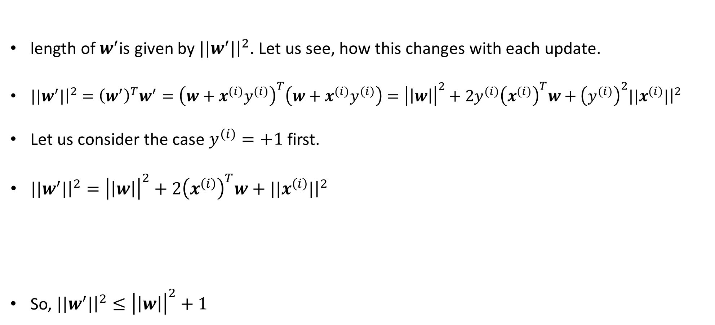
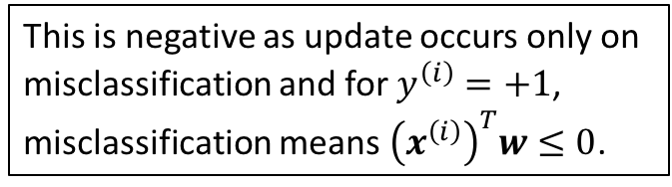
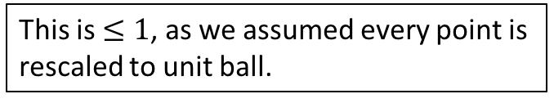
Perceptron Learning Algorithm – Convergence Proof
length of $w^{′}$is given by ${||w}^{′}|{\left.​\right|}^{2}$. Let us see, how this changes with each update.
${||w}^{′}|{\left.​\right|}^{2}={\left(w^{′}\right)}^{T}w^{′}={\left(w+x^{\left(i\right)}y^{\left(i\right)}\right)}^{T}\left(w+x^{\left(i\right)}y^{\left(i\right)}\right)={\left|\left|w\right|\right|}^{2}+2y^{\left(i\right)}{\left(x^{\left(i\right)}\right)}^{T}w+{\left(y^{\left(i\right)}\right)}^{2}{||x}^{\left(i\right)}|{\left.​\right|}^{2}$
Let us consider the case $y^{\left(i\right)}=+1$ first.
${||w}^{′}|{\left.​\right|}^{2}={\left|\left|w\right|\right|}^{2}+2{\left(x^{\left(i\right)}\right)}^{T}w+{||x}^{\left(i\right)}|{\left.​\right|}^{2}$
So, ${||w}^{′}|{\left.​\right|}^{2}≤{\left|\left|w\right|\right|}^{2}+1$
This is negative as update occurs only on misclassification and for $y^{\left(i\right)}=+1$, misclassification means ${\left(x^{\left(i\right)}\right)}^{T}w≤0$.
This is $≤1$, as we assumed every point is rescaled to unit ball.

Slide 16
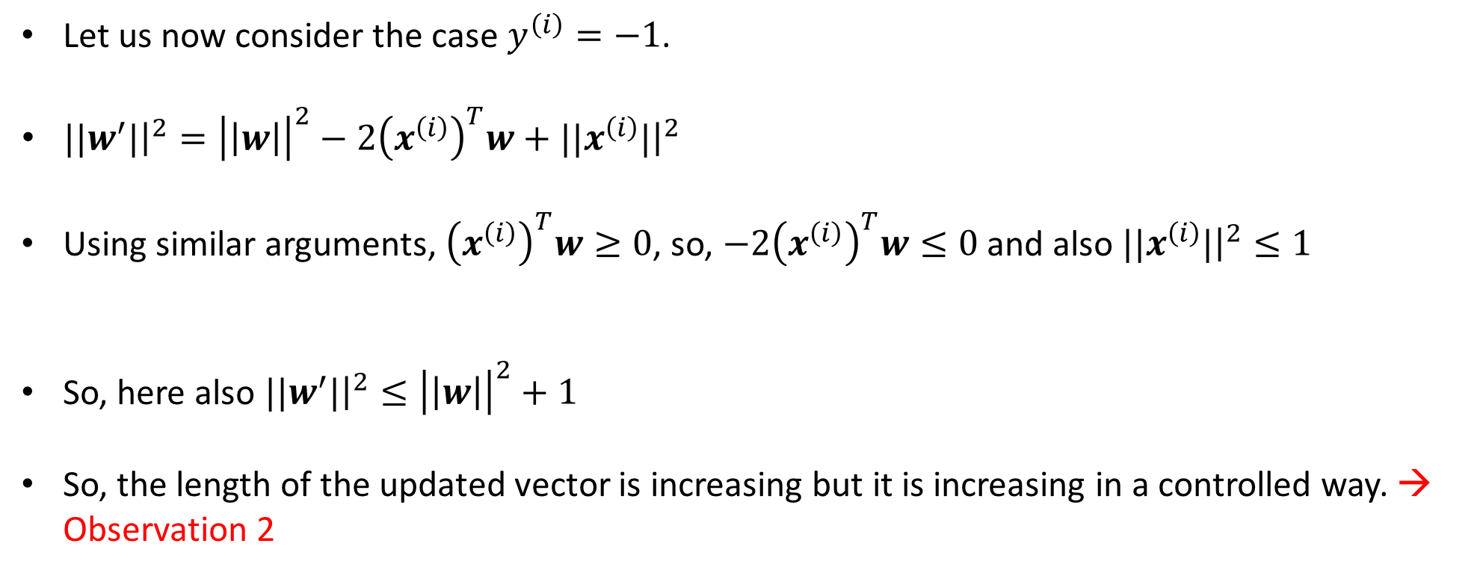
Perceptron Learning Algorithm – Convergence Proof
Let us now consider the case $y^{\left(i\right)}=−1$.
${||w}^{′}|{\left.​\right|}^{2}={\left|\left|w\right|\right|}^{2}−2{\left(x^{\left(i\right)}\right)}^{T}w+{||x}^{\left(i\right)}|{\left.​\right|}^{2}$
Using similar arguments, ${\left(x^{\left(i\right)}\right)}^{T}w≥0$, so, $−2{\left(x^{\left(i\right)}\right)}^{T}w≤0$ and also ${||x}^{\left(i\right)}|{\left.​\right|}^{2}≤1$
So, here also ${||w}^{′}|{\left.​\right|}^{2}≤{\left|\left|w\right|\right|}^{2}+1$
So, the length of the updated vector is increasing but it is increasing in a controlled way. → Observation 2

Slide 17
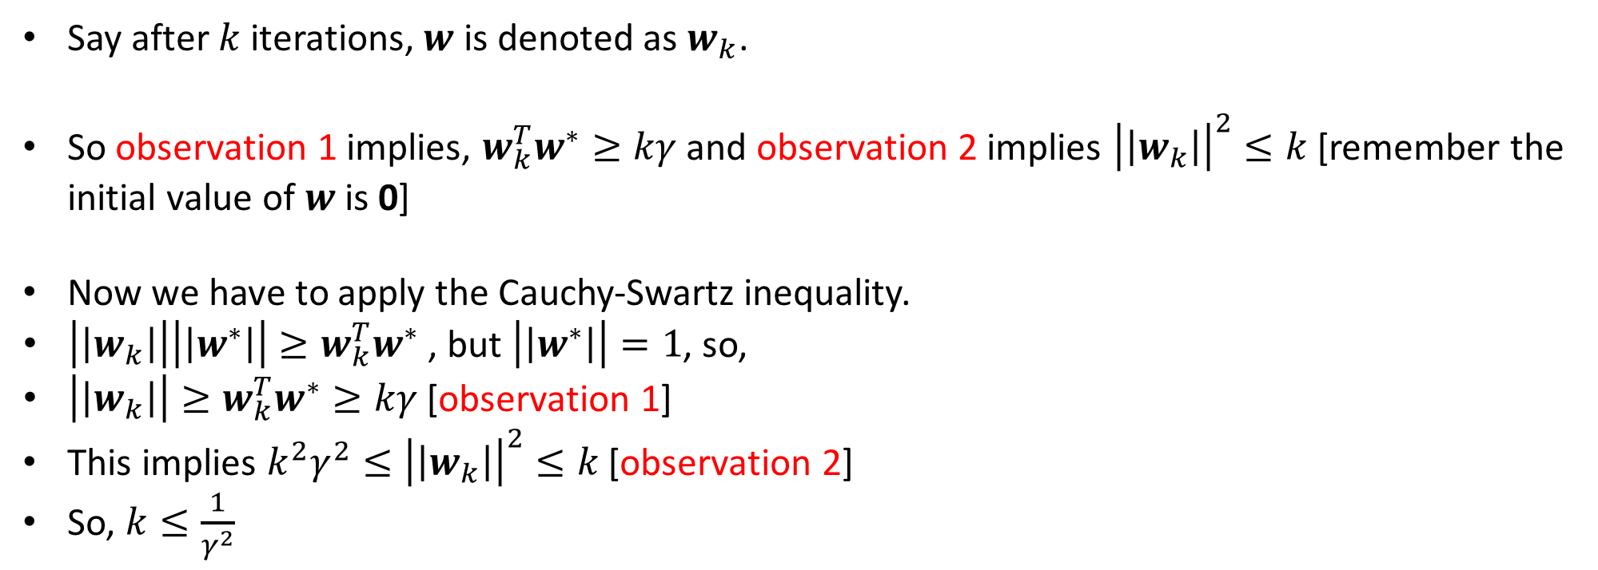
Perceptron Learning Algorithm – Convergence Proof
Say after $k$ iterations, $w$ is denoted as $w_{k}$.
So observation 1 implies, $w_{k}^{T}w^{∗}≥kγ$ and observation 2 implies ${\left|\left|w_{k}\right|\right|}^{2}≤k$ [remember the initial value of $w$ is 0]
Now we have to apply the Cauchy-Swartz inequality.
$\left|\left|w_{k}\right|\right|\left|\left|w^{∗}\right|\right|≥w_{k}^{T}w^{∗}$ , but $\left|\left|w^{∗}\right|\right|=1$, so,
$\left|\left|w_{k}\right|\right|≥w_{k}^{T}w^{∗}≥kγ$ [observation 1]
This implies $k^{2}γ^{2}≤{\left|\left|w_{k}\right|\right|}^{2}≤k$ [observation 2]
So, $k≤\frac{1}{γ^{2}}$

Slide 18
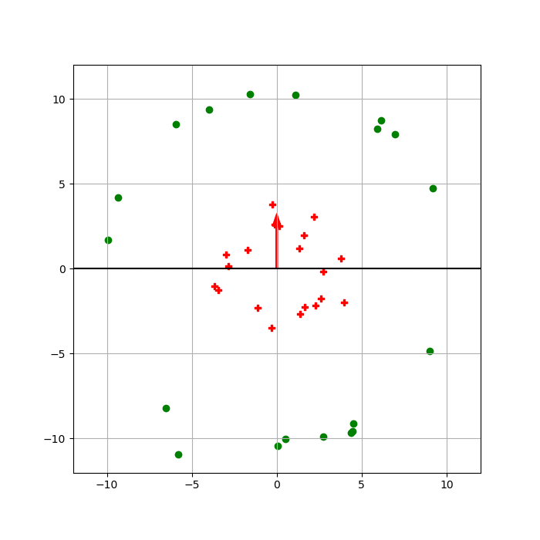

Slide 19
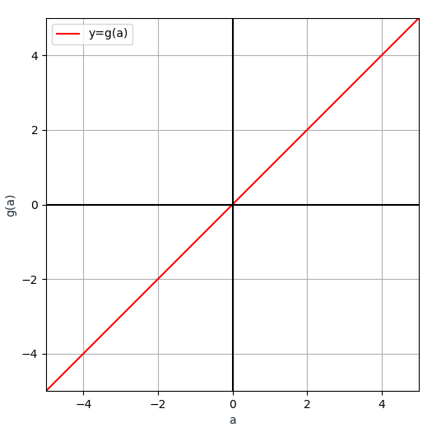
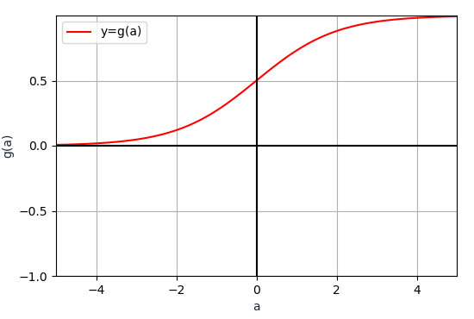
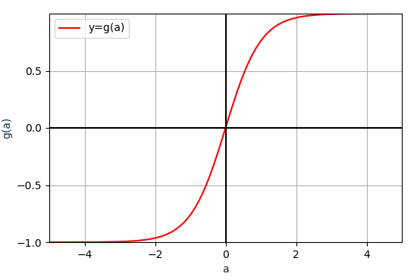
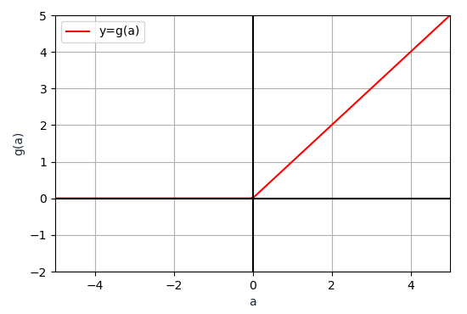
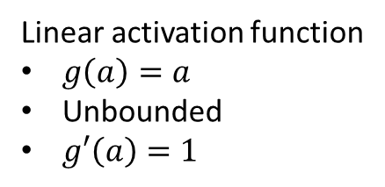
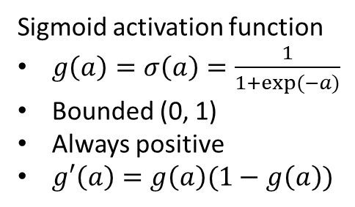
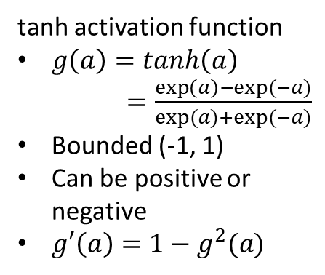
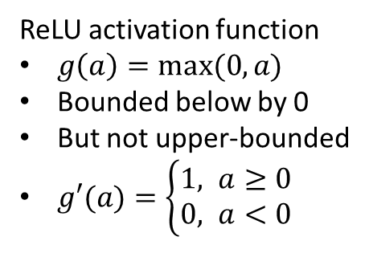
Popular Choices of Activation Functions
Linear activation function
$g\left(a\right)=a$
Unbounded
$g′\left(a\right)=1$
Sigmoid activation function
$g\left(a\right)=σ\left(a\right)=\frac{1}{1+exp⁡(−a)}$
Bounded (0, 1)
Always positive
$g′\left(a\right)=g\left(a\right)(1−g\left(a\right))$
tanh activation function
$g\left(a\right)=tanh\left(a\right)$
$=\frac{\exp\left(a\right)−exp⁡(−a)}{exp⁡(a)+exp⁡(−a)}$
Bounded (-1, 1)
Can be positive or
negative
$g′\left(a\right)=1−g^{2}(a)$
ReLU activation function
$g\left(a\right)=max⁡(0,a)$
Bounded below by 0
But not upper-bounded
$g′(a)=\left\{\begin{aligned}1, a≥0 \\ &0, a<0\end{aligned}\right.$

Slide 20






















Multilayer Neural Network
$$x_{1}$$
$$w_{1}$$
$$x_{1}$$
$$w_{1}$$
$$w_{2}$$
$$a(x)$$
$$w_{2}$$
$$x_{2}$$
$$g(a)$$
$$y$$
$$x_{2}$$
$$y$$
$$g(a)$$
$$W_{0}=b$$
$$W_{0}=b$$
$$x_{d}$$
$$w_{d}$$
$$x_{d}$$
$$w_{d}$$
$$1$$
$$1$$
A bit of notation change

Slide 21


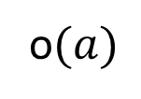








Input Layer
Hidden Layer
Multilayer Neural Network
$$x_{1}$$
$$1$$
$$x_{2}$$
$$g(a)$$
$$1$$
Output Layer
Intuition:-
Hidden Layer: Extracts better representation of the input data
Output layer: Does the classification
$$x_{d}$$
$$y$$
$$g(a)$$
o$(a)$
$$1$$
$$g(a)$$

Slide 22


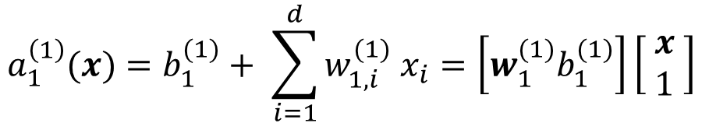






Input Layer
Hidden Layer
Multilayer Neural Network
$$x_{1}$$
$$w_{1,1}^{(1)}$$
$$1$$
$$a_{1}^{\left(1\right)}(x)=b_{1}^{(1)}+ \sum_{i=1}^{d}{w_{1,i}^{(1)} x_{i}}=\left[w_{1}^{(1)}b_{1}^{(1)}\right]\left[\begin{matrix} x \\ 1 \end{matrix}\right]$$
$$w_{1,0}^{(1)}=b_{1}^{(1)}$$
$$x_{2}$$
$$w_{1,2}^{(1)}$$
$$h_{1}^{(1)}$$
$$g(a)$$
Row vector
$$\left[w_{1, 1}^{(1)},w_{1, 2}^{(1)}, ⋯,w_{1, d}^{(1)}\right]$$
Column vector
$${\left[x_{1} x_{2}…x_{d}\right]}^{T}$$
$$h_{1}^{(1)}=g\left(a_{1}^{\left(1\right)}\left(x\right)\right)$$
$$x_{d}$$
$$w_{1,d}^{(1)}$$

Slide 23


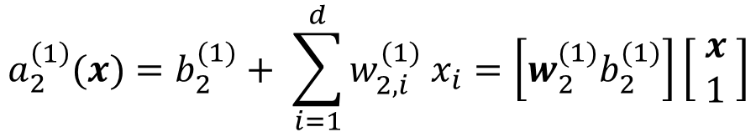












Input Layer
Hidden Layer
Multilayer Neural Network
$$x_{1}$$
$$w_{1,1}^{(1)}$$
$$1$$
$$a_{1}^{\left(1\right)}(x)=b_{1}^{(1)}+ \sum_{i=1}^{d}{w_{1,i}^{(1)} x_{i}}=\left[w_{1}^{(1)}b_{1}^{(1)}\right]\left[\begin{matrix} x \\ 1 \end{matrix}\right]$$
$$w_{1,0}^{(1)}=b_{1}^{(1)}$$
$$w_{1,2}^{(1)}$$
$$x_{2}$$
$$w_{2,1}^{(1)}$$
$$h_{1}^{(1)}$$
$$g(a)$$
$$h_{1}^{(1)}=g\left(a_{1}^{\left(1\right)}\left(x\right)\right)$$
$$w_{2,2}^{(1)}$$
$$1$$
$$a_{2}^{\left(1\right)}(x)=b_{2}^{(1)}+ \sum_{i=1}^{d}{w_{2,i}^{(1)} x_{i}}=\left[w_{2}^{(1)}b_{2}^{(1)}\right]\left[\begin{matrix} x \\ 1 \end{matrix}\right]$$
$$w_{2,0}^{(1)}=b_{2}^{(1)}$$
$$w_{2,3}^{(1)}$$
$$h_{2}^{(1)}$$
$$x_{d}$$
$$w_{1,d}^{(1)}$$
$$g(a)$$
$$h_{2}^{(1)}=g\left(a_{2}^{\left(1\right)}\left(x\right)\right)$$

Slide 24






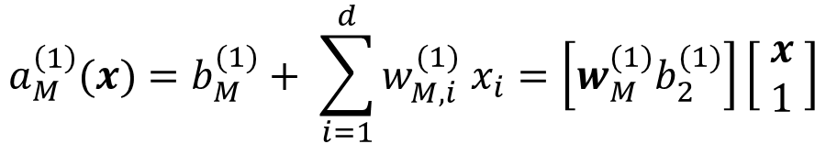







Input Layer
Hidden Layer
Multilayer Neural Network
$$x_{1}$$
$$w_{1,1}^{(1)}$$
$$1$$
$$a_{1}^{\left(1\right)}(x)=b_{1}^{(1)}+ \sum_{i=1}^{d}{w_{1,i}^{(1)} x_{i}}=\left[w_{1}^{(1)}b_{1}^{(1)}\right]\left[\begin{matrix} x \\ 1 \end{matrix}\right]$$
$$w_{1,0}^{(1)}=b_{1}^{(1)}$$
$$w_{1,2}^{(1)}$$
$$x_{2}$$
$$w_{2,1}^{(1)}$$
$$h_{1}^{(1)}$$
$$g(a)$$
$$h_{1}^{(1)}=g\left(a_{1}^{\left(1\right)}\left(x\right)\right)$$
$$w_{2,2}^{(1)}$$
$$1$$
$$a_{2}^{\left(1\right)}(x)=b_{2}^{(1)}+ \sum_{i=1}^{d}{w_{2,i}^{(1)} x_{i}}=\left[w_{2}^{(1)}b_{2}^{(1)}\right]\left[\begin{matrix} x \\ 1 \end{matrix}\right]$$
$$w_{2,0}^{(1)}=b_{2}^{(1)}$$
$$w_{M,2}^{(1)}$$
$$w_{2,3}^{(1)}$$
$$h_{2}^{(1)}$$
$$x_{d}$$
$$w_{1,d}^{(1)}$$
$$g(a)$$
$$h_{2}^{(1)}=g\left(a_{2}^{\left(1\right)}\left(x\right)\right)$$
$$w_{M,1}^{(1)}$$
$$a_{M}^{\left(1\right)}(x)=b_{M}^{(1)}+ \sum_{i=1}^{d}{w_{M,i}^{(1)} x_{i}}=\left[w_{M}^{(1)}b_{2}^{(1)}\right]\left[\begin{matrix} x \\ 1 \end{matrix}\right]$$
$$w_{M,3}^{(1)}$$
$$1$$
$$w_{M,0}^{(1)}=b_{M}^{(1)}$$
$$h_{M}^{(1)}=g\left(a_{M}^{\left(1\right)}\left(x\right)\right)$$
$$h_{M}^{(1)}$$
$$g(a)$$

Slide 25


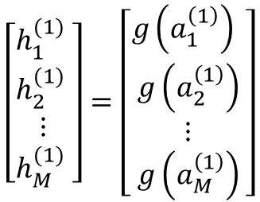




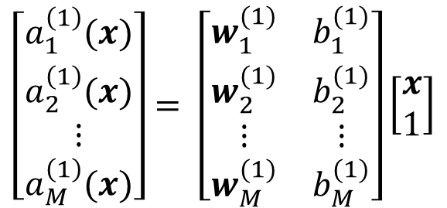
Input Layer
Hidden Layer
Multilayer Neural Network
$$x_{1}$$
$$1$$
$$a_{1}^{\left(1\right)}(x)=\left[w_{1}^{(1)}b_{1}^{(1)}\right]\left[\begin{matrix} x \\ 1 \end{matrix}\right]$$
$$\left[\begin{aligned}\begin{matrix}a_{1}^{\left(1\right)}(x) \\ a_{2}^{\left(1\right)}(x) \\ ⋮\end{matrix} \\ a_{M}^{\left(1\right)}(x)\end{aligned}\right]= \left[\begin{matrix}w_{1}^{(1)} & b_{1}^{(1)} \\ \begin{aligned}w_{2}^{(1)} \\ ⋮\end{aligned} & \begin{aligned}b_{2}^{(1)} \\ ⋮\end{aligned} \\ w_{M}^{(1)} & b_{M}^{(1)}\end{matrix}\right]\left[\begin{matrix}x \\ 1\end{matrix}\right]$$
$$a_{2}^{\left(1\right)}(x)=\left[w_{2}^{(1)}b_{2}^{(1)}\right]\left[\begin{matrix} x \\ 1 \end{matrix}\right]$$
$$x_{2}$$
$$h_{1}^{(1)}$$
$$g(a)$$
$$⋮$$
$$a_{M}^{\left(1\right)}(x)=\left[w_{M}^{(1)}b_{2}^{(1)}\right]\left[\begin{matrix} x \\ 1 \end{matrix}\right]$$
$$1$$
$$a^{\left(1\right)}\left(x\right)=\left[W^{(1)}b^{(1)}\right]\left[\begin{matrix} x \\ 1 \end{matrix}\right]$$
$$x_{d}$$
$$h_{2}^{(1)}$$
$$g(a)$$
Matrix
Column vector
Column vector
Column vector
$$1$$
$$\left[\begin{aligned}\begin{matrix}h_{1}^{(1)} \\ h_{2}^{(1)} \\ ⋮\end{matrix} \\ h_{M}^{(1)} \end{aligned}\right]=\left[\begin{aligned}\begin{matrix}g\left(a_{1}^{\left(1\right)}\right) \\ g\left(a_{2}^{\left(1\right)}\right) \\ ⋮\end{matrix} \\ g\left(a_{M}^{\left(1\right)}\right)\end{aligned}\right]$$
Hidden Layer Activation
$$h^{\left(1\right)}=g\left(a^{(1)}\right)$$
$$h_{M}^{(1)}$$
$$g(a)$$

Slide 26
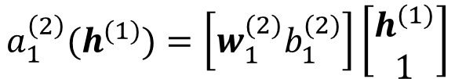







Input Layer
Hidden Layer
Multilayer Neural Network
$$x_{1}$$
$$1$$
Output Layer Pre-activation
$$a_{1}^{\left(2\right)}(h^{(1)})=\left[w_{1}^{(2)}b_{1}^{(2)}\right]\left[\begin{matrix}h^{(1)} \\ 1 \end{matrix}\right]$$
$$x_{2}$$
$$h_{1}^{(1)}$$
$$g(a)$$
$$w_{1,1}^{(2)}$$
Output Layer
Output Layer Activation
$$1$$
$$y=o\left(a_{1}^{\left(2\right)}(h^{(1)})\right)$$
$$h_{2}^{(1)}$$
$$x_{d}$$
$$y$$
$$g(a)$$
o$(a)$
o can have many options
sigmoid
tanh
Relu etc.
$$w_{1,2}^{(2)}$$
$$1$$
$$w_{1,M}^{(2)}$$
One special is softmax function
$$g(a)$$
$$h_{M}^{(1)}$$

Slide 27
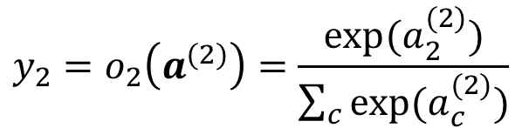
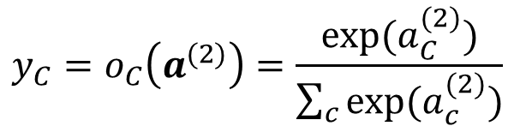
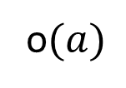
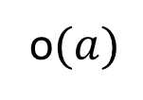
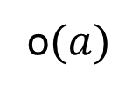




Input Layer
Hidden Layer
Multilayer Neural Network
Output Layer
$$x_{1}$$
$$1$$
$$a_{1}^{(2)}$$
$${y_{1}=o}_{1}\left(a^{(2)}\right)=\frac{exp⁡(a_{1}^{(2)})}{\sum_{c}{exp⁡(a_{c}^{(2)})}}$$
$$x_{2}$$
$$g(a)$$
o$(a)$
$$1$$
Softmax function:
Exponentiate each component of output activation vector and elementwise divide by the sum of the exponentials.
$$a_{2}^{(2)}$$
$${y_{2}=o}_{2}\left(a^{(2)}\right)=\frac{exp⁡(a_{2}^{(2)})}{\sum_{c}{exp⁡(a_{c}^{(2)})}}$$
$$x_{d}$$
$$g(a)$$
o$(a)$
$$1$$
$$a_{C}^{(2)}$$
$${y_{C}=o}_{C}\left(a^{(2)}\right)=\frac{exp⁡(a_{C}^{(2)})}{\sum_{c}{exp⁡(a_{c}^{(2)})}}$$
$$g(a)$$
o$(a)$

Slide 28











Training a Neural Network – Loss Function
$$x_{1}$$
$$1$$
$$x_{2}$$
Probability that $x$ belongs to class 1
So we can aim to maximize the probability corresponding to the correct class for any example $x$
$$y_{1}$$
$$g(a)$$
o$(a)$
$$1$$
Probability that $x$ belongs to class 2
$$\max{y_{c}}$$
$$x_{d}$$
$$y_{2}$$
$$g(a)$$
o$(a)$
$$≡max (log{y_{c}})$$
$$≡min (−log{y_{c}})$$
$$1$$
Can be equivalently expressed as $−\sum_{i}{𝕀\left(i=c\right)log⁡(y_{i})}$ known as cross-entropy loss
Probability that $x$ belongs to class C
$$y_{C}$$
$$g(a)$$
o$(a)$

Slide 29

















Forward Pass in a Nutshell
$θ$ is the collection of all learnable parameters i.e., all $W$ and $b$
$$x$$
$${(h}^{(0)})$$
$$W^{(1)},b^{(1)}$$
$$g(.)$$
$$W^{(2)},b^{(2)}$$
$$g(.)$$
$$W^{(L)},b^{(L)}$$
o$(.)$
$$y=f(x, θ)$$
$$a^{(1)}$$
$$h^{(1)}$$
$$a^{(2)}$$
$$h^{(2)}$$
$$a^{(L)}$$
Hidden layer pre-activation:
For $l=1,…,L; a^{\left(l\right)}=W^{\left(l\right)}h^{\left(l−1\right)}+b^{(l)}$
Hidden layer activation:
For $l=1,…,L−1; h^{\left(l\right)}={g(a}^{\left(l\right)})$
Output layer activation:
For $l=L; h^{\left(L\right)}={o(a}^{\left(L\right)})=f(x, θ)$

Slide 30















Backpropagation
$$h^{(l−1)}$$
$$W^{(l)},b^{(l)}$$
$$g(.)$$
$$W^{(l+1)},b^{(l+1)}$$
$$g(.)$$
$$W^{(L)},b^{(L)}$$
o$(.)$
$$y=f(x, θ)$$
$$a^{(l)}$$
$$h^{(l)}$$
$$a^{(l+1)}$$
$$h^{(l+1)}$$
$$a^{(L)}$$
$$J\left(f\left(x, θ\right),c \right)$$
True class of the example
For gradient descent we need to compute $\frac{∂J}{∂W_{i,j}^{(l)}}$ and $\frac{∂J}{∂b_{i}^{(l)}} ∀i,j,l$
Backpropagation consists of intelligent use of the chain rule of differentiation for computation of these gradients

Slide 31




Backpropagation
$$h^{(l−1)}$$
$$W^{(l)},b^{(l)}$$
$$g(.)$$
$$W^{(l+1)},b^{(l+1)}$$
$$g(.)$$
$$W^{(L)},b^{(L)}$$
o$(.)$
$$y=f(x, θ)$$
$$a^{(l)}$$
$$h^{(l)}$$
$$a^{(l+1)}$$
$$h^{(l+1)}$$
$$a^{(L)}$$
$$J\left(f\left(x, θ\right),c \right)$$
$W_{i,j}^{(l)}$ influences $J$ through $a_{i}^{(l)}$. That means $J$ is a function of $a_{i}^{(l)}$ and $a_{i}^{(l)}$, in turn, is a function of$W_{i,j}^{(l)}$
$$\frac{∂J}{∂W_{i,j}^{(l)}}=\frac{∂J}{∂a_{i}^{(l)}}\frac{∂a_{i}^{(l)}}{∂W_{i,j}^{(l)}}$$
$$a_{i}^{\left(l\right)}=\sum_{j}{W_{i,j}^{(l)} h_{j}^{(l−1)}}+b_{i}^{(l)}=W_{i,1}^{(l)} h_{1}^{(l−1)}+W_{i,2}^{(l)} h_{2}^{(l−1)}+…+W_{i,j}^{\left(l\right)} h_{j}^{\left(l−1\right)}+…+b_{i}^{(l)}$$
$$⇒\frac{∂J}{∂W_{i,j}^{(l)}}=\frac{∂J}{∂a_{i}^{(l)}}\frac{∂a_{i}^{(l)}}{∂W_{i,j}^{(l)}}=\frac{∂J}{∂a_{i}^{(l)}}h_{j}^{\left(l−1\right)}$$
… (1)
We know $h_{j}^{\left(l−1\right)}$ from forward pass, so we need $\frac{∂J}{∂a_{i}^{(l)}}$
And similarly $\frac{∂J}{∂b_{i}^{(l)}}=\frac{∂J}{∂a_{i}^{(l)}}\frac{∂a_{i}^{(l)}}{∂b_{i}^{(l)}}=\frac{∂J}{∂a_{i}^{(l)}}$
… (2)

Slide 32

Backpropagation
$$h^{(l−1)}$$
$$W^{(l)},b^{(l)}$$
$$g(.)$$
$$W^{(l+1)},b^{(l+1)}$$
$$g(.)$$
$$W^{(L)},b^{(L)}$$
o$(.)$
$$y=f(x, θ)$$
$$a^{(l)}$$
$$h^{(l)}$$
$$a^{(l+1)}$$
$$h^{(l+1)}$$
$$a^{(L)}$$
$$J\left(f\left(x, θ\right),c \right)$$
$a_{i}^{(l)}$ influences $J$ through $h_{i}^{(l)}$. That means $J$ is a function of $h_{i}^{(l)}$ and $h_{i}^{(l)}$, in turn, is a function of$a_{i}^{(l)}$
$$\frac{∂J}{∂a_{i}^{(l)}}=\frac{∂J}{∂h_{i}^{(l)}}\frac{∂h_{i}^{(l)}}{∂a_{i}^{(l)}}=\frac{∂J}{∂h_{i}^{(l)}}g′\left(a_{i}^{(l)}\right)$$
… (3)
We know $g′\left(a_{i}^{(l)}\right)$ from forward pass, so we need $\frac{∂J}{∂h_{i}^{(l)}}$

Slide 33




Backpropagation
$$h^{(l−1)}$$
$$W^{(l)},b^{(l)}$$
$$g(.)$$
$$W^{(l+1)},b^{(l+1)}$$
$$g(.)$$
$$W^{(L)},b^{(L)}$$
o$(.)$
$$y=f(x, θ)$$
$$a^{(l)}$$
$$h^{(l)}$$
$$a^{(l+1)}$$
$$h^{(l+1)}$$
$$a^{(L)}$$
$$J\left(f\left(x, θ\right),c \right)$$
$h_{i}^{(l)}$ influences $J$ through $a_{1:M_{l+1}}^{(l+1)}$ . That means $J$ is a function of${ a}_{1:M_{l+1}}^{(l+1)}$and each of $a_{1:M_{l+1}}^{(l+1)}$, in turn, is a function of$h_{i}^{(l)}$
Number of neurons in hidden layer $(l+1)$
$$\frac{∂J}{∂h_{i}^{(l)}}=\sum_{m=1}^{M_{l+1}}{\frac{∂J}{∂a_{m}^{(l+1)}}}\frac{∂a_{m}^{(l+1)}}{∂h_{i}^{(l)}}$$
Remember I$f, u=f\left(x,y\right), where x=φ\left(t\right), y=ψ\left(t\right), then \frac{∂u}{∂t}=\frac{∂u}{∂x}\frac{∂x}{∂t}+\frac{∂u}{∂y}\frac{∂y}{∂t}$
$$a_{m}^{\left(l+1\right)}=\sum_{j}{W_{m,j}^{(l+1)} h_{j}^{(l)}}+b_{m}^{(l+1)}=W_{m,1}^{(l+1)} h_{1}^{(l)}+W_{m,2}^{(l+1)} h_{2}^{(l)}+…+W_{m,i}^{\left(l+1\right)} h_{i}^{\left(l\right)}+…+b_{m}^{(l+1)}$$
$$⇒\frac{∂J}{∂h_{i}^{(l)}}=\sum_{m=1}^{M_{l+1}}{\frac{∂J}{∂a_{m}^{(l+1)}}}W_{m,i}^{\left(l+1\right)}$$
… (4)
Notes:
The rule is obtained from result 9.8 in Dada’s pass course Math book

Slide 34














Backpropagation
$$\left[W_{m,i}^{(l)} \right]$$
$$b_{i}^{(l)}$$
$$\left[W_{i,j}^{(l)} \right]$$
$$h_{j}^{\left(l−1\right)}$$
$$×$$
$$+$$
$$a_{i}^{(l)}$$
$$g(.)$$
$$h_{j}^{\left(l\right)}$$
$$\frac{∂J}{∂a_{i}^{(l)}}=\frac{∂J}{∂h_{i}^{(l)}}g′\left(a_{i}^{(l)}\right)$$
… (3)
$$g′(.)$$
$$\frac{∂J}{∂a_{i}^{(l)}}$$
$$×$$
$$\frac{∂J}{∂h_{i}^{(l)}}$$

Slide 35


Backpropagation
$$\left[W_{m,i}^{(l)} \right]$$
$$\frac{∂J}{∂b_{i}^{(l)}}$$
$$b_{i}^{(l)}$$
$$\left[W_{i,j}^{(l)} \right]$$
$$h_{j}^{\left(l−1\right)}$$
$$×$$
$$+$$
$$a_{i}^{(l)}$$
$$g(.)$$
$$h_{j}^{\left(l\right)}$$
$$\frac{∂J}{∂a_{i}^{(l)}}=\frac{∂J}{∂h_{i}^{(l)}}g′\left(a_{i}^{(l)}\right)$$
… (3)
$$\frac{∂J}{∂b_{i}^{(l)}}=\frac{∂J}{∂a_{i}^{(l)}}$$
… (2)
$$g′(.)$$
$$\frac{∂J}{∂a_{i}^{(l)}}$$
$$×$$
$$\frac{∂J}{∂h_{i}^{(l)}}$$

Slide 36



Backpropagation
$$\left[W_{m,i}^{(l)} \right]$$
$$\frac{∂J}{∂W_{i,j}^{(l)}}$$
$$\frac{∂J}{∂b_{i}^{(l)}}$$
$$b_{i}^{(l)}$$
$$\left[W_{i,j}^{(l)} \right]$$
$$×$$
$$h_{j}^{\left(l−1\right)}$$
$$×$$
$$+$$
$$a_{i}^{(l)}$$
$$g(.)$$
$$h_{j}^{\left(l\right)}$$
$$\frac{∂J}{∂a_{i}^{(l)}}=\frac{∂J}{∂h_{i}^{(l)}}g′\left(a_{i}^{(l)}\right)$$
… (3)
$$\frac{∂J}{∂b_{i}^{(l)}}=\frac{∂J}{∂a_{i}^{(l)}}$$
… (2)
$$g′(.)$$
$$\frac{∂J}{∂W_{i,j}^{(l)}}=\frac{∂J}{∂a_{i}^{(l)}}h_{j}^{\left(l−1\right)}$$
… (1)
$$\frac{∂J}{∂a_{i}^{(l)}}$$
$$×$$
$$\frac{∂J}{∂h_{i}^{(l)}}$$

Slide 37





Backpropagation
$$\left[W_{m,i}^{(l)} \right]$$
$$\frac{∂J}{∂W_{i,j}^{(l)}}$$
$$\frac{∂J}{∂b_{i}^{(l)}}$$
$$b_{i}^{(l)}$$
$$\left[W_{i,j}^{(l)} \right]$$
$$×$$
$$h_{j}^{\left(l−1\right)}$$
$$×$$
$$+$$
$$a_{i}^{(l)}$$
$$g(.)$$
$$h_{j}^{\left(l\right)}$$
$$\frac{∂J}{∂a_{i}^{(l)}}=\frac{∂J}{∂h_{i}^{(l)}}g′\left(a_{i}^{(l)}\right)$$
… (3)
$$∀i=1:M_{L}$$
$$\frac{∂J}{∂b_{i}^{(l)}}=\frac{∂J}{∂a_{i}^{(l)}}$$
… (2)
$$g′(.)$$
$$\frac{∂J}{∂W_{i,j}^{(l)}}=\frac{∂J}{∂a_{i}^{(l)}}h_{j}^{\left(l−1\right)}$$
… (1)
$$\frac{∂J}{∂h_{i}^{(l−1)}}$$
$$×$$
$$\frac{∂J}{∂a_{i}^{(l)}}$$
$$\frac{∂J}{∂h_{i}^{(l)}}$$
$$\frac{∂J}{∂h_{i}^{(l−1)}}=\sum_{m=1}^{M_{l}}{\frac{∂J}{∂a_{m}^{(l)}}}W_{m,i}^{\left(l\right)}$$
and
$$∀i=1:M_{L}$$
$$×$$
… (4)
$$+$$

Slide 38

Training Multilayer Neural Network for non-linearly Separable Data
Training Data

Slide 39








Learned Decision Boundary with Single Hidden Layer
# of hidden neurons = 2
# of hidden neurons = 4
# of hidden neurons = 8
# of hidden neurons = 16
# of hidden neurons = 32
# of hidden neurons = 64
# of hidden neurons = 128
# of hidden neurons = 256

Slide 40





Learned Decision Boundary with Two Hidden Layers
# of neurons in each hidden layer = 2
# of neurons in each hidden layer = 4
# of neurons in each hidden layer = 8
# of neurons in each hidden layer = 16
# of neurons in each hidden layer = 32

