Slide 1
Markov Logic Networks: Exploring their Application to Social Network Analysis
Parag Singla
Dept. of Computer Science and Engineering
Indian Institute of Technology, Delhi
Joint work with people at
University of Washington and IIT Delhi

Slide 2
Overview
Motivation
Markov logic
Application to Social Network Analysis
Opportunities/Challenges

Slide 3

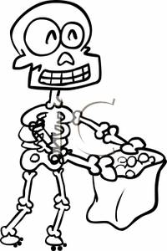
Social Network and Smoking Behavior
Smoking
Cancer

Slide 4
Social Network and Smoking Behavior
Smoking leads to
Cancer

Slide 5


Social Network and Smoking Behavior
Smoking leads to
Cancer
Friendship Similar Smoking Habits

Slide 6
Social Network and Smoking Behavior
Smoking leads to
Cancer
Friendship leads to Similar Smoking Habits

Slide 7
Examples
Web search
Information extraction
Natural language processing
Perception
Medical diagnosis
Computational biology
Social networks
Ubiquitous computing
Etc.

Slide 8
Examples
Web search
Information extraction
Natural language processing
Perception
Medical diagnosis
Computational biology
Social networks
Ubiquitous computing
Etc.

Slide 9
Motivation
Real World
  Entities and Relationships
  Uncertain Behavior

Slide 10
Motivation
Real World
  Entities and Relationships
  Uncertain Behavior
Markov Logic
=
First Order Logic
+
Markov Networks

Slide 11
Overview
Motivation
Markov logic
Application to Social Network Analysis
Future Directions

Slide 12
Markov Logic
[Richardson and Domingos 06]
A logical KB : A set of hard constraints
How can we make them soft constraints
Give each formula a weight
(Higher weight ⇒ Stronger constraint)

Slide 13
Example: Friends & Smokers

Slide 14
Example: Friends & Smokers

Slide 15
Example: Friends & Smokers
Two constants: Anil (A) and Bunty (B)

Slide 16
Example: Friends & Smokers
Two constants: Anil (A) and Bunty (B)
Smokes(A)
Smokes(B)
Cancer(A)
Cancer(B)

Slide 17
Example: Friends & Smokers
Two constants: Anil (A) and Bunty (B)
Friends(A,B)
Friends(A,A)
Smokes(A)
Smokes(B)
Friends(B,B)
Cancer(A)
Cancer(B)
Friends(B,A)

Slide 18
Example: Friends & Smokers
Two constants: Anil (A) and Bunty (B)
Friends(A,B)
Friends(A,A)
Smokes(A)
Smokes(B)
Friends(B,B)
Cancer(A)
Cancer(B)
Friends(B,A)

Slide 19
Example: Friends & Smokers
Two constants: Anil (A) and Bunty (B)
Friends(A,B)
Friends(A,A)
Smokes(A)
Smokes(B)
Friends(B,B)
Cancer(A)
Cancer(B)
Friends(B,A)

Slide 20
Example: Friends & Smokers
Two constants: Anil (A) and Bunty (B)
Friends(A,B)
Friends(A,A)
Smokes(A)
Smokes(B)
Friends(B,B)
Cancer(A)
Cancer(B)
Friends(B,A)
State of the World ≡ {0,1} Assignment to the nodes

Slide 21
Probability Distribution
Weight of formula i
No. of true groundings of formula i in x

Slide 22
Computing Probabilities: Marginal Inference
Friends(A,B)
Friends(A,A)
Smokes(A)?
Smokes(B)?
Friends(B,B)
Cancer(A)
Cancer(B)?
Friends(B,A)
What is the probability Smokes(B) = 1?

Slide 23
Inference: Belief Propagation
Smokes(Anil)
Smokes(Anil) ∧ Friends(Anil, Bunty)
⇒ Smokes(Bunty)
Variables
Clauses
Notes:
23

Slide 24
Belief Propagation
Variables
Clauses
Notes:
24

Slide 25
Lifted Belief Propagation
[Singla and Domingos, 2008]
α,β :
Functions of edge counts
α
β
Variables
Clauses
Notes:
25

Slide 26
Learning Parameters
[Lowd and Domingos 07]

Slide 27
Learning Parameters
[Lowd and Domingos 07]
Three constants: Anil, Bunty, Priya
Smokes
Smokes(Anil)
Smokes(Bunty)
Cancer
Cancer(Anil)
Cancer(Bunty)
Friends
Friends(Anil, Bunty)
Friends(Bunty, Anil)
Friends(Anil, Priya)
Friends(Priya, Anil)
Closed World Assumption:
Anything not in the database is assumed false.

Slide 28
Overview
Motivation
Markov logic
Application to Social Network Analysis
Observations/Challenges

Slide 29
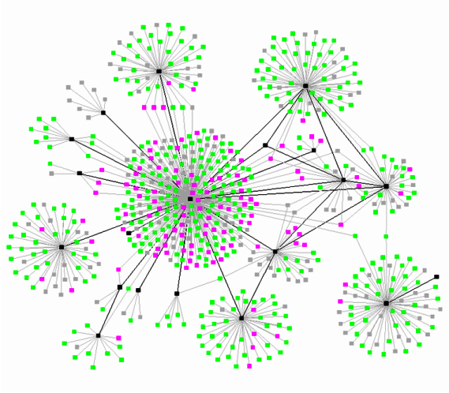
Large Social Network Analysis

Slide 30
Twitter Datasets
[Ruhela et al. ANTS 2011]
SNAP Twitter7 | : | 196 Million Tweets 9.8 Million Users
Kaist | : | 1.4 Billion Social Relations
Twitter | : | 7.4 Million User Locations
Yahoo! PlaceFinder | : | 4 Million user location mapped to Latitude-Longitude
OpenCalais | : | Semantic categorization of 114 Million Tweets into 4135 different topics
Notes:
Dataset: Start with what we need, and then go into how we got the data

Slide 31
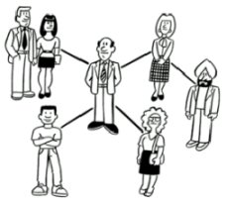
Who “Tweets” on what?
Century of Centuries! Wow!
Sachin is my favorite batsman!
He’s going to do get the century!
Cricket tonight!
Go Sachin go!

Slide 32
Who “Tweets” on what?
Century of Centuries! Wow!
I am going to watch the match today!
Sachin is my favorite batsman!
He’s going to do get the century!
Cricket tonight!
Go Sachin go!

Slide 33
Who “Tweets” on what?
Century of Centuries! Wow!
I am going to watch the match today!
Sachin is my favorite batsman!
He’s going to do get the century!
Attribution
Problem
Cricket tonight!
Go Sachin go!

Slide 34
Features: Own Past Behavior
Time
t = 1…50
T = 51
Anil
Anil
tweets(uid,topic,+t) => tweet_T(uid,topic)

Slide 35
Features: Followers’ Past Behavior
Time
t = 1…50
T = 51
Anil
Anil
Bunty
Priya
tweets(uid1,topic,+t) ^ follows(uid2,uid1) => tweets_T(uid2,topic)

Slide 36
Features: Followers’ Current Behavior
Time
t = 1…50
T = 51
Anil
Anil
Bunty
Bunty
Priya
Priya
tweets_T(uid1,topic) ^ follows(uid2,uid1) => tweets_T(uid2,topic)

Slide 37
Overview
Motivation
Markov logic
Application to Social Network Analysis
Challenges/Opportunities

Slide 38
Challenges/Opportunities
Scaling up – extremely large-sized networks
Lifted Belief Propagation
  Cluster “approximately similar” nodes
Micro/Macro Properties
  Can we abstract out micro details?
Learning
  Time varying data
  Incremental (online) learning

Slide 39
Other Research Directions
Lifted Inference - Graph-Cut, SAT
Learning with partial observability
Video Activity Recognition

