Slide 1
Causal Analytics with Social Media Content
Lipika Dey
Innovation Labs, Delhi

Slide 2
Agenda
Introduction to Innovation Labs
Social media content for business analytics
Behavioral analysis
Future Directions
Agenda
2
2
Notes:
2
2
2

Slide 3
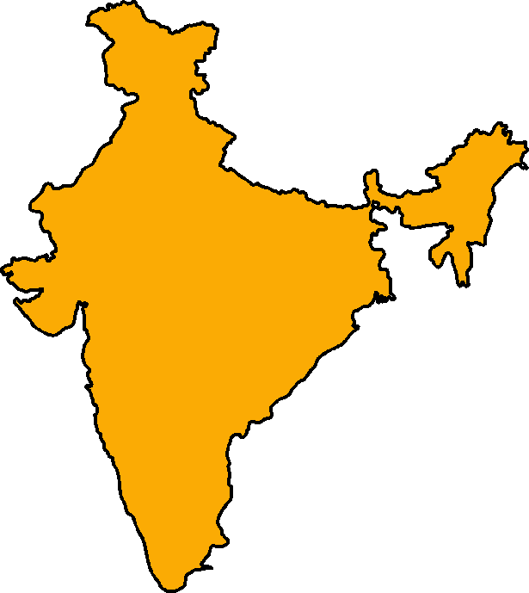
TCS R&D – Innovation Labs
~ 600 people; 60 PhDs.
Data Analytics - Text Mining, Enterprise Information Fusion, Big Data Management
Software Architecture
Graphics & Virtual Reality
Multimedia Applications & Computer Vision
Natural Language Processing
Speech Technology
Performance Engineering
DELHI
KOLKATA
Wireless (WiMAX, 4G, RFID)
Signal Processing
MUMBAI
Analytics & Data Mining
Large Scale Systems
Software Engineering Tools
PUNE
HYDERABAD
Data Security (PKI, ECDSA)
Life Sciences (Bioinformatics)
BANGALORE
CHENNAI
Embedded Systems (VLSI)
Green IT (Power Management)
3

Slide 4
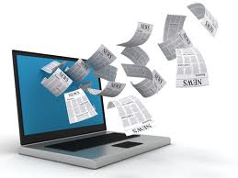
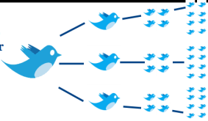
Social media based analytics
Content Analysis
Sentiment Analysis
Causal Analytics
Social Network Analysis

Slide 5
Social-media Intelligence
Social Media
Issues and Opportunities
Events
Context to interpret Business Data
Impact on business

Slide 6
The Retail Story
Shampoo sales are going down
Market basket Analysis – Shampoo sells with milk and bread
Milk and bread sell as quick-refill – sales showed decline
Survey conducted – are you satisfied with quality / price / availability of milk and bread
More positive than negative
?
?
?

Slide 7
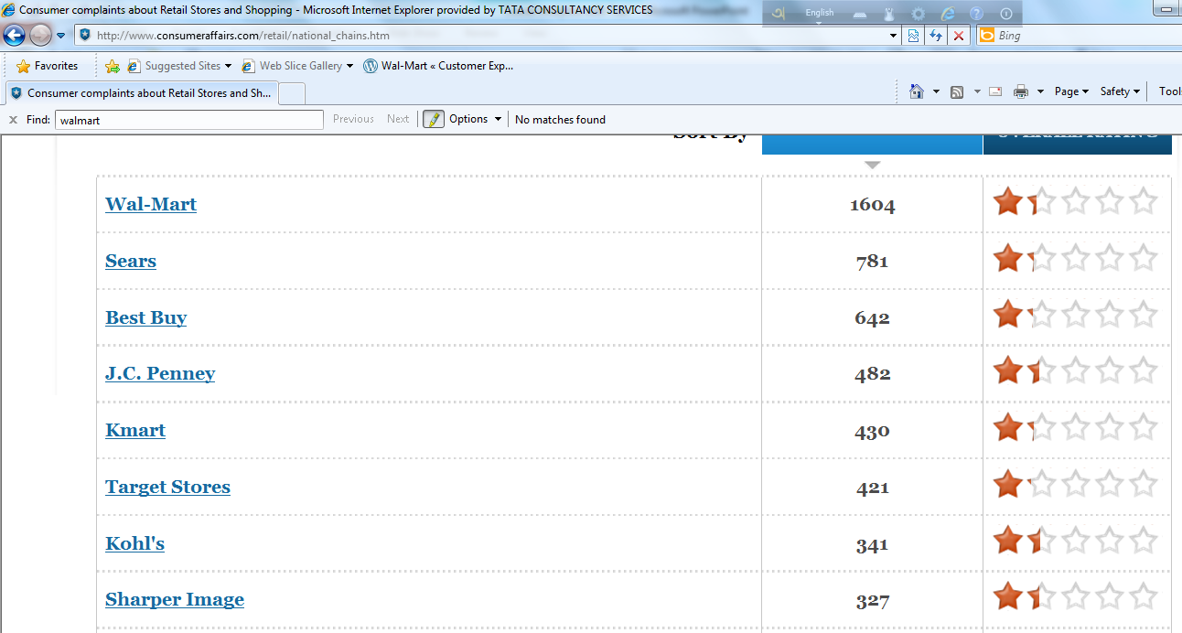
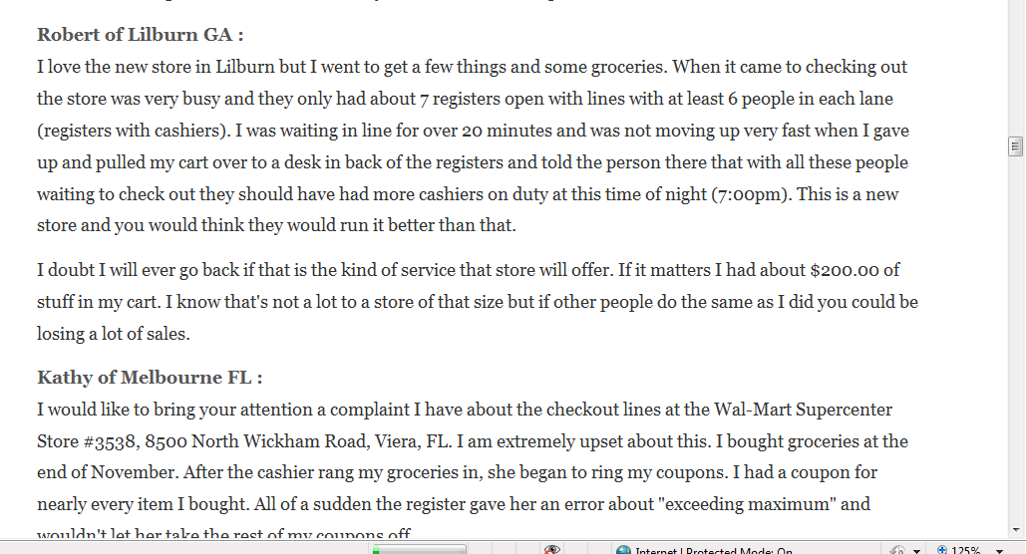
Seek answer in social-media

Slide 8
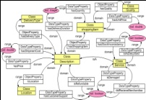
Goal-driven text analytics
Action
Knowledge Acquisition
Recommendation / Prediction
Domain knowledge
Expert
Prioritization of issues
Business Case
Feedback /
Impact
Business Knowledge
Business units
Business Goals
Business Analysis
Key drivers for satisfaction / dissatisfaction / problems
Segment-wise reports
Causal Analysis
Knowledge-driven Analytics
Mapping issues to goals
Measuring Performance Indicators
Customer Pain-points and Delights
Events
Trends
Frequent patterns
Text Mining
Consumer-generated Text

Slide 9
Text Analytics Process
Expect
Improvement in performance
Gather
Mine
Map
Interpret
Improve
Knowledge-base
Analysis
KPIs to measure process performance
Mapping
Text components to Business Processes
Domain Ontology
Semi-supervised Fuzzy Clustering
Content Classification
Value from Text Analytics
Involvement of business expert
Mining
Text elements - terms extracted from
Consumer –generated Unstructured Text
Cleaning and pre-processing
Natural Language Processing
Statistical Text Processing

Slide 10
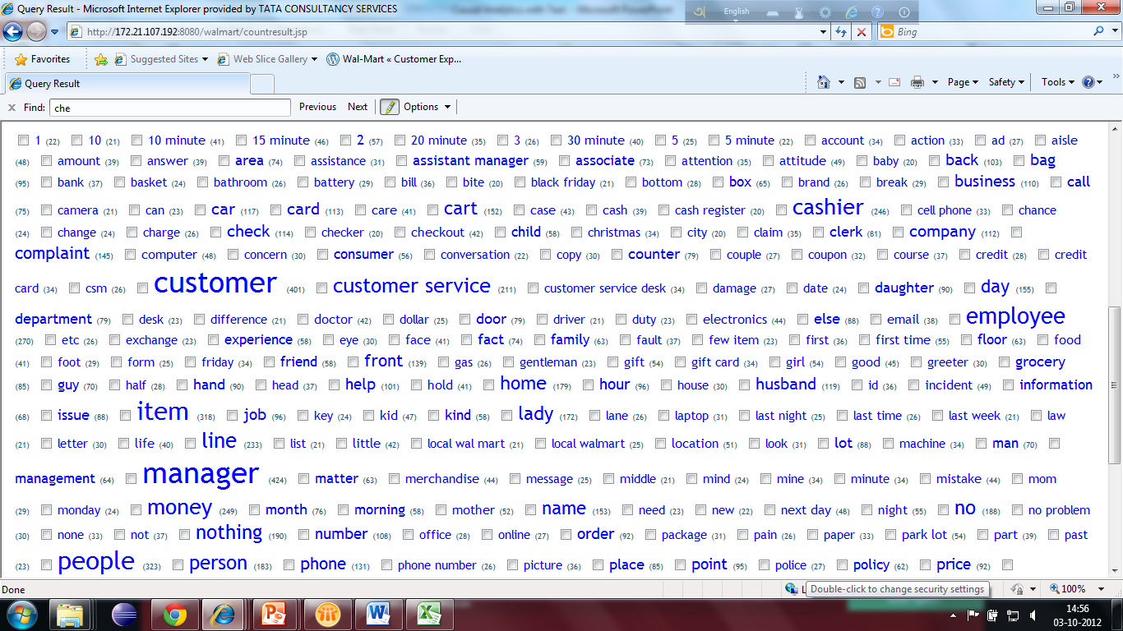
Reports for the Retail Store
Discovering New issues
Relevance / representativeness
Anomaly detection
Novelty of issues
Divergence of issues across stores/regions/products/categories
Learn from correlations

Slide 11
Content Discovery and Analytics
Semi-supervised fuzzy Clustering
Seeded clustering
Learn domain terms
Topic Discovery (Latent Dirichlet Allocation)
Topic novelty
Topic spread
Topic affinity
Topic relevance
Event detection
Entity and action-oriented (Conditional Random Fields)
Event linking – story building

Slide 12
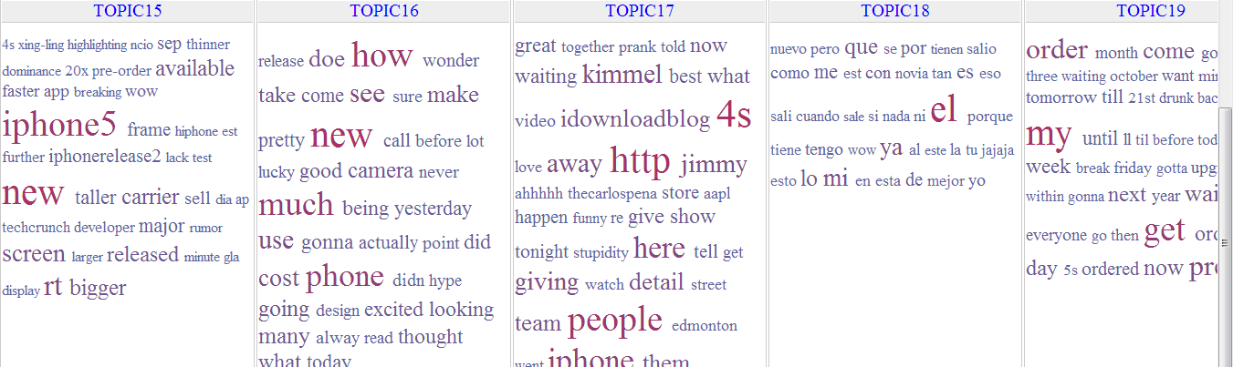
Topic discovery – iPhone related tweets
Features
Comparison
TV show
Gifts

Slide 13
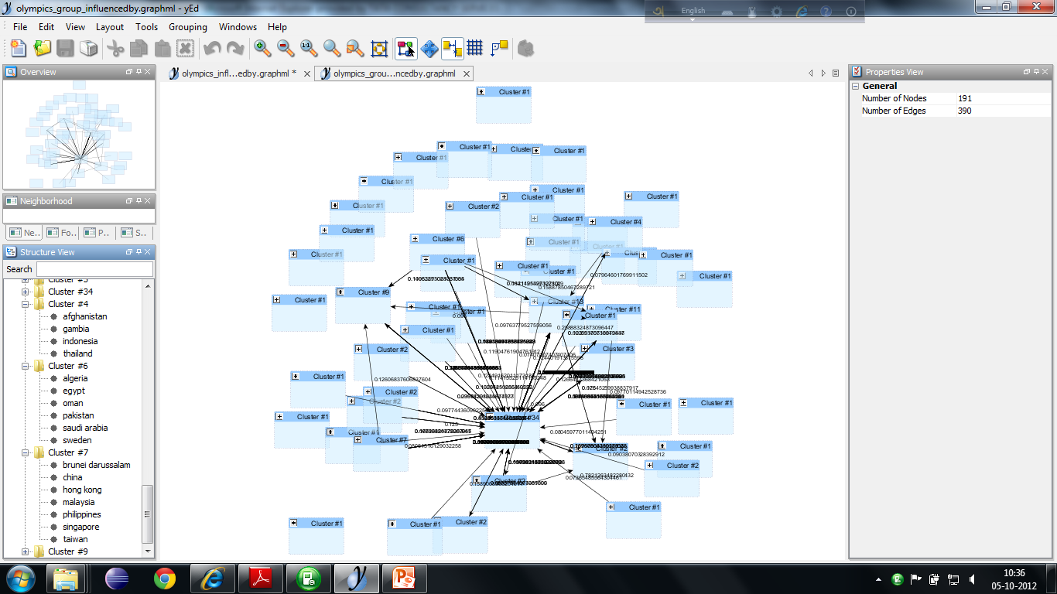
Influence-driven analysis

Slide 14
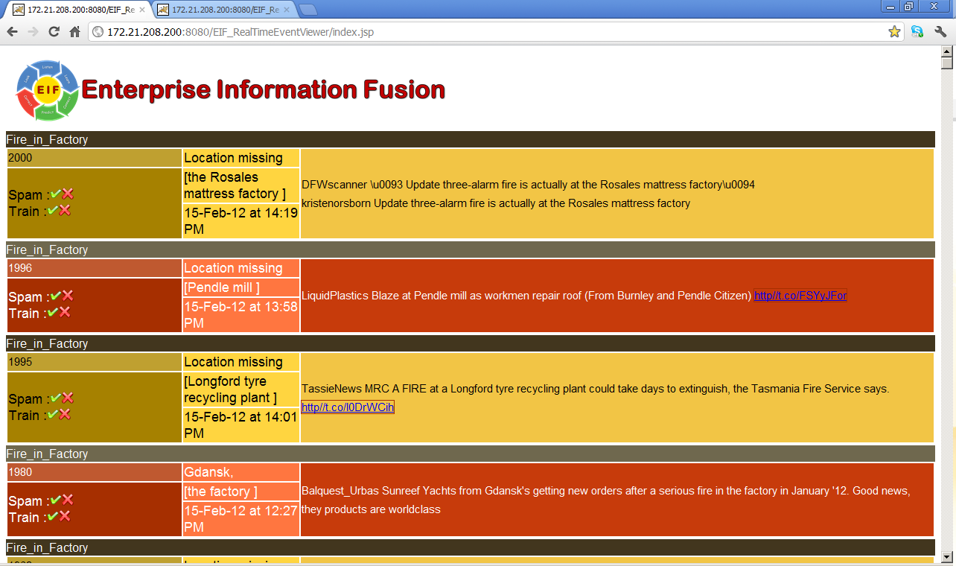
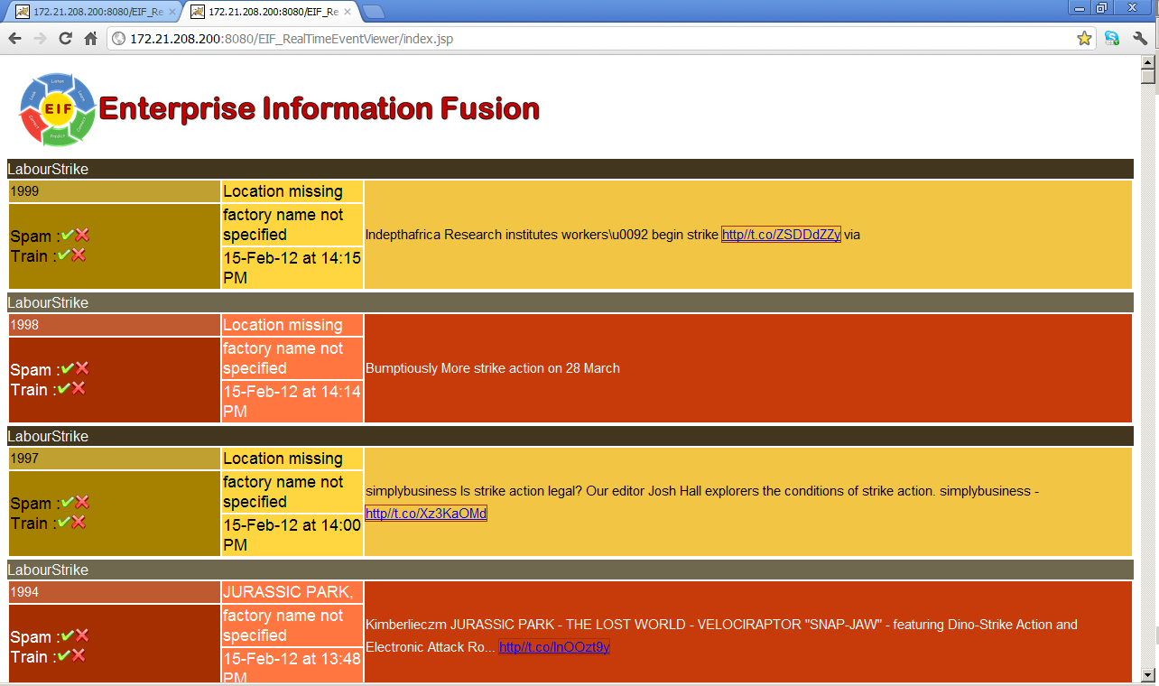
Learning to identify relevant content
Event detection
Entity Detection
Address resolution
Raise alarm
Throw alerts
WSDM - 2012

Slide 15
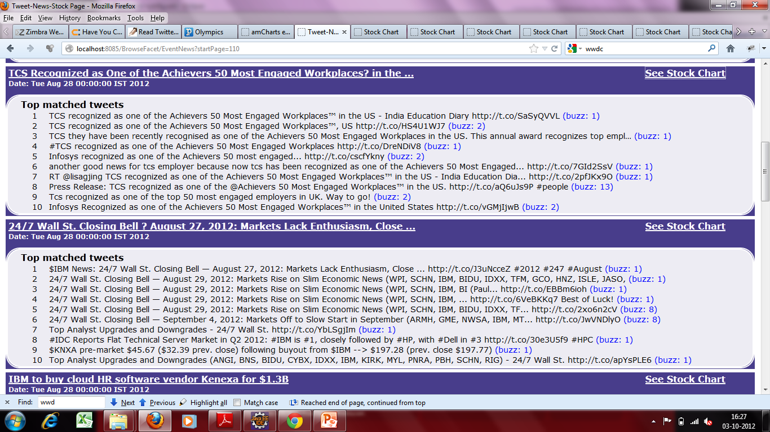
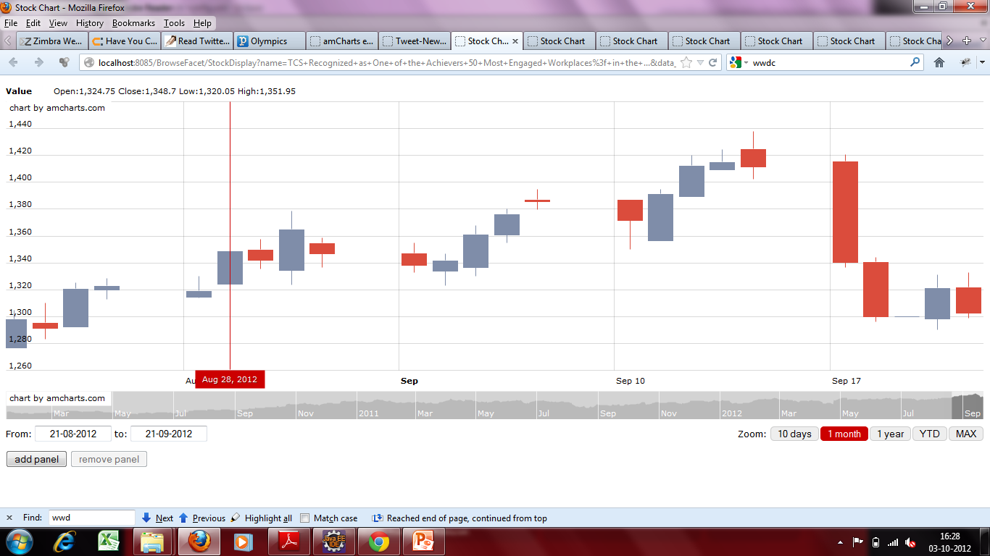
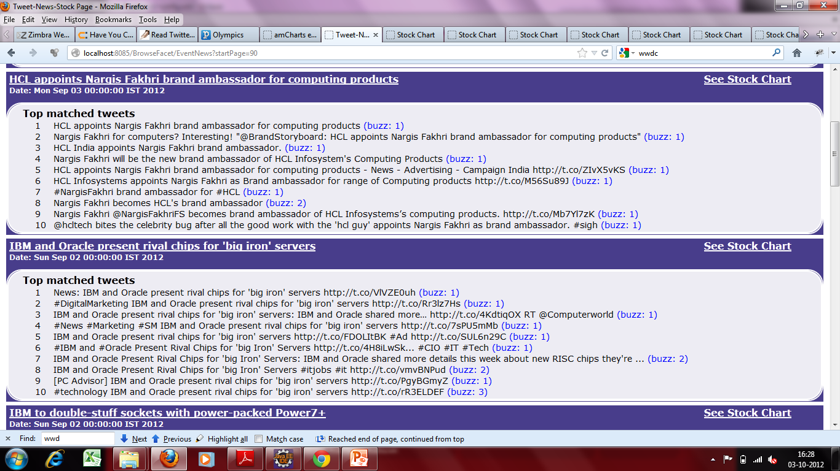
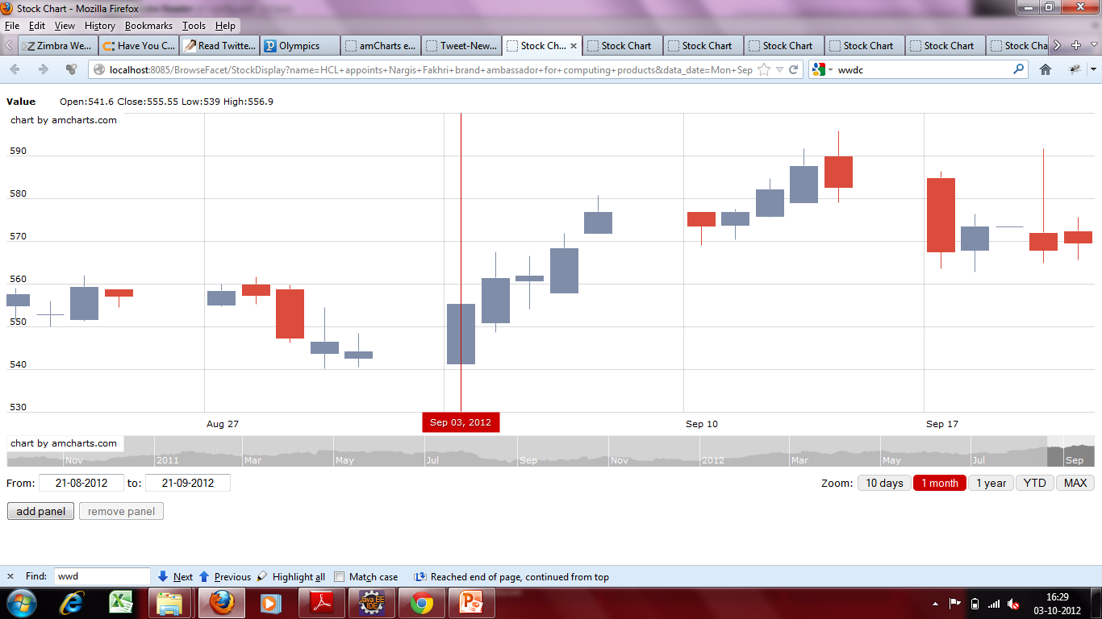
Learning cause-effect relationships
Reinforcement learning framework to learn critical events

Slide 16
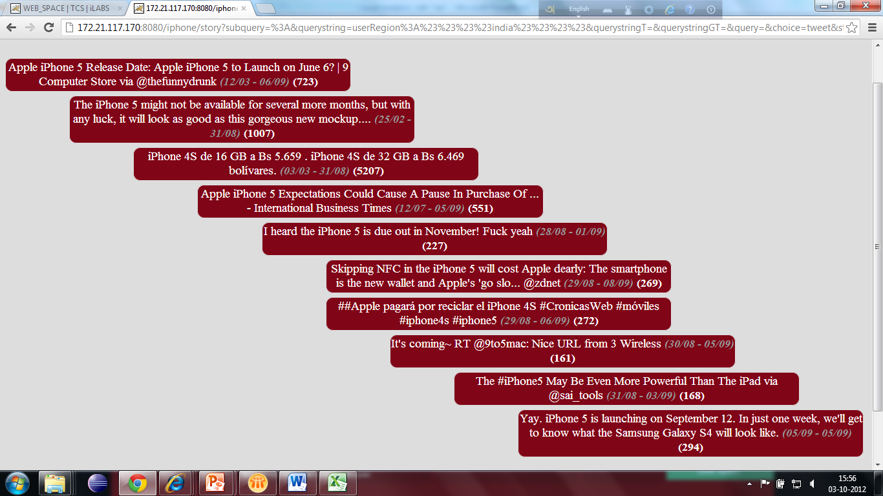
Topic spread – Topic evolution – Topic affinity
Event history – India
Olympics - 2012
IJCAI 2011 – From News
From Twitter -To be presented at WI - 2012

Slide 17
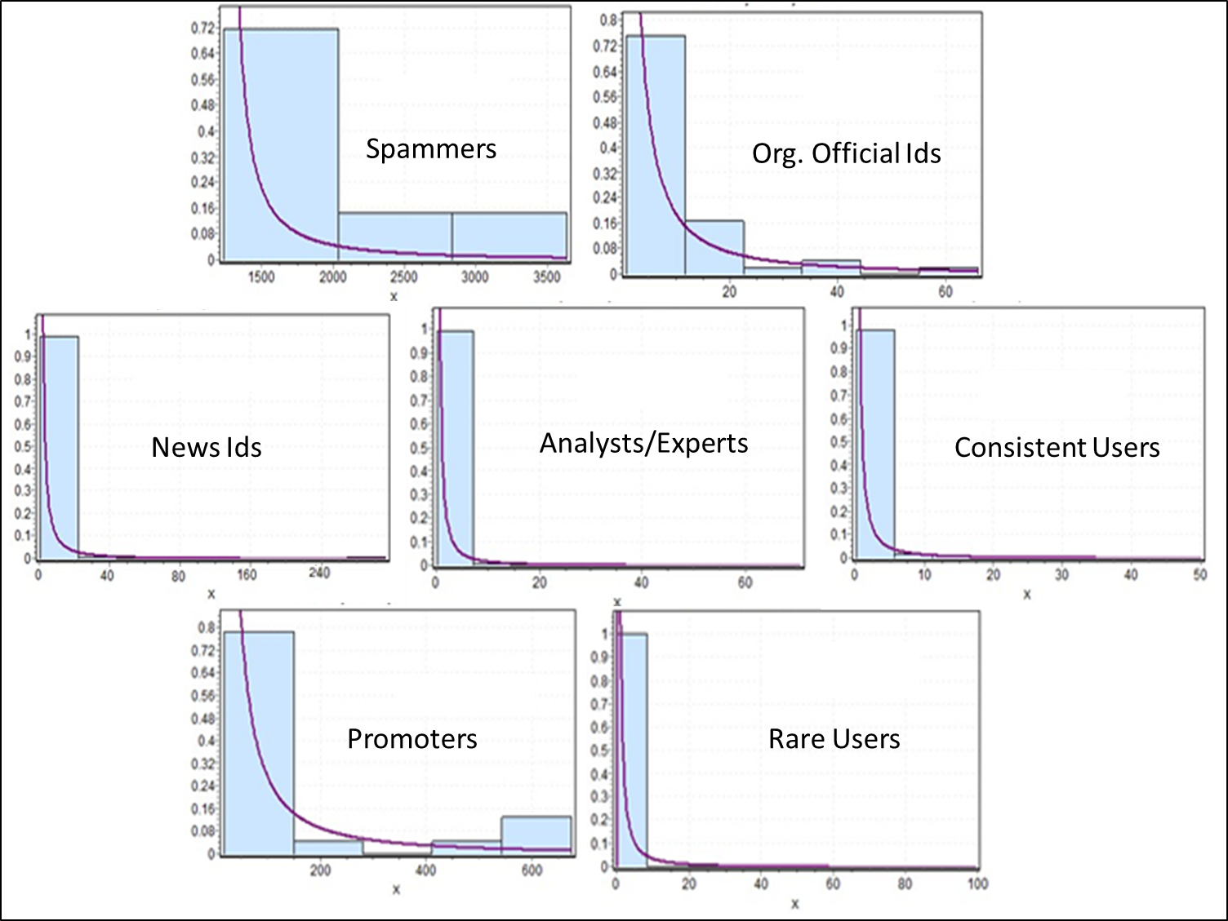
Behavioral Analysis on Social Networks
Problem
Clustering and characterizing users based on their activity patterns
Volume, Regularity, Consistency
Use
Provides insights about different categories of users
(i). Trade Promoters
(ii). News Agencies
(iii). Analysts
(iv). Regular users
(v). Spammers
Predict actions and information flow
Methodology
A wavelet-based clustering mechanism that groups users according
to their temporal activity profiles
(To be presented at ICPR 2012, Japan)
Irregular, Inconsistent
Extreme
Regular, Consistent, Low volume
Regular, Consistent, Medium volume
Periodic, Consistent, Low volume
Less regular, consistent, Low volume
Regular, consistent, High volume
Irregular, inconsistent, Low volume

Slide 18
Interested in
Content-based analytics
Supply-chain models revisited
Demand forecasting
Identity resolution across social-media
Social CRM
Fraud detection
Spammers
Fake identities
Information diffusion
Across regions
Interestingness
Effect
Intent mining

Slide 19
Thank You

