Slide 1
The Google File System (GFS)
CS60002: Distributed Systems
Antonio Bruto da Costa
Ph.D. Student, Formal Methods Lab,
Dept. of Computer Sc. & Engg.,
Indian Institute of Technology Kharagpur

Slide 2
Design constraints
Motivating application: Google
Component failures are the norm
1000s of components: inexpensive servers and clients
Bugs, human errors, failures of memory, disk, connectors, networking, and power supplies
Constant monitoring, error detection, fault tolerance, automatic recovery are integral to the system
Files are huge by traditional standards
Multi-GB files are common; each file contains application objects such as web documents
Billions of objects

Slide 3
Design constraints
Most modifications are appends
Random writes are practically nonexistent
Many files are written once, and read sequentially
Types of reads
Data Analysis Programs reading large repositories
Large streaming reads (read once)
Small random reads (in the forward direction)
Sustained bandwidth more important than latency

Slide 4
Interface Design
Familiar file system interface
Create, delete, open, close, read, write
Files are organized hierarchically in directories and identified by path names
Additional operations
Snapshot (for cloning files or directories)
Record append by multiple clients concurrently guaranteeing atomicity but without locking

Slide 5
Architectural Design
A GFS cluster
A single master
Multiple chunkservers per master
Accessed by multiple clients
Running on commodity Linux machines
A file
Represented as fixed-sized chunks
Labeled with 64-bit unique and immutable global IDs
Stored at chunkservers on local disks as linux files
Replicated across chunkservers for reliability

Slide 6
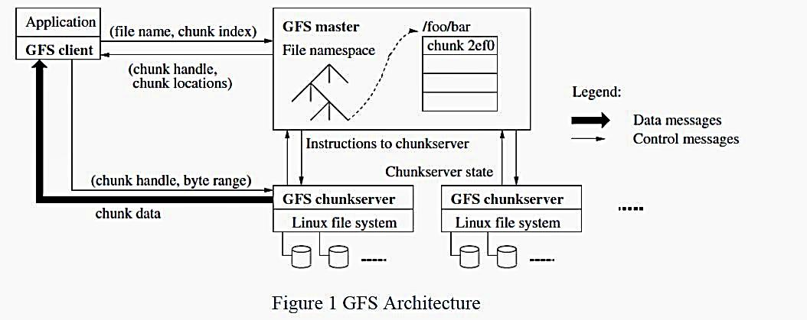
GFS Architecture

Slide 7
Master server
Maintains all metadata
Name space, access control, file-to-chunk mappings
Chunk lease management
Garbage collection, chunk migration
Sending Heartbeat messages to chunk servers
Giving instructions; Collection of state information

Slide 8
GFS clients
Linked to applications
Communicates with master and chunkservers on behalf of the client
Consult master for metadata
Access data from chunkservers
No caching of file data at clients and chunkservers
Streaming reads and append writes do not benefit from caching

Slide 9
Single-Master Design
Can use global knowledge to devise efficient decisions for chunk placement and replication
Clients ask Master which chunkserver it should contact
This information is cached at the client for some time
A client typically asks for multiple chunk locations in a single request
The master proactively provides chunk locations immediately following those requested
Reduces future interactions at no cost

Slide 10
Chunk Size
64 MB; much larger than typical file system block size
Fewer chunk location requests to the master
Good for applications that mostly read and write large files sequentially
Reduced network overhead to access a chunk
May keep a persistent TCP connection for some time
Fewer metadata entries
Kept in memory
Some potential problems with fragmentation

Slide 11
Metadata
Three major types
File and chunk namespaces
File-to-chunk mappings
Locations of a chunk’s replicas
All kept in memory
The first two metadata are also kept persistent
Quick global scans
Garbage collections
Reorganizations for chunk failures, balancing load and better disk space utilization.
64 bytes per 64 MB of data

Slide 12
Chunk Locations
No persistent states
Polls chunkservers at startup
Use heartbeat messages to monitor chunk servers thereafter
On-demand approach vs. coordination
On-demand wins when changes (failures) are often
Chunkservers join and leave a cluster
Chunkservers may change names, fail or restart
Changes happen often with a cluster having hundreds of servers

Slide 13
Operation Logs
Metadata updates are logged
e.g., <old value, new value> pairs
Log replicated on remote machines
Files and chunks, and their versions are also identified by the logical times at which they are created
Take global snapshots (checkpoints) to truncate logs
Recovery
Latest checkpoint + subsequent log files

Slide 14
System Interactions
The master grants a chunk lease to a replica, called the primary
The primary picks a serial order for all mutations to the chunk
A mutation is an operation that changes the contents or the metadata of a chunk
Write or append operation
The replica holding the lease determines the order of updates to all replicas
Lease
60 second timeouts
Can be extended indefinitely by the primary as long as the chunk is being changed
Extension request are piggybacked on heartbeat messages
After a timeout expires, the master can grant new leases

Slide 15
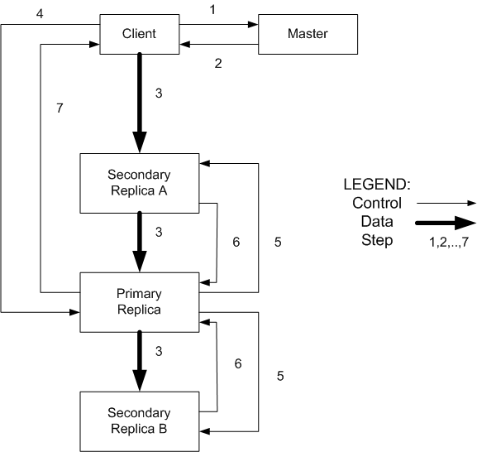
Write Process

Slide 16
Consistency Model
Changes to namespace (i.e., metadata) are atomic
Done by single master server
Master uses log to define global total order of namespacechanging operations
Data changes more complicated
File region is consistent if all clients see as same, regardless of replicas they read from
File region is defined after data mutation if it is consistent, and all clients see that entire mutation

Slide 17
Serial writes guarantee region is defined and consistent
But multiple writes from the same client may be interleaved or overwritten by concurrent operations from other clients
Consistent but not defined
Record append completes at least once, at offset of GFS’ choosing
Application must cope with this semantics, and possible duplicates

Slide 18
Data Flow
Separation of control and data flows
Avoid network bottleneck
Control flows from the client to the primary and then to all secondaries
Data are pushed linearly among chain of chunkservers having replicas
Each machine forwards data to its closest machine which has not received it
Pipelined transfers using a switched networks with full duplex links

Slide 19
Master Operations
Namespace management with locking
Replica creation, re-replication
Garbage Collection
Stale chunk detection

Slide 20
Locking Operations
Many master operations can be time consuming
Allow multiple master operations and use locks over regions of the namespace
GFS does not have a per directory data structure
GFS does not allow hard or symbolic links
Represents namespace as a lookup table mapping full pathnames to metadata.
A lock per path
To access /d1/d2/leaf, need to lock /d1, /d1/d2, and /d1/d2/leaf
Can modify a directory concurrently
Each thread acquires a read lock on a directory and a write lock on a file
Totally ordered (first by level and lexicographically in the same level) locking to prevent deadlocks

Slide 21
Replica Placement
Goals:
Maximize data reliability and availability
Maximize network bandwidth
Need to spread chunk replicas across machines and racks
Guards against disk or machine failures (different machines)
Guards against network switch failures (different racks)
Utilizes aggregate network bandwidth for read operations
Write traffic has to flow through different racks
Higher priority to replica chunks with lower replication factors
Limited resources spent on replication

Slide 22
Replica creation, re-replication
Creation of empty replicas
Placement in servers with below average disk utilization
Limit recent creation on the same server
Spread replicas across racks
Re-replication
Server becomes unavailable or corrupted
Re-replicate chunks with some priority
Chunks having one replica
Chunks with live usage with running applications
Master is involved only in picking up a high priority chunk and then instructs a suitable server for cloning directly from the valid replica

Slide 23
Garbage Collection
Deleted files are marked and hidden for three days
Then they are garbage collected
Master deletes the metadata for the deleted file
Server identifies the set of deleted chunks during regular heartbeat messages
Server deletes its deletes replicas of chunks
Combined with other background operations (regular scans of namespaces or handshakes with servers)
Done in batches and thus the cost is amortized
Simpler than eager deletion due to
Unfinished replicated creation
Lost deletion messages
Safety net against accidental irreversible deletions

Slide 24
Fault Tolerance and Diagnosis
Fast recovery
Master and chunkserver are designed to restore their states and start in seconds regardless of termination conditions
No distinction between normal and abnormal termination
Chunk replication
Master replication
Master state is replicated on multiple machines
Operation log and checkpoints are replicated
Commit to a mutation happens after flushing logs to all replicas
Infrastucture outside GFS starts a new master on failure
Clients use a canonical name which is a DNC-alias for a server
Shadow masters provide read-only access when the primary master is down

Slide 25
Fault Tolerance: Data Integrity
A chunk is divided into 64-KB blocks having 32bit checksum
Each chunkserver uses checksum to detect corruption of stored data
Verified at read and write times
Chunkserver returns error to the requestor and reports the error to master
Master creates a new replica and instructs to the server to delete its chunk
Checksum has little performance overhead on read operations and on record append operations
Chunkservers employ background scans for rarely used chunks

Slide 26
GFS: Summary
Success: used actively by Google to support search service and other applications
Availability and recoverability on cheap hardware
High throughput by decoupling control and data
Supports massive data sets and concurrent appends
Semantics not transparent to apps
Must verify file contents to avoid inconsistent regions, repeated appends (at-least-once semantics)
Performance not good for all apps

