Slide 1
Distributed File Systems
CS60002: Distributed Systems
Antonio Bruto da Costa
Ph.D. Student, Formal Methods Lab,
Dept. of Computer Sc. & Engg.,
Indian Institute of Technology Kharagpur

Slide 2
What is a Distributed File System
DFS: distributed implementation of a file system
Files, file servers, and users are all dispersed around the network
Main Goal: DFS should look like a centralized file system to a user
Ability to open and update any file on any machine on the network
Ability to share files, the same as shared local files
DESIGN GOALS
Network Transparency
High Availability
Scalability
Concurrency

Slide 3
Design Goals
Network transparency
Same set of file operations for both local and remote files
Uniform naming scheme for local and remote files
Similar access time for local and remote files
High availability
Files should not become unavailable for “small” failures
Scalability
No. of users, file servers, files handled etc.
Concurrency
Handle concurrent access by different clients in the network

Slide 4
DFS Architecture
Client Server Architecture
Network File System (NFS)
Cluster Based Architecture
Google File System

Slide 5
Design Issues : Naming Schemes
Files named by combination of host name and local name
Not location transparent
Single global namespace spanning all files
Location transparent
All systems see the same directory structure
A server crash affects all machines
Example: Andrew File System (AFS)

Slide 6
DNS Names
Mount remote directories to local directories
Location transparent
Directory structure seen by different machines possibly different
Mount only when needed, what is needed
Mounted remote directories can be accessed transparently
Example: Network File System (NFS)

Slide 7
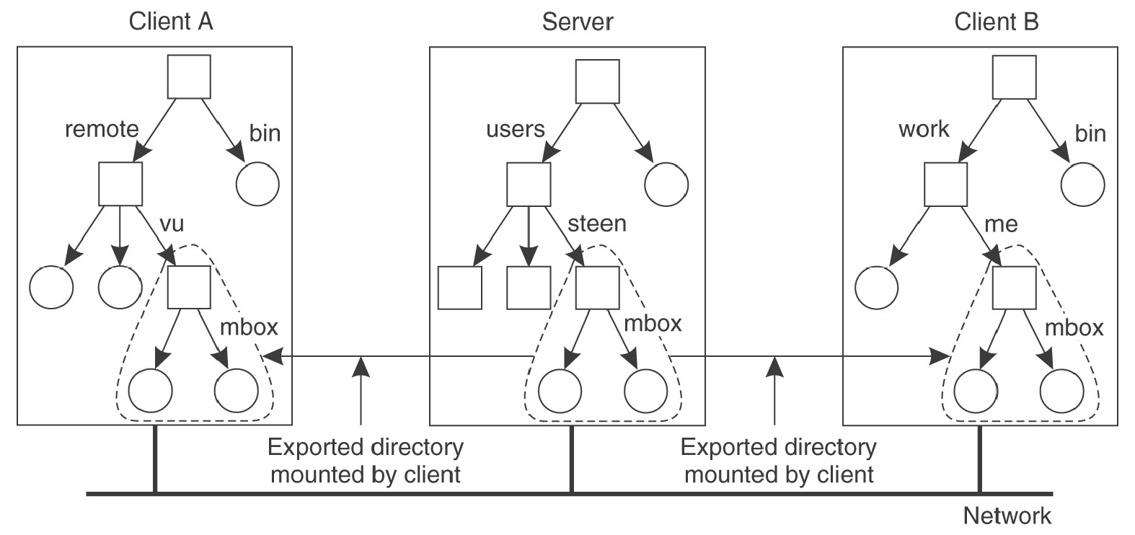
Mounting Remote Directories (An Example: NFS)

Slide 8
Pathname Translation
Consider /remote/vu/mbox in A
/remote/vu looked up in A the usual way
Low level entry for vu contains information that it is actually /users/steen in server
Request sent to server to look up /users/steen/mbox
What if the name crosses multiple machine boundaries?

Slide 9
Caching to Improve Performance
Reduce network traffic by retaining recently accessed disk blocks in local cache
Repeated accesses to the same information can be handled locally from the cached copy
If data accessed not in cache, copy of data brought from the server to the local cache
Copies of parts of file may be scattered in different caches.
Cache-consistency problem – keeping the cached copies consistent with the master file in the presence of write operations

Slide 10
Design Issue: Caching
Cache location
Granularity of cached data
Update policy
Cache consistency

Slide 11
Cache Location
In client memory
Faster access
Good when local usage is transient
Enables diskless workstations
On client disk
Good when local usage dominates
Can cache larger files
Helps protect clients from server crashes

Slide 12
Granularity of Cached Data
Whole file
Easier to maintain consistency
High transfer time, specially if only a small part of the file is accessed
One or more blocks
Low transfer time, transfer as and when needed
More complex consistency issues
In general, increasing granularity means higher chance of finding next accessed data, but also higher transfer time

Slide 13
Cache Update Policies
When is cached data at the client updated in the master file?
Write-through – write data through to disk when cache is updated
Reliable, but poor performance
Delayed-write – cache and then write to the server later
Write operations complete quickly; some data may be overwritten in cache, saving needless network I/O
Poor reliability
Unwritten data may be lost when client machine crashes
Inconsistent data
Variation – write dirty blocks back at regular intervals

Slide 14
Cache Consistency
Is locally cached copy of the data consistent with the master copy?
Client-initiated approach
Client initiates a validity check with server
Server verifies local data with the master copy
Can use timestamps, version no….
Server-initiated approach
Server records (parts of) files cached in each client
When server detects a potential inconsistency, it invalidates the client caches

Slide 15
Sharing Semantics in DFS
Unix Semantics
Read after write
Every change becomes instantly visible to all processes
Session Semantics
Same as unix semantics for local clients of a file
For remote clients, changes to a file are initially visible to the process that modified the file. Only when the file is closed, the changes are visible to other processes.
Immutable files

Slide 16
Stateless vs Stateful Service
Stateless service
No open and close calls to access files
Each request identifies the file and position in file
No client state information in server by making each request self-contained
Advantages
Better failure recovery
Disadvantage
Longer request messages, longer processing time

Slide 17
Stateful Service
Client opens a file
Server fetches information about file from disk, stores in server memory
Returns to client a connection identifier unique to client and open file
Identifier used for subsequent accesses until session ends
Server must reclaim space used by no longer active clients
Advantages
Increased performance; fewer disk accesses
Disadvantages
Poor failure recovery

Slide 18
Network File System (NFS)
CS60002: Distributed Systems
Antonio Bruto da Costa
Ph.D. Student, Formal Methods Lab,
Dept. of Computer Sc. & Engg.,
Indian Institute of Technology Kharagpur

Slide 19
Main Idea
Server exports parts of a filesystem to clients (Ex. specified in /etc/exports file in Linux)
Clients “mount” server exported namespace at specific mount points in its namespace tree (specified in /etc/fstab in Linux; can be mounted separately by mount command also)
Same server filesystem can be mounted at different mount points at different clients, so no single global name space
Mounts can be cascaded
But client must mount from different servers explicitly itself

Slide 20
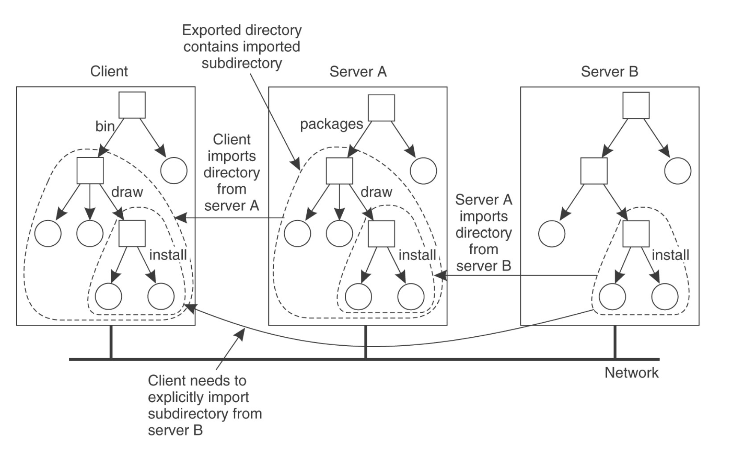
Nested Mounting (NFS v3)

Slide 21
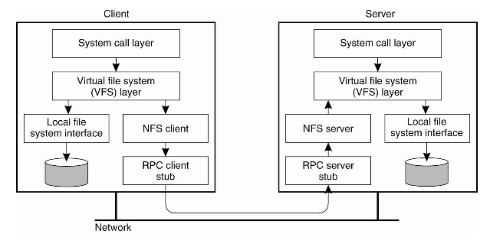
Basic NFS Architecture

Slide 22
Other details
Location transparent naming (host id needed only during mount)
Pathname translation
Look up each component in the pathname recursively
Lookup call made to server when a mount point is crossed
Cascading mounts can involve multiple servers during translation
Set of operations provided for operations on files
Lookup, read, write, mkdir, rename, rmdir, readdir, getattr, setattr…
No open or close calls (stateless server)
Most data-modifying calls are synchronous
Most calls work on an opaque (to client) file handle returned to the client by the server
Uniquely identifies the file in the server
RPC (Remote Procedure Call) used to communicate between server and client

Slide 23
Caching in NFSv3
Strictly not part of NFS protocol, but used in practice for performance
File attributes cached along with file block.
Cached file block used subject to consistency checks on file attributes
8 Kb blocks for v2, negotiable for v3
No locking, no synchronization as part of NFS
Separate centralized locking mechanism using lockd
No clear semantics because of caching nature

Slide 24
NFS v4 Improvements
Improved access and good performance on the Internet
Transit across firewalls, perform well in high latency low bandwidth scenarios, scale to very large numbers of clients per server
Strong security with negotiation built into the protocol.
Supports the RPCSEC_GSS protocol, provides a mechanism for clients and servers to negotiate security parameters, requires clients and servers to support a minimal set of security schemes
Good cross-platform interoperability

Slide 25
NFS v4: COMPOUND Operation
Allows building more complex requests by combining one or more traditional NFS procedures
Example: read data from a file in one request by combining LOOKUP, OPEN, and READ operations in a single COMPOUND RPC.
Reduces the number of RPCs needed for logical file system operations
The operations combined within a COMPOUND request are evaluated in order by the server. Once an operation returns a failing result, the evaluation ends and the results of all evaluated operations are returned to the client
Still uses filehandle as the id of the file. Passes a filehandle from one operation to another within the sequence of operations

Slide 26
NFS v4: Open and Close
The NFS version 4 protocol introduces OPEN and CLOSE operations
Stateful model
The OPEN operation provides a single point where file lookup, creation, and share semantics can be combined
The CLOSE operation also provides for the release of state accumulated by OPEN.

Slide 27
NFS v4: Locking
Locking
No separate lock manager as in v3
Lease based locking model as part of NFS
State associated with file locks maintained at the server

Slide 28
NFS v4: Caching
The client checks validity of cached file data when the file is opened
Checks with server if the file has been changed
Based on this, the client determines if the cached file data should kept or released
When the file is closed, any modified data is written to the server
Serializing access to file data can be done through locking

Slide 29
NFS v4: Open Delegation
Server can delegate some responsibilities to the client for a file
At OPEN, the server may provide the client either a read or write delegation for the file
Assures certain semantics to the client
If the client is granted an open delegation, the client machine can locally handle open and close operations from other clients in the same machine.
Allows the client to locally service operations such as OPEN, CLOSE, LOCK, LOCKU, READ, WRITE without immediate interaction with the server

Slide 30
NFS v4: Recalling Delegation
Delegations can be recalled by the server
If another client requests access to the file such that the access conflicts with the granted delegation, the server can recall the delegation from initial client
Problems with delegation and stateful servers
Failure handling

Slide 31
NFS v4: Replication
locations attribute at server can store the location of a file system
If a file system is migrated in between, the client will receive an error when operating on the file system
The client can then probe the server query for the new file system location.
The attribute can also hold multiple server locations to allow replication of file systems
Client can use its own policies to access one of the replicas

Slide 32
NFS v4: Security
Use of RPCSEC_GSS
Security framework to support multiple ways of setting up secure channels
Supports message integrity and confidentiality
Should be configured with Kerberos
Support for authentication
It must also support a method LIPKEY
LIPKEY is a public key system
Clients are authenticated using passwords
Servers are authenticated using a public key

