Slide 1

Kerberos
CS60002: Distributed Systems
Antonio Bruto da Costa
Ph.D. Student, Formal Methods Lab,
Dept. of Computer Sc. & Engg.,
Indian Institute of Technology Kharagpur

Slide 2
Origins
Project Athena
Started in 1983 by MIT, Digital Equipment Corporation and IBM
Purpose of producing a campus wide distributed computing environment for educational use.
Outcomes of Project Athena include : X-Windowing System, Kerberos, Zephyr Notification System
Design Considerations for Kerberos
No passwords communicated over the n/w.
Cryptographic protection
Limited period of validity of sessions
Timestamping to prevent replay attacks.
Mutual authentication

Slide 3
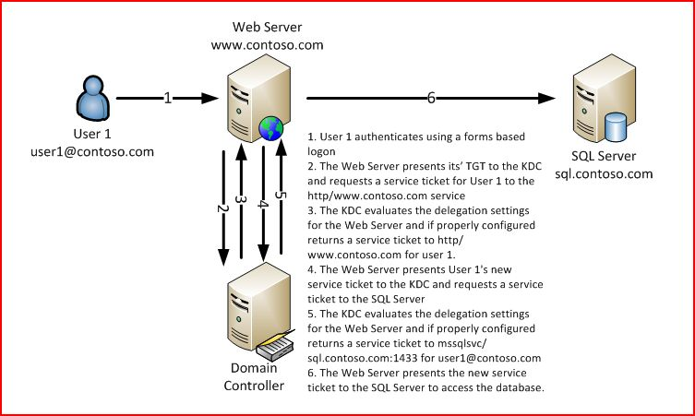
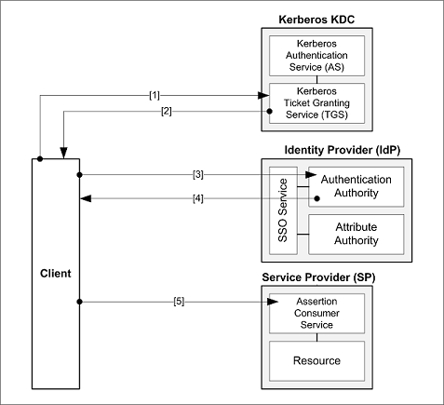
Use-case

Slide 4
Authenticating to Multiple Servers
Consider a set of users that needs to access different services on the net
Need to authenticate to each of them
Naïve solution: every server knows every user’s password
Insecure: breaking into one server can compromise all users
Inefficient: to change password, a user must contact every server

Slide 5
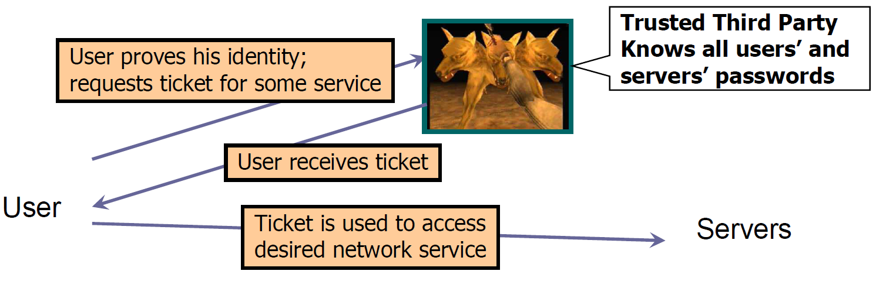
Trusted Third Party
Trusted authentication service on the network
Knows all passwords, can grant access to any server
Convenient, but also the single point of failure
Requires high level of physical security

Slide 6
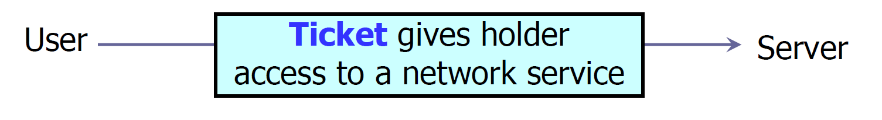
What is a ticket?
Ticket cannot include server’s plaintext password
Otherwise, next time user will access server directly without proving his identity to authentication service
Solution: encrypt some information with a key known to the server (but not the user!)
Server can decrypt ticket and verify information
User does not learn server’s key

Slide 7
Contents of a Ticket
User name
Server name
Address of user’s workstation
Otherwise, a user on another workstation can steal the ticket and use it to gain access to the server
Ticket lifetime (duration for which valid)
A few other things (e.g., session key)
Typically encrypted using the private key of the service or TGS to be accessed.

Slide 8
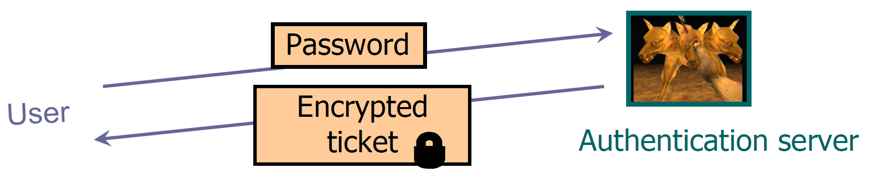
User Authentication to Third Party
Insecure:
Eavesdropper can steal the password and later impersonate the user to the authentication server
Inconvenient:
Need to send the password each time to obtain the ticket for any network service
Separate authentication for email, printing, etc.

Slide 9
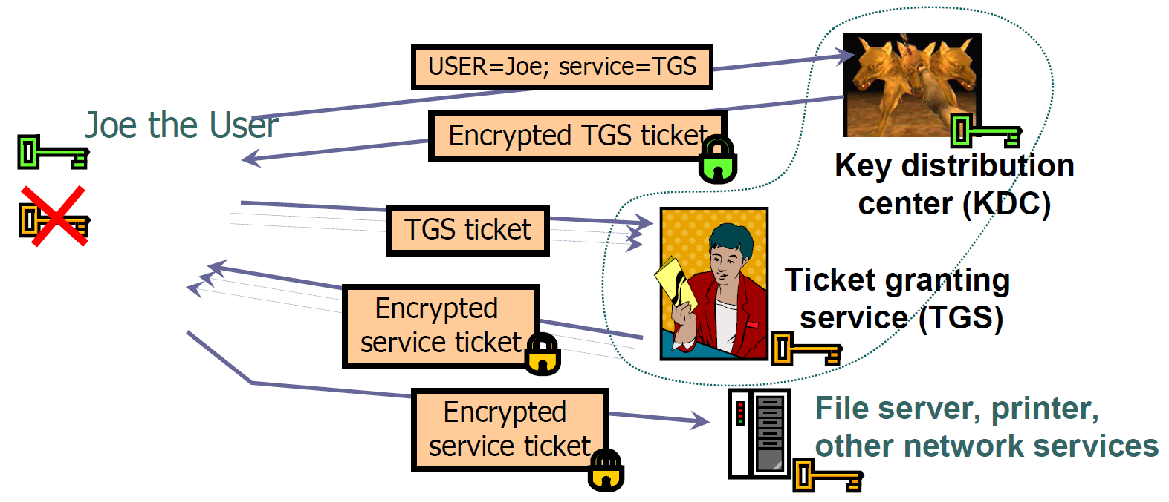
Two-Step Authentication
Prove identity once to KDC obtain special TGS ticket
Use TGS ticket in communications with TGS to get tickets for any network service

Slide 10
Symmetric Keys in Kerberos
K_{c} : private key of client C
Derived from user’s password
Known to client and key distribution center (KDC)
K_{TGS} : private key of TGS
Known to KDC and ticket granting service (TGS)
K_{v} : private key of network service V
Known to V and TGS; separate key for each service
K_{c,TGS} : session key between C and TGS
Created by KDC, known to C and TGS, valid only for one session (some lifetime) between C and TGS
K_{c,v} : session key between C and V
Created by TGS, known to C and V, valid only for one session (some lifetime) between C and TGS

Slide 11
“Single Logon” Authentication
Client C types in password once
Converted to client key K_{c}
C sends to KDC : (IDC, IDTGS, time_{C})
KDC sends to C : (K_{c,TGS} , ID_{TGS}, time_{KDC}, lifetime, ticket_{TGS}) encrypted with K_{c}
ticket_{TGS} = (K_{c,TGS} , ID_{C}, Addr_{C} , ID_{TGS} , time_{KDC} , lifetime) encrypted with K_{TGS}
Client will use this ticket to get other tickets without re-authenticating
K_{C,TGS} : short term session key
used for communication between C and TGS during lifetime
Typical validity of TGS ticket – 1 day
Client only needs to obtain TGS ticket once a day (say, every morning)
Password is entered once and then deleted from the client machine after obtaining the TGS ticket
Password is never sent over the network
Ticket is encrypted; client cannot forge it or tamper with it

Slide 12
Obtaining a Service Ticket
Client C sends to TGS: (ID_{V} , ticket_{TGS}, auth_{C})
auth_{C} = (ID_{C} , Addr_{C} , time_{C}) encrypted with K_{C,TGS}
authenticator to ensure it is the same client that got the ticket
TGS sends to C: (K_{C,V} , ID_{V} , time_{TGS} , ticket_{V}) encrypted with K_{C,TGS}
ticket_{V} = (K_{C,V}, ID_{C}, Addr_{C}, ID_{V} , time_{TGS}, lifetime) encrypted with K_{V}
Client uses TGS ticket to obtain a service ticket and a short-term session key for each network service
One encrypted, unforgeable ticket per service (printer, email, etc.)

Slide 13
Obtaining Service
C sends to V: (ticket_{V} , auth_{C})
auth_{C} = (ID_{C} , Addr_{C} , time_{C}) encrypted with K_{C,V}
V sends to C: (time_{C}+1) encrypted with K_{C,V}
Authenticates server to client
For each service request, client uses the short-term session key for that service and the ticket he received from TGS

Slide 14
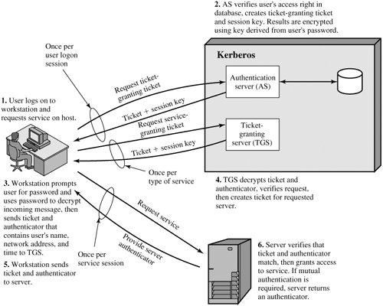
Summary of Kerberos
User is authenticated by the KDC, receives a ticket for the TGS.
User uses TGS ticket (typical validity of one day) to request a service ticket from the TGS.
User uses Service Ticket to contact service.

Slide 15
Important Ideas in Kerberos
Short-term session keys
Long-term secrets used only to derive short-term keys
Separate session key for each user-server pair
… but multiple user-server sessions re-use the same key
Proofs of identity are based on authenticators
Client encrypts his identity, address and current time using a short-term session key
Also prevents replays (if clocks are globally synchronized)
Server learns this key separately (via encrypted ticket that client can’t decrypt) and verifies user’s identity

Slide 16
Kerberos in Larger Networks
One KDC isn’t enough for large networks (why?)
Network is divided into realms
KDCs in different realms have different key databases
To access a service in another realm, users must do cross-realm authentication
Get ticket for home-realm TGS from home-realm KDC
Get ticket for remote-realm TGS from home-realm TGS
As if remote-realm TGS were just another network service
Get ticket for remote service from that realm’s TGS
Use remote-realm ticket to access service
N(N-1)/2 key exchanges for full N-realm interoperation (NOT SCALABLE)
Use Hierarchical cross-realm authentication

Slide 17
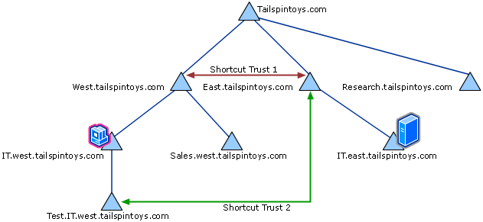
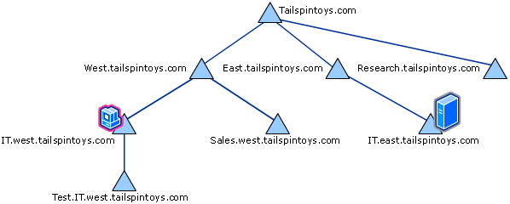
Hierarchical Cross-realm Authentication
Organise the realms as trees
Each node’s TGS knows the TGS key of its parent and children.
Without Shortcut Paths
With Shortcut Paths

Slide 18
Additional Caveats
Tickets can be of different types
Renewabel Ticket:
Can be a TGS or Service Ticket
Client gets a ticket with renewable flag set and 2 timelimits t₁(Current Expiry) and t₂(Max Expiry)
Possibility 1: Ticket expires at t₁ (nothing is done to renew)
Possibility 2: Ticket is presented to ticketing agent (KDC or TGS) before t₁ for renewal.

Slide 19
Forwardable Tickets
Authentication forwarding is an instance of a proxy where the service that is granted is complete use of the client's identity.
The FORWARDABLE flag in a ticket is normally only interpreted by the ticket-granting service. It can be ignored by application servers.
With the FORWARDABLE flag TGTs may also be issued with different network addresses.
This flag allows for authentication forwarding without requiring the user to enter a password again.
The FORWARDED flag is set by the TGS on request.
Client supplies a set of addresses for the new ticket. It is also set in all tickets issued based on tickets with the FORWARDED flag set.
Application servers may choose to process FORWARDED tickets differently than non-FORWARDED tickets.
S₁
C
S₂
TGS

