Slide 1
Commit Protocols
CS60002: Distributed Systems

Slide 2
Distributed Transactions
Transaction may access data at several sites.
Each site has a local transaction manager responsible for:
Maintaining a log for recovery purposes
Participating in coordinating the concurrent execution of the transactions
executing at that site.
Each site has a transaction coordinator, which is responsible for:
Starting the execution of transactions that originate at the site.
Distributing subtransactions at appropriate sites for execution.
Coordinating the termination of each transaction that originates at the site,
which may result in the transaction being committed at all sites or aborted at
all sites.

Slide 3
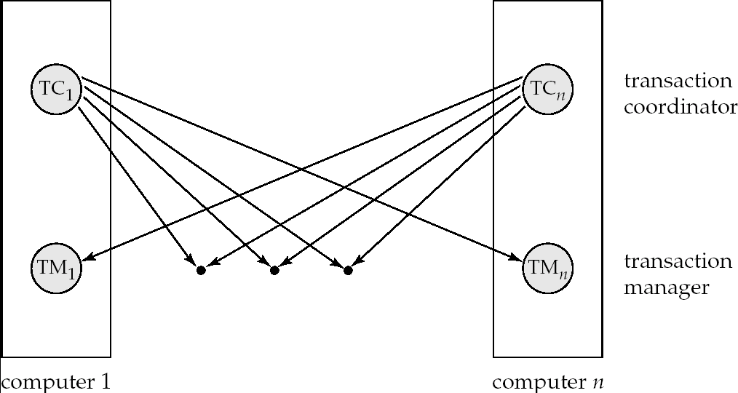
Transaction System Architecture

Slide 4
System Failure Modes
Failures unique to distributed systems:
Failure of a site.
Loss of massages
Handled by network transmission control protocols such as TCP-IP
Failure of a communication link
Handled by network protocols, by routing messages via alternative links
Network partition
A network is said to be partitioned when it has been split into two or more subsystems that lack any connection between them
Note: a subsystem may consist of a single node
Network partitioning and site failures are generally indistinguishable.

Slide 5
Commit Protocols
Commit protocols are used to ensure atomicity across sites
a transaction which executes at multiple sites must either be committed at all the sites, or aborted at all the sites.
not acceptable to have a transaction committed at one site and aborted at another
The two-phase commit (2PC) protocol is widely used
The three-phase commit (3PC) protocol is more complicated and more expensive, but avoids some drawbacks of two-phase commit protocol. This protocol is not used in practice.

Slide 6
Two Phase Commit Protocol (2PC)
Assumes fail-stop model – failed sites simply stop working, and do not cause any other harm, such as sending incorrect messages to other sites.
Execution of the protocol is initiated by the coordinator after the last step of the transaction has been reached.
The protocol involves all the local sites at which the transaction executed
Let T be a transaction initiated at site S_{i}, and let the transaction coordinator at S_{i} be C_{i}

Slide 7
Phase 1: Obtaining a Decision
Coordinator asks all participants to prepare to commit transaction T_{i}.
C_{i} adds the records <prepare T> to the log and forces log to stable storage
sends prepare T messages to all sites at which T executed
Upon receiving message, transaction manager at site determines if it can commit the transaction
if not, add a record <no T> to the log and send abort T message to C_{i}
if the transaction can be committed, then:
add the record <ready T> to the log
force all records for T to stable storage
send ready T message to C_{i}

Slide 8
Phase 2: Recording the Decision
T can be committed of C_{i} received a ready T message from all the participating sites: otherwise T must be aborted.
Coordinator adds a decision record, <commit T> or <abort T>, to the log and forces record onto stable storage. Once the record stable storage it is irrevocable (even if failures occur)
Coordinator sends a message to each participant informing it of the decision (commit or abort)
Participants take appropriate action locally.

Slide 9
Handling of Failures - Site Failure
When site S_{i} recovers, it examines its log to determine the fate of transactions active at the time of the failure.
Log contain <commit T> record: site executes redo (T)
Log contains <abort T> record: site executes undo (T)
Log contains <ready T> record: site must consult C_{i} to determine the fate of T.
If T committed, redo (T)
If T aborted, undo (T)
The log contains no control records concerning T replies that S_{k} failed before responding to the prepare T message from C_{i}
since the failure of S_{k} precludes the sending of such a response C₁ must abort T
S_{k} must execute undo (T)

Slide 10
Handling of Failures- Coordinator Failure
If coordinator fails while the commit protocol for T is executing then participating sites must decide on T’s fate:
If an active site contains a <commit T> record in its log, then T must be committed.
If an active site contains an <abort T> record in its log, then T must be aborted.
If some active participating site does not contain a <ready T> record in its log, then the failed coordinator C_{i} cannot have decided to commit T. Can therefore abort T.
If none of the above cases holds, then all active sites must have a <ready T> record in their logs, but no additional control records (such as <abort T> of <commit T>). In this case active sites must wait for C_{i} to recover, to find decision.
Blocking problem : active sites may have to wait for failed coordinator to recover.

Slide 11
Handling of Failures - Network Partition
If the coordinator and all its participants remain in one partition, the failure has no effect on the commit protocol.
If the coordinator and its participants belong to several partitions:
Sites that are not in the partition containing the coordinator think the coordinator
has failed, and execute the protocol to deal with failure of the coordinator.
No harm results, but sites may still have to wait for decision from coordinator.
The coordinator and the sites are in the same partition as the coordinator think that the sites in the other partition have failed, and follow the usual commit protocol.
Again, no harm results

Slide 12
Recovery and Concurrency Control
In-doubt transactions have a <ready T>, but neither a <commit T>, nor an <abort T> log record.
The recovering site must determine the commit-abort status of such transactions by contacting other sites; this can slow and potentially block recovery.
Recovery algorithms can note lock information in the log.
Instead of <ready T>, write out <ready T, L> L = list of locks held by T when the log is written (read locks can be omitted).
For every in-doubt transaction T, all the locks noted in the <ready T, L> log record are reacquired.
After lock reacquisition, transaction processing can resume; the commit or rollback of in-doubt transactions is performed concurrently with the execution of new transactions.

Slide 13
Three Phase Commit (3PC)
Assumptions:
No network partitioning
At any point, at least one site must be up.
At most K sites (participants as well as coordinator) can fail
Phase 1: Obtaining Preliminary Decision: Identical to 2PC Phase 1.
Every site is ready to commit if instructed to do so

Slide 14
Three Phase Commit (3PC)
Phase 2 of 2PC is split into 2 phases, Phase 2 and Phase 3 of 3PC
In phase 2 coordinator makes a decision as in 2PC (called the pre-commit
decision) and records it in multiple (at least K) sites
In phase 3, coordinator sends commit/abort message to all participating sites,
Under 3PC, knowledge of pre-commit decision can be used to commit despite coordinator failure
Avoids blocking problem as long as < K sites fail
Drawbacks:
higher overheads
assumptions may not be satisfied in practice

