Slide 1
Teasing your Brain
to Think Critically
The Art and Science of Solving Puzzles
Pritam Bhattacharya
(STCS, TIFR)

Slide 2
A Roadmap
The River Crossing Problem
The Mathematician’s Daughters
Love in Kleptopia

Slide 3
A Roadmap
The River Crossing Problem
The Mathematician’s Daughters
Love in Kleptopia
Hilbert’s Infinite Hotel

Slide 4
The River Crossing Problem
There are 3 cannibals & 3 missionaries,
all standing on one bank of a river
They need to get across a river
There is a boat of capacity 2
If they are outnumbered, missionaries
will be devoured by the cannibals
How can all of them get to the other side of the river safely?

Slide 5
The River Crossing Problem
(An Approach to a Solution)
A Feasible Path Based Approach

Slide 6
The River Crossing Problem
(Some Questions to Ponder)
Is the solution we just saw the only possible solution? If not, how many other solutions exist?
Among all possible solutions, did the solution we just saw use the least number of trips?

Slide 7
The Mathematician’s Daughters
Mathematician has 3 daughters
Product of their ages = 36
Sum of their ages = 13
Youngest daughter had a haircut
What were the ages of the mathematician’s daughters?
(Assume ages to be integers)

Slide 8
The Mathematician’s Daughters
(The Path to the Solution)
Product of their ages = 36
Sum of their ages = 13
Youngest daughter had a haircut
(1,1,36)
(1,6,6)
(1,3,12)
(1,4,9)
(1,2,18)
(3,3,4)
(2,3,6)
(2,2,9)

Slide 9
Love in Kleptopia
Kleptopia is a country full of thieves.
Bob and Alice are citizens of Kleptopia.
Bob plans to send an engagement ring to Alice.
Needs to send it in a locked box to prevent theft.
But then, Bob also needs to send the key to Alice.
Key will get stolen if not sent in a locked box.
How can Bob send the ring
so that it does not get stolen
and Alice can retrieve it?

Slide 10
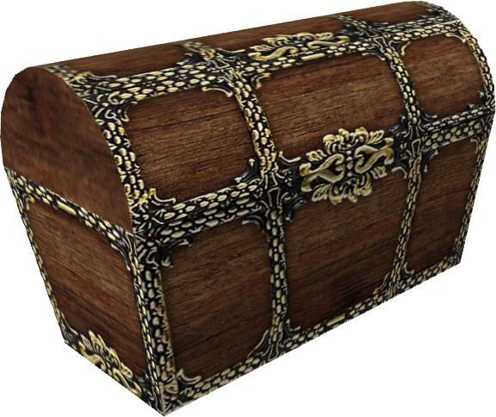
BOB
Alice

Slide 11
BOB
Alice

Slide 12
BOB
Alice

Slide 13
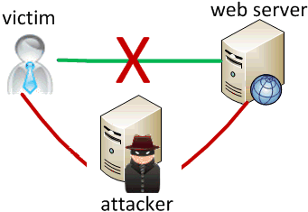
A Connection to Data Security
RSA Cryptosystem
Diffie-Hellman Key Exchange

Slide 14
The Hardness of Factorization
Given 2 integers, it is easy to find their product.
However, given an integer, it can be quite hard
to find its prime factors, especially when it has
large prime factors.
For certain numbers with lots of digits, it can take
even the fastest supercomputers a few years to
come up with the prime factors of that integer.
Can you tell me the prime factors of the number 8192?
Can you tell me the prime factors of the number 8633?
The security of the RSA cryptosystem is based on
this very fact that factorization can be really hard.

Slide 15
Hilbert’s Infinite Hotel (v1)
There is a grand hotel with infinitely many rooms.
On a particular morning, a mathematician comes
along and asks for a room.
Despite being told repeatedly by the manager
that there are no vacancies, he insists that he can
still be accommodated and actually proves it.
How did the mathematician justify his claim and convince the manager of the hotel?

Slide 16
Hilbert’s Infinite Hotel (v1) –
The Solution
Ask the guest in room 1 to move to room 2, the
guest in room 2 to move to room 3, the guest in
room 3 to move to room 4, and so on …
This ensures that every guest who already had a
room in the hotel gets a new room to stay in.
But, at the same time, the room 1 is freed up,
allowing the new guest to be accommodated.

Slide 17
Hilbert’s Infinite Hotel (v2)
On a particular morning, a bus carrying an infinite
number of mathematicians arrives at the same
hotel and they all ask for rooms to be put up in.
Despite being told repeatedly by the manager
that there are no vacancies, they insist that all of
them can still be accommodated and prove it.
How did the mathematicians justify their claim and convince the manager of the hotel?

Slide 18
Hilbert’s Infinite Hotel (v2) –
The Solution
Ask the guest in room 1 to move to room 2, the
guest in room 2 to move to room 4, the guest in
room 3 to move to room 6, and so on …
This ensures that every guest who already had a
room in the hotel gets a new room to stay in.
But, at the same time, all odd-numbered rooms
are freed up, allowing the infinitely many new
guests to be accommodated.

Slide 20
Take Home Message
Solving logical puzzles can be loads of fun!
They hone your critical thinking abilities.
May lead to solution for a real-life problem.
May lend insight into a deep concept.

Slide 21
Take Home Message
Solving logical puzzles can be loads of fun!
They hone your critical thinking abilities.
May lead to solution for a real-life problem.
THANK YOU!

