Slide 1
Lecture 12: Relevance Feedback & Query Expansion - II

Slide 2
Take-away today
Interactive relevance feedback: improve initial retrieval results by telling the IR system which docs are relevant / nonrelevant
Best known relevance feedback method: Rocchio feedback
Query expansion: improve retrieval results by adding synonyms / related terms to the query
Sources for related terms: Manual thesauri, automatic thesauri, query logs
2

Slide 3
Rocchio 1971 algorithm (SMART)
Used in practice:
q_{m}: modified query vector; q₀: original query vector; D_{r} and D_{nr} : sets of known relevant and nonrelevant documents respectively; α, β, and γ: weights
New query moves towards relevant documents and away from nonrelevant documents.
Tradeoff α vs. β/γ: If we have a lot of judged documents, we want a higher β/γ.
Set negative term weights to 0.
“Negative weight” for a term doesn’t make sense in the vector space model.
3

Slide 4
Positive vs. negative relevance feedback
Positive feedback is more valuable than negative feedback.
For example, set β = 0.75, γ = 0.25 to give higher weight to positive feedback.
Many systems only allow positive feedback.
4

Slide 5
Relevance feedback: Assumptions
When can relevance feedback enhance recall?
Assumption A1: The user knows the terms in the collection well enough for an initial query.
Assumption A2: Relevant documents contain similar terms (so I can “hop” from one relevant document to a different one when giving relevance feedback).
5

Slide 6
Violation of A1
Assumption A1: The user knows the terms in the collection well enough for an initial query.
Violation: Mismatch of searcher’s vocabulary and collection vocabulary
Example: cosmonaut / astronaut
6

Slide 7
Violation of A2
Assumption A2: Relevant documents are similar.
Example for violation: [contradictory government policies]
Several unrelated “prototypes”
Subsidies for tobacco farmers vs. anti-smoking campaigns
Aid for developing countries vs. high tariffs on imports from developing countries
Relevance feedback on tobacco docs will not help with finding docs on developing countries.
7

Slide 8
Relevance feedback: Evaluation
Pick one of the evaluation measures from last lecture, e.g., precision in top 10: P@10
Compute P@10 for original query q₀
Compute P@10 for modified relevance feedback query q1
In most cases: q₁ is spectacularly better than q₀!
Is this a fair evaluation?
8

Slide 9
Evaluation: Caveat
True evaluation of usefulness must compare to other methods taking the same amount of time.
Alternative to relevance feedback: User revises and resubmits query.
Users may prefer revision/resubmission to having to judge relevance of documents.
There is no clear evidence that relevance feedback is the “best use” of the user’s time.
9

Slide 10
Relevance feedback: Problems
Relevance feedback is expensive.
Relevance feedback creates long modified queries.
Long queries are expensive to process.
Users are reluctant to provide explicit feedback.
It’s often hard to understand why a particular document was retrieved after applying relevance feedback.
The search engine Excite had full relevance feedback at one point, but abandoned it later.
10

Slide 11
Pseudo-relevance feedback
Pseudo-relevance feedback automates the “manual” part of true relevance feedback.
Pseudo-relevance algorithm:
Retrieve a ranked list of hits for the user’s query
Assume that the top k documents are relevant.
Do relevance feedback (e.g., Rocchio)
Works very well on average
But can go horribly wrong for some queries.
Several iterations can cause query drift.
11

Slide 12
Pseudo-relevance feedback at TREC4
Cornell SMART system
Results show number of relevant documents out of top 100 for 50 queries (so total number of documents is 5000):
method | number of relevant documents
lnc.ltc | 3210
lnc.ltc-PsRF | 3634
Lnu.ltu | 3709
Lnu.ltu-PsRF | 4350
Results contrast two length normalization schemes (L vs. l) and pseudo-relevance feedback (PsRF).
The pseudo-relevance feedback method used added only 20 terms to the query. (Rocchio will add many more.)
This demonstrates that pseudo-relevance feedback is effective on average.
12

Slide 13
Outline
Motivation
Relevance feedback: Basics
Relevance feedback: Details
Query expansion

Slide 14
Query expansion
Query expansion is another method for increasing recall.
We use “global query expansion” to refer to “global methods for query reformulation”.
In global query expansion, the query is modified based on some global resource, i.e. a resource that is not query-dependent.
Main information we use: (near-)synonymy
A publication or database that collects (near-)synonyms is called a thesaurus.
We will look at two types of thesauri: manually created and automatically created.
14

Slide 15
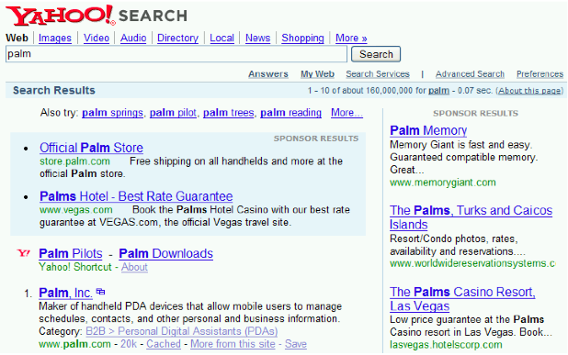
Query expansion: Example
15

Slide 16
Types of user feedback
User gives feedback on documents.
More common in relevance feedback
User gives feedback on words or phrases.
More common in query expansion
16

Slide 17
Types of query expansion
Manual thesaurus (maintained by editors, e.g., PubMed)
Automatically derived thesaurus (e.g., based on co-occurrence statistics)
Query-equivalence based on query log mining (common on the web as in the “palm” example)
17

Slide 18
Thesaurus-based query expansion
For each term t in the query, expand the query with words the thesaurus lists as semantically related with t.
Example from earlier: HOSPITAL → MEDICAL
Generally increases recall
May significantly decrease precision, particularly with ambiguous terms
INTEREST RATE → INTEREST RATE FASCINATE
Widely used in specialized search engines for science and engineering
It’s very expensive to create a manual thesaurus and to maintain it over time.
A manual thesaurus has an effect roughly equivalent to annotation with a controlled vocabulary.
18

Slide 19
Automatic thesaurus generation
Attempt to generate a thesaurus automatically by analyzing the distribution of words in documents
Fundamental notion: similarity between two words
Definition 1: Two words are similar if they co-occur with similar words.
“car” ≈ “motorcycle” because both occur with “road”, “gas” and “license”, so they must be similar.
Definition 2: Two words are similar if they occur in a given grammatical relation with the same words.
You can harvest, peel, eat, prepare, etc. apples and pears, so apples and pears must be similar.
Co-occurrence is more robust, grammatical relations are more accurate.
19

Slide 20
Co-occurence-based thesaurus: Examples
20

Slide 21
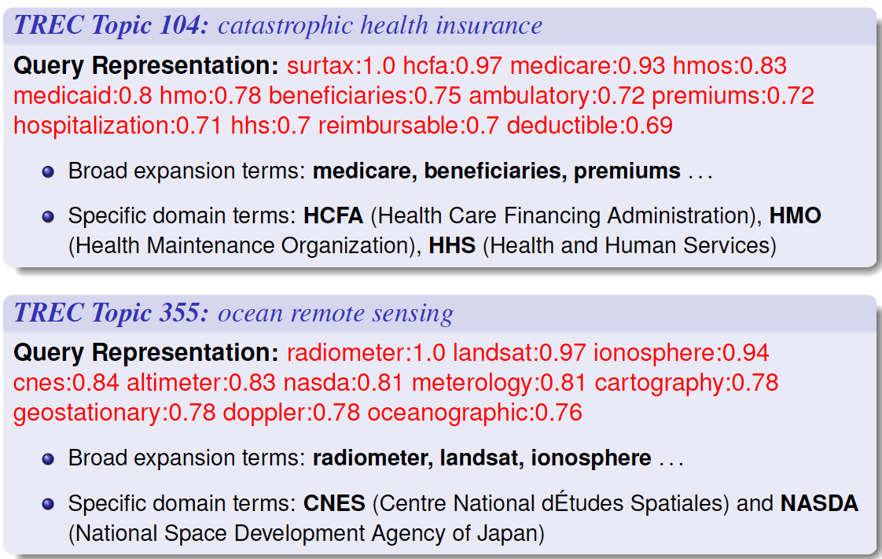
Query Expansion: Examples
Query Expansion: Examples

Slide 22
Query expansion at search engines
Main source of query expansion at search engines: query logs
Example 1: After issuing the query [herbs], users frequently search for [herbal remedies].
→ “herbal remedies” is potential expansion of “herb”.
Example 2: Users searching for [flower pix] frequently click on the URL photobucket.com/flower. Users searching for [flower clipart] frequently click on the same URL.
→ “flower clipart” and “flower pix” are potential expansions of each other.
22

