Slide 1
Lecture 15: Text Classification & Naive Bayes

Slide 2
A text classification task: Email spam filtering
From: ‘‘’’ <takworlld@hotmail.com>
Subject: real estate is the only way... gem oalvgkay
Anyone can buy real estate with no money down
Stop paying rent TODAY !
There is no need to spend hundreds or even thousands for similar courses
I am 22 years old and I have already purchased 6 properties using the
methods outlined in this truly INCREDIBLE ebook.
Change your life NOW !
=================================================
Click Below to order:
http://www.wholesaledaily.com/sales/nmd.htm
=================================================
How would you write a program that would automatically detect
and delete this type of message?
2

Slide 3
Formal definition of TC: Training
Given:
A document set X
Documents are represented typically in some type of high-dimensional space.
A fixed set of classes C = {c₁, c₂, . . . , c_{J}}
The classes are human-defined for the needs of an application (e.g., relevant vs. nonrelevant).
A training set D of labeled documents with each labeled document <d, c> ∈ X × C
Using a learning method or learning algorithm, we then wish to
learn a classifier ϒ that maps documents to classes:
ϒ : X → C
3

Slide 4
Formal definition of TC: Application/Testing
Given: a description d ∈ X of a document Determine: ϒ (d) ∈ C,
that is, the class that is most appropriate for d
4

Slide 5
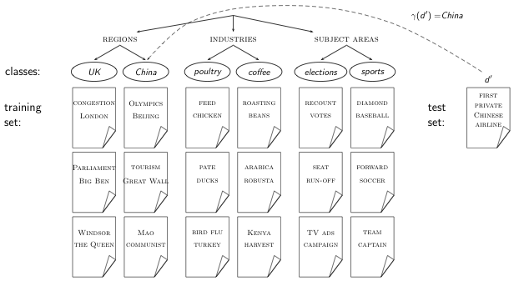
Topic classification
5

Slide 6
Examples of how search engines use classification
Language identification (classes: English vs. French etc.)
The automatic detection of spam pages (spam vs. nonspam)
Topic-specific or vertical search – restrict search to a “vertical” like “related to health” (relevant to vertical vs. not)
6

Slide 7
Classification methods: Statistical/Probabilistic
This was our definition of the classification problem – text classification as a learning problem
(i) Supervised learning of a the classification function ϒ and
(ii) its application to classifying new documents
We will look at doing this using Naive Bayes
requires hand-classified training data
But this manual classification can be done by non-experts.
7

Slide 8
Derivation of Naive Bayes rule
We want to find the class that is most likely given the document:
Apply Bayes rule
Drop denominator since P(d) is the same for all classes:
8

Slide 9
Too many parameters / sparseness
There are too many parameters , one for each unique combination of a class and a sequence of words.
We would need a very, very large number of training examples to estimate that many parameters.
This is the problem of data sparseness.
9

Slide 10
Naive Bayes conditional independence assumption
To reduce the number of parameters to a manageable size, we
make the Naive Bayes conditional independence assumption:
We assume that the probability of observing the conjunction of
attributes is equal to the product of the individual probabilities
P(Xk = tk |c).
10

Slide 11
The Naive Bayes classifier
The Naive Bayes classifier is a probabilistic classifier.
We compute the probability of a document d being in a class c
as follows:
n_{d} is the length of the document. (number of tokens)
P(t_{k} |c) is the conditional probability of term t_{k} occurring in a
document of class c
P(t_{k} |c) as a measure of how much evidence t_{k} contributes
that c is the correct class.
P(c) is the prior probability of c.
If a document’s terms do not provide clear evidence for one
class vs. another, we choose the c with highest P(c).
11

Slide 12
Maximum a posteriori class
Our goal in Naive Bayes classification is to find the “best” class.
The best class is the most likely or maximum a posteriori (MAP) class cmap:
12

Slide 13
Taking the log
Multiplying lots of small probabilities can result in floating point underflow.
Since log(xy) = log(x) + log(y), we can sum log probabilities instead of multiplying probabilities.
Since log is a monotonic function, the class with the highest score does not change.
So what we usually compute in practice is:
13

Slide 14
Naive Bayes classifier
Classification rule:
Simple interpretation:
Each conditional parameter log is a weight that indicates how good an indicator t_{k} is for c.
The prior log is a weight that indicates the relative frequency of c.
The sum of log prior and term weights is then a measure of how much evidence there is for the document being in the class.
We select the class with the most evidence.
14

Slide 15
Parameter estimation take 1: Maximum likelihood
Estimate parameters and from train data: How?
Prior:
N_{c} : number of docs in class c; N: total number of docs
Conditional probabilities:
T_{ct} is the number of tokens of t in training documents from class c (includes multiple occurrences)
We’ve made a Naive Bayes independence assumption here:
15

Slide 16
The problem with maximum likelihood estimates: Zeros
P(China|d) ∝ P(China) ・ P(BEIJING|China) ・ P(AND|China)
・ P(TAIPEI|China) ・ P(JOIN|China) ・ P(WTO|China)
If WTO never occurs in class China in the train set:
16

Slide 17
The problem with maximum likelihood estimates: Zeros
(cont)
If there were no occurrences of WTO in documents in class China, we’d get a zero estimate:
→ We will get P(China|d) = 0 for any document that contains WTO!
Zero probabilities cannot be conditioned away.
17

Slide 18
To avoid zeros: Add-one smoothing
Before:
Now: Add one to each count to avoid zeros:
B is the number of different words (in this case the size of the vocabulary: |V | = M)
18

Slide 19
To avoid zeros: Add-one smoothing
Estimate parameters from the training corpus using add-one smoothing
For a new document, for each class, compute sum of (i) log of prior and (ii) logs of conditional probabilities of the terms
Assign the document to the class with the largest score
19

Slide 20
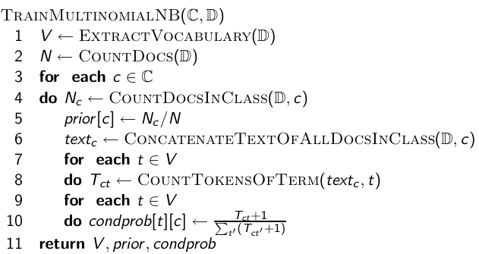
Naive Bayes: Training
20

Slide 21
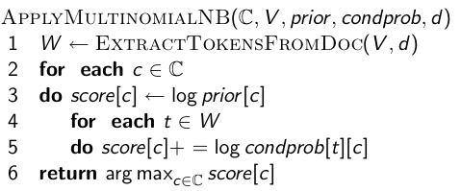
Naive Bayes: Testing
21

Slide 22
Exercise
Estimate parameters of Naive Bayes classifier
Classify test document
22

Slide 23
Example: Parameter estimates
The denominators are (8 + 6) and (3 + 6) because the lengths of
text_{c} and are 8 and 3, respectively, and because the constant
B is 6 as the vocabulary consists of six terms.
23

Slide 24
Example: Classification
Thus, the classifier assigns the test document to c = China. The
reason for this classification decision is that the three occurrences
of the positive indicator CHINESE in d₅ outweigh the occurrences
of the two negative indicators JAPAN and TOKYO.
24

Slide 25
Generative model
Generate a class with probability P(c)
Generate each of the words (in their respective positions), conditional on the class, but independent of each other, with probability P(t_{k} |c)
To classify docs, we “reengineer” this process and find the class that is most likely to have generated the doc.
25

Slide 26
Evaluating classification
Evaluation must be done on test data that are independent of the training data (usually a disjoint set of instances).
It’s easy to get good performance on a test set that was available to the learner during training (e.g., just memorize the test set).
Measures: Precision, recall, F₁, classification accuracy
26

Slide 27
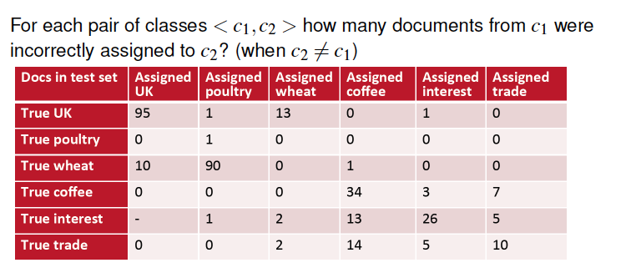
Constructing Confusion Matrix c

Slide 28
Precision P and recall R
P = TP / ( TP + FP)
R = TP / ( TP + FN)
28

Slide 29
A combined measure: F
F1 allows us to trade off precision against recall.
This is the harmonic mean of P and R:
29

Slide 30
Averaging: Micro vs. Macro
We now have an evaluation measure (F₁) for one class.
But we also want a single number that measures the aggregate performance over all classes in the collection.
Macroaveraging
Compute F₁ for each of the C classes
Average these C numbers
Microaveraging
Compute TP, FP, FN for each of the C classes
Sum these C numbers (e.g., all TP to get aggregate TP)
Compute F₁ for aggregate TP, FP, FN
30

Slide 31
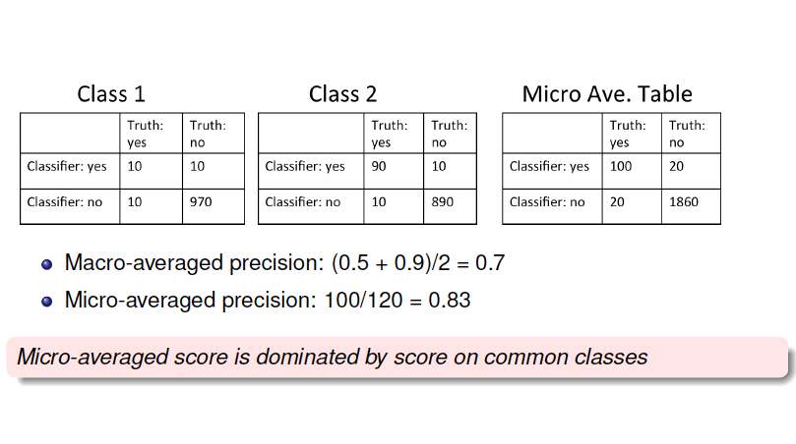
Micro- vs. Macro-average: Example

