Slide 1
Lecture 14: Language Models for IR

Slide 2
Using language models (LMs) for IR
LM = language model
We view the document as a generative model that generates the query.
What we need to do:
Define the precise generative model we want to use
Estimate parameters (different parameters for each document’s model)
Smooth to avoid zeros
Apply to query and find document most likely to have generated the query
Present most likely document(s) to user

Slide 3
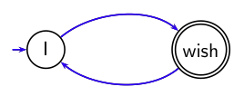
What is a language model?
We can view a finite state automaton as a deterministic language model.
I wish I wish I wish I wish . . . Cannot generate: “wish I wish”
or “I wish I”. Our basic model: each document was generated by a different automaton like this except that these automata are probabilistic.
3

Slide 4
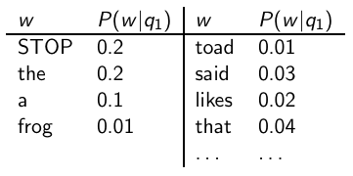
A probabilistic language model
This is a one-state probabilistic finite-state automaton – a unigram language model – and the state emission distribution for its one state q₁. STOP is not a word, but a special symbol indicating that the automaton stops. frog said that toad likes frog STOP
P(string) = 0.01 · 0.03 · 0.04 · 0.01 · 0.02 · 0.01 · 0.02
= 0.0000000000048
4

Slide 5
A different language model for each document
frog said that toad likes frog STOP P(string|M_{d1} ) = 0.01 · 0.03 · 0.04 · 0.01 · 0.02 · 0.01 · 0.02 = 0.0000000000048 = 4.8 · 10⁻¹²
P(string|M_{d2} ) = 0.01 · 0.03 · 0.05 · 0.02 · 0.02 · 0.01 · 0.02 = 0.0000000000120 = 12 · 10⁻¹² P(string|M_{d1} ) < P(string|M_{d2} )
Thus, document d₂ is “more relevant” to the string “frog said that toad likes frog STOP” than d₁ is.
5

Slide 6
Using language models in IR
Each document is treated as (the basis for) a language model.
Given a query q
Rank documents based on P(d|q)
P(q) is the same for all documents, so ignore
P(d) is the prior – often treated as the same for all d
But we can give a prior to “high-quality” documents, e.g., those with high PageRank.
P(q|d) is the probability of q given d.
So to rank documents according to relevance to q, ranking according to P(q|d) and P(d|q) is equivalent.
6

Slide 7
Where we are
In the LM approach to IR, we attempt to model the query generation process.
Then we rank documents by the probability that a query would be observed as a random sample from the respective document model.
That is, we rank according to P(q|d).
Next: how do we compute P(q|d)?
7

Slide 8
How to compute P(q|d)
We will make the same conditional independence assumption as for Naive Bayes.
(|q|: length of q; t_{k} : the token occurring at position k in q)
This is equivalent to:
tf_{t,q}: term frequency (# occurrences) of t in q
Multinomial model (omitting constant factor)
8

Slide 9
Parameter estimation
Missing piece: Where do the parameters P(t|M_{d}). come from?
Start with maximum likelihood
(|d|: length of d; tf_{t,d} : # occurrences of t in d)
we have a problem with zeros.
A single t with P(t|M_{d}) = 0 will make zero.
We would give a single term “veto power”.
For example, for query [Michael Jackson top hits] a document about “top songs” (but not using the word “hits”) would have P(t|M_{d}) = 0. – That’s bad.
We need to smooth the estimates to avoid zeros.
9

Slide 10
Smoothing
Key intuition: A non-occurring term is possible (even though it didn’t occur), . . .
. . . but no more likely than would be expected by chance in the collection.
Notation: M_{c}: the collection model; cf_{t}: the number of occurrences of t in the collection; : the total number of tokens in the collection.
We will use to “smooth” P(t|d) away from zero.
10

Slide 11
Mixture model
P(t|d) = λP(t|M_{d}) + (1 - λ)P(t|M_{c})
Mixes the probability from the document with the general collection frequency of the word.
High value of λ: “conjunctive-like” search – tends to retrieve documents containing all query words.
Low value of λ: more disjunctive, suitable for long queries
Correctly setting λ is very important for good performance.
11

Slide 12
Mixture model: Summary
What we model: The user has a document in mind and generates the query from this document.
The equation represents the probability that the document that the user had in mind was in fact this one.
12

Slide 13
Example
Collection: d₁ and d₂
d₁ : Jackson was one of the most talented entertainers of all time
d₂: Michael Jackson anointed himself King of Pop
Query q: Michael Jackson
Use mixture model with λ = 1/2
P(q|d₁) = [(0/11 + 1/18)/2] · [(1/11 + 2/18)/2] ≈ 0.003
P(q|d₂) = [(1/7 + 1/18)/2] · [(1/7 + 2/18)/2] ≈ 0.013
Ranking: d₂ > d₁
13

Slide 14
Exercise: Compute ranking
Collection: d₁ and d₂
d₁ : Xerox reports a profit but revenue is down
d₂: Lucene narrows quarter loss but decreases further
Query q: revenue down
Use mixture model with λ = 1/2
P(q|d₁) = [(1/8 + 2/16)/2] · [(1/8 + 1/16)/2] = 1/8 · 3/32 =
3/256
P(q|d₂) = [(1/8 + 2/16)/2] · [(0/8 + 1/16)/2] = 1/8 · 1/32 =
1/256
Ranking: d₂ > d₁
14

Slide 15
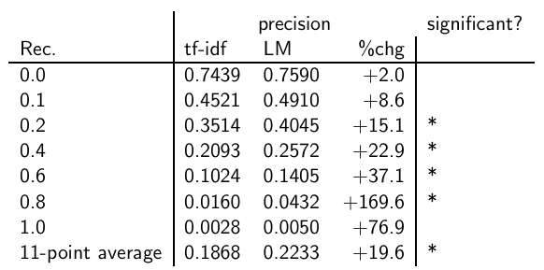
Vector space (tf-idf) vs. LM
The language modeling approach always does better in these experiments . . . . . . but note that where the approach shows significant gains is at higher levels of recall.
15

Slide 16
LMs vs. vector space model (1)
LMs have some things in common with vector space models.
Term frequency is directed in the model.
But it is not scaled in LMs.
Probabilities are inherently “length-normalized”.
Cosine normalization does something similar for vector space.
Mixing document and collection frequencies has an effect similar to idf.
Terms rare in the general collection, but common in some documents will have a greater influence on the ranking.
16

Slide 17
LMs vs. vector space model (2)
LMs vs. vector space model: commonalities
Term frequency is directly in the model.
Probabilities are inherently “length-normalized”.
Mixing document and collection frequencies has an effect similar to idf.
LMs vs. vector space model: differences
LMs: based on probability theory
Vector space: based on similarity, a geometric/ linear algebra notion
Collection frequency vs. document frequency
Details of term frequency, length normalization etc.
17

Slide 18
Language models for IR: Assumptions
Simplifying assumption: Queries and documents are objects of same type. Not true!
The vector space model makes the same assumption.
Simplifying assumption: Terms are conditionally independent.
Again, vector space model (and Naive Bayes) makes the same assumption.
Cleaner statement of assumptions than vector space
Thus, better theoretical foundation than vector space
… but “pure” LMs perform much worse than “tuned” LMs.
18

Slide 19
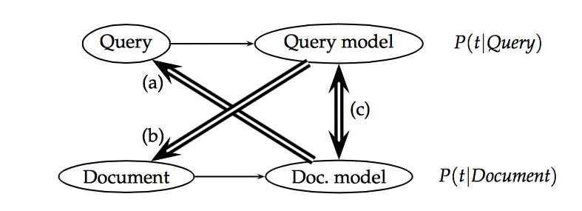
Three ways of developing language modeling approach
Kullback-Leibler Divergence

Slide 20
Query Expansion in Language Modeling
Basic Idea: We assume that the translation model
can be represented by a conditional probability
distribution T(·|·) between vocabulary terms.
The form of the translation query generation model:

