Slide 1
Scribe Sumbission
Date: 28th October, 2013
By M. Sudeep Kumar
Notes:
1

Slide 2
SYNTAX DIRECTED DEFINITIONS
Generalization of a CFG in which each grammar symbol has an associated set of attributes, partitioned into two subsets called the synthesized and inherited attributes of that grammar symbol.
For each grammar production A -> α has associated with it a set of semantic rules of the form b:= f(c₁, c₂,……..,c_{k}), where f is a function, and either:
b is a synthesized attribute of A and c₁, c₂,……..,c_{k} are attributes belonging to the grammar symbols of the production, or,
b is an inherited attribute of one of the grammar symbols on the right side of the production, and c₁, c₂,……..,c_{k} are attributes belonging to the grammar symbols of the production.
Notes:
2

Slide 3
REPRESENTING SYNTAX TREE
Leaf Node:
Operand: i) Identifier ( entry is the pointer to the entry in the symbol table)
ii) Literal (entry = value returned from lexical analyzer)
Internal Node:
Op entry
Pointer to operator mode
Pointer to the parent
Pointer to children nodes

Slide 4
REPRESENTING SYNTAX TREE
LEAF(op, val) Creates a leaf node for the syntax tree.
NODE(op, c₁, c_{2,} c₃….., c_{k}) Creates an internal node having parent operator op and children c₁, c_{2,} c₃….., c_{k.}

Slide 5
EXAMPLE
SEMANTIC RULES:
E E₁ + T [E.node_addr = new Node(+, E₁.node_addr,T.node_addr)]
E E – T [E.node_addr = new Node(-, E.node_addr,T.node_addr)]
E T [E.node_addr = new T.node_addr]
T id [T.node_addr = new Leaf(id, entry in symbol table)]
T num [T.node_addr = new Leaf(num, val)]

Slide 6
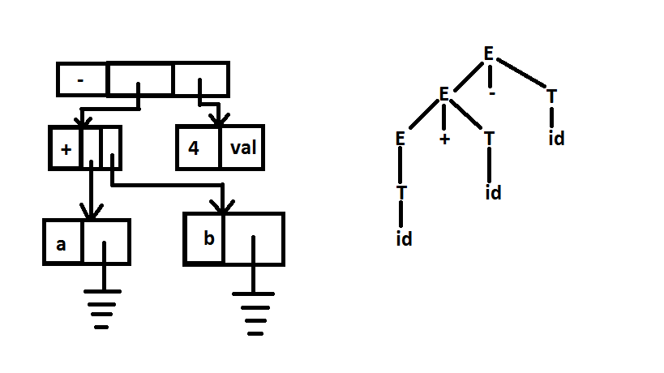
EXAMPLE( contd.)
Attributes: node_addr (synthesized) stores the address of the node corresponding to the non-terminal)
Prepare the semantic rules in such a way such that on the post-order traversal of the parse tree, the syntax tree gets generated.

Slide 7
SYNTAX DIRECTED TRANSLATION( SDT)
Takes an abstract syntax tree and produces an Interpreter code (Translation output).
Embed a part of the code within the production.
Example: A -> XY{a}Z
The net effect of semantic actions is to print out a translation of the input to a desired output form.

Slide 8
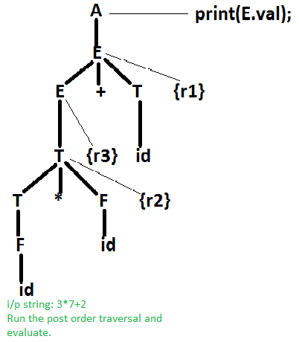
EXAMPLE
Production | Actions
L -> E | {print(E>val);}
E -> E1 + T | {E.val = E1.val + T.val}r1
E -> T | {E.val = T.val}r3
T -> T * F | {T.val = T.val * F.val}r2
T -> F | {T.val = F.val}
F -> id | {F.val = id}

