Slide 1
Scribing
K SAMPATH KUMAR 11CS10022
scribing

Slide 2
Definition of a Regular Expression
R is a regular expression if it is:
a for some a in the alphabet ∑, standing for the language {a}
ε, standing for the language {ε}
Ø, standing for the empty language
R₁+R₂ where R₁ and R₂ are regular expressions, and + signifies union (sometimes | is used)
R₁R₂ where R₁ and R₂ are regular expressions and this signifies concatenation
R* where R is a regular expression and signifies closure
(R) where R is a regular expression, then a parenthesized R is also a regular expression
scribing

Slide 3
Nondeterministic Finite Automata (NFA)
A set of states S
A set of input symbols Σ
A transition function move that maps state-symbol pairs to sets of states
A state s₀ that is distinguished as the start (initial) state
A set of states F distinguished as accepting (final) states.
scribing

Slide 4
Conversion of Regular Expression to NFA
Thompson’s construction - an NFA from a regular expression
Input: a regular expression r over an alphabet Σ.
Output: an NFA N accepting L(r)
scribing

Slide 5
Step 1
First parse r into its constituent subexpressions.
Construct NFA’s for each of the basic symbols in r.
for ε
for a in Σ
scribing

Slide 6
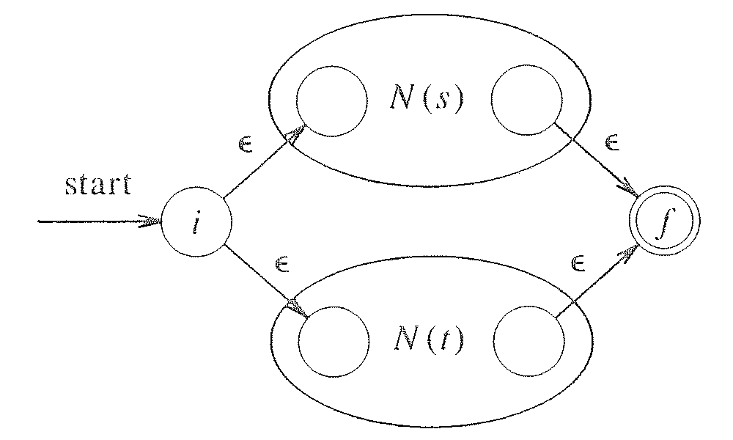
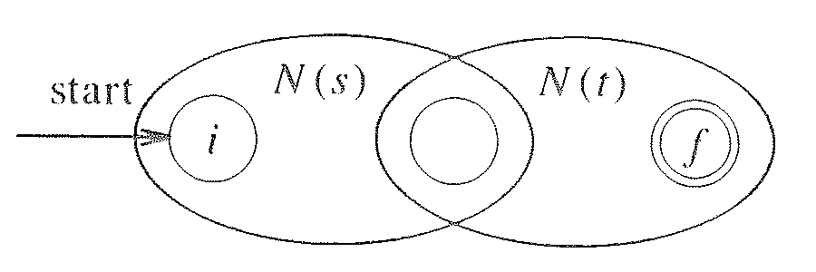
Step 2
For the regular expression s|t,
For the regular expression st,
scribing

Slide 7
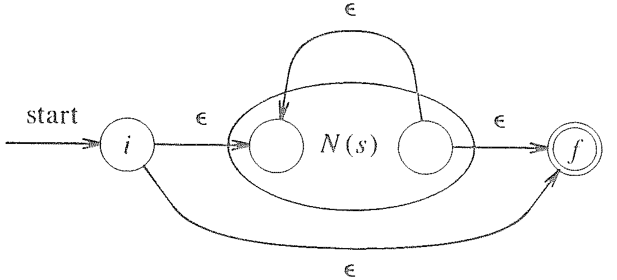
Step 3
For the regular expression s*,
For the parenthesized regular expression (s), use N(s) itself as the NFA.
Every time we construct a new state, we give it a distinct name.
scribing

Slide 8
Step 4
Finally suppose r = (s) .Then L(r) = L(s)
so we can use NFA N(s) as N(r).
scribing

Slide 9
N(r) has at most twice as many states as there are operators and operands in r. This bound follows from the fact that each step of the algorithm creates at most two new states.
N(r) has one start state and one accepting state. The accepting state has no outgoing transitions, and the start state has no incoming transitions.
Each state of N (r) other than the accepting state has either one outgoing transition on a symbol in C or two outgoing transitions, both on E.
scribing

Slide 10
(ab+a)* NFA
ε
a
ε
b
ε
ε
ε
ε
ε
a
ε
ε
scribing

