Slide 1

Reversible Color Image Watermarking in YCoCg-R Color Space
Aniket Roy
under the supervision of
Dr. Rajat Subhra Chakraborty

Slide 2
Today’s talk
Reversible watermarking
Problem in color image reversible watermarking
color space exploitation: YCoCg-R color space
Conclusion

Slide 3
Reversible Watermarking
Secret information i.e, watermark is embedded into the cover medium such that both the watermark and the cover image can be retrieved bit-by-bit.
Cover medium can be image, audio or video.
Here we consider reversible image watermarking.
Watermark is generally a hash of cover image.
Used in the industries dealing with highly sensitive data – medical, military, legal industries etc.

Slide 4
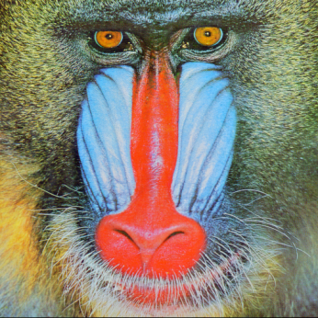
Watermark
Embed
Watermarked image
Cover image
Cover image
Extract
Watermarked image
Watermark

Slide 5
Problems in color image reversible watermarking
Existing algorithms deal with mainly grayscale images.
Color image reversible watermarking algorithms are just an extention of grayscale algorithms in R, G, B color spaces.
Problem of selecting proper color space for reversible watermark embedding is not fully exploited.

Slide 6
So the question arises.
Which is the appropriate color space for high embedding capacity reversible color image watermarking?
What is the theoretical justification for choosing such color space?
Is there any added constraint for selecting color spaces for reversible watermarking?

Slide 7
Transform Coding Gain
When we transform the representation of color image from one color space to another ,
Transform Coding Gain is defined as the ratio of the arithmetic mean to the geometric mean of the variances of the variables in the new transformed domain co-ordinates.
Transform Coding Gain is a metric to estimate compression performance.

Slide 8

Sepian-Wolf Coding Theorem
Given two correlated finite alphabet random variables X and Y, the theoretical bound for lossless coding rate for distributed coding of two sources are related by,
i.e, the total rate R = H(X,Y) is sufficient for lossless encoding of two correlated random sequences X and Y.

Slide 9
Capacity Maximization:
Proposition :
If the cover color image is (losslessly) converted into a different color space with higher coding gain , i.e, better compression performance before watermark embedding , then the watermark embedding capacity in the transformed color space is greater than the original color space.

Slide 10
Consider color components of a color image are three discrete random variable X, Y and Z as shown in venn diagram.
Area of each circle is proportional to its entropy.
A bijection ‘T’ is applied from original sample space (X,Y,Z) to (X’,Y’,Z’).
Transform ‘T’ has higher coding gain i.e, better compression performance.
T is invertible and lossless.

Slide 11
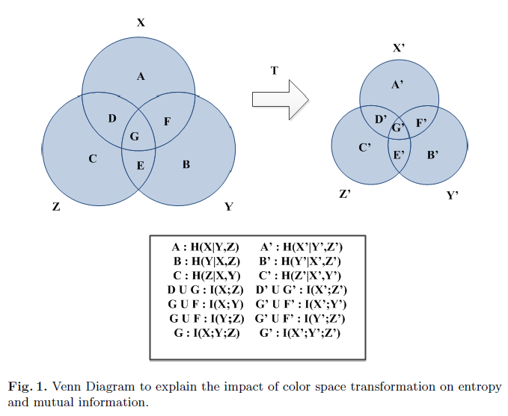
Venn Diagram :

Slide 12


Transform ‘T’ makes intra-correlation of the color channels high.
High correlation between values implies less entropy.
Joint entropy of X,Y and Z is denoted by H(X,Y,Z) and represented by the union of the three circles as depicted in fig.

Slide 13
We can draw an analogy between lossless watermarking and lossless encoding .
We have to losslessly encode the cover image into the watermarked image so that it can be retrieved bit-by-bit.
We can use sepian-wolf coding to estimate the capacity of reversible watermarking.

Slide 14
Color image ‘I’ consist of color channels X,Y and Z. Let its size be N bits.
Applying sepian-wolf theorem, we need a minimum coding rate of H(X,Y,Z) bits for lossless encoding of color channels.
Remaining bits we can use for data embedding.
i.e, capacity, C = N – H(X,Y,Z).

Slide 15


If we compare the color spaces (X,Y,Z) and (X’,Y’,Z’).
For 1st color space,
For 2nd color space,
As,
That implies,
i.e, color space transform ‘T’ results higher embedding capcity.

Slide 16
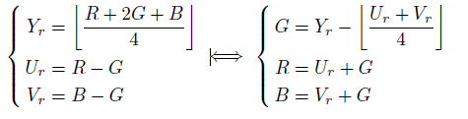
RCT color space:
Lossless color transform used in JPEG 2000 standard.
Reversible and integer-to-integer transform.

Slide 17
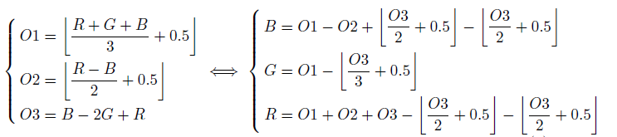
O1O2O3 color space:
Lossless color transform with high compression ratio.
Integer-to-integer reversibility.

Slide 18
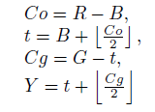
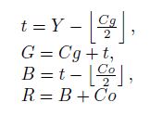
YCoCg-R color space:
Higher transform coding gain.
Acheives close to optimal compression performance.
Integer-to-integer reversibility.
Lower correlation among color channels.
Simple and Efficient implementation in software and hardware.

Slide 19
Embedding Algorithm:
1. Color Space transform:
Transform the color cover image from RGB to YCoCg-R color space using transformation:

Slide 20
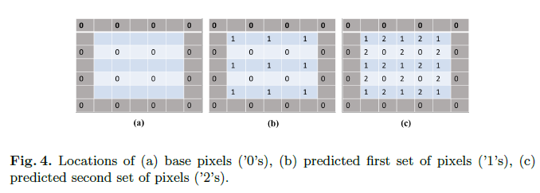
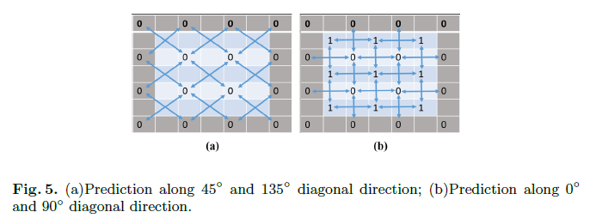
2. Pixel Prediction:

Slide 21




Pixel prediction:
We use weighted mean based pixel prediction proposed by Luo et. al:
Interpolated values along directions 45 and 135 are calculated.
Interpolation error corresponding to the pixel at position (2i,2j) along 45 and 135 directions are calculated:
Sets are formed as,
Mean value of the base pixels around the pixel to be predicted, denoted by u.

Slide 22




In the weighted mean based prediction, weights of the means are calculated using variance along both diagonal direction. Variance along 45 and 135 are denoted as are calculated as:
Weights of the means along 45 and 135 directions are denoted by,
Estimate the first level predicted pixel value p’, as a weighted mean of the diagonal interpolation terms:

Slide 23
Example:
Mean₄₅=(S₄₅ (1)+S₄₅ (3))/2
=(60+40)/2
=50
Mean₁₃₅=(S₁₃₅ (1)+S₁₃₅ (3))/2
=(30+50)/2
=40
60 | 91 | 30 | 20 | 20
24 | 52 | 18 | 45 | 60
50 | 47 | 40 | 43 | 50
75 | 45 | 67 | 22 | 50
50 | 60 | 60 | 40 | 30
u= ( Mean₄₅+ Mean₁₃₅ )/ 2
= (50+40)/2
= 45
Cover image X
S₄₅= {60, 52,40}
S₁₃₅={30, 52,50}
60 | 91 | 30 | 20 | 20
24 |  |  |  | 60
50 |  | 40 |  | 50
75 |  |  |  | 50
50 | 60 | 60 | 40 | 30
45
35
50
45
Interpolation X ’

Slide 24
Example (Cont.)
Mean₀=(S₀ (1)+S₀(3))/2
=(45+35)/2
=40
Mean₉₀=(S₉₀ (1)+S₉₀ (3))/2
=(30+40)/2
=35
60 | 91 | 30 | 20 | 20
24 | 45 | 18 | 35 | 60
50 | 47 | 40 | 43 | 50
75 | 50 | 67 | 45 | 50
50 | 60 | 60 | 40 | 30
u= ( Mean₀+ Mean₉₀ )/ 2
= (40+35)/2
= 37.5
Cover image X
1
3
1
3
σ
=
∑
−
σ
=
∑
−
2
(
e
)
(
S
(
k
)
u
(
2
)
e
)
(
S
(
k
)
u
S₀= {45,18,35}
)
90
90
0
3
0
3
k
=
k
=
1
1
=
147.58
S₉₀={30,18,40}
=
147.583
.
60 | 91 | 30 | 20 | 20
24 |  |  |  | 60
50 |  | 40 |  | 50
75 |  |  |  | 50
50 | 60 | 60 | 40 | 30
'
=
•
+
•
X
w
Mean
w
Mean
45
38
35
0
0
90
90
43
σ
σ
(
e
)
(
46
=
•
+
e
)
•
90
35
0
48.5
49
45
σ
+
σ
σ
+
σ
(
e
)
(
e
)
(
e
)
(
50
e
)
0
90
0
90
=
0.5
×
40
+
0.5
⋅
35
Interpolation X ’
≈
38

Slide 25

Embedding Algorithm:
Color cover image is transformed into YCoCg-R color space.
Each color channel is predicted using weighted mean based prediction.
Prediction error is calculated:
Frequency histograms of prediction errors are constructed.
Select a threshold ‘T’.

Slide 26



Frequency histogram of prediction errors in the range [-T,T] are histogram-bin-shifted to embed the watermark bits. Hence prediction errors are modified as:
Where ‘b’ is the next watermarking bit to be embedded and sign of prediction error:
Finally, the modified prediction errors are combined with the predicted pixels:

Slide 27
Embedding Method
60 | 91 | 30 | 20 | 20 | 12 | 41
24 | 47 | 43 | 35 | 60 | 14 | 17
50 | 47 | 40 | 42 | 50 | 18 | 52
75 | 50 | 50 | 45 | 50 | 50 | 52
50 | 60 | 60 | 40 | 30 | 54 | 73
24 | 47 | 43 | 35 | 60 | 14 | 17
60 | 65 | 75 | 72 | 75 | 81 | 64
60 | 91 | 30 | 20 | 20 | 12 | 41
24 | 47 | 42 | 34 | 59 | 14 | 17
50 | 47 | 40 | 43 | 50 | 20 | 52
75 | 50 | 49 | 46 | 49 | 51 | 52
50 | 60 | 60 | 39 | 30 | 52 | 73
24 | 47 | 44 | 34 | 59 | 11 | 17
60 | 65 | 75 | 72 | 75 | 81 | 64
 | 0 | 1 | -1 | 0 | 0
 | 0 |  | -1 |  | -2
 | 0 | 1 | -1 | 1 | -1
 | 0 |  | 1 |  | 2
 | 0 | -1 | 1 | 1 | 3
-
=
Cover image X
Interpolation X ’
Difference E
LM
RM
LM
RM
LN
RN
LM-1
RM+1

Slide 28
Embedding Method
W= 1 0 1 1 0 1 1 1 0 0 1 0 1
 | -1 | 1 | -1 | -1 | -1
 | 0 |  | -1 |  | -2
 | -1 | 2 | -1 | 2 | -1
 | 0 |  | 1 |  | 2
 | -1 | -1 | 1 | 2 | 3
60 | 91 | 30 | 20 | 20 | 12 | 41
24 | 47 | 42 | 34 | 59 | 14 | 17
50 | 47 | 40 | 43 | 50 | 20 | 52
75 | 50 | 49 | 46 | 49 | 51 | 52
50 | 60 | 60 | 39 | 30 | 52 | 73
24 | 47 | 44 | 34 | 59 | 11 | 17
60 | 65 | 75 | 72 | 75 | 81 | 64
 | 0 | 1 | -1 | 0 | 0
 | 0 |  | -1 |  | -2
 | 0 | 1 | -1 | 1 | -1
 | 0 |  | 1 |  | 2
 | 0 | -1 | 1 | 1 | 3
Difference E’
+
Interpolation X ’
Difference E
60 | 91 | 30 | 20 | 20 | 12 | 41
24 | 47 | 42 | 34 | 59 | 14 | 17
50 | 47 | 40 | 43 | 50 | 20 | 52
75 | 50 | 49 | 46 | 49 | 51 | 52
50 | 60 | 60 | 39 | 30 | 52 | 73
24 | 47 | 44 | 34 | 59 | 11 | 17
60 | 65 | 75 | 72 | 75 | 81 | 64
LM
RM
Interpolation X ’
LM-1
RM+1
=
60 | 91 | 30 | 20 | 20 | 12 | 41
24 | 46 | 43 | 33 | 58 | 13 | 17
50 | 47 | 40 | 42 | 50 | 18 | 52
75 | 49 | 51 | 45 | 51 | 50 | 52
50 | 60 | 60 | 40 | 30 | 54 | 73
24 | 46 | 43 | 35 | 61 | 14 | 17
60 | 65 | 75 | 72 | 75 | 81 | 64
Watermarked image

Slide 29
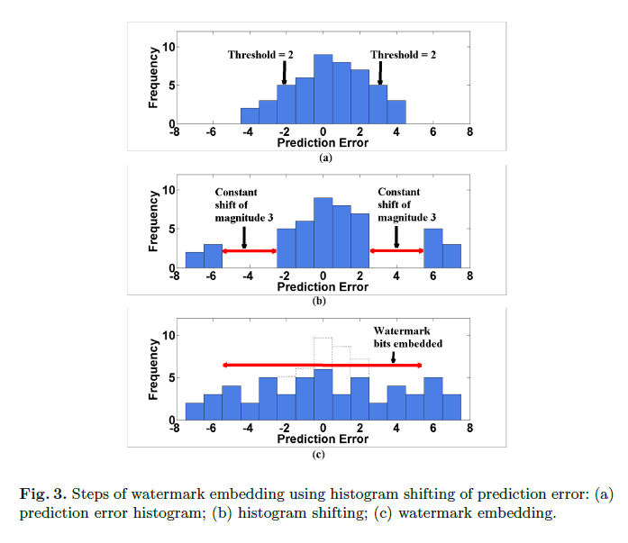
Illustration:

Slide 30
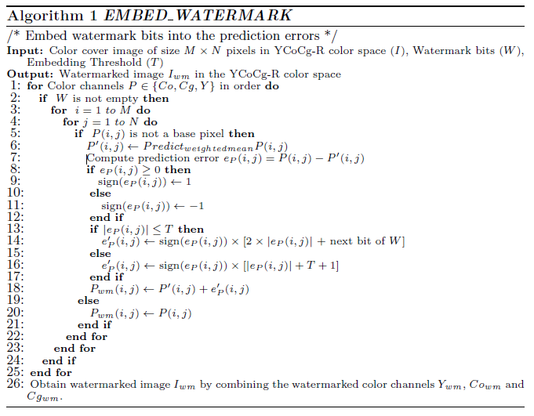
Embedding Algorithm:

Slide 31



Extraction Algorithm:
Watermarked image is decomposed into YCoCg-R color space.
Same prediction is applied to watermarked image.
Prediction errors are calculated:
Prediction error histogram is generated and watermarks are extracted from the histogram bins defined by threshold ‘T’.

Slide 32

Extracted watermark bit,
After extraction, all bins are shifted back to their original positions. Hence prediction errors are restored:
Predicted pixels are combined with restored errors to obtain retrived color channels:

Slide 33
Proposed Method
Extracting(Non-Sample pixels)
60 | 91 | 30 | 20 | 20 | 12 | 41
24 | 46 | 43 | 33 | 58 | 13 | 17
50 | 47 | 40 | 42 | 50 | 18 | 52
75 | 49 | 51 | 45 | 51 | 50 | 52
50 | 60 | 60 | 40 | 30 | 54 | 73
24 | 46 | 43 | 35 | 61 | 14 | 17
60 | 65 | 75 | 72 | 75 | 81 | 64
60 | 91 | 30 | 20 | 20 | 12 | 41
24 | 47 | 42 | 34 | 59 | 14 | 17
50 | 47 | 40 | 43 | 50 | 20 | 52
75 | 50 | 49 | 46 | 49 | 51 | 52
50 | 60 | 60 | 39 | 30 | 52 | 73
24 | 47 | 44 | 34 | 59 | 11 | 17
60 | 65 | 75 | 72 | 75 | 81 | 64
 | -1 | 1 | -1 | -1 | -1
 | 0 |  | -1 |  | -2
 | -1 | 2 | -1 | 2 | -1
 | 0 |  | 1 |  | 2
 | -1 | -1 | 1 | 2 | 3
-
=
Watermarked images
Interpolation X ’
+
Difference E’
LM=0
RM=1
LN=-3
RN=4
 | 0 | 1 | -1 | 0 | 0
 | 0 |  | -1 |  | -2
 | 0 | 1 | -1 | 1 | -1
 | 0 |  | 1 |  | 2
 | 0 | -1 | 1 | 1 | 3
60 | 91 | 30 | 20 | 20 | 12 | 41
24 | 47 | 43 | 35 | 60 | 14 | 17
50 | 47 | 40 | 42 | 50 | 18 | 52
75 | 50 | 50 | 45 | 50 | 50 | 52
50 | 60 | 60 | 40 | 30 | 54 | 73
24 | 47 | 43 | 35 | 60 | 14 | 17
60 | 65 | 75 | 72 | 75 | 81 | 64
=
Difference E’
W =1 0 1 1 0 1 1 1 0 0 1 0 1
Cover Image X

Slide 34
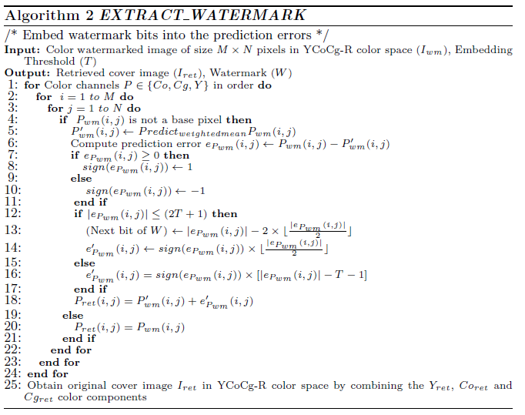
Extraction Algorithm :

Slide 35
Handling of overflow and underflow:
Underflow condition:
Overflow condition:
In extraction phase, possible pixels causes overflow and underflow:
1. During embedding it causes overflow or underflow, hence not used for embedding.
2. Previously the pixel did not cause underflow or overflow, but after watermark embedding it causes overflow or underflow.

Slide 36
To distinguish between which one of the cases have occurred, a binary bit stream called ‘location map’ is generally used.
Assign ‘0’ to 1st case , and ‘1’ to 2nd case.
‘Location map’ is inserted into the LSBs of the base pixels.

Slide 37
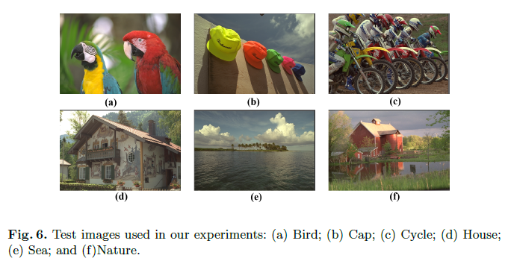
Results:
Proposed algorithm is implemented in MATLAB and tested on several images from Kodak Image Database.

Slide 38
Metrices:
Maximum embedded capacity:
Average number of bits that can be embedded per pixel, i.e, bits-per-pixel (bpp).

Slide 39

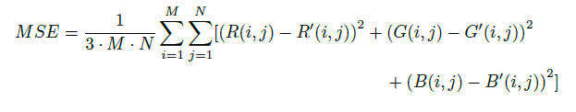
Distortion of watermarked image w.r.t the original image.
Peak Signal to Noise Ratio (PSNR):
Where MAX represent the maximum possible pixel value.
R(i,j), G(i,j) and B(i,j) represents the red, green and blue color pixel in location (i,j) of the original image; R(i,j), G(i,j) and B(i,j) reperesents the red, green, blue color pixel of the watermarked image.

Slide 40
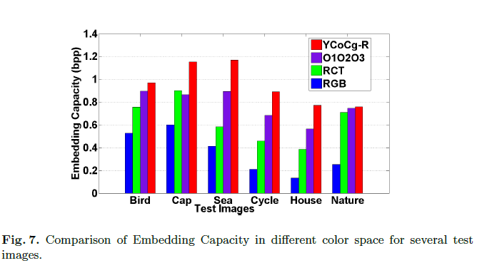
Comparison of embedding capacity:

Slide 41
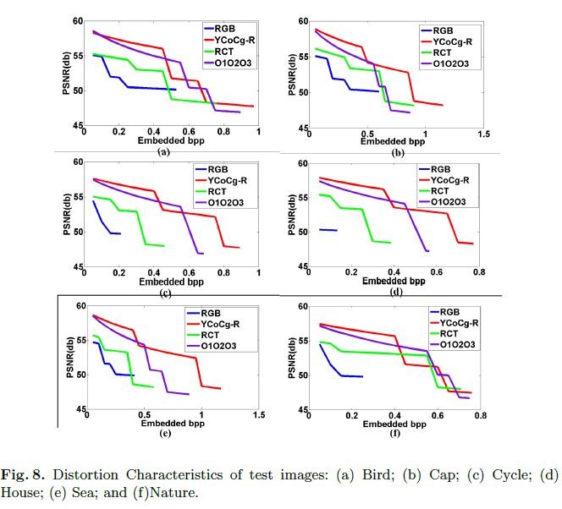
Distortion Characteristics:

Slide 42
Conclusion:
Embedding capacity improves in YCoCg-R color space.
Distortion characteristics improves in YCoCg-R color space.

