Slide 1
Exploiting the Order of Multiplier Operands: A Low-Cost Approach for HCCA Resistance
Poulami Das and Debapriya Basu Roy
under the supervision of
Dr. Debdeep Mukhopadhyay

Slide 2
Today’s talk
Introduction
ECC implementation vulnerabilities – power analysis
HCCA
Our Countermeasure
Conclusion

Slide 3
Private-Key Cryptography
Key is shared by both sender and receiver
if the key is disclosed communications are compromised
also known as symmetric, both parties are equal
hence does not protect sender from receiver forging a message & claiming is sent by sender

Slide 4
Public-Key Cryptography
probably most significant advance in the 3000 year history of cryptography
uses two keys – a public key and a private key
asymmetric since parties are not equal
uses clever application of number theory concepts to function
complements rather than replaces private key cryptography

Slide 5
Public-Key Cryptography

Slide 6
Public-Key Cryptography
developed to address two key issues:
key distribution – how to have secure communications in general without having to trust a KDC with your key
digital signatures – how to verify a message comes intact from the claimed sender
public invention due to Whitfield Diffie & Martin Hellman at Stanford U. in 1976
known earlier in classified community

Slide 7
Public-Key Cryptography
Public key schemes utilise problems that are easy (P type) one way but hard (NP type) the other way, e.g. exponentiation vs logs, multiplication vs factoring.
2 most popular public-key crypto-primitives are
RSA
ECC

Slide 8
ECC vs RSA

Slide 9
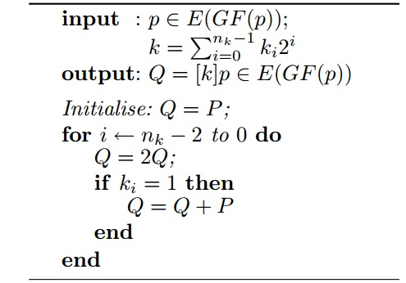
Elliptic Curve scalar multiplication
k.P = (P + P + .. + P)
k times
Naïve Double-and-Add Algorithm

Slide 10
ECDLP security
Theoretically secure against ECDLP
ECDLP (Elliptic Curve Discrete Logarithm Problem): Suppose E is an elliptic curve over . .
Given a multiple Q of P, the elliptic curve
discrete logarithm problem is to find
given Q = k.P

Slide 11
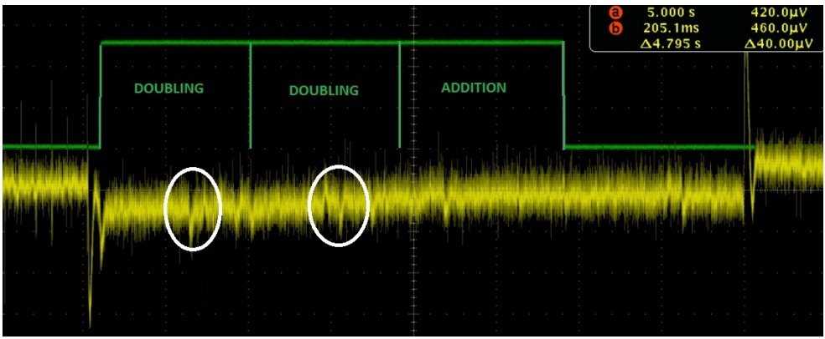
Vulnerabilities
Simple power analysis of a naïve Double-and-Add algorithm.
Power trace for key bit 5

Slide 12
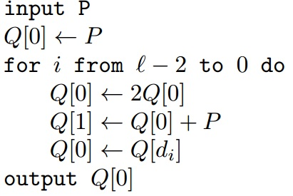
Remedies for preventing SPA
[CHES ‘99] SPA-resistant Double-and-Add algorithm

Slide 13
Disadvantages
cost overhead of dummy operations
prone to C-Safe Error Attack
vulnerable to DPA (Differential Power Analysis)

Slide 14
Alternatives
Atomic formula-based Algorithms
applicable to NIST curves
[IEEE TC 2004] Chavelliar-Mames and others, Low-cost solutions for preventing simple side-channel analysis.
[IACR eprint 2008] Patrick Longa and others, Accelerating the elliptic curve cryptosystems over prime fields.
[CARDIS 2010] Giraud and others, Atomicity improvement for elliptic curve scalar multiplication.

Slide 15
More Alternatives …
Unified Addition formula inherently secure against SPA – same formula for both addition and doubling operations.
[PKC 2002] Eric Brier and others,Weierstrass elliptic curves and side-channel attacks.
[ASIACRYPT 2007] Bernstein and others, Faster addition and doubling on elliptic curves.
proposed use of Edward Curves in ECC

Slide 16
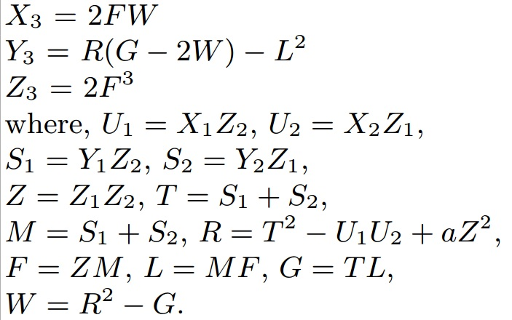
[PKC 2002] Brier-Joye Addition formula
Y²Z = X³ + aXZ² + bZ³,
(X, Y, Z) E(F_{p}), (a,b) ∈ F_{p}
∈

Slide 17
[ASIACRYPT 2007] Edward Curve unified formula

Slide 18
[SAC 2013] Horizontal Collision Correlation Analysis
Assumptions:
Underlying field multiplication uses school-book long integer multiplication algorithm
Adversary can detect whether a pair of field multiplications share any common operand
(AXB, CXD)
(AXB, CXB)
(AXB, AXB)

Slide 19
Horizontal Collision Correlation Analysis
We define:
property 1: when a pair of field multiplications (m_{i}, m_{j}) share one/ two common operands among themselves.
property 1a: when a pair of multiplications share exactly one common operand, e.g. – (AB, CB)
property 1b: when a pair of multiplications share exactly two common operands e.g. – (AB, AB)
property 2: when a pair of field multiplications (m_{i}, m_{j}) share no common operand among themselves, e.g. – (AB, CD)
property 3: Given two sets containing field multiplications, only one of the two sets satisfy property 1.

Slide 20
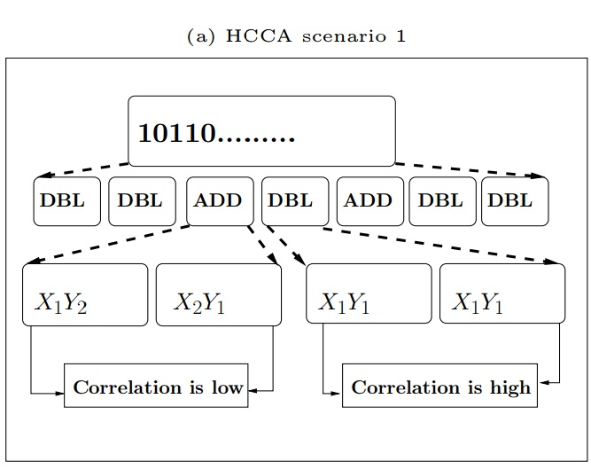
Horizontal Collision Correlation Analysis

Slide 21
Horizontal Collision Correlation Analysis

Slide 22
Horizontal Collision Correlation Analysis
HCCA scenario 1:
condition: Only one of addition and doubling should satisfy condition property 3
HCCA scenario 2:
- can be launched unconditionally

Slide 23
Our Contribution
A zero-cost countermeasure that prevents scenario 1 of HCCA
A randomized countermeasure that requires minimal cost to prevent HCCA scenario 2
First practical results on HCCA, and our countermeasure validation

Slide 24
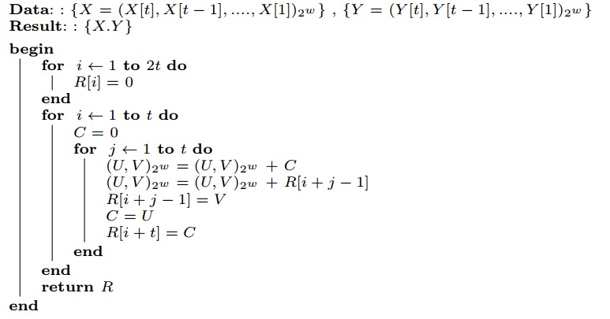
Asymmetric Leakage of Field Multipliers
Long Integer Multiplication Algorithm

Slide 25
Asymmetric Leakage of Field Multipliers
Information Leakage model to approximate the correlation between power consumptions of two field multiplications:

Slide 26
Asymmetric Leakage of Field Multipliers
Let us define:
Corr(AB,CB)
Corr(AB,BC)

Slide 27
Asymmetric Leakage of Field Multipliers
Corr(AB,CD)

Slide 28
Asymmetric Leakage of Field Multipliers
Observation 1:
Observation 2:
Observation 3:
for a multiplication pair with property 1b

Slide 29
Conversion of ECC algorithm to secure sequence - Example

Slide 30
Conversion for the Brier-Joye formula

Slide 31
Secure-sequence conversion Algorithm – Countermeasure 1
Create_Graph();
Find_Graphcomponents();
Find_Safeseq();

Slide 32
Countermeasure 2 – algorithm:

Slide 33
Countermeasure 1 – zero-cost
Countermeasure 2 – minimal cost
HCCA security achieved !!

Slide 34
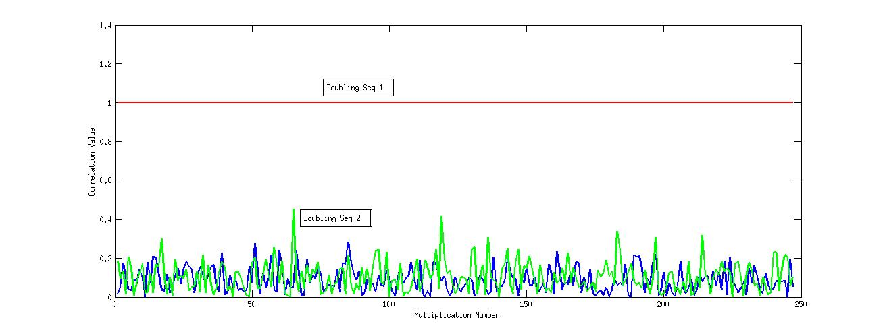
Simulation results on HCCA and countermeasure validation
Results on Curve1174 (Edward curve) using a 16-bit architecture model

Slide 35
Results on SASEBO-GII

Slide 36
Conclusion
Currently focusing on experimental validations
Future work –
Can we apply our countermeasure to other ECC algorithms (atomic-formula based algorithms, pairing-based ECC algorithms) ?

