Slide 1
Pairing based IBE

Slide 2
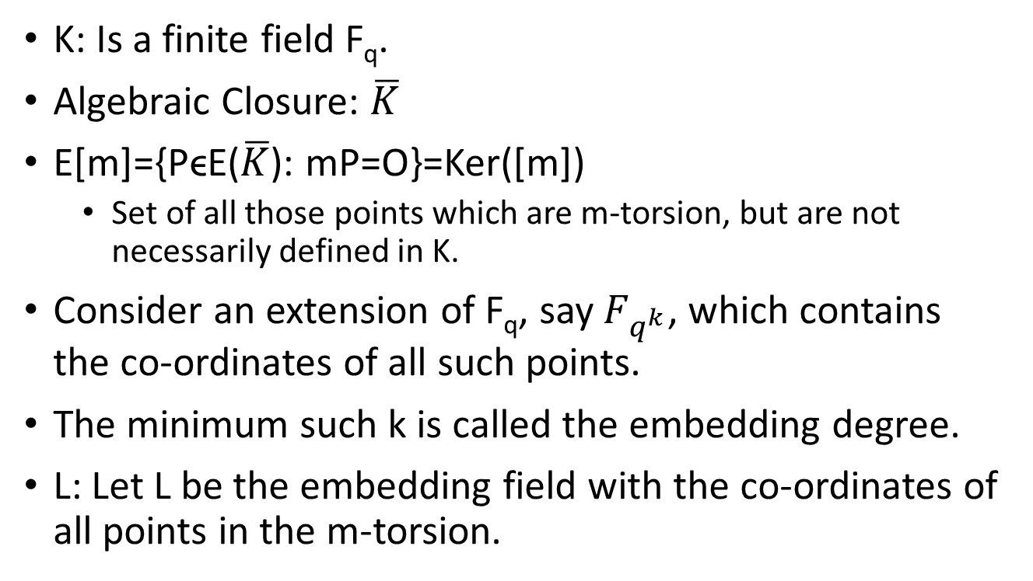
Some Definitions
K: Is a finite field F_{q}.
Algebraic Closure: $\overline{K}$
E[m]={PϵE($\overline{K}$): mP=O}=Ker([m])
  Set of all those points which are m-torsion, but are not necessarily defined in K.
Consider an extension of F_{q}, say $F_{q^{k}}$, which contains the co-ordinates of all such points.
The minimum such k is called the embedding degree.
L: Let L be the embedding field with the co-ordinates of all points in the m-torsion.

Slide 3
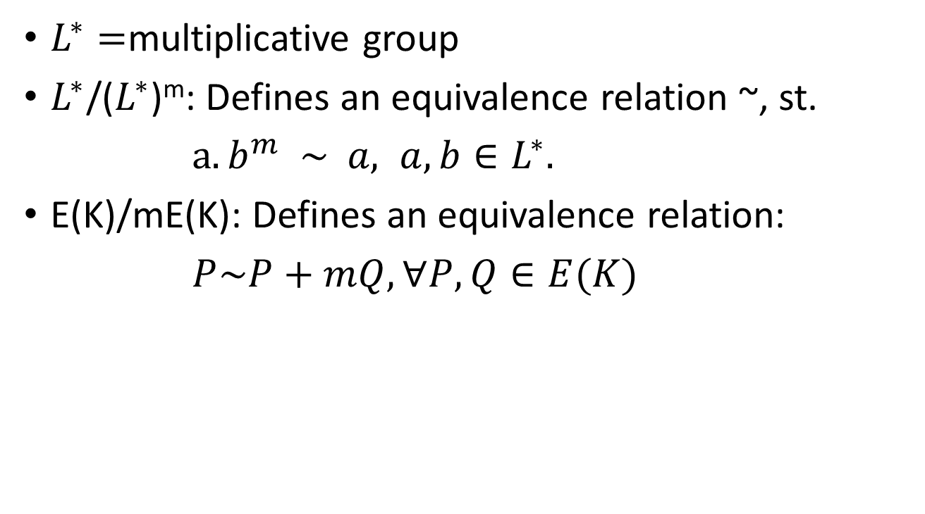
Some more definitions
$L^{∗}=$multiplicative group
$L^{∗}$/($L^{∗}$)^{m}: Defines an equivalence relation ~, st.
$a. b^{m} \sim a, a, b∈L^{∗}.$
E(K)/mE(K): Defines an equivalence relation:
$P\sim P+mQ, ∀P,Q∈E(K)$

Slide 4
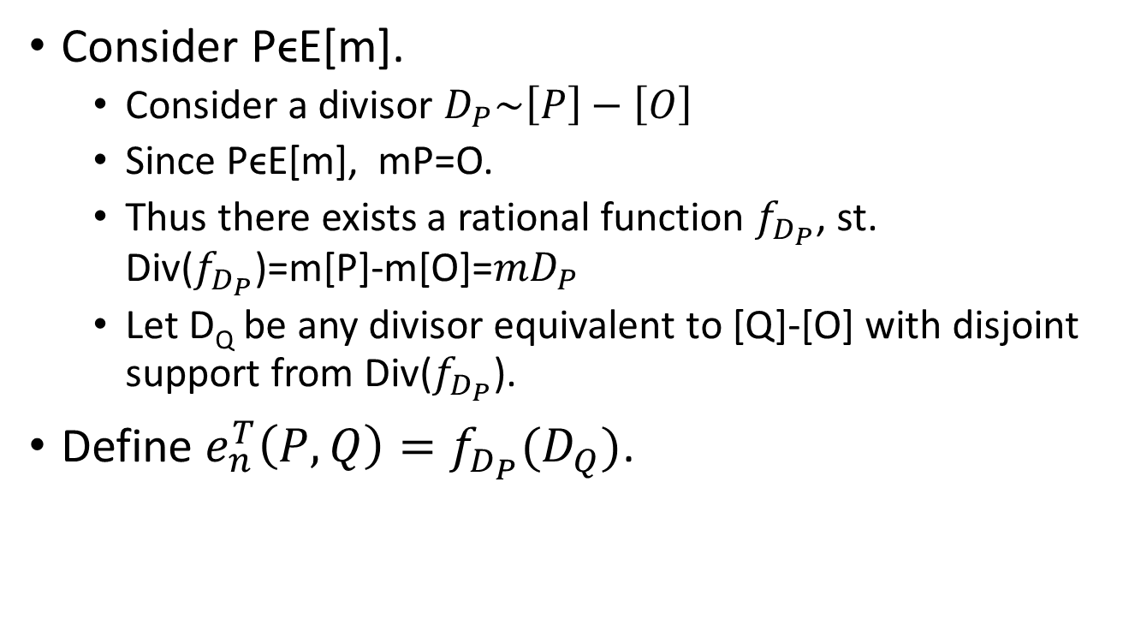
Tate Pairing
Consider PϵE[m].
  Consider a divisor $D_{P}\sim \left[P\right]−\left[O\right]$
  Since PϵE[m], mP=O.
  Thus there exists a rational function $f_{D_{P}}$, st. Div($f_{D_{P}}$)=m[P]-m[O]=${mD}_{P}$
  Let D_{Q} be any divisor equivalent to [Q]-[O] with disjoint support from Div($f_{D_{P}}$).
Define $e_{n}^{T}\left(P,Q\right)=f_{D_{P}}(D_{Q})$.

Slide 5
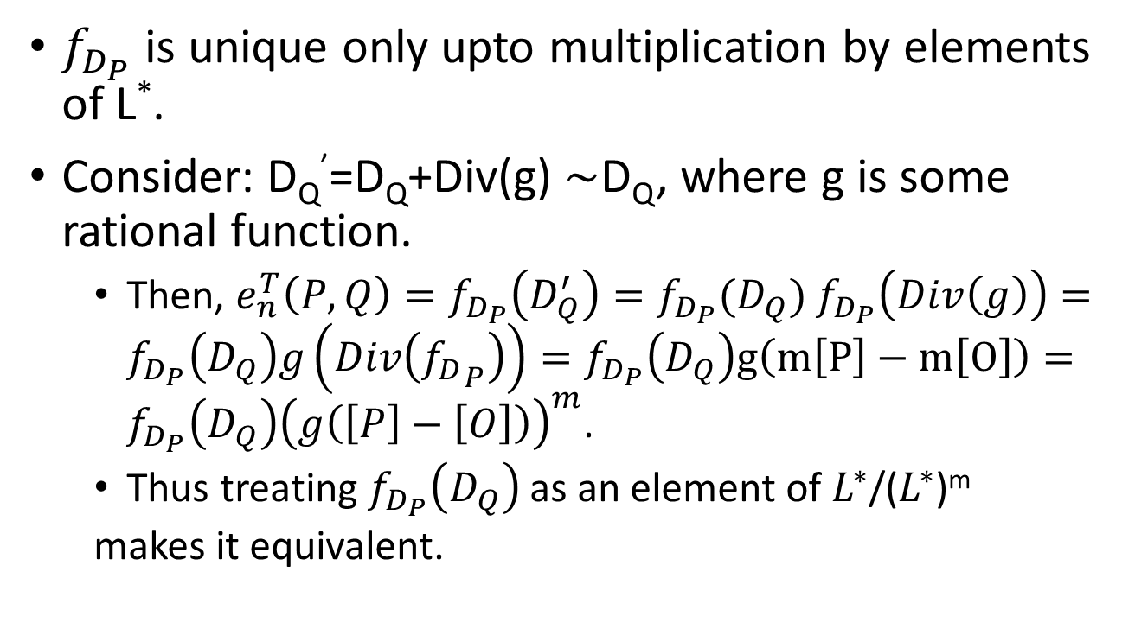
Few Details
$f_{D_{P}}$ is unique only upto multiplication by elements of L*.
Consider: D_{Q}’=D_{Q}+Div(g) $\sim$D_{Q}, where g is some rational function.
  Then, $e_{n}^{T}\left(P,Q\right)=f_{D_{P}}\left(D_{Q}^{′}\right)=f_{D_{P}}(D_{Q})$ $f_{D_{P}}\left(Div\left(g\right)\right)=f_{D_{P}}\left(D_{Q}\right)g\left(Div\left({f_{D}}_{P}\right)\right)=f_{D_{P}}\left(D_{Q}\right)g\left(m\left[P\right]−m\left[O\right]\right)=f_{D_{P}}\left(D_{Q}\right){\left(g\left(\left[P\right]−\left[O\right]\right)\right)}^{m}$.
  Thus treating $f_{D_{P}}\left(D_{Q}\right)$ as an element of $L^{∗}$/($L^{∗}$)^{m}
  makes it equivalent.

Slide 6
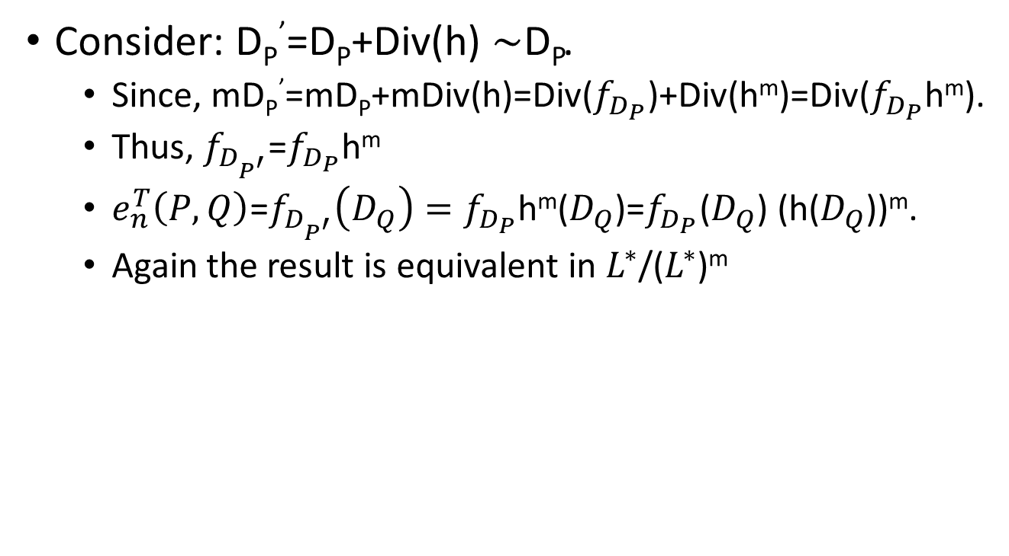
Few Details
Consider: D_{P}’=D_{P}+Div(h) $\sim$D_{P}.
  Since, mD_{P}’=mD_{P}+mDiv(h)=Div($f_{D_{P}}$)+Div(h^{m})=Div($f_{D_{P}}$h^{m}).
  Thus, $f_{D_{P^{′}}}$=$f_{D_{P}}$h^{m}
  $e_{n}^{T}\left(P,Q\right)$=$f_{D_{P^{′}}}\left(D_{Q}\right)=f_{D_{P}}$h^{m}($D_{Q}$)=$f_{D_{P}}$($D_{Q}$) (h($D_{Q}$))^{m}.
  Again the result is equivalent in $L^{∗}$/($L^{∗}$)^{m}

Slide 7
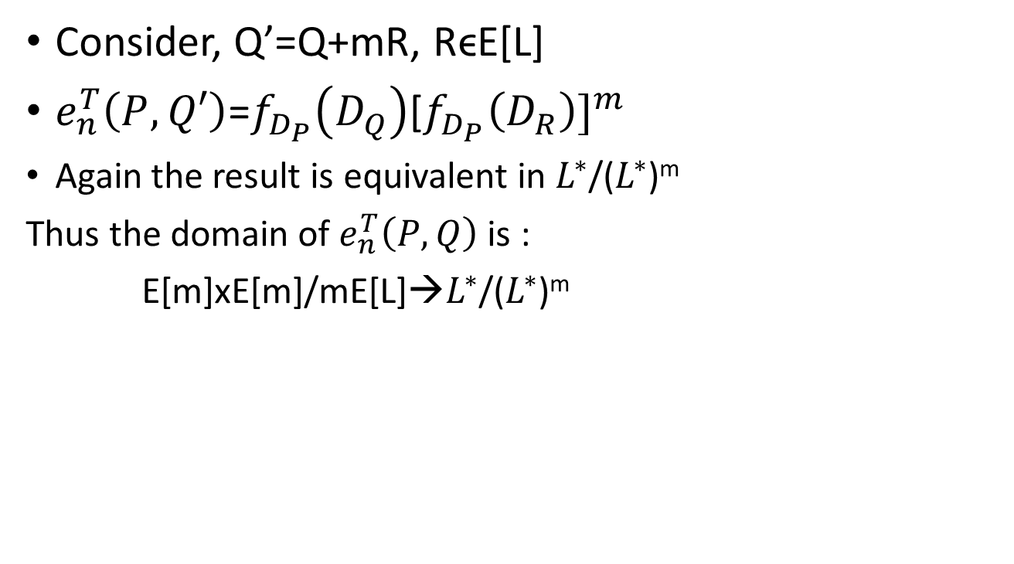
Few Details
Consider, Q’=Q+mR, RϵE[L]
$e_{n}^{T}\left(P,Q′\right)$=$f_{D_{P}}\left(D_{Q}\right){\text{[}f_{D_{P}}\left(D_{R}\right)]}^{m}$
  Again the result is equivalent in $L^{∗}$/($L^{∗}$)^{m}
  Thus the domain of $e_{n}^{T}\left(P,Q\right)$ is :
  E[m]xE[m]/mE[L]→$L^{∗}$/($L^{∗}$)^{m}

Slide 8
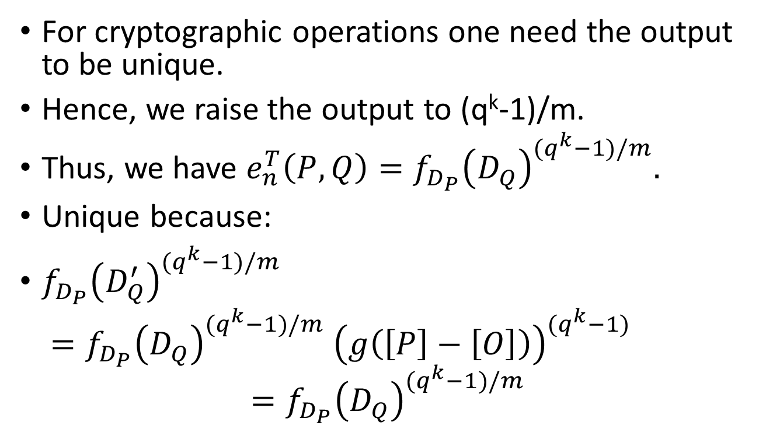
Making the output unique
For cryptographic operations one need the output to be unique.
Hence, we raise the output to (q^{k}-1)/m.
Thus, we have ${e_{n}^{T}\left(P,Q\right)=f}_{D_{P}}{\left(D_{Q}\right)}^{{(q}^{k}−1)/m}.$
Unique because:
$f_{D_{P}}{\left(D_{Q}^{′}\right)}^{{(q}^{k}−1)/m}$
$=f_{D_{P}}{\left(D_{Q}\right)}^{{(q}^{k}−1)/m} {\left(g\left(\left[P\right]−\left[O\right]\right)\right)}^{{(q}^{k}−1)}$
$$=f_{D_{P}}{\left(D_{Q}\right)}^{{(q}^{k}−1)/m}$$

Slide 9

Tate Pairing and Weil Pairing
Weil Pairing : e_{m}(P,Q)
Tate Pairing: <P,Q>_{m}
e_{m}(P,Q)=$\frac{<P,Q>_{m}}{<Q,P>_{m}}$

Slide 10
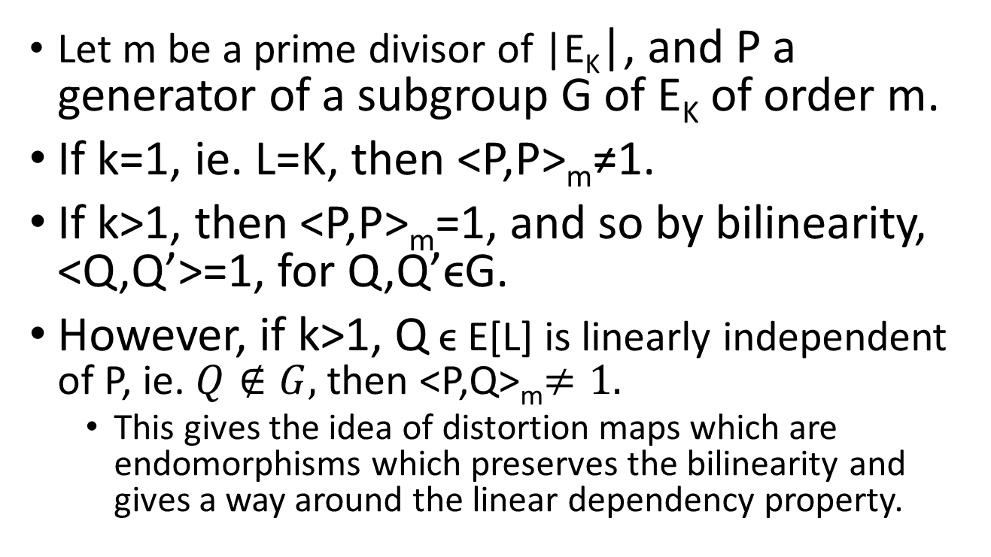
Linear Dependence Property
Let m be a prime divisor of |E_{K}|, and P a generator of a subgroup G of E_{K} of order m.
If k=1, ie. L=K, then <P,P>_{m}≠1.
If k>1, then <P,P>_{m}=1, and so by bilinearity, <Q,Q’>=1, for Q,Q’ϵG.
However, if k>1, Q ϵ E[L] is linearly independent of P, ie. $Q∉G,$then <P,Q>_{m}$≠1.$
  This gives the idea of distortion maps which are endomorphisms which preserves the bilinearity and gives a way around the linear dependency property.

Slide 11
Application of Pairings: Finally!
Two Party One-round Key agreement Protocol
P is a base point of an EC. Public Knowledge: (n,P).
Alice selects aϵ[1,n-1] and sends aP.
Bob selects bϵ[1,n-1] and sends bP.
Both can compute abP.
Eavesdropper is faced with the task of computing K given (P,aP,bP). This instance of problem is called DHP (Diffie-Hellman Problem).
Alice
(a)
aP
Bob
(b)
bP

Slide 12
Extending to Three Parties
Can be easily extended to 3 parties
Alice
(a)
Bob
(b)
bP
aP
cP
Chris
(c)
Round 1

Slide 13
Extending to Three Parties
Can be easily extended to 3 parties
Key=abcP.
Attackers’s Problem: Compute abcP from (P,aP,bP,cP,abP,bcP,caP).
Alice
(a)
Bob
(b)
bcP
Round 2
abP
caP
Chris
(c)

Slide 14
Can this be done in one round?
Problem remained open till 2000 when Joux devised a surprisingly simple protocol using bilinear pairings.
This triggered interest in Pairings, and two next most important applications emerged:
  Boneh-Franklin IBE
  Boneh,Lynn,Shacham short-signature scheme

Slide 15
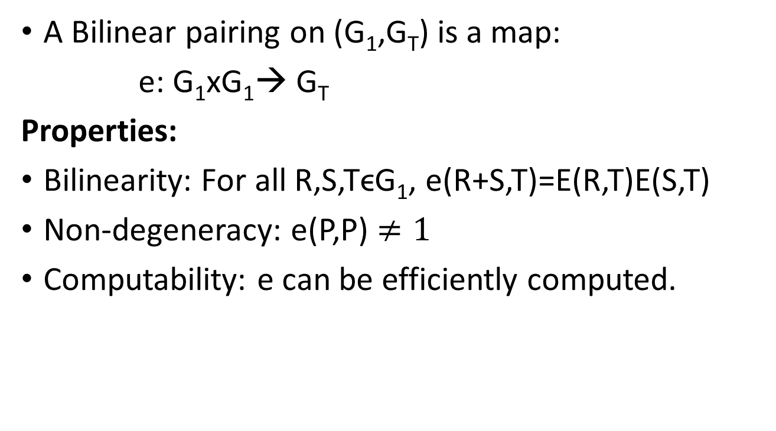
Quick Refresh on Pairings
A Bilinear pairing on (G₁,G_{T}) is a map:
e: G₁xG₁→ G_{T}
Properties:
Bilinearity: For all R,S,TϵG₁, e(R+S,T)=E(R,T)E(S,T)
Non-degeneracy: e(P,P) $≠1$
Computability: e can be efficiently computed.

Slide 16
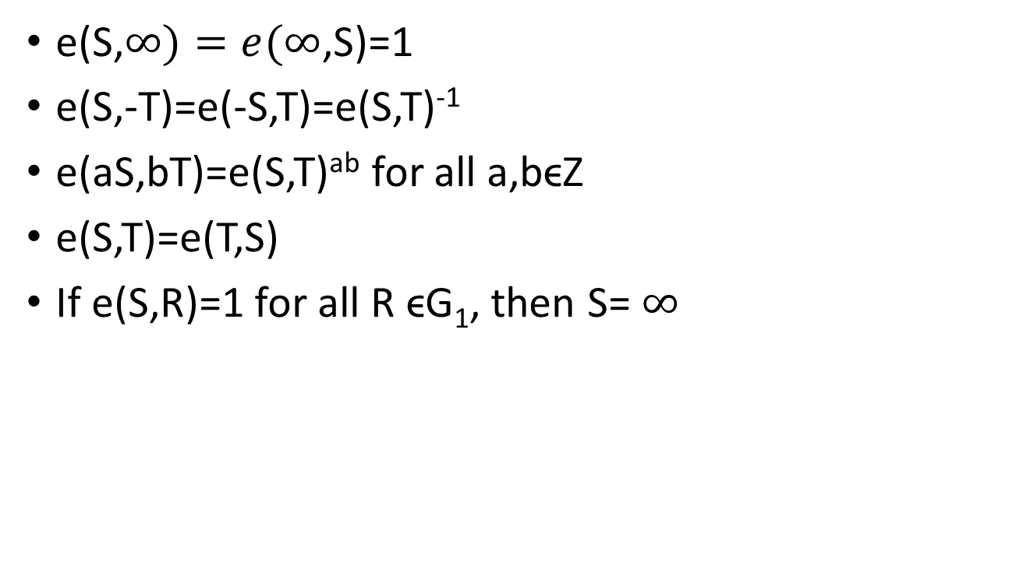
Some more Derived Properties
e(S,$∞)=e(∞$,S)=1
e(S,-T)=e(-S,T)=e(S,T)⁻¹
e(aS,bT)=e(S,T)^{ab} for all a,bϵZ
e(S,T)=e(T,S)
If e(S,R)=1 for all R ϵG₁, then S= $∞$

Slide 17
Implication on DLP
Discrete Log Problem (DLP): Let aϵ[0,n-1] be a secret, given aP, compute a.
Believed to be intractable for a chosen group (like multiplicative group of a finite field, group of points on an EC defined over a finite field).
One consequence of the bilinearity property is that the DLP in G₁ can be efficiently reduced to the DLP in G_{T}.

Slide 18
Implication on DLP
One consequence of the bilinearity property is that the DLP in G₁ can be efficiently reduced to the DLP in G_{T}.
  If (P,Q) is an instance of DLP in G₁ where Q=xP, then e(P,Q)=e(P,xP)=e(P,P)^{x}.
  Thus, log_{P}Q=log_{q}h, where h=e(P,Q), and g=e(P,P) are elements of G_{T}.

Slide 19
Bilinear Diffie-Hellman Problem (BDHP)
Let e be a bilinear pairing on (G₁,G_{T}). The BDHP is the following:
  Given P,aP,bP,cP, compute e(P,P)^{abc}
Hardness of BDHP => Hardness of DHP in both G₁ and G_{T}.
If DHP in G₁ is not hard => BDHP is not hard.
  ap, bP => Compute abP
  e(abP,cP)=e(P,P)^{abc}

Slide 20
Security Implications
If DHP in G_{T} is not hard => BDHP is not hard.
  Compute g=e(P,P).
  Compute e(aP,bP)=g^{ab}ϵG_{T}
  Compute e(cP,P)=g^{c}ϵG_{T}
  Compute g^{abc} from g^{ab} and g^{c}.

Slide 21
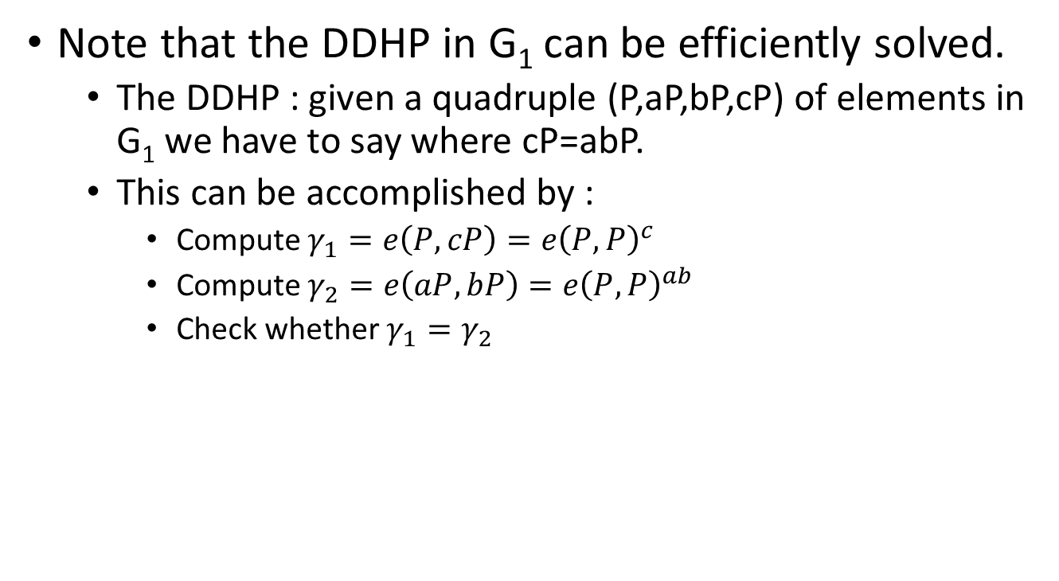
Decisional Diffie-Hellman Problem due to Pairings
Note that the DDHP in G₁ can be efficiently solved.
  The DDHP : given a quadruple (P,aP,bP,cP) of elements in G₁ we have to say where cP=abP.
  This can be accomplished by :
    Compute $γ_{1}=e\left(P,cP\right)=e{\left(P,P\right)}^{c}$
    Compute $γ_{2}=e\left(aP,bP\right)=e{\left(P,P\right)}^{ab}$
    Check whether $γ_{1}=γ_{2}$

Slide 22
Few Fundamental Protocols using Pairings
3-Party One Round Key Agreement:
Alice
(a)
aP
Bob
(b)
bP
cP
cP
aP
bP
Chris
(c)
Round 1
Alice (and likewise the others) can compute: e(bP,cP)ª=e(P,P)^{abc}

Slide 23
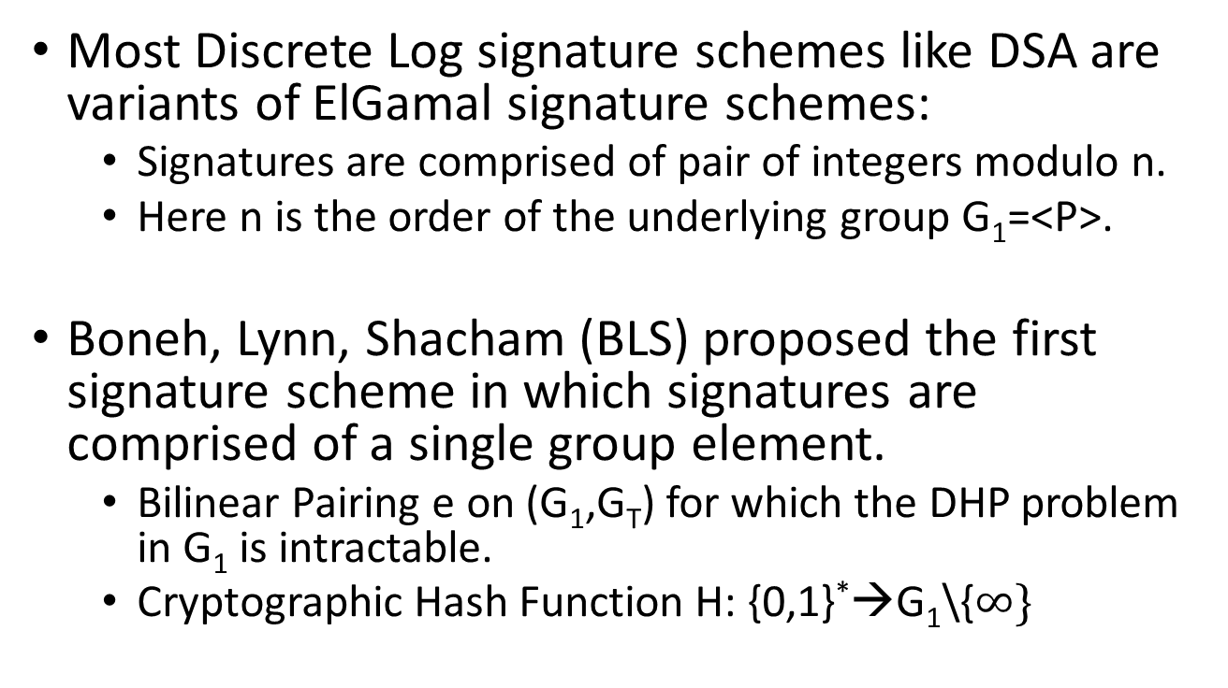
Short Signatures
Most Discrete Log signature schemes like DSA are variants of ElGamal signature schemes:
  Signatures are comprised of pair of integers modulo n.
  Here n is the order of the underlying group G₁=<P>.
Boneh, Lynn, Shacham (BLS) proposed the first signature scheme in which signatures are comprised of a single group element.
  Bilinear Pairing e on (G₁,G_{T}) for which the DHP problem in G₁ is intractable.
  Cryptographic Hash Function H: {0,1}*→G₁\{$∞\}$

Slide 24
BLS Signatures
Alice’s private key, aϵ[1,n-1]
Public key: A=aP.
Sign:
  Alice’s Signature on a message mϵ{0,1}*
  M=H(m), s=aM.
Verify:
  Bob with the public key A=aP can easily verify.
  Bob calculates M=H(m)
  Then Bob checks whether (P,A=aP,M,s=aM) is a valid quadruple by solving DDHP in G₁ (check e(P,s)=e(A,M))

Slide 25
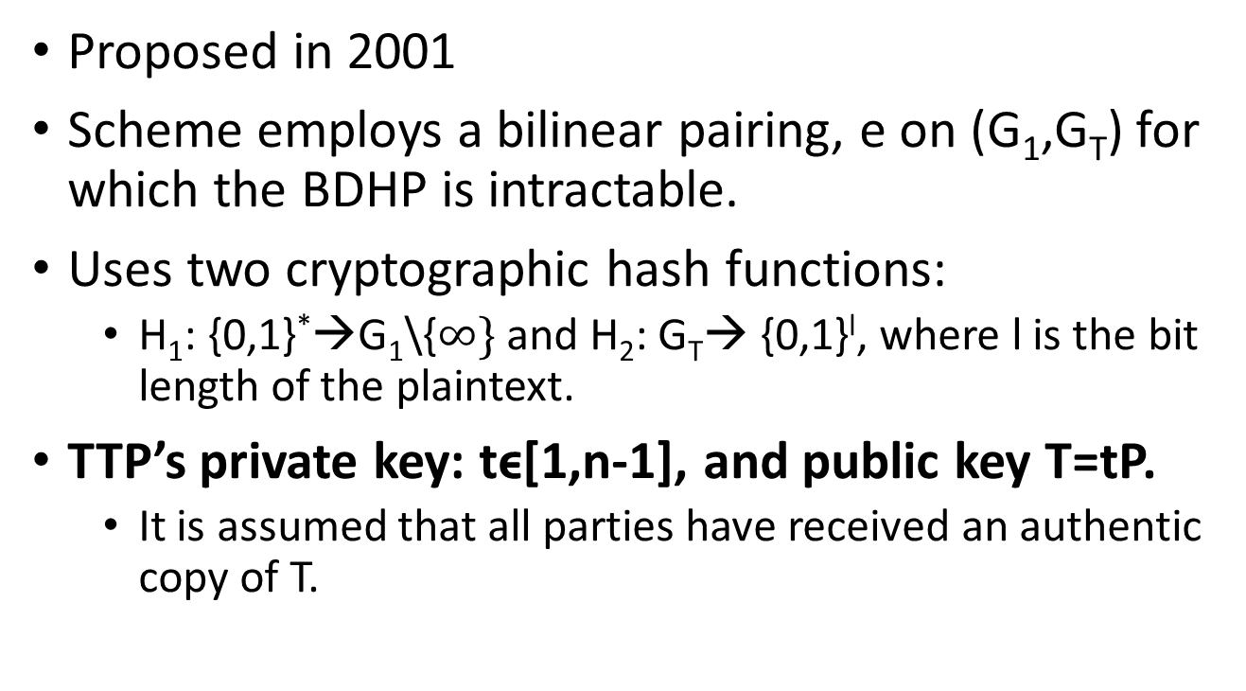
Boneh Franklin’s IBE
Proposed in 2001
Scheme employs a bilinear pairing, e on (G₁,G_{T}) for which the BDHP is intractable.
Uses two cryptographic hash functions:
  H₁: {0,1}*→G₁\{$∞\}$ and H₂: G_{T}→ {0,1}^{l}, where l is the bit length of the plaintext.
TTP’s private key: tϵ[1,n-1], and public key T=tP.
  It is assumed that all parties have received an authentic copy of T.

Slide 26
Private Key of Alice
Alice requests her private key d_{A}:
  TTP creates Alice’s identity string ID_{A}, computes d_{A}=tH₁(ID_{A}).
  Securely transforms d_{A} to Alice.
  Note that d_{A} is the BLS signature on the message ID_{A}.

Slide 27
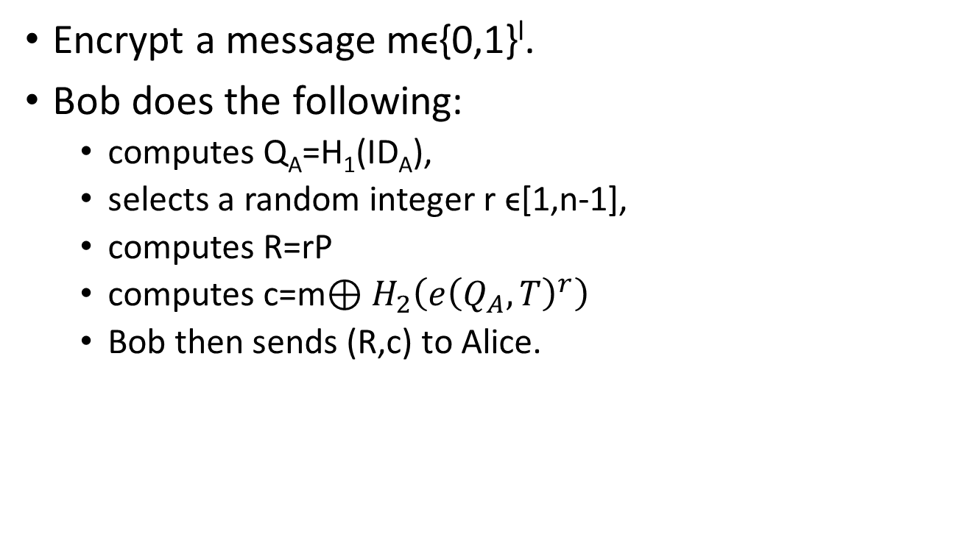
Bob’s Encryption for Alice
Encrypt a message mϵ{0,1}^{l}.
Bob does the following:
  computes Q_{A}=H₁(ID_{A}),
  selects a random integer r ϵ[1,n-1],
  computes R=rP
  computes c=m$⊕H_{2}\left(e{\left(Q_{A},T\right)}^{r}\right)$
  Bob then sends (R,c) to Alice.

Slide 28
Alice’s Decryption
Bob uses his decryption key d_{A}, and:
  computes e(d_{A},R)=e(tH₁(ID_{A}),rP)=e(Q_{A},tP)^{r}=e(Q_{A},T)^{r}
  Thus Bob can recover m.
  The eavesdropper has to compute e(Q_{A},T)^{r} from (P,Q_{A},T, R)

Slide 29
CCA Security
Given a target ciphertext (R,c), flips the first bit of c to get c’, and then obtains m’ using the decryption oracle.
Then flips the first bit of m’ to get m.

Slide 30

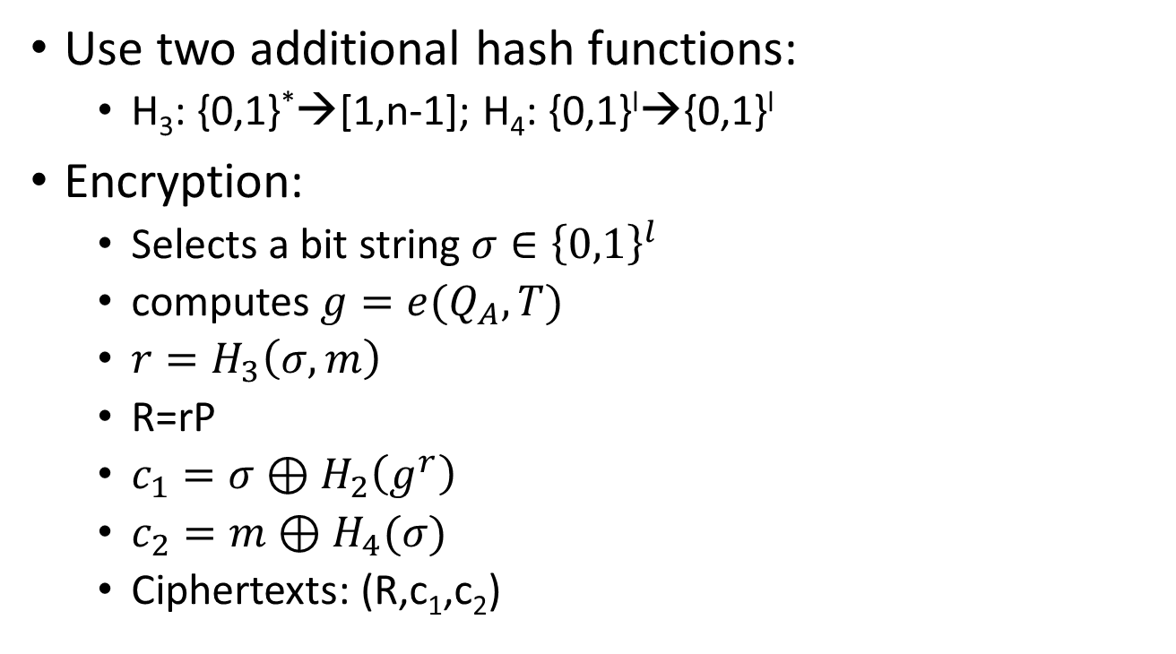
CCA security
Use two additional hash functions:
  H₃: {0,1}*→[1,n-1]; H₄: {0,1}^{l}→{0,1}^{l}
Encryption:
  Selects a bit string $σ∈{\left\{0,1\right\}}^{l}$
  computes $g=e(Q_{A},T)$
  $r=H_{3}\left(σ,m\right)$
  R=rP
  $c_{1}=σ⊕H_{2}\left(g^{r}\right)$
  $c_{2}=m⊕H_{4}(σ)$
  Ciphertexts: (R,c₁,c₂)
Decryption works:
Alice computes: g^{r}=e(d_{A},R).
Then $σ=c_{1}⊕H_{2}\left(g^{r}\right)$
Finally, $m=c_{2}⊕H_{4}\left(σ\right)$
Also, $r=H_{3}\left(σ,m\right).$
Alice accepts the message provided R=rP.
Note, that the previous attack fails because of the integrity check on R.

Slide 31
Few More Security Implications
Bilinear DHP (BDHP): Given (P,aP,bP,cP)
  Decisional: c=ab?
  Computational: Compute cP=abP
Inverse DHP (IDHP):
  Decisional: c=a⁻¹b? Equivalently, b=a⁻¹?
  Computational: cP=a⁻¹bP. Equivalently, bP=a⁻¹P.
These hardness assumptions are the basis of most Pairing based protocols.
Now consider few attack oracles.

Slide 32
Attack Oracles
FAPI: Fixed Argument Pairing Inversion.
Consider a pairing: e: G₁xG₂→G_{T}
  FAPI-1 : O1
    Input PϵG₁, zϵG_{T}
    Output QϵG₂, e(P,Q)=z.
  FAPI-2: O2
    Input QϵG₂,zϵG_{T}
    Output PϵG₁, st. e(P,Q)=z

Slide 33
Solve BCDHP
Bilinear DHP: Given (P,aP,bP,cP)
  Computational: Compute cP=abP
z₁=e(aP,Q)
aQ=O₁(P,z₁)
z₂=e(bP,aQ)
abQ=O₁(P,z₂)
abP=O₂(Q,z₂)

Slide 34
Solve IDHP
Inverse DHP (IDHP): Given (P,aP)
  Computational: Compute bP=a⁻¹P.
  Choose QϵG₂.
  z₁=e(aP,Q)
  aQ=O₁(P,z₁)
  z₂=e(P,Q)
  a⁻¹P=O₂(aQ,z₂)

