Slide 1
Hardware Implementations of Finite Field Primitives
Debdeep Mukhopadhyay
Chester Rebeiro
Dept. of Computer Science and Engineering
Indian Institute of Technology Kharagpur
INDIA

Slide 2
Finite Fields
For any prime p ,the set GF(p)={1,2,…,p-1} along with 2 operations : addition modulo p and multiplication modulo p forms a finite field
This means that
You can add, subtract, or multiply any two elements in GF(p). The result would also be in GF(p).
You can divide any element in GF(p) by another non-zero element, and the result is in GF(p).
Multiplication distributes over addition.
Such a finite field is called a Prime Field.

Slide 3
When p=2
P = {0, 1}
Addition : EX-OR 0 + 0 mod 2 = 0 0 + 1 mod 2 = 1 1 + 0 mod 2 = 1 1 + 1 mod 2 = 0 | Subtraction : EX-OR 0 - 0 mod 2 = 0 0 - 1 mod 2 = 1 1 - 0 mod 2 = 1 1 - 1 mod 2 = 0
Multiplication : AND 0 * 0 mod 2 = 0 0 * 1 mod 2 = 0 1 * 0 mod 2 = 0 1 * 1 mod 2 = 1 | Division : 0/1 mod 2 = 0 1/1 mod 2 = 1

Slide 4
Extension Fields
This is represented by GF(p^{m})
Every element in the field is represented by a polynomial with coefficients in GF(p) and degree at most m-1.
Example : if p=5 and m=4
3x³ + 1x² + 4x+ 2
In a computer only the coefficients of the polynomial need to be stored.
For p=2, this works well because the coefficients are either 0 or 1.
Another Example : if p = 2 and m=8
x⁸ + x⁴ + x³ + x + 1
So for the example above the representation is (1 0001 1011)₂
When p =2, the extension fields are called binary field

Slide 5
Irreducible Polynomial
A polynomial P(x) is said to irreducible if it cannot be factored into non-trivial polynomials in the same field.
Every extension field has an irreducible polynomial of degree m which has coefficients in GF(p).
All operations in the extension field is done modulo P(x)

Slide 6
Operations in Binary Fields
Consider the binary field GF(2^{m}) with irreducible polynomial x⁴ + x + 1.
The elements in GF(2^{m}) are

Slide 7
Addition in Binary Fields
Addition is polynomial addition modulo 2 this is equivalent to polynomial addition using ex-ors
Eg.
Binary notation : (1101)₂ ^ (0111)₂ = (1001)₂
Note that the degree of the result is always less than m. Therefore the result is naturally be in the field.w
Note that unlike integer addition there are no carries generated.
Hardware implementation therefore requires only m ex-or gates.

Slide 8
Subtraction in Binary Fields
Subtraction is exactly same as addition and is done using ex-ors
Ex:

Slide 9
Multiplication in Binary Fields
If A(x), B(x) Є GF(2^{m}) and the irreducible polynomial is P(x) then
C(x) = A(x) * B(x) mod P(x)
Two step process:
First do a polynomial multiplication A(x) * B(x) to obtain a polynomial C’(x) of degree 2m-2
Then do a modular reduction C’(x) mod P(x) to obtain C(x).
Example: In GF(2⁴)
Modular Reduction (x⁶ + x⁵ + x³ + x²) mod (x⁴+x+1) = (x² + x)
x³ + x² + x
x³ + x
x⁴ + x³ + x²
x⁶ + x⁵ + x⁴
x⁶ + x⁵ + x³ + x²

Slide 10
Modular Reduction for Trinomials
Let α be a root of the irreducible polynomial P(x) = x^{m} + x^{n} + 1
This means :
α^{m} + α^{n} + 1 = 0
α^{m} = α^{n} + 1
α^{m+1} = α^{n+1} + α // multiplying by α
α^{m+2} = α^{n+2} + α² // multiplying again by α
Thus we can reduce larger powers.

Slide 11
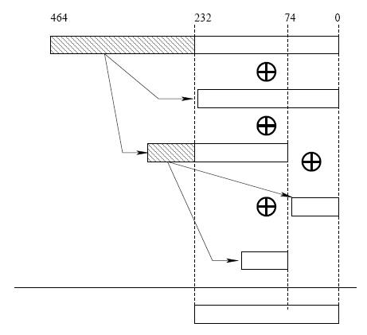
Modular Reduction Algorithm
Example is for m=233
Output of multiplier is 465 bits
Step 1:
β = α_{[232:0]} + α_{[464:233]} + α_{[464:233]}x⁷⁴
Step 2:
c = β_{[232:0]} + β_{[306:233]} + α_{[306:233]}x⁷⁴
We stop after 2 steps because the result is less than 233

Slide 12
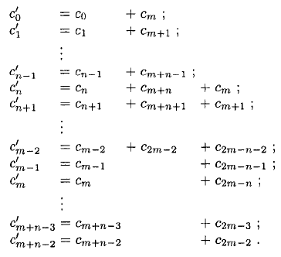
Modular Reduction as a Matrix
C(x) = c_{2m-2}x^{2m-2} + c_{2m-1}x^{2m-1} … + c₂x² + cx + 1 is the output of the polynomial multiplication then the reduced output is
This can be put in the form of a matrix called Q

Slide 13
Algorithms for Polynomial Multiplication
Classical Multiplier (aka. School Book Multiplier)
Mastrovito Multiplier
Montgomery Multiplier
Karatsuba Multipliera

Slide 14
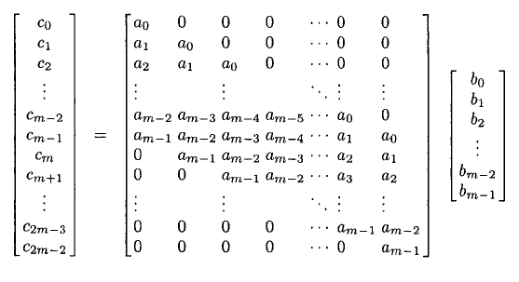
Classical Multiplier
A(x) = a_{m-1}x^{m-1} + a_{m-2}x^{m-1} … + a₂x² + ax + 1
B(x) = b_{m-1}x^{m-1} + b_{m-2}x^{m-1} … + b₂x² + bx + 1
Then,

Slide 15
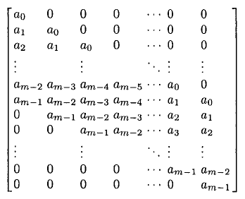
Mastrovito Multiplier
L
U

Slide 16
Montogomery Multiplier
Instead of computing C(x) = A(x)B(x)mod P(x), this multiplier computes
Where
R(x) is chosen to result in fast reduction (eg x^{m})
:

Slide 17
Proof of Correctness
implies
therefore
From Step 2 :
Step 3 can be written as follows
Substituting,

Slide 18
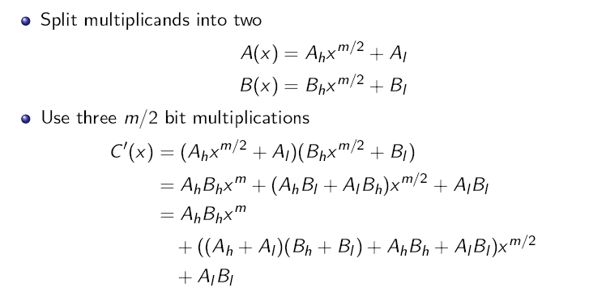
Karatsuba Multiplier

Slide 19
The m-bit Karatsuba Algorithm
Invoke First m/2 bit Karatsuba Algorithm
Invoke Second m/2 bit Karatsuba Algorithm
Invoke Third m/2 bit Karatsuba Algorithm
Combine the partial products

Slide 20
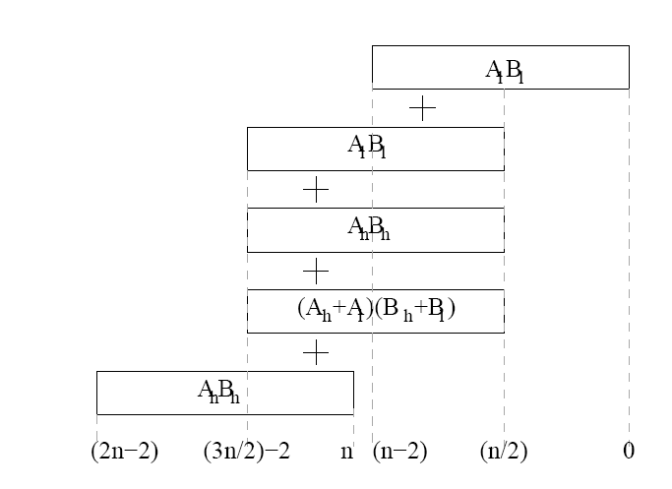
Combining the Partial Products

Slide 21
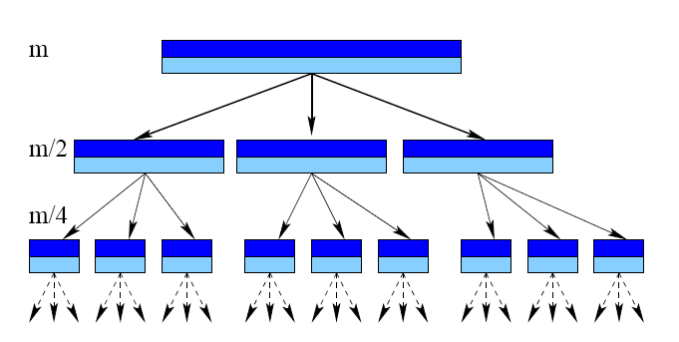
Recursive Karatsuba Multiplier when m = 2^{k}

Slide 22
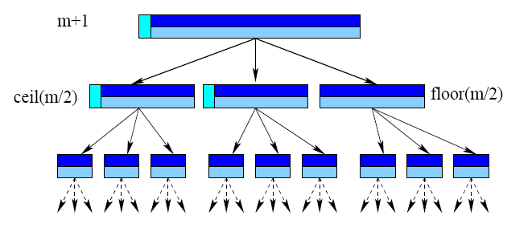
Recursive Karatsuba Multiplier when m ≠2^{k}

Slide 23
Generalizing the Karatsuba Multiplier with degree 2
A(x) = a₂x² + a₁x + a₀
B(x) = b₂x² + b₁x + b₀
D₀ = a₀b₀ , D1 = a₁b₁, D2 = a₂b₂,
D_{0,1}=(a₀+a₁)(b₀+b₁), D_{0,2}=(a₀+a₂)(b₀+b₂), D_{1,2}=(a₁+a₂)(b₁+b₂)
C(x) = D₂x⁴ + (D_{1,2}x-D₁-D₂)x³ + (D_{0,2}-D₂-D₀+D₁)x² + (D_{0,1}-D₁-D₀x) + D₀

Slide 24
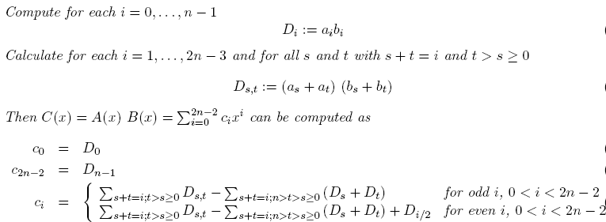
Generalizing Karatsuba for Arbitrary Degree (d)
Consider n = d + 1

Slide 25
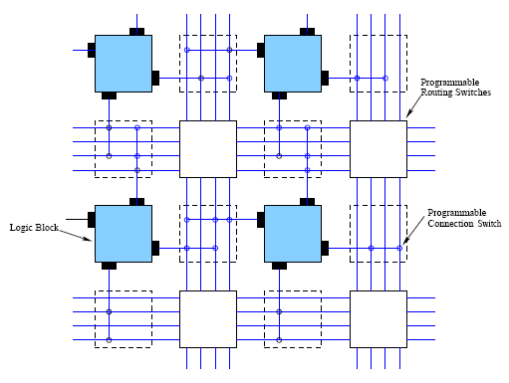
Efficient Implementation of Karatsuba for FPGAs

Slide 26
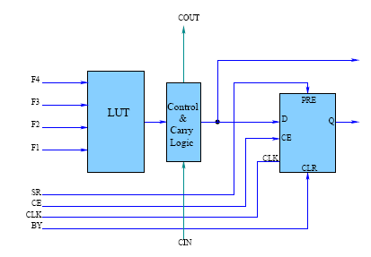
Logic Block of an FPGA
LUTs is a costly so has to be utilized efficiently

Slide 27
LUT Utilization

Slide 28
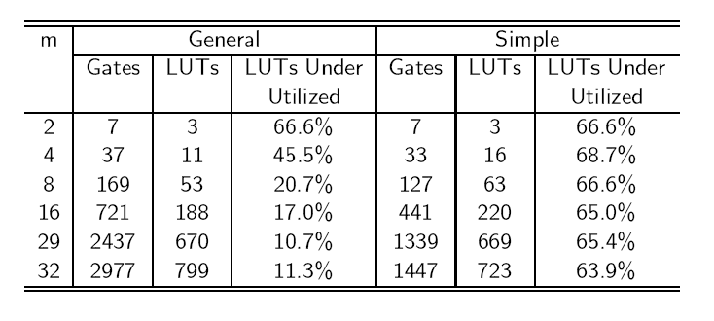
Karatsuba vs Generalized Karatsuba on FPGAs

Slide 29
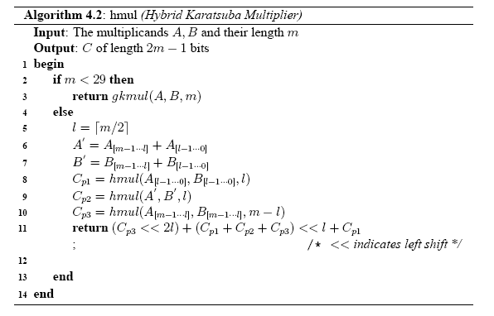
Hybrid Karatsuba Algorithm
Invoke General Karatsuba Multiplier
Split operands
Invoke hybrid karatsuba recursively
Combine Partial Products

Slide 30
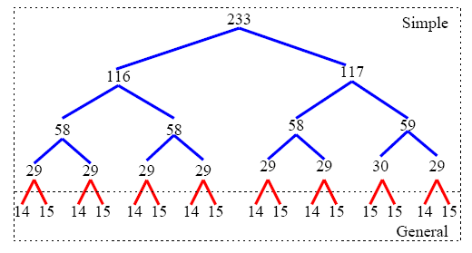
Hybrid Karatsuba Multiplier for GF(2²³³)

Slide 31
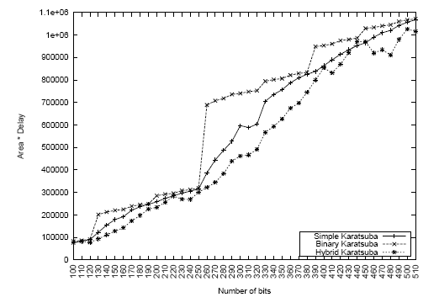
Performance of the Hybrid Karatsuba Multiplier

Slide 32
Comparison with other multiplication implementations

