Slide 1
Improved Practical Differential Fault Analysis of Grain-128
Prakash Dey, Abhishek Chakraborty, Avishek Adhikari and Debdeep Mukhopadhyay
Departments of Pure Mathematics, University of Calcutta and
Computer Science and Engineering, Indian Institute of Technology Kharagpur, India

Slide 2
Outline
Motivation of our Work
Basic Idea
Grain-128 Cipher
Preliminaries
Simulation Based Results
Fault Injection Setup
Experimental Results
Conclusions

Slide 3
Motivation of our Work
Differential Fault Attacks on stream ciphers : An active field of research
Practical realizations of such DFA : Not reported in the literature
How realistic are the assumed fault models for DFA on stream ciphers?
Need to be revisited from a practical view point
We considered a low-cost clock glitch based fault injection on eSTREAM finalist Grain-128
Notes:
Differential fault analysis is a type of side channel attack in the field of cryptography, specifically cryptanalysis. The principle is to induce faults—unexpected environmental conditions—into cryptographic implementations, to reveal their internal states.

Slide 4
Basic Idea
SINGLE CLOCK GLITCH
GRAIN-128
NOT
ENOUGH
FAULTS
MULTI CLOCK GLITCHES
GRAIN-128
ENOUGH
FAULTS

Slide 5
Overview: Work Procedure
Offline stage:
i) Simulation of faults many times
ii) Identification of a bitwise XOR pattern between the normal and faulty keystream
Online stage:
i) Introduction of clock glitch introduced faults on hardware
ii) Identification of the fault location
iii) SAT solver: Obtain internal state of Grain-128

Slide 6
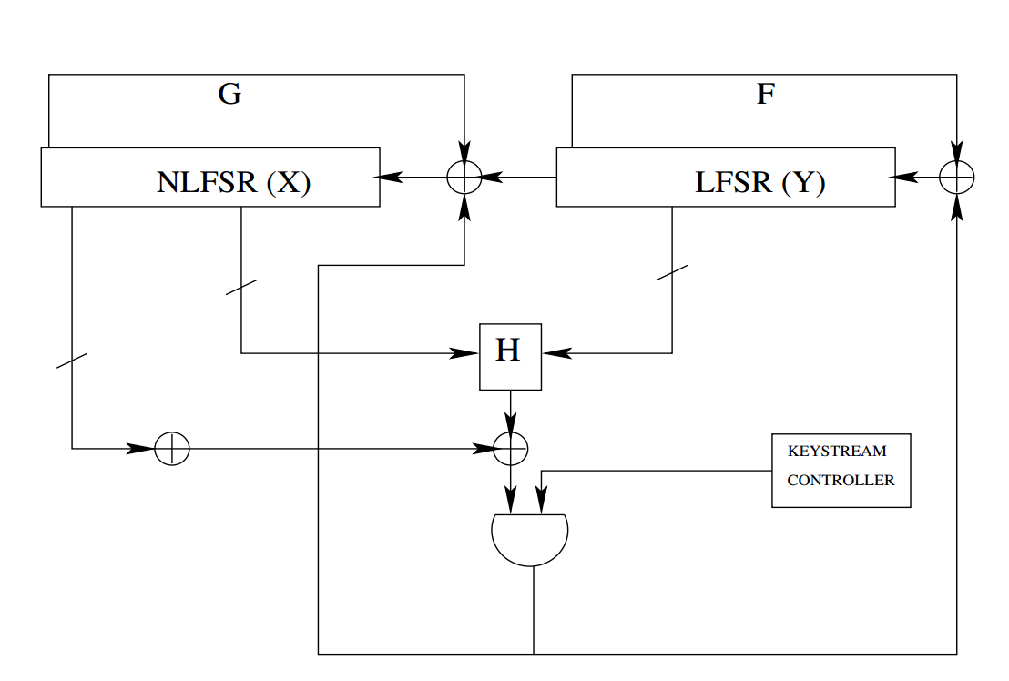
Grain-128 Stream Cipher
eSTREAM hardware port folio finalist
Designed by M. Hell, T. Johansson, A. Maximov and W. Meier
Abhishek Chakraborty, Indian Institute of Technology Kharagpur

Slide 7
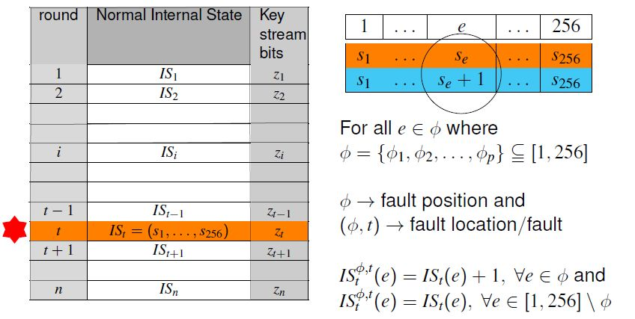
Fault and Fault position
Abhishek Chakraborty, Indian Institute of Technology Kharagpur

Slide 8
The XOR Differential Keystream
In order to detect the fault, one needs to identify a pattern in the XOR differential keystream
Abhishek Chakraborty, Indian Institute of Technology Kharagpur

Slide 9
Signature of Faults
Key-IV independent Differential Pattern corresponding to a fault
Abhishek Chakraborty, Indian Institute of Technology Kharagpur

Slide 10
Signature: A Toy Example
Abhishek Chakraborty, Indian Institute of Technology Kharagpur

Slide 11
Generating Polynomial Equations
SAT solver
Abhishek Chakraborty, Indian Institute of Technology Kharagpur
Notes:
Now the system of polynomial equations are simply passed on to the SAT solver for the extraction of solution for the variables of IS_t

Slide 12
Experimental Results - 1
Fault location Identification Probability
Bad Fault Rejection Probability
Abhishek Chakraborty, Indian Institute of Technology Kharagpur
Notes:
One standalone desktop PC with AMD 4.0 GHz FX-8350 processor and 32 GB RAM
Beowulf Cluster of 20 desktop PC each with 2.60 GHz Intel Pentium E5300 Dual-core processor and 4 GB RAM
SAT solver Cryptominisat - 2.9.6 installed in SAGE - 6.1.1
All simulation based experiments were performed assuming PRGA(keystream generation) round 1 as target round
For each column of both the tables we considered 2^20 experiments … ie randomly varying key-IV and fault positions within k neighbourhood
Key Iv pairs are distinct uniformly random and independent
Faults other than k neighbourhood fault at a fixed PRGA round is c

Slide 13
Experimental Results - 2
SAT Solving Results with timeout of 4 hours
Abhishek Chakraborty, Indian Institute of Technology Kharagpur
Notes:
m: denotes the number of random faults introduced (uniformly and independently)
N: no. of PRGA rounds considred for analysis NOE: Num of experiments
NOT: Num of timed out cases
PRGA: Pseudo Random keystream Generation Algorithm

Slide 14
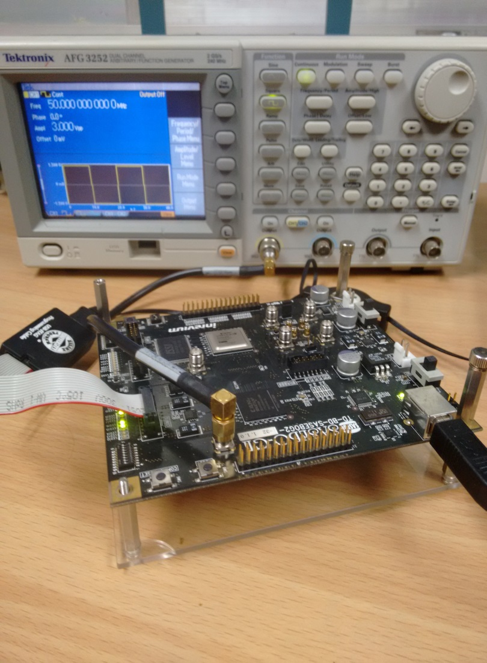
Fault Injection Setup
Grain-128 cipher implemented in Spartan 3A FPGA
Clock glitches at different frequencies
Xilinx DCM to drive the CUT
Internal state monitored using Chipscope Pro 12.3
Abhishek Chakraborty, Indian Institute of Technology Kharagpur

Slide 15
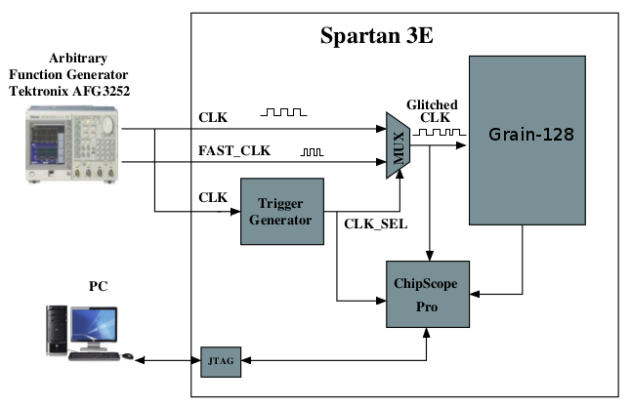
Fault Injection Technique
Spartan 3A
Abhishek Chakraborty, Indian Institute of Technology Kharagpur

Slide 16
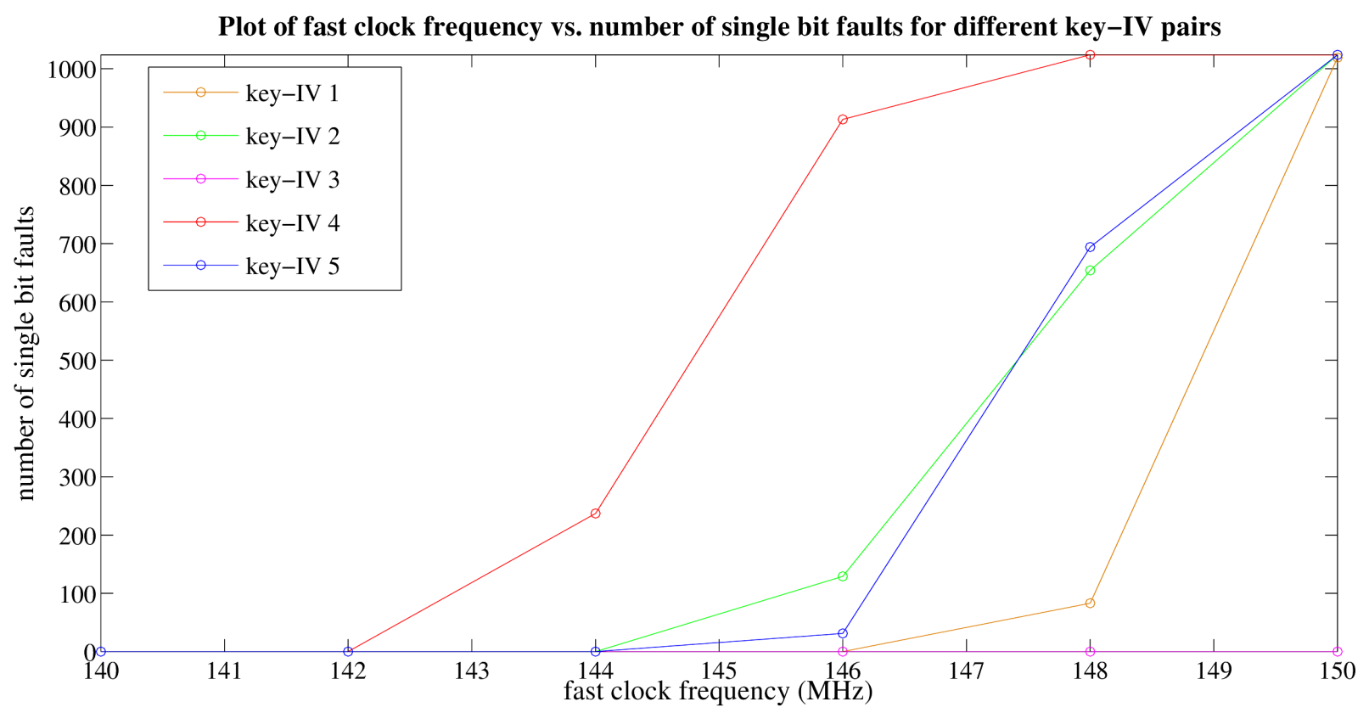
Experimental Results - 3
All the faults were single bit faults
No multiple bit faults
Single bit faults biased at the 128th NLFSR bit
Abhishek Chakraborty, Indian Institute of Technology Kharagpur

Slide 17
Grain-128 : Critical Path
Abhishek Chakraborty, Indian Institute of Technology Kharagpur

Slide 18
Multiple Bit Faults
Outcome: No random single bit faults as required for the attack proposed by S.Sarkar et.al (2013)
Solution? Random Multiple Bit Faults in a single round
Modified fault injection technique: Introduce k- neighbourhood random multiple bit faults
Abhishek Chakraborty, Indian Institute of Technology Kharagpur

Slide 19
Introducing k- neighbourhood faults
Abhishek Chakraborty, Indian Institute of Technology Kharagpur

Slide 20
Experimental Results - 4
SAT solver time: 527.83 secs
To recover the internal state
`94b7841c7bff0ca4765cd312e25c51de269e886808dde1a2faed03df8fed13a0‘
at PRGA round 17
Abhishek Chakraborty, Indian Institute of Technology Kharagpur

Slide 21
Conclusions
For the first time, we provide actual chip results of clock glitch induced faults on any stream cipher (Grain-128)
Occurrence of biased faults at a single bit
Existing single bit fault based DFA on Grain-128 will not be feasible
Modified fault injection technique: Combining the effect of the clock glitches and also the shift in the registers
Revisiting the DFA algorithm on Grain-128: Relaxed fault model with key recovery possible for k-neighbourhood fault
Abhishek Chakraborty, Indian Institute of Technology Kharagpur

Slide 22
References
Abhishek Chakraborty, Indian Institute of Technology Kharagpur

Slide 23
References (Contd..)
Abhishek Chakraborty, Indian Institute of Technology Kharagpur

Slide 24
Thank you
Questions ?
Abhishek Chakraborty, Indian Institute of Technology Kharagpur

