Slide 1
Functions
Courtsey: University of Pittsburgh-CSD-Khalifa

Slide 2
Introduction
Function
  A self-contained program segment that carries out some specific, well-defined task.
Some properties:
  Every C program consists of one or more functions.
    One of these functions must be called “main”.
    Execution of the program always begins by carrying out the instructions in “main”.
  A function will carry out its intended action whenever it is called or invoked.

Slide 3
  In general, a function will process information that is passed to it from the calling portion of the program, and returns a single value.
    Information is passed to the function via special identifiers called arguments or parameters.
    The value is returned by the “return” statement.
  Some function may not return anything.
    Return data type specified as “void”.

Slide 4
#include <stdio.h>
int factorial (int m)
{
int i, temp=1;
for (i=1; i<=m; i++)
temp = temp * i;
return (temp);
}
main()
{
int n;
for (n=1; n<=10; n++)
printf (“%d! = %d \n”,
n, factorial (n) );
}

Slide 5
Functions: Why?
Functions
  Modularize a program
  All variables declared inside functions are local variables
    Known only in function defined
  Parameters
    Communicate information between functions
    They also become local variables.
Benefits
  Divide and conquer
    Manageable program development
  Software reusability
    Use existing functions as building blocks for new programs
    Abstraction - hide internal details (library functions)
  Avoids code repetition

Slide 6
Defining a Function
A function definition has two parts:
  The first line.
  The body of the function.
    return-value-type function-name ( parameter-list )
    {
    declarations and statements
    }

Slide 7
The first line contains the return-value-type, the function name, and optionally a set of comma-separated arguments enclosed in parentheses.
  Each argument has an associated type declaration.
  The arguments are called formal arguments or formal parameters.
Example:
  int gcd (int A, int B)
The argument data types can also be declared on the next line:
  int gcd (A, B)
  int A, B;

Slide 8
The body of the function is actually a compound statement that defines the action to be taken by the function.
  int gcd (int A, int B)
  {
  int temp;
  while ((B % A) != 0) {
  temp = B % A;
  B = A;
  A = temp;
  }
  return (A);
  }
BODY

Slide 9
When a function is called from some other function, the corresponding arguments in the function call are called actual arguments or actual parameters.
  The formal and actual arguments must match in their data types.
Point to note:
  The identifiers used as formal arguments are “local”.
    Not recognized outside the function.
    Names of formal and actual arguments may differ.

Slide 10
  #include <stdio.h>
  /* Compute the GCD of four numbers */
  main()
  {
  int n1, n2, n3, n4, result;
  scanf (“%d %d %d %d”, &n1, &n2, &n3, &n4);
  result = gcd ( gcd (n1, n2), gcd (n3, n4) );
  printf (“The GCD of %d, %d, %d and %d is %d \n”,
  n1, n2, n3, n4, result);
  }

Slide 11
Function Not Returning Any Value
Example: A function which only prints if a number if divisible by 7 or not.
  void div7 (int n)
  {
  if ((n % 7) == 0)
  printf (“%d is divisible by 7”, n);
  else
  printf (“%d is not divisible by 7”, n);
  return;
  }
OPTIONAL

Slide 12
Returning control
  If nothing returned
    return;
    or, until reaches right brace
  If something returned
    return expression;

Slide 13
Function: An Example
#include <stdio.h>
int square(int x)
{
int y;
y=x*x;
return(y);
}
void main()
{
int a,b,sum_sq;
printf(“Give a and b \n”);
scanf(“%d%d”,&a,&b);
sum_sq=square(a)+square(b);
printf(“Sum of squares= %d \n”,sum_sq);
}
Function declaration
Name of function
Return data-type
parameter
Functions called
Parameters Passed

Slide 14
Invoking a function call : An Example
#include <stdio.h>
int square(int x)
{
int y;
y=x*x;
return(y);
}
void main()
{
int a,b,sum_sq;
printf(“Give a and b \n”);
scanf(“%d%d”,&a,&b);
sum_sq=square(a)+square(b);
printf(“Sum of squares= %d \n”,sum_sq);
}
Assume value of a is 10
a
10
x
10
returns
*
y
100

Slide 15
Function Definitions
Function definition format (continued)
  return-value-type function-name( parameter-list )
  {
  declarations and statements
  }
  Declarations and statements: function body (block)
    Variables can be declared inside blocks (can be nested)
    Function can not be defined inside another function
  Returning control
    If nothing returned
      return;
      or, until reaches right brace
    If something returned
      return expression;

Slide 16
An example of a function
Return
datatype
Function name
int sum_of_digits(int n)
{
int sum=0;
while (n != 0) {
sum = sum + (n % 10);
n = n / 10;
}
return(sum);
}
Parameter
List
Local
variable
Expression
Return
statement

Slide 17
Variable Scope
int A;
void main()
    { A = 1;
    myProc();
    printf ( "A = %d\n", A);
    }
    void myProc()
    { int A = 2;
    while( A==2 )
    {
    int A = 3;
    printf ( "A = %d\n", A);
    break;
    }
    printf ( "A = %d\n", A);
    }
    . . .
Printout:
--------------
A = 3
A = 2
A = 1

Slide 18
Function: Summary
#include <stdio.h>
int factorial (int m)
{
int i, temp=1;
for (i=1; i<=m; i++)
temp = temp * i;
return (temp);
}
main()
{
int n;
for (n=1; n<=10; n++)
printf (“%d! = %d \n”, n, factorial (n) );
}
main()
is a function
Returned data-type
parameter
Function name
Local vars
Calling a function
Return statement
Self contained programme

Slide 19
Some Points
A function cannot be defined within another function.
  All function definitions must be disjoint.
Nested function calls are allowed.
  A calls B, B calls C, C calls D, etc.
  The function called last will be the first to return.
A function can also call itself, either directly or in a cycle.
  A calls B, B calls C, C calls back A.
  Called recursive call or recursion.

Slide 20
Math Library Functions
Math library functions
  perform common mathematical calculations
  #include <math.h>
  cc <prog.c> -lm
Format for calling functions
  FunctionName (argument);
    If multiple arguments, use comma-separated list
  printf( "%.2f", sqrt( 900.0 ) );
    Calls function sqrt, which returns the square root of its argument
    All math functions return data type double
  Arguments may be constants, variables, or expressions

Slide 21
Math Library Functions
double acos(double x) -- Compute arc cosine of x.
double asin(double x) -- Compute arc sine of x.
double atan(double x) -- Compute arc tangent of x.
double atan2(double y, double x) -- Compute arc tangent of y/x.
double ceil(double x) -- Get smallest integral value that exceeds x.
double floor(double x) -- Get largest integral value less than x.
double cos(double x) -- Compute cosine of angle in radians.
double cosh(double x) -- Compute the hyperbolic cosine of x.
double sin(double x) -- Compute sine of angle in radians.
double sinh(double x) - Compute the hyperbolic sine of x.
double tan(double x) -- Compute tangent of angle in radians.
double tanh(double x) -- Compute the hyperbolic tangent of x.
double exp(double x -- Compute exponential of x
double fabs (double x ) -- Compute absolute value of x.
double log(double x) -- Compute log(x).
double log10 (double x ) -- Compute log to the base 10 of x.
double pow (double x, double y) -- Compute x raised to the power y.
double sqrt(double x) -- Compute the square root of x.
http://www.cs.cf.ac.uk/Dave/C/node17.html#SECTION001710000000000000000

Slide 22
More about scanf and printf

Slide 23
Entering input data :: scanf function
General syntax:
    scanf (control string, arg1, arg2, …, argn);
  “control string refers to a string typically containing data types of the arguments to be read in;
  the arguments arg1, arg2, … represent pointers to data items in memory.
    Example: scanf (%d %f %c”, &a, &average, &type);
The control string consists of individual groups of characters, with one character group for each input data item.
  ‘%’ sign, followed by a conversion character.

Slide 24
  Commonly used conversion characters:
    c single character
    d decimal integer
    f floating-point number
    s string terminated by null character
    X hexadecimal integer
  We can also specify the maximum field-width of a data item, by specifying a number indicating the field width before the conversion character.
    Example: scanf (“%3d %5d”, &a, &b);

Slide 25
Writing output data :: printf function
General syntax:
    printf (control string, arg1, arg2, …, argn);
  “control string refers to a string containing formatting information and data types of the arguments to be output;
  the arguments arg1, arg2, … represent the individual output data items.
The conversion characters are the same as in scanf.

Slide 26
Examples:
    printf (“The average of %d and %d is %f”, a, b, avg);
    printf (“Hello \nGood \nMorning \n”);
    printf (“%3d %3d %5d”, a, b, a*b+2);
    printf (“%7.2f %5.1f”, x, y);
Many more options are available:
  Read from the book.
  Practice them in the lab.
String I/O:
  Will be covered later in the class.

Slide 27
Function Prototypes
Usually, a function is defined before it is called.
  main() is the last function in the program.
  Easy for the compiler to identify function definitions in a single scan through the file.
However, many programmers prefer a top-down approach, where the functions follow main().
  Must be some way to tell the compiler.
  Function prototypes are used for this purpose.
    Only needed if function definition comes after use.

Slide 28
Function Prototype (Contd.)
  Function prototypes are usually written at the beginning of a program, ahead of any functions (including main()).
  Examples:
    int gcd (int A, int B);
    void div7 (int number);
    Note the semicolon at the end of the line.
    The argument names can be different; but it is a good practice to use the same names as in the function definition.
;

Slide 29
Function Prototype: Examples
int ncr (int n, int r)
{
return (fact(n) / fact(r) / fact(n-r));
}
int fact (int n)
{
int i, temp=1;
for (i=1; i<=n; i++)
temp *= I;
return (temp);
}
#include <stdio.h>
int ncr (int n, int r);
int fact (int n);
main()
{
int i, m, n, sum=0;
printf(“Input m and n \n”);
scanf (“%d %d”, &m, &n);
for (i=1; i<=m; i+=2)
sum = sum + ncr (n, i);
printf (“Result: %d \n”, sum);
}
Prototype
declaration
Function
definition

Slide 30
Header Files
Header files
  contain function prototypes for library functions
  <stdlib.h> , <math.h> , etc
  Load with
  #include <filename>
  #include <math.h>
Custom header files
  Create file with functions
  Save as filename.h
  Load in other files with #include "filename.h"
  Reuse functions

Slide 31
/* Finding the maximum of three integers */
Prototype
Declaration
#include <stdio.h>
int maximum( int, int, int ); /* function prototype */
int main()
{
int a, b, c;
printf( "Enter three integers: " );
Function
Calling
scanf( "%d%d%d", &a, &b, &c );
printf( "Maximum is: %d\n", maximum( a, b, c ) );
return 0;
}
/* Function maximum definition */
int maximum( int x, int y, int z )
{
Function
Definition
int max = x;
if ( y > max )
max = y;
if ( z > max )
max = z;
return max;
}

Slide 32
Calling Functions: Call by Value and Call by Reference
Used when invoking functions
Call by value
  Copy of argument passed to function
  Changes in function do not effect original
  Use when function does not need to modify argument
    Avoids accidental changes
Call by reference
  Passes original argument
  Changes in function effect original
  Only used with trusted functions
For now, we focus on call by value

Slide 33
An Example: Random Number Generation
rand function
  Prototype defined in <stdlib.h>
  Returns "random" number between 0 and RAND_MAX (at least 32767)
  i = rand();
  Pseudorandom
    Preset sequence of "random" numbers
    Same sequence for every function call
Scaling
  To get a random number between 1 and n
  1 + ( rand() % n )
    rand % n returns a number between 0 and n-1
    Add 1 to make random number between 1 and n
    1 + ( rand() % 6) // number between 1 and 6

Slide 34
Random Number Generation: Contd.
srand function
  Prototype defined in <stdlib.h>
  Takes an integer seed - jumps to location in "random" sequence
  srand( seed );

Slide 35
1 /* A programming example
2 Randomizing die-rolling program */
3 #include <stdlib.h>
4 #include <stdio.h>
Algorithm
1. Initialize seed
2. Input value for seed
2.1 Use srand to change random sequence
2.2 Define Loop
3. Generate and output random numbers
5
6 int main()
7 {
8 int i;
9 unsigned seed;
10
11 printf( "Enter seed: " );
12 scanf( "%u", &seed );
13 srand( seed );
14
15 for ( i = 1; i <= 10; i++ ) {
16 printf( "%10d ", 1 + ( rand() % 6 ) );
17
18 if ( i % 5 == 0 )
19 printf( "\n" );
20 }
21
22 return 0;
23 }

Slide 36
Program Output
Enter seed: 67
6 1 4 6 2
1 6 1 6 4
Enter seed: 867
2 4 6 1 6
1 1 3 6 2
Enter seed: 67
6 1 4 6 2
1 6 1 6 4

Slide 37
#include: Revisited
Preprocessor statement in the following form
#include “filename”
Filename could be specified with complete
path.
#include “/usr/home/rajan/myfile.h”
The content of the corresponding file will be
included in the present file before compilation and the compiler will compile thereafter considering the content as it is.

Slide 38
#include: Contd.
#include <stdio.h>
int x;
main()
{
printf(“Give value of x \n)”;
scanf(“%d”,&x);
printf(“Square of x=%d \n”,x*x);
}
#include “myfile.h”
main()
{
printf(“Give value of x \n”);
scanf(“%d”,&x);
printf(“Square of x=%d \n”,x*x);
}
#include <stdio.h>
int x;
myfile.h
/usr/include/filename.h
#include <filename.h>
It includes the file “filename.h” from a
specific directory known as include directory.
prog.c

Slide 39
#define: Macro definition
#include <stdio.h>
#define PI 3.14
main()
{
float r=4.0,area;
area=PI*r*r;
}
#include <stdio.h>
main()
{
float r=4.0,area;
area=3.14*r*r;
}
Preprocessor directive in the following form
#define string1 string2
Replaces the string1 by string2 wherever it occurs before compilation, e.g.
#define PI 3.14

Slide 40
#define with argument
#define statement may be used with argument e.g.
#define sqr(x) ((x)*(x))
Which one is faster to execute?
#include <stdio.h>
#define sqr(x) ((x)*(x))
main()
{
int y=5;
printf(“value=%d \n”, sqr(y)+3);
}
#include <stdio.h>
main()
{
int y=5;
printf(“value=%d \n”, ((y)*(y))+3);
}
sqr(x) written
as macro definition?
sqr(x) written
as an ordinary function?

Slide 41
#define with arguments: A Caution
#define sqr(x) x*x
  How macro substitution will be carried out?
    r = sqr(a) + sqr(30); ➔ r = a*a + 30*30;
    r = sqr(a+b); ➔ r = a+b*a+b;
  The macro definition should have been written as:
    #define sqr(x) (x)*(x)
    r = (a+b)*(a+b);
WRONG?

Slide 42
Recursion
A process by which a function calls itself repeatedly.
  Either directly.
    X calls X.
  Or cyclically in a chain.
    X calls Y, and Y calls X.
Used for repetitive computations in which each action is stated in terms of a previous result.
  fact(n) = n * fact (n-1)

Slide 43
Contd.
For a problem to be written in recursive form, two conditions are to be satisfied:
  It should be possible to express the problem in recursive form.
  The problem statement must include a stopping condition
    fact(n) = 1, if n = 0
    = n * fact(n-1), if n > 0

Slide 44
Examples:
  Factorial:
    fact(0) = 1
    fact(n) = n * fact(n-1), if n > 0
  GCD:
    gcd (m, m) = m
    gcd (m, n) = gcd (m-n, n), if m > n
    gcd (m, n) = gcd (n, n-m), if m < n
  Fibonacci series (1,1,2,3,5,8,13,21,….)
    fib (0) = 1
    fib (1) = 1
    fib (n) = fib (n-1) + fib (n-2), if n > 1

Slide 45
Example 1 :: Factorial
long int fact (n)
int n;
{
if (n = = 0)
return (1);
else
return (n * fact(n-1));
}

Slide 46
Mechanism of Execution
When a recursive program is executed, the recursive function calls are not executed immediately.
  They are kept aside (on a stack) until the stopping condition is encountered.
  The function calls are then executed in reverse order.

Slide 47
Example :: Calculating fact(4)
  First, the function calls will be processed:
      fact(4) = 4 * fact(3)
      fact(3) = 3 * fact(2)
      fact(2) = 2 * fact(1)
      fact(1) = 1 * fact(0)
  The actual values return in the reverse order:
      fact(0) = 1
      fact(1) = 1 * 1 = 1
      fact(2) = 2 * 1 = 2
      fact(3) = 3 * 2 = 6
      fact(4) = 4 * 6 = 24

Slide 48
Factorials: Contd.
Example: factorials
  5! = 5 * 4 * 3 * 2 * 1
  Notice that
    5! = 5 * 4!
    4! = 4 * 3! ...
  Can compute factorials recursively
  Solve base case (1! = 0! = 1) then plug in
    2! = 2 * 1! = 2 * 1 = 2;
    3! = 3 * 2! = 3 * 2 = 6;

Slide 49
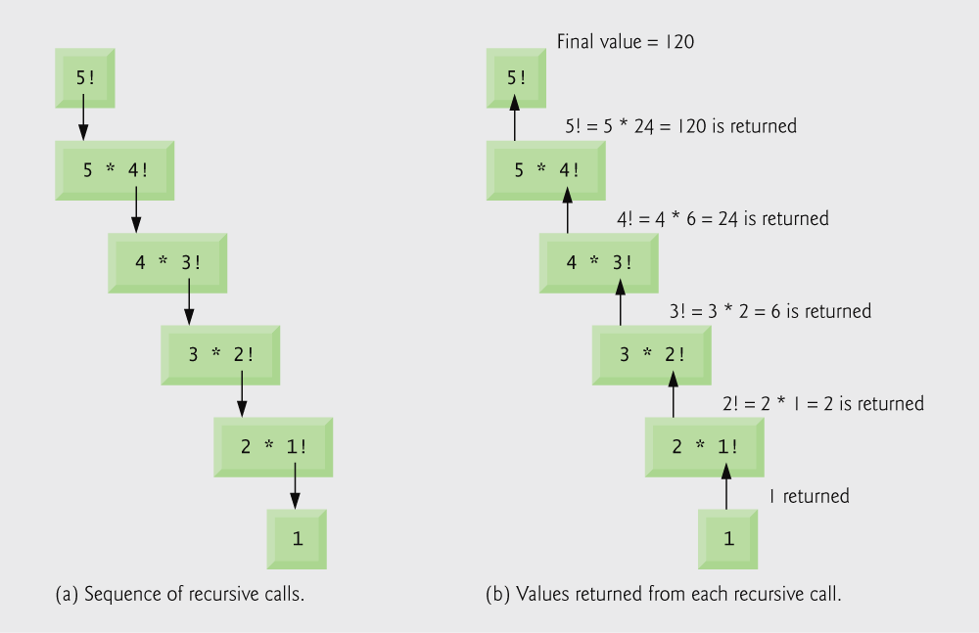
Recursive evaluation of 5!.

Slide 50
Terminating
Criterion

Slide 51
Trace Recursive factorial
animation
Executes factorial(4)

Slide 52
Trace Recursive factorial
animation
Executes factorial(3)

Slide 53
Trace Recursive factorial
animation
Executes factorial(2)

Slide 54
Trace Recursive factorial
animation
Executes factorial(1)

Slide 55
Trace Recursive factorial
animation
Executes factorial(0)

Slide 56
Trace Recursive factorial
animation
returns 1

Slide 57
Trace Recursive factorial
animation
returns factorial(0)

Slide 58
Trace Recursive factorial
animation
returns factorial(1)

Slide 59
Trace Recursive factorial
animation
returns factorial(2)

Slide 60
Trace Recursive factorial
animation
returns factorial(3)

Slide 61
Trace Recursive factorial
animation
returns factorial(4)

Slide 62

Recursive Algorithms Computer Implementation
long factorial(int n){
if (n<=0) return 1;
return n*factorial(n-1);
}
Compute 5!

Slide 63
Recursive Algorithms Computer Implementation
long factorial(int n){
if (n<=0) return 1;
return n*factorial(n-1);
}
f(5)=5·f(4)

Slide 64
Recursive Algorithms Computer Implementation
long factorial(int n){
if (n<=0) return 1;
return n*factorial(n-1);
}
f(4)=4·f(3) | f(5)=5·f(4)

Slide 65
Recursive Algorithms Computer Implementation
long factorial(int n){
if (n<=0) return 1;
return n*factorial(n-1);
}
f(3)=3·f(2) | f(4)=4·f(3) | f(5)=5·f(4)

Slide 66
Recursive Algorithms Computer Implementation
long factorial(int n){
if (n<=0) return 1;
return n*factorial(n-1);
}
f(2)=2·f(1) | f(3)=3·f(2) | f(4)=4·f(3) | f(5)=5·f(4)

Slide 67
Recursive Algorithms Computer Implementation
long factorial(int n){
if (n<=0) return 1;
return n*factorial(n-1);
}
f(1)=1·f(0) | f(2)=2·f(1) | f(3)=3·f(2) | f(4)=4·f(3) | f(5)=5·f(4)

Slide 68
Recursive Algorithms Computer Implementation
long factorial(int n){
if (n<=0) return 1;
return n*factorial(n-1);
}
f(0)= 1→ | f(1)=1·f(0) | f(2)=2·f(1) | f(3)=3·f(2) | f(4)=4·f(3) | f(5)=5·f(4)

Slide 69
Recursive Algorithms Computer Implementation
long factorial(int n){
if (n<=0) return 1;
return n*factorial(n-1);
}
1·1= 1→ | f(2)=2·f(1) | f(3)=3·f(2) | f(4)=4·f(3) | f(5)=5·f(4)

Slide 70
Recursive Algorithms Computer Implementation
long factorial(int n){
if (n<=0) return 1;
return n*factorial(n-1);
}
2·1= 2→ | f(3)=3·f(2) | f(4)=4·f(3) | f(5)=5·f(4)

Slide 71
Recursive Algorithms Computer Implementation
long factorial(int n){
if (n<=0) return 1;
return n*factorial(n-1);
}
3·2= 6→ | f(4)=4·f(3) | f(5)=5·f(4)

Slide 72
Recursive Algorithms Computer Implementation
long factorial(int n){
if (n<=0) return 1;
return n*factorial(n-1);
}
4·6= 24→ | f(5)=5·f(4)

Slide 73
Recursive Algorithms Computer Implementation
long factorial(int n){
if (n<=0) return 1;
return n*factorial(n-1);
}
5·24= 120→

Slide 74
Recursive Algorithms Computer Implementation
long factorial(int n){
if (n<=0) return 1;
return n*factorial(n-1);
}
Return 5! = 120

Slide 75
Another Example :: Fibonacci number
Fibonacci number f(n) can be defined as:
  f(0) = 0
  f(1) = 1
  f(n) = f(n-1) + f(n-2), if n > 1
  The successive Fibonacci numbers are:
    0, 1, 1, 2, 3, 5, 8, 13, 21, …..
Function definition:
int f (int n)
{
if (n < 2) return (n);
else return (f(n-1) + f(n-2));
}

Slide 76
Tracing Execution
How many times the function is called when evaluating f(4) ?
Inefficiency:
  Same thing is computed several times.
f(4)
f(3)
f(2)
f(2)
f(1)
f(1)
f(0)
f(1)
f(0)
9 times

Slide 77
Example Codes: fibonacci()
  Code for the fibonacci function
    long fibonacci( long n )
    {
    if (n == 0 || n == 1) // base case
    return n;
    else
    return fibonacci( n - 1) +
    fibonacci( n – 2 );
    }

Slide 78
27 /* Recursive definition of function fibonacci */
28 long fibonacci( long n )
29 {
30 /* base case */
31 if ( n == 0 || n == 1 ) {
32 return n;
33 } /* end if */
34 else { /* recursive step */
35 return fibonacci( n - 1 ) + fibonacci( n - 2 );
36 } /* end else */
37
38 } /* end function fibonacci */
Enter an integer: 0 Fibonacci( 0 ) = 0
Enter an integer: 1 Fibonacci( 1 ) = 1
Enter an integer: 2 Fibonacci( 2 ) = 1 (continued on next slide… )

Slide 80
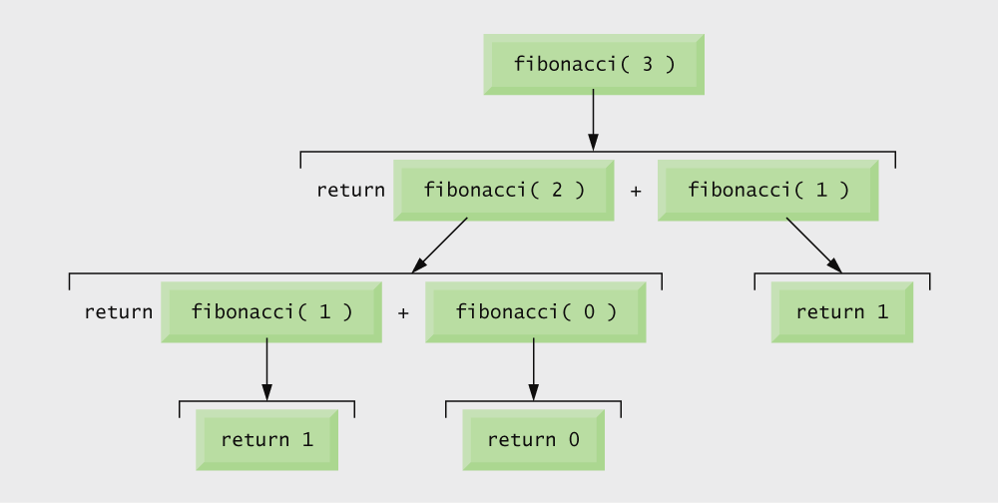
Set of recursive calls for fibonacci(3).

Slide 81
Performance Tip
Avoid Fibonacci-style recursive programs which result in an exponential “explosion” of calls.

Slide 82
Example: Towers of Hanoi Problem
1
2
3
4
5
LEFT
CENTER
RIGHT

Slide 83
The problem statement:
  Initially all the disks are stacked on the LEFT pole.
  Required to transfer all the disks to the RIGHT pole.
    Only one disk can be moved at a time.
    A larger disk cannot be placed on a smaller disk.

Slide 84
Recursive statement of the general problem of n disks.
  Step 1:
    Move the top (n-1) disks from LEFT to CENTER.
  Step 2:
    Move the largest disk from LEFT to RIGHT.
  Step 3:
    Move the (n-1) disks from CENTER to RIGHT.

Slide 85
#include <stdio.h>
void transfer (int n, char from, char to, char temp);
main()
{
int n; /* Number of disks */
scanf (“%d”, &n);
transfer (n, ‘L’, ‘R’, ‘C’);
}
void transfer (int n, char from, char to, char temp)
{
if (n > 0) {
transfer (n-1, from, temp,to);
printf (“Move disk %d from %c to %c \n”, n, from, to);
transfer (n-1, temp, to, from);
}
return;
}

Slide 86
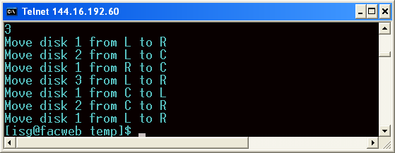

Slide 87
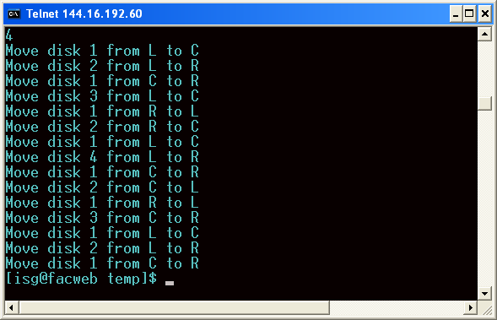

Slide 88
Recursion vs. Iteration
Repetition
  Iteration: explicit loop
  Recursion: repeated function calls
Termination
  Iteration: loop condition fails
  Recursion: base case recognized
Both can have infinite loops
Balance
  Choice between performance (iteration) and good software engineering (recursion)

Slide 89
Software Engineering Observation
Any problem that can be solved recursively can also be solved iteratively (nonrecursively). A recursive approach is normally chosen in preference to an iterative approach when the recursive approach more naturally mirrors the problem and results in a program that is easier to understand and debug. Another reason to choose a recursive solution is that an iterative solution may not be apparent.

Slide 90
Performance Tip
Avoid using recursion in performance situations. Recursive calls take time and consume additional memory.

Slide 91
How are function calls implemented?
In general, during program execution
  The system maintains a stack in memory.
    Stack is a last-in first-out structure.
    Two operations on stack, push and pop.
  Whenever there is a function call, the activation record gets pushed into the stack.
    Activation record consists of the return address in the calling program, the return value from the function, and the local variables inside the function.
    At the end of function call, the corresponding activation record gets popped out of the stack.

Slide 92
main()
{
……..
x = gcd (a, b);
……..
}
int gcd (int x, int y)
{
……..
……..
return (result);
}
Local
Variables
STACK
Return Value
Return Addr
Before call
After call
After return

Slide 93
main()
{
……..
x = ncr (a, b);
……..
}
int ncr (int n, int r)
{
return (fact(n)/
fact(r)/fact(n-r));
}
int fact (int n)
{
………
return (result);
}
3 times
LV2, RV2, RA2
LV1, RV1, RA1
LV1, RV1, RA1
LV1, RV1, RA1
Before call
Call ncr
Call fact
fact returns
ncr returns

Slide 94
What happens for recursive calls?
What we have seen ….
  Activation record gets pushed into the stack when a function call is made.
  Activation record is popped off the stack when the function returns.
In recursion, a function calls itself.
  Several function calls going on, with none of the function calls returning back.
    Activation records are pushed onto the stack continuously.
    Large stack space required.
    Activation records keep popping off, when the termination condition of recursion is reached.

Slide 95
We shall illustrate the process by an example of computing factorial.
  Activation record looks like:
Local
Variables
Return Value
Return Addr

Slide 96
Example:: main() calls fact(3)
main()
{
int n;
n = 4;
printf (“%d \n”, fact(n) );
}
int fact (int n)
{
if (n = = 0)
return (1);
else
return (n * fact(n-1));
}

Slide 97
TRACE OF THE STACK DURING EXECUTION
n = 0
1
RA .. fact
n = 1
n = 1
n = 1
fact returns to main
main calls fact
-
-
1*1 = 1
RA .. fact
RA .. fact
RA .. fact
n = 2
n = 2
n = 2
n = 2
n = 2
-
-
-
-
2*1 = 2
RA .. fact
RA .. fact
RA .. fact
RA .. fact
RA .. fact
n = 3
n = 3
n = 3
n = 3
n = 3
n = 3
n = 3
-
-
-
-
-
-
3*2 = 6
RA .. main
RA .. main
RA .. main
RA .. main
RA .. main
RA .. main
RA .. main

Slide 98
Do Yourself
Trace the activation records for the following version of Fibonacci sequence.
#include <stdio.h>
int f (int n)
{
int a, b;
if (n < 2) return (n);
else {
a = f(n-1);
b = f(n-2);
return (a+b); }
}
main() {
printf(“Fib(4) is: %d \n”, f(4));
}
Local
Variables
(n, a, b)
Return Value
X
Return Addr
(either main,
or X, or Y)
Y
main

Slide 99
Storage Class of Variables

Slide 100
What is Storage Class?
It refers to the permanence of a variable, and its scope within a program.
Four storage class specifications in C:
  Automatic: auto
  External: extern
  Static: static
  Register: register

Slide 101
Automatic Variables
These are always declared within a function and are local to the function in which they are declared.
  Scope is confined to that function.
This is the default storage class specification.
  All variables are considered as auto unless explicitly specified otherwise.
  The keyword auto is optional.
  An automatic variable does not retain its value once control is transferred out of its defining function.

Slide 102
#include <stdio.h>
int factorial(int m)
{
auto int i;
auto int temp=1;
for (i=1; i<=m; i++)
temp = temp * i;
return (temp);
}
main()
{
auto int n;
for (n=1; n<=10; n++)
printf (“%d! = %d \n”,
n, factorial (n));
}

Slide 103
Static Variables
Static variables are defined within individual functions and have the same scope as automatic variables.
Unlike automatic variables, static variables retain their values throughout the life of the program.
  If a function is exited and re-entered at a later time, the static variables defined within that function will retain their previous values.
  Initial values can be included in the static variable declaration.
    Will be initialized only once.
An example of using static variable:
  Count number of times a function is called.

Slide 104
EXAMPLE 1
#include <stdio.h>
int factorial (int n)
{
static int count=0;
count++;
printf (“n=%d, count=%d \n”, n, count);
if (n == 0) return 1;
else return (n * factorial(n-1));
}
main()
{
int i=6;
printf (“Value is: %d \n”, factorial(i));
}

Slide 105
Program output:
  n=6, count=1
  n=5, count=2
  n=4, count=3
  n=3, count=4
  n=2, count=5
  n=1, count=6
  n=0, count=7
  Value is: 720

Slide 106
EXAMPLE 2
#include <stdio.h>
int fib (int n)
{
static int count=0;
count++;
printf (“n=%d, count=%d \n”, n, count);
if (n < 2) return n;
else return (fib(n-1) + fib(n-2));
}
main()
{
int i=4;
printf (“Value is: %d \n”, fib(i));
}

Slide 107
f(4)
Program output:
  n=4, count=1
  n=3, count=2
  n=2, count=3
  n=1, count=4
  n=0, count=5
  n=1, count=6
  n=2, count=7
  n=1, count=8
  n=0, count=9
  Value is: 3 [0,1,1,2,3,5,8,….]
f(3)
f(2)
f(2)
f(1)
f(1)
f(0)
f(1)
f(0)

Slide 108
Register Variables
These variables are stored in high-speed registers within the CPU.
  Commonly used variables may be declared as register variables.
  Results in increase in execution speed.
  The allocation is done by the compiler.

Slide 109
External Variables
They are not confined to single functions.
Their scope extends from the point of definition through the remainder of the program.
  They may span more than one functions.
  Also called global variables.
Alternate way of declaring global variables.
  Declare them outside the function, at the beginning.

Slide 110
#include <stdio.h>
int count=0; /** GLOBAL VARIABLE **/
int factorial (int n)
{
count++;
printf (“n=%d, count=%d \n”, n, count);
if (n == 0) return 1;
else return (n * factorial(n-1));
}
main() {
int i=6;
printf (“Value is: %d \n”, factorial(i));
printf (“Count is: %d \n”, count);
}

Slide 111
Program output:
  n=6, count=1
  n=5, count=2
  n=4, count=3
  n=3, count=4
  n=2, count=5
  n=1, count=6
  n=0, count=7
  Value is: 720
  Count is: 7

Slide 112
Common Errors in Writing Recursive Methods
Non-terminating Recursive Methods (Infinite recursion):
  No base case.
  The base case is never reached for some parameter values.
int badFactorial(int x) {
return x * badFactorial(x-1);
}
int anotherBadFactorial(int x) {
if(x == 0)
return 1;
else
return x*(x-1)*anotherBadFactorial(x -2);
// When x is odd, base case never reached!!
}
Notes:
112

Slide 113
Common Errors in Writing Recursive Functions
int badSum1(int x) {
int sum=0;
if(x==1) return sum+1;
sum=x+badSum1(x-1);
return sum;
}
int badSum2(int x) {
if(x==1) return 1;
return(badSum2(x--));
}
Notes:
113

Slide 114
Exercise 1: count zeros in an Integer
The problem is: given an integer, how many of its digits are zero?
Insight:
How to get least digit?
Check if that is zero → Based on this, what can we say about the number of zeros in the integer

Slide 115
int zeros( int number){ if(number<10) return 0; if (number%10 == 0) return(1+zeros(number/10)); else return(zeros(number/10));
}
zeros(10200)
zeros(1020) + zeros(0)
zeros(102) + zeros(0) + zeros(0)
zeros(10) + zeros(2) + zeros(0) + zeros(0)
zeros(1) + zeros(0) + zeros(2) + zeros(0) + zeros(0)

Slide 116
Another Approach
int zeros(int numb){
if(numb==0) // 1 digit (zero/non-zero):
return 1; // bottom out.
else if(numb < 10 && numb > -10)
return 0;
else // > 1 digits: recursion
return zeros(numb/10) + zeros(numb%10);
}
Spring Semester 2013
Programming and Data Structure
116

Slide 117
Exercise 2
How to read an integer value and display it’s digit reversed?
void printReversed (int i){
if (i < 10) {
printf(“%d\n”, i); return;}
else {
printf(“%d”, i%10);
printReversed(i/10);
}
}

Slide 118
Exercise 2
Modify last program to read an integer value and display it’s digits as it is (i.e. not reversed) in different lines?
void printReversed (int i){
if (i < 10) {
printf(“%d\n”, i); return;}
else {
printReversed(i/10);
printf(“%d\n”, i%10);
}
}
Spring Semester 2013
Programming and Data Structure
118

Slide 119
Exercise 4
Convert an int to a string
String toString (int i){
if (i < 10)
return (char)(i+’0’);
else
return strcat(toString(i/10) + (char)(i%10+’0’));
}

Slide 120
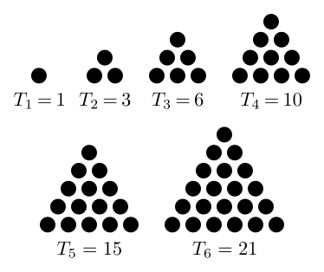
Triangular Number
A triangular number counts the objects that can form an equilateral triangle:
  As in the diagram

Slide 121
Triangular Numbers
Consider the numbers 1, 3, 6, 10, 15….
What is the recurrence?
The n^{th} term in the series is obtained by adding n to the previous number.
int triangle(int n){
if(n == 1) return 1;
else return(n + triangle(n-1));
}

Slide 122
Exercise
Write a recursive function for the following problem:
Given a number n (n > 0), if n is even, calculate 0 + 2 + 4 + ... + n. If n is odd, calculate 1 + 3 + 5 + ... + n

